Slide 1


Radiation Health and Safety

Slide 2
1. What Is Radiation?/Biological effects
2. Radiation Regulations
3. Radiation Hazards
4. Reducing Radiation Exposure
5. Nuclear Incidents
6.Review
Radiation: Introduction
There are 6 sections that will cover:
What Is Radiation? – How is it classified? What are its biological effects?
Radiation Hazards – Sources of radiation and contamination hazards
Radiation Regulations – Government regulations regarding radiation doses and operating procedures
Reducing Radiation Exposure – ALARA principle and its application
Nuclear Incidents – Incidents of radiation exposure and lessons learned
Review – a summary of the key concepts learned.

Slide 3
1. What Is Radiation?/Biological effects
In this section you will learn:
What is radiation?
The two categories of radiation.
The four types of ionizing radiation.
How damaging different types of radiation are & the biological impact of radiation.
Government imposed radiation limits.
Relative strength of exposure compared to other activities.

Slide 4
1. What Is Radiation?/Biological effects
Section 1 – What is Radiation?
Radiation comes in two types:
Ionizing
  Capable of knocking an election out of orbit
Non-Ionizing
  Not capable of knocking an electron out of orbit
Ionizing radiation is the focus of this module

Slide 5
1. What Is Radiation?/Biological effects
Section 1 – What is Radiation?
Two types of sources for ionizing radiation
Man-made
Radio-active atoms
X-ray machines
Smoke detectors
  Contains americium 241
Luminous watches
X-ray security systems
Unstable nuclei
Man made radioactive atoms
  Iodine 131
  Cobalt 60
Naturally occurring radioactive atoms
  Uranium
  Plutonium

Slide 6
1. What Is Radiation?/Biological effects
Section 1 – What is Radiation?
Ionizing radiation comes in four varieties:
Alpha Particle
Beta Particle (electrons)
  Can have either positive of negative charge
Gamma/X-rays
Neutrons

Slide 7
1. What Is Radiation?/Biological effects
Section 1 – What is Radiation?
Different materials can block different forms of radiation
Paper
Aluminum
Steel/Lead
Water
Alpha
Beta
Gamma/X-ray
Neutrons

Slide 8
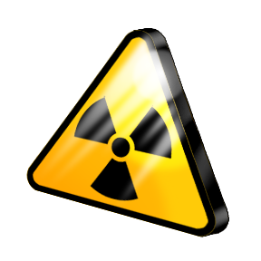
1. What Is Radiation?/Biological effects
Section 1 – What is Radiation?
Radioactivity is a measure of the rate of radioactive decay
The unit used in Canada and internationally for radioactivity is the Becquerel (Bq)
1 Bq = 1 disintegration /second
The United States uses the Curie
1 Curie = 37 billion Bq

Slide 9
1. What Is Radiation?/Biological effects
Section 1 – What is Radiation?
Half-Life
The amount of time it takes for half of the radioactive material to decay
Is a measure of how long it will remain radioactive
Every radioactive substance has a specific half-life

Slide 10
1. What Is Radiation?/Biological effects
Section 1 – What is Radiation?
Radiation Measurements
Absorbed Dose
Effective Dose
Equivalent Dose
Amount of radiation per unit mass
Unit used is Gray
1 Gy = 1 joule/kg
Milligray used more often
Different types of radiation have different biological damage at same gray value
A measurement of how damaging an absorbed dose can be
Absorbed dose multiplied by a weighting factor
Unit used is Sievert (Sv)
A measurement of how big an impact on health an effective dose can be
Effective dose multiplied by an organ weighting factors
Unit same as effective dose

Slide 11
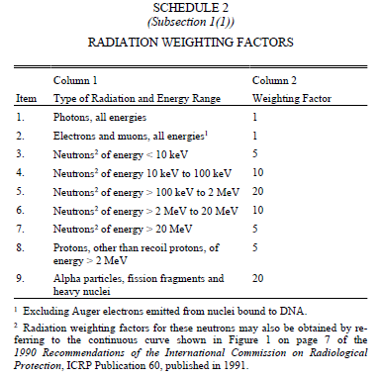
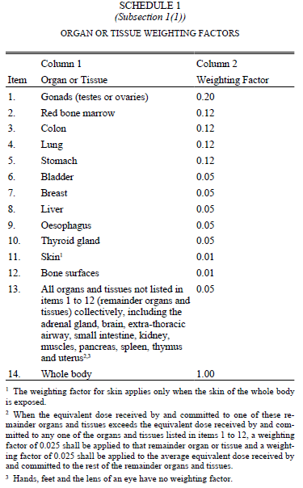
1. What Is Radiation?/Biological effects
Section 1 – What is Radiation?
Radiation Weighting Factors
Taken from Radiation Protection Regulations pgs. 20 &21
Equivalent Dose
Effective Dose

Slide 12

1. What Is Radiation?/Biological effects
Section 1 – What is Radiation?
Cell protection systems
Cells can do one of two things to repair a damaged area:
Use enzymes to repair the damaged area
Destroy the damaged cells so that new ones can be made

Slide 13
1. What Is Radiation?/Biological effects
Section 1 – What is Radiation?
Biological impact of radiation exposure
Effects
Interferes with cell’s repair mechanisms
Can lead to cell mutation if the chromosomes have been altered
Cell mutation usually leads to cancer
Radiation exposure increases cancer risk

Slide 14
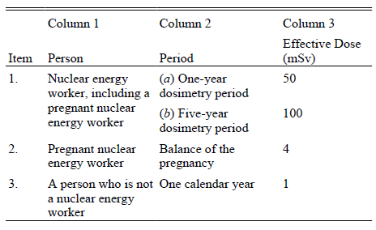
1. What Is Radiation?/Biological effects
Section 1 – What is Radiation?
Radiation effective dose limits
Taken from Radiation Protection Regulations Pg. 13

Slide 15
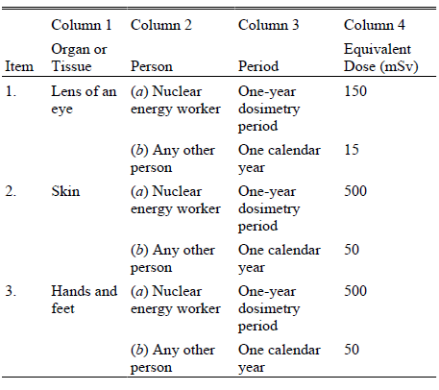
1. What Is Radiation?/Biological effects
Section 1 – What is Radiation?
Radiation equivalent dose limits
Taken from Radiation Protection Regulations Pg. 14

Slide 16
1. What Is Radiation?/Biological effects
Section 1 – What is Radiation?
Typical organ effective doses from various radiological examinations
Study Type | Relevant Organ | Dose (mSv)
Dental x-ray | Brain | 0.01¹
Chest x-ray | Lung | 0.1¹
Screening mammography | Breast | 3²
Adult abdominal CT | Stomach | 10²
Neonatal abdominal CT | Stomach | 20²
¹ Ionizing Radiation Exposure of the Population of the United States", NCRP Report No. 160, 2009
² Brenner and Hall (2007)
Source: http://www.cnsc-ccsn.gc.ca/eng/readingroom/radiation/radiation_doses.cfm

Slide 17

1. What Is Radiation?/Biological effects
Section 1 – What is Radiation?
Biological effects of high radiation doses
Typical symptoms include:
Nausea
Diarrhea
Malaise
  Feeling out or sorts

Slide 18
1. What Is Radiation?/Biological effects
Section 1 – Quiz
Alpha particles have 5 times the damage capacity of electrons
True
False

Slide 19

1. What Is Radiation?/Biological effects
Section 1 – Quiz
Alpha particles have 5 times the damage capacity of electrons
True
False
Alpha particles have 20 times the damage capacity

Slide 20
1. What Is Radiation?/Biological effects
Section 1 – Quiz
Effective dose is the measure of how a particular radiation dose can affect the health of a particular organ
True
False

Slide 21
1. What Is Radiation?/Biological effects
Section 1 – Quiz
Effective dose is the measure of how a particular radiation dose can affect the health of a particular organ
True
False

Slide 22
1. What Is Radiation?/Biological effects
Section 1 – Quiz
Determine the Equivalent and Effective doses from 0.1 Gray of electrons to the gonads
Determine the Equivalent and Effective doses from 0.01 Gray of Alpha Particles to the stomach
Which is more biologically damaging?

Slide 23
1. What Is Radiation?/Biological effects
Section 1 – Quiz
Determine the Equivalent and Effective doses from 0.1 Gray of electrons to the gonads
Equivalent dose = 0.1 Gy* 1 = 0.1 Sv = 100 mSv
Effective dose = 0.1 Sv * 0.2 = 0.02 Sv = 20 mSv
Determine the Equivalent and Effective doses from 0.01 Gray of Alpha Particles to the stomach
Equivalent dose = 0.01 Gy* 20 = 0.2 Sv = 200 mSv
Effective dose = 0.2 Sv * 0.12 = 0.024 Sv = 24 mSv
Which is more biologically damaging?
The alpha particles

Slide 24
1. What Is Radiation?/Biological effects
Section 1 – Quiz
If an energy worker receives 35 mSv effective dose over an eight month period. Will this person exceed their yearly radiation limit?
A pregnant energy worker receives 0.25 mSv per month over the entirety of her pregnancy. Will she exceed her limit?

Slide 25
1. What Is Radiation?/Biological effects
Section 1 – Quiz
If an energy worker receives 35 mSv effective dose over an eight month period. Will this person exceed their yearly radiation limit?
35 mSv = 8 Months
X mSv = 12 Months
X = (35 mSv*12 Months)/8Months
X = 52.5 mSv
No, they will not exceed their yearly limit
A pregnant energy worker receives 0.25 mSv per month over the entirety of her pregnancy. Will she exceed her limit?
Dose = 0.25 mSv*9 Months
Dose = 2.25 mSv
No, she will not exceed her limit

Slide 26
2. Radiation Regulations
In this section you will learn:
What is the Canadian Nuclear Safety Commission?
Categories of nuclear materials
Radiation protection requirements
Actions taken if limits are exceeded.
Information required by employees/employers
ALARA Principle

Slide 27
2. Radiation Regulations
Section 2 – Radiation Regulations
Canadian Nuclear Safety Commission (CNSC)
Established in 1946 as the Atomic Energy Control Board
Changed to CNSC in 2000
CNSC regulates not only power plants but also production/storage/use of medical isotopes
Protects public and environment
  Including anti nuclear proliferation

Slide 28
2. Radiation Regulations
Section 2 – Radiation Regulations
Nuclear Safety Control Act
Following materials qualify:
  Uranium & thorium ores of over 0.05% by mass
  Special materials:
    Plutonium
    U-233
    Enriched U-233 & 235
    By products

Slide 29
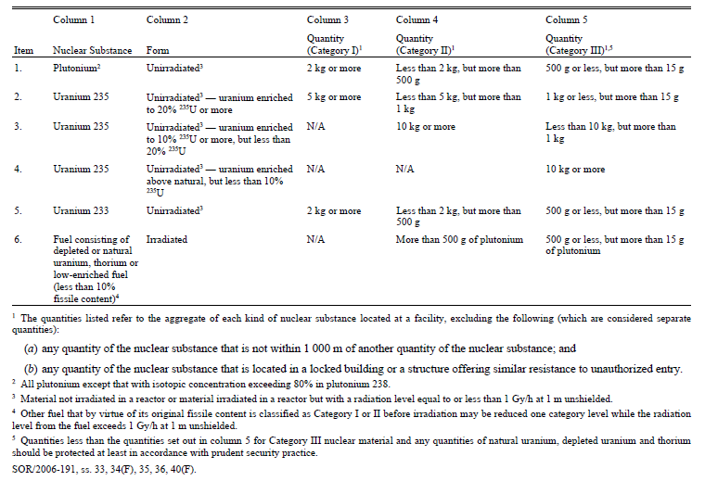
2. Radiation Regulations
Section 2 – Radiation Regulations
Categories of nuclear material
Taken from Nuclear Security Regulations Pg. 46

Slide 30

2. Radiation Regulations
Section 2 – Radiation Regulations
Radiation Protection Requirements
Keep effective and equivalent doses as low as reasonably achievable (ALARA) by:
  Management control of work
  Personnel training
  Control of exposure levels
    Worker and public
  Planning for the unexpected
Record the radioactive material concentration released by:
  Direct measurement
  Estimation if direct methods are not available

Slide 31
2. Radiation Regulations
Section 2 – Radiation Regulations
Actions taken
The following must be done if radiation limits are exceeded
Investigate why it happened
Take any appropriate action to return radiation levels to below limits
Notify the Canadian Nuclear Safety Commission within the time specified on the licence

Slide 32
2. Radiation Regulations
Section 2 – Radiation Regulations
Information required to be given by employer
The employee is responsible for giving written confirmation that they have received this information
Notify he/she they are a nuclear worker
The risks associated with radiation
Effective dose limits
Their dose level received from the job
The rights & obligations of a pregnant nuclear worker:
  A pregnant worker must inform their employer in writing when a pregnancy is confirmed
  The employer shall make accommodations to reduce the exposure sustained

Slide 33
2. Radiation Regulations
Section 2 – Radiation Regulations
When a worker has exceeded the dose limits
The employer has to tell the worker and the CNSC of the incident
The worker is required to leave any work that will increase the radiation dose
The employer shall investigate why this happened and how much radiation the worker was exposed to
The employer will solve the problem and take precautions so the incident won`t happen again
The employer must report their findings or progress to the CNSC within 21 days

Slide 34
2. Radiation Regulations
Section 2 – Radiation Regulations
When a worker can return to work
Only the CNSC or a designated officer has the power to allow a worker to return to work
A workers new dose limit is the sum of the dose limit over the dosimetry period and the dose that caused them to leave work
  E.g. If exposed to 50 mSv over six months and had to leave work because the limit was 75 mSv a year then the new limit would be 125 mSv per year once they returned to work

Slide 35
2. Radiation Regulations
Section 2 – Radiation Regulations
When a worker exceed the radiation dose limits
A worker may voluntarily chose to expose themselves to an effective dose of up to 500 mSv and an equivalent dose of 5 Sv to the skin in order to protect human life
Pregnant workers cannot do this

Slide 36
2. Radiation Regulations
Section 2 – Radiation Regulations
ALARA Principal
A
  As
L
  Low
A
  As
R
  Reasonably
A
  Achievable
Works on the theory that cancer incidence at high exposure levels will be proportionally less at lower levels

Slide 37
2. Radiation Regulations
Section 2 – Radiation Regulations
Areas where ALARA can be implemented
Physical
Workplace
Reducing the radioactive source
  Removal of source from area
  Radioactive decay
Minimizing exposure time
Maximizing distance from the source
Using appropriate shielding
Planning work in advance
Briefings for workers
Decontamination
Protective clothing including respirators
Alarm dosimeters

Slide 38
2. Radiation Regulations
Section 2 – Radiation Regulations
Time, Distance, Shielding
Time relates to dose received:
  Dose = Time x Dose Rate
Rearranging the above formula to find time
  Time = Dose / Dose Rate
This shows how long a person can be exposed if the dose rate for a given material is known or measured

Slide 39
2. Radiation Regulations
Section 2 – Radiation Regulations
Time, Distance, Shielding
Maximize the distance between the person and the radiation source or area
Analogy of a campfire:
  The closer you are to the campfire the hotter you feel

Slide 40

2. Radiation Regulations
Section 2 – Radiation Regulations
Time, Distance, Shielding
Shielding materials used to protect personnel from the radiation
Different types of radiation require different types of shielding
  Type of radiation must be known
  Appropriate amount of material must be known

Slide 41
2. Radiation Regulations
Section 2 – Radiation Regulations
Time, Distance, Shielding
 | Alpha | Beta | Gamma/X-rays | Neutrons
Shielding Material | A piece of paper | Aluminum sheet | Heavy materials with lots of electrons | Light materials with few electrons

Slide 42
2. Radiation Regulations
Section 2 – Quiz
Uranium and Thorium ores over what percentage of mass qualify under the Nuclear Safety Control Act?
0.01%
0.05%
0.1%
0.15%
0.2%

Slide 43
2. Radiation Regulations
Section 2 – Quiz
Uranium and Thorium ores over what percentage of mass qualify under the Nuclear Safety Control Act?
0.01%
0.05%
0.1%
0.15%
0.2%

Slide 44
2. Radiation Regulations
Section 2 – Quiz
What is the maximum equivalent dose that can be taken in order to save human life?
0.01 Sv
0.05 Sv
5 Sv
20 Sv
0.1 Sv

Slide 45
2. Radiation Regulations
Section 2 – Quiz
What is the maximum equivalent dose that can be taken in order to save human life?
0.01 Sv
0.05 Sv
5 Sv
20 Sv
0.1 Sv

Slide 46
2. Radiation Regulations
Section 2 – Quiz
Which of the following is the only person with authority to authorize someone to return to work?
Owner of the power plant
Officer delegated by the CNSC
Shift supervisor
Co-worker
Department Manager

Slide 47
2. Radiation Regulations
Section 2 – Quiz
Which of the following is the only person with authority to authorize someone to return to work?
Owner of the power plant
Officer delegated by the CNSC
Shift supervisor
Co-worker
Department Manager

Slide 48
2. Radiation Regulations
Section 2 – Quiz
Which of the following is the most effective shield against neutrons?
A piece of paper
Your skin
Steel
Water
Lead

Slide 49
2. Radiation Regulations
Section 2 – Quiz
Which of the following is the most effective shield against neutrons?
A piece of paper
Your skin
Steel
Water
Lead

Slide 50
3. Radiation Hazards
In this section you will learn:
What radiation hazards exist
Sources for each type of radiation hazard
What contamination hazards exist
Sources for each type of contamination hazard
1 of 12

Slide 51
3. Radiation Hazards
Section 3 – Radiation Hazards
Hazards come in two varieties
Radiation Hazards
Contamination Hazards
Gamma
X-rays
External Beta
Alpha
Neutrons
Tritium
Airborne Particulate
Airborne Gaseous Contamination
Fixed/Loose Surface Contamination
Contaminated Fluids

Slide 52
3. Radiation Hazards
Section 3 – Radiation Hazards
Gamma Radiation
High energy
Observed in:
  Fission
  Decay of fission products
  Neutron capture (activation)
  Decay of activation products
  Radiotracers in oil and mining industries
  Used in mining and metallurgy
  Gamma ray therapy

Slide 53


3. Radiation Hazards
Section 3 – Radiation Hazards
External Beta
Size of an electron
  Can have either a positive or negative charge
Observed in:
  Decay of fission products
  Decay of activation products
  Radiation therapy

Slide 54
3. Radiation Hazards
Section 3 – Radiation Hazards
Neutrons
Highly penetrating
Ionizes indirectly
Observed in:
  Fission
  Released from a photon bombarded atom as a photo neutron
  Radiation therapy
  Used to activate materials to determine material composition

Slide 55
3. Radiation Hazards
Section 3 – Radiation Hazards
Alpha Particles
He
Very heavy compared to other forms of radiation
Ionizes very quickly
Observed in:
  Defective nuclear fuel
  Uranium mine wastes
  Mining and processing of phosphate ore for fertilizers

Slide 56
3. Radiation Hazards
Section 3 – Radiation Hazards
Contamination: Tritium
Radioactive isotope of hydrogen
  Contains 1 proton and 2 neutrons
Ionizes indirectly
Observed in:
  Fission
  Nuclear weapons
  Self-luminecent properties used in signs, displays, paints, wrist watches

Slide 57

3. Radiation Hazards
Section 3 – Radiation Hazards
Contamination: Airborne
Two types:
  Short lived
    External/internal hazard
    Can come from defective fuel
    Found in fission or activation products
  Long lived
    External/internal hazard
    Found in fission or activation product
    Greater internal threat
© Jeremy Johnson/ http://www.meddlingwithnature.com/ CC-BY-SA 3.0

Slide 58
3. Radiation Hazards
Section 3 – Radiation Hazards
Contamination: Airborne Hazards
Soluble
Inhaled into lungs
Transferred to bloodstream
Deposited in organs
Insoluble
Inhaled into lungs
Retained by lungs
May find way into digestive system
Can be excreted through feces

Slide 59
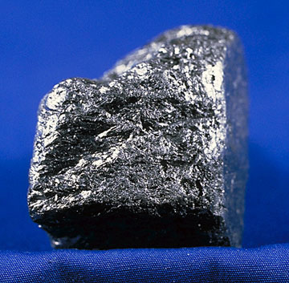
3. Radiation Hazards
Section 3 – Radiation Hazards
Contamination: C-14
Emits low energy beta particles
Does not emit gamma rays
Exists mostly as CO2
Whole body can be affected
Inhalation is the biggest hazard
U.S. federal government/ Wikimedia Commons/ Public Domain

Slide 60
3. Radiation Hazards
Section 3 – Radiation Hazards
Contamination: Activated Noble Gases
Ar-41
  Activation product
Kr-88, Xe-138
  Fission product

Slide 61
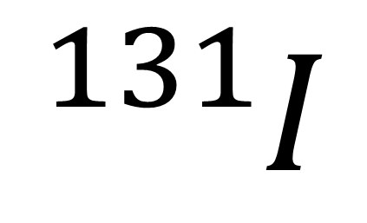
3. Radiation Hazards
Section 3 – Radiation Hazards
Contamination: Iodine-131
Specifically targets the thyroid
Used in nuclear medicine as a beta/gamma emitter
  Beta contributes over 90% of the dose to the thyroid
Useful for diagnosing thyroid problems
Used as radiotracer element
$${}_{}^{131}I$$

Slide 62
3. Radiation Hazards
Section 3 – Radiation Hazards
Contamination: Surface
Two types of surface hazards
  Loose
    Beta/gamma decay
    External/internal hazard
  Fixed
    Beta/gamma decay
    External hazard

Slide 63

3. Radiation Hazards
Section 3 – Radiation Hazards
Contamination: Surface
Sources
Air particulates settling
Contaminated water drying up
Opening a nuclear system
Spilling spent resin
Machining radioactive materials
Damaged or defective fuel
Leaching from previously contaminated surfaces

Slide 64
3. Radiation Hazards
Section 3 – Radiation Hazards
Contamination: Discrete Radioactive Particles
Small in size
Insoluble
Produces gamma/beta doses
Can generate its own electrostatic charge which could cause movement

Slide 65
3. Radiation Hazards
Section 3 – Radiation Hazards
Contamination: Liquids & Solids
Comes from any liquid containing activation products
Powders
Dust
Debris
Shavings
Waste receptacles overturned

Slide 66
3. Radiation Hazards
Section 3 – Quiz
Which of the following is not a radiation hazard?
Gamma Rays
Beta Particles
Airborne Particles
Electrons
Tritium

Slide 67
3. Radiation Hazards
Section 3 – Quiz
Which of the following is not a radiation hazard?
Gamma Rays
Beta Particles
Airborne Particles
Electrons
Tritium

Slide 68
3. Radiation Hazards
Section 3 – Quiz
Which of the following targets the Thyroid Gland?
Gamma Rays
Carbon 14
Airborne Particles
Iodine 131
Tritium

Slide 69
3. Radiation Hazards
Section 3 – Quiz
Which of the following targets the Thyroid Gland?
Gamma Rays
Carbon 14
Airborne Particles
Iodine 131
Tritium

Slide 70
3. Radiation Hazards
Section 3 – Quiz
Match the length of life of an airborne hazard with its type of hazard
Short Lived Airborne
Internal Hazard
External Hazard
Long Lived Air Borne

Slide 71
3. Radiation Hazards
Section 3 – Quiz
Match the length of life of an airborne hazard with its type of hazard
Short Lived Airborne
Internal Hazard
External Hazard
Long Lived Air Borne

Slide 72
3. Radiation Hazards
Section 3 – Quiz
Which of the following can generate its own electrostatic charge?
Gamma Rays
Carbon 14
Airborne Particles
Iodine 131
Discrete Radioactive Particles

Slide 73
3. Radiation Hazards
Section 3 – Quiz
Which of the following can generate its own electrostatic charge?
Gamma Rays
Carbon 14
Airborne Particles
Iodine 131
Discrete Radioactive Particles

Slide 74
4. Reducing Radiation Exposure
In this section you will learn:
Source geometries
How to calculate radiation intensities
Principles to reduce exposure from different source types

Slide 75
4. Reducing Radiation Exposure
Section 4 – Reducing Radiation Exposure
Source Geometry
Three types of source geometry
Point
Line
Plane

Slide 76
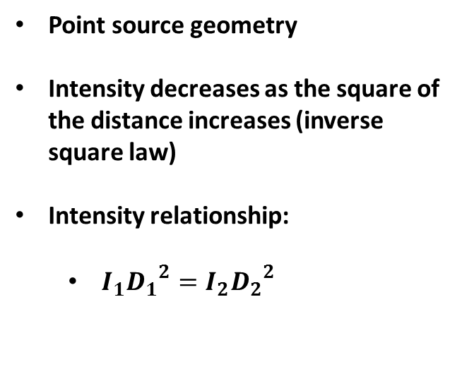
4. Reducing Radiation Exposure
Section 4 – Reducing Radiation Exposure
Source Geometry
Point source geometry
Intensity decreases as the square of the distance increases (inverse square law)
Intensity relationship:
  $I_{1}{D_{1}}^{2}=I_{2}{D_{2}}^{2}$

Slide 77
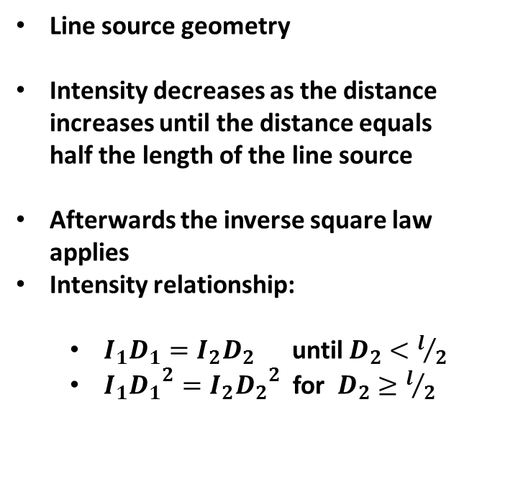
4. Reducing Radiation Exposure
Section 4 – Reducing Radiation Exposure
Source Geometry
Line source geometry
Intensity decreases as the distance increases until the distance equals half the length of the line source
Afterwards the inverse square law applies
Intensity relationship:
  $I_{1}D_{1}=I_{2}D_{2}$ until $D_{2}<l/2$
  $I_{1}{D_{1}}^{2}=I_{2}{D_{2}}^{2}$ for $D_{2}≥l/2$
L

Slide 78
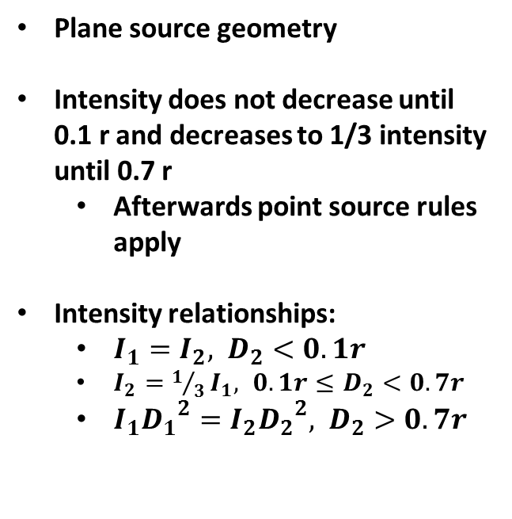
4. Reducing Radiation Exposure
Section 4 – Reducing Radiation Exposure
Source Geometry
Plane source geometry
Intensity does not decrease until 0.1 r and decreases to 1/3 intensity until 0.7 r
  Afterwards point source rules apply
Intensity relationships:
  $I_{1}=I_{2}, D_{2}<0.1r$
  $I_{2}=1/3I_{1}, 0.1r≤D_{2}<0.7r$
  $I_{1}{D_{1}}^{2}=I_{2}{D_{2}}^{2}, D_{2}>0.7r$
r

Slide 79
4. Reducing Radiation Exposure
Section 4 – Reducing Radiation Exposure
Gamma Radiation
Primary concern for external absorption
Time:
  Limit exposure time so as not to exceed dose limits set by government
Distance
  Use of intensity formulas depending on source type
Requires a lot of shielding
  Large amounts of material
  Use materials containing large numbers of electrons

Slide 80
4. Reducing Radiation Exposure
Section 4 – Reducing Radiation Exposure
External Beta
Along with alpha are primary concerns for internal exposure
Time:
  Limit exposure time so as not to exceed dose limits set by government
  If beta particles are taken internally then biological half life is the determining factor
Distance
  Use of intensity formulas depending on source type
Requires little shielding
  Can be stopped by 1 cm of material
2.0

Slide 81

4. Reducing Radiation Exposure
Section 4 – Reducing Radiation Exposure
Neutrons
Time:
  Limit exposure time so as not to exceed dose limits set by government
Distance
  Use of intensity formulas depending on source type
Requires lost of shielding
  Requires materials with few protons and lots of hydrogen (water)
Zscout370/ Wikimedia Commons/ Public Domain

Slide 82
4. Reducing Radiation Exposure
Section 4 – Reducing Radiation Exposure
Alpha Particles
Along with beta particles are the primary concern for internal exposure
Time:
  Limit exposure time so as not to exceed dose limits set by government
  If alpha particles are taken internally the effective half-life is the determining factor
  Effective half-life is a combination of the radioactive half life and the biological half-life

Slide 83
4. Reducing Radiation Exposure
Section 4 – Reducing Radiation Exposure
Alpha Particles
Distance
  Use of intensity formulas depending on source type
Requires little shielding
  A piece of paper will stop alpha particles

Slide 84
4. Reducing Radiation Exposure
Section 4 – Reducing Radiation Exposure
Contamination: Tritium
Internal exposure hazard of beta radiation
Shielding is not required
Personal protective equipment covering skin and mouth is required

Slide 85

4. Reducing Radiation Exposure
Section 4 – Reducing Radiation Exposure
Contamination: Airborne
Short Lived (external)
  Time
    Exposure
    Decay
  Personal protective equipment for skin and mouth
Long Lived (internal)
  Time
    Biological decay
  Personal protective equipment for skin and mouth

Slide 86
4. Reducing Radiation Exposure
Section 4 – Reducing Radiation Exposure
Contamination: C-14
Emits low energy beta particles
Internal hazard
No shielding required
Personal protective equipment is required for skin and mouth
CO2

Slide 87
4. Reducing Radiation Exposure
Section 4 – Reducing Radiation Exposure
Contamination: Activated Noble Gases
Ar-41
  Personal protective equipment for skin
Kr-88, Xe-138
  Personal protective equipment for skin

Slide 88
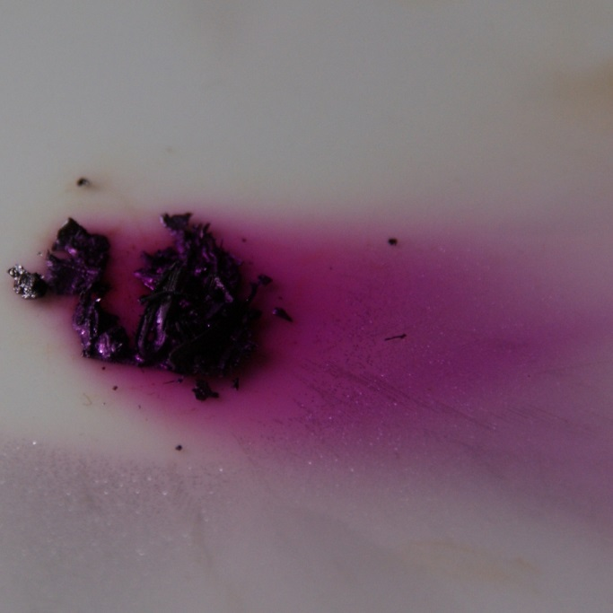
4. Reducing Radiation Exposure
Section 4 – Reducing Radiation Exposure
Contamination: Iodine-131
Seen as particulates, vapour, or gas
Personal protective equipment for skin and mouth
Protecting thyroid with potassium iodine (KI) or potassium iodate (KI3)
Ventilation
© Jurii/ http://images-of-elements.com/iodine.php/ CC-BY-SA-3.0

Slide 89

4. Reducing Radiation Exposure
Section 4 – Reducing Radiation Exposure
Contamination: Surface
Time:
  Limit exposure time so as not to exceed dose limits set by government
Distance
  Use of intensity formulas depending on source type
Requires shielding appropriate for the type of radiation
Personal protective equipment to cover the skin and mouth
Decontamination of the area

Slide 90
4. Reducing Radiation Exposure
Section 4 – Reducing Radiation Exposure
Contamination: Discrete Radioactive Particles
Use of personal protective equipment to cover the skin and face
Using work practices that do not disturb any radioactive materials

Slide 91
4. Reducing Radiation Exposure
Section 4 – Reducing Radiation Exposure
Contamination: Liquids & Solids
Time:
  Limit exposure time so as not to exceed dose limits set by government
Distance
  Use of intensity formulas depending on source type
Appropriate shielding for the radiation observed
Personal protective equipment if shielding is not required

Slide 92
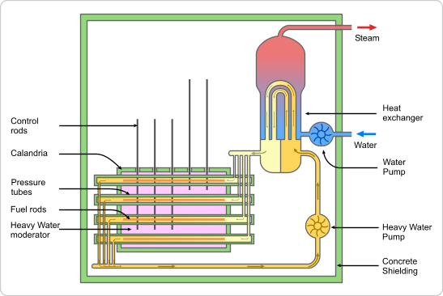
4. Reducing Radiation Exposure
Section 4 – Reducing Radiation Exposure
Example: Nuclear Power Plant
Nuclear Power Plants have many layers of radiation protection:
For example: Reactor Design
  Fuel pellets
  Fuel sheath
  Pressure tube
  Calandria
  Containment building
Water and air filtration systems are used to ensure that radiation exposure to the environment are minimal
© Emoscopes/Wikimedia Commons/CC-BY-SA-2.5

Slide 93
4. Reducing Radiation Exposure
Section 4 – Reducing Radiation Exposure
Example: Nuclear Power Plant
At Bruce Power:
  Employees must wear exposure monitoring devices in designated areas
  They also must report immediately to the Radiation Protection Department if the device is lost or if the readings go off the scale
  Employees must keep track of their exposure and make sure they don’t exceed limits including off site exposures

Slide 94

4. Reducing Radiation Exposure
Section 4 – Reducing Radiation Exposure
Example: Nuclear Power Plant
Radiation dose records must be:
  Readily available
  Protected from extreme conditions as well as theft and vandalism
Record keeping standards can be set by the company but can include things like:
  Station where the employee works including location and function
  Signature or employee number
  Supervisors signature

Slide 95
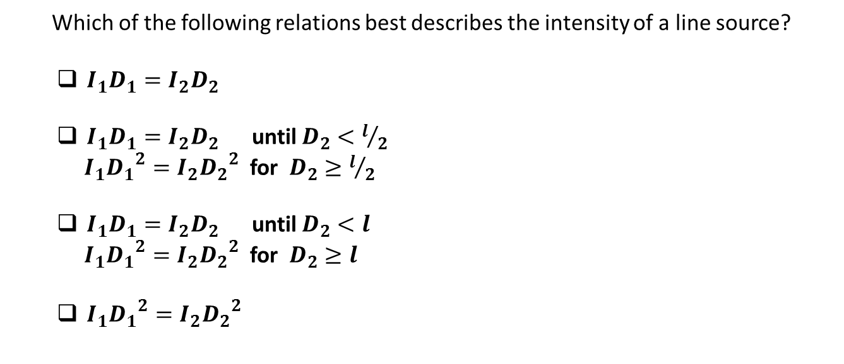
4. Reducing Radiation Exposure
Section 4 – Quiz
Which of the following relations best describes the intensity of a line source?
  $I_{1}D_{1}=I_{2}D_{2}$
  $I_{1}D_{1}=I_{2}D_{2}$ until $D_{2}<l/2$
  $I_{1}{D_{1}}^{2}=I_{2}{D_{2}}^{2}$ for $D_{2}≥l/2$
  $I_{1}D_{1}=I_{2}D_{2}$ until $D_{2}<l$
  $I_{1}{D_{1}}^{2}=I_{2}{D_{2}}^{2}$ for $D_{2}≥l$
  $I_{1}{D_{1}}^{2}=I_{2}{D_{2}}^{2}$

Slide 96
4. Reducing Radiation Exposure
Section 4 – Quiz
Which of the following relations best describes the intensity of a line source?
  $I_{1}D_{1}=I_{2}D_{2}$
  $I_{1}D_{1}=I_{2}D_{2}$ until $D_{2}<l/2$
  $I_{1}{D_{1}}^{2}=I_{2}{D_{2}}^{2}$ for $D_{2}≥l/2$
  $I_{1}D_{1}=I_{2}D_{2}$ until $D_{2}<l$
  $I_{1}{D_{1}}^{2}=I_{2}{D_{2}}^{2}$ for $D_{2}≥l$
  $I_{1}{D_{1}}^{2}=I_{2}{D_{2}}^{2}$

Slide 97
4. Reducing Radiation Exposure
Section 4 – Quiz
What are the three principles used to reduce radiation exposure?
  Distance, Time, Shielding
  Time, Height, Protection.
  Distance, Shielding, Exposure
  Shielding, Height, Exposure

Slide 98
4. Reducing Radiation Exposure
Section 4 – Quiz
What are the three principles used to reduce radiation exposure?
  Distance, Time, Shielding
  Time, Height, Protection.
  Distance, Shielding, Exposure
  Shielding, Height, Exposure

Slide 99
4. Reducing Radiation Exposure
Section 4 – Quiz
Which of the following is NOT used to reduce radiation exposure?
  Personal protective equipment
  Potassium Iodide pills
  Non-alarming radiation badges
  Specific work practices

Slide 100
4. Reducing Radiation Exposure
Section 4 – Quiz
Which of the following is NOT used to reduce radiation exposure?
  Personal protective equipment
  Potassium Iodide pills
  Non-alarming radiation badges
  Specific work practices

Slide 101
4. Reducing Radiation Exposure
Section 4 – Quiz
Carbon-14 is released mostly as…?
  Radioactive graphite
  Single atoms
  Carbon dioxide
  Microscopic diamonds

Slide 102
4. Reducing Radiation Exposure
Section 4 – Quiz
Carbon-14 is released mostly as…?
  Radioactive graphite
  Single atoms
  Carbon dioxide
  Microscopic diamonds

Slide 103
5. Nuclear Incidents
In this section you will learn:
Four radiation incidents
How they happened
How they were dealt with
What was learned

Slide 104
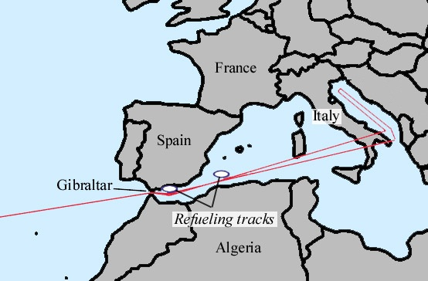
5. Nuclear Incidents
Section 5 – Nuclear Incidents
Palomares B-52 Crash
January 17 1966
A Boeing B-52 & a Boeing KC-135 collided during a mid-air refueling
The B-52 was carrying four nuclear bombs
Two of the bombs warheads broke open and spread plutonium over the surrounding area
© Emt147/en.wikipedia.org/ CC-BY-SA-2.5

Slide 105
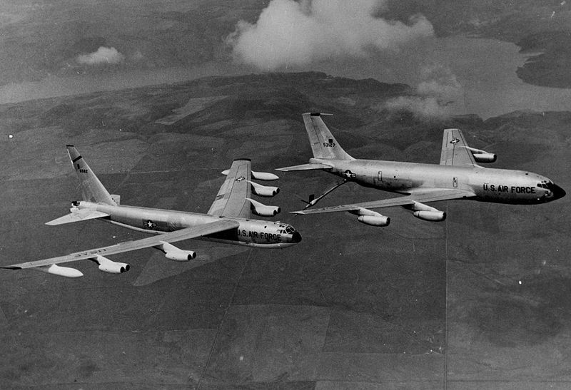
5. Nuclear Incidents
Section 5 – Nuclear Incidents
Palomares B-52 Crash
The recovery operation took 81 days
Debris from the two leaking warheads were shipped back to the U.S.
Drinking water had to be shipped in
Daily sanitation of both personnel and their clothing was required
U.S. federal government/ Wikimedia Commons/ Public Domain

Slide 106
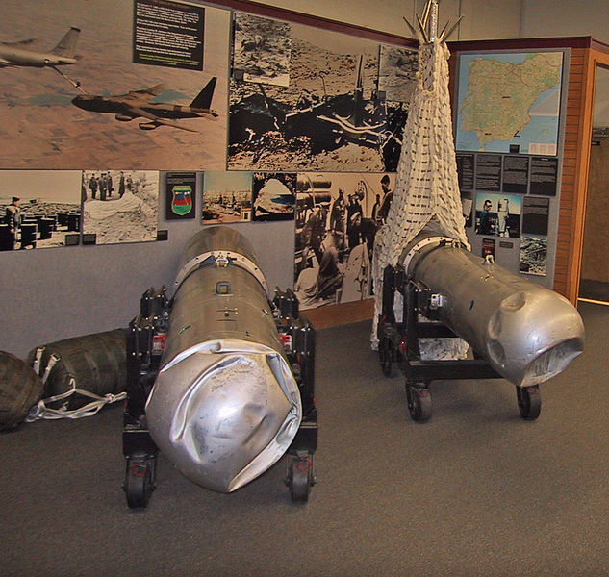
5. Nuclear Incidents
Section 5 – Nuclear Incidents
Palomares B-52 Crash
Alpha radiation has little penetrative power
Detectors of the time had two problems:
  Detectors had to be very close the ground
  Irregular terrain skewed results
Personnel were required to wear:
  Gas masks
  Radiation protective coveralls
  Gloves
Plumbob78/ Wikimedia Commons/ Public Domain

Slide 107
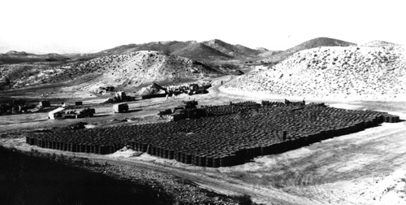
5. Nuclear Incidents
Section 5 – Nuclear Incidents
Palomares B-52 Crash
On 23 February 1966 an agreement over the soil was reached:
  Any soil testing over 60,000 cpm (10,000 Bq) was shipped back to the U.S. and stored
  Any soil testing over 10,000 cpm but below 60,000 cpm would be washed and tilled back in
  Any soil testing under 10,000 was considered safe but would be watered down if practical
United States Air Force/ http://www.brookings.edu/projects/archive/nucweapons/palomares.aspx/ Public Domain

Slide 108
5. Nuclear Incidents
Section 5 – Nuclear Incidents
Palomares B-52 Crash: Lessons Learned
PAC-1S detector used was ineffective:
  Had a steep learning curve
  Frequently broke
  Had difficulties on un-even terrain
USAF recommended not using the PAC-1S detector again in the field
USAF started developing a new Pu-239 alpha detector after this incident
Effective lines of communication between the Task Force Commander and the Chief of Naval Operations proved to be important in carrying out the operation
No unit trained in the recovery of nuclear weapons under water
  New unit was created because of this incident

Slide 109
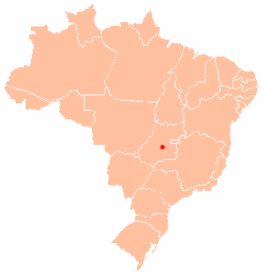
5. Nuclear Incidents
Section 5 – Nuclear Incidents
Goiania Incident
In 1987 a radiation clinic in Goiania, Brazil changed locations
The building was later demolished but the radiation units were left
Around the 11th of September two people took the cesium-137 housing
On the 18th one of the people opened the unit and found the cesium chloride powder
© Joao Xavier/Wikimedia Commons/CC-BY-SA-3.0

Slide 110
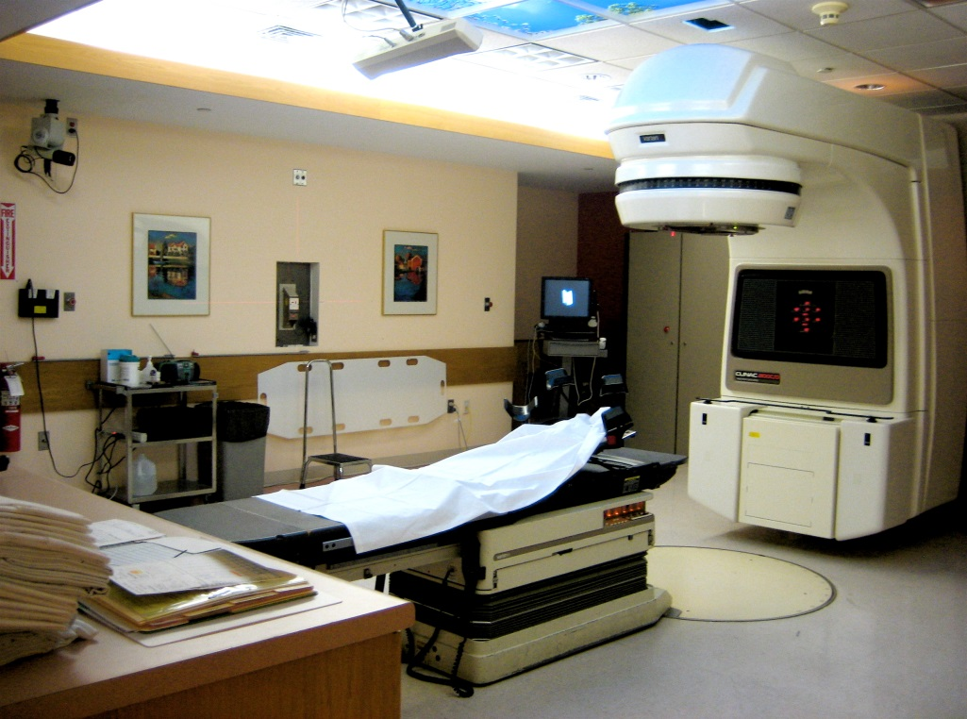
5. Nuclear Incidents
Section 5 – Nuclear Incidents
Goiania Incident
The cesium chloride was sold to an owner of a scrapyard
Thinking it was something valuable (it glowed blue) many of his friends came to see it
Some put it on their skin
People with radiation sickness were diagnosed as having a tropical disease
© Liz west/http://www.flickr.com/photos/calliope/361570738//CC-BY-SA-2.0

Slide 111
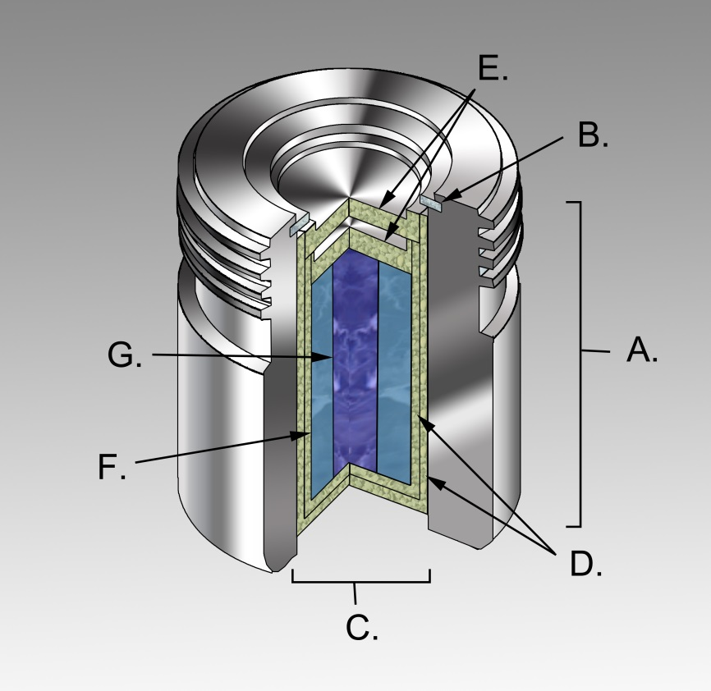
5. Nuclear Incidents
Section 5 – Nuclear Incidents
Goiania Incident
What was left of the cesium chloride was taken to a clinic and thrown in a corner of the courtyard
Many of the people first exposed to the cesium chloride dies of exposure of between 3-8 gray
People exposed were taken to the Olympic stadium
© KDS444/Wikimedia Commons/CC-BY-SA-3.0

Slide 112
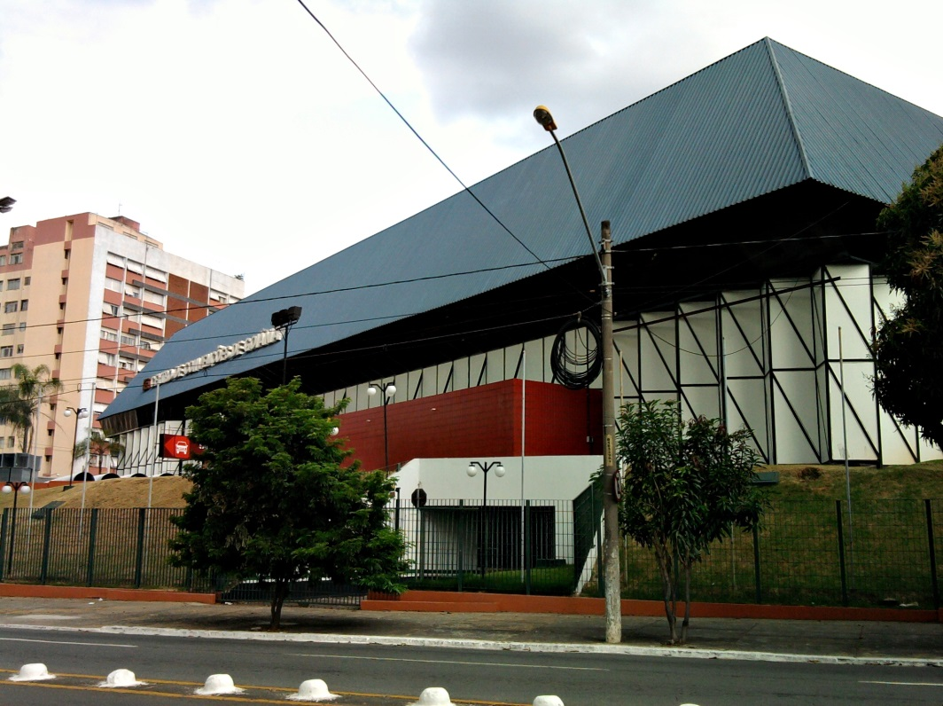
5. Nuclear Incidents
Section 5 – Nuclear Incidents
Goiania Incident
Areas that had exposure rates of over 2.5 mSv/hr were evacuated
  International standards are 50 msv/year for workers
  Civilian limits are 10 times lower
A sewer pipe was placed over the radiation source in the courtyard and filled with concrete
3000 cubic metres of earth had to be dug up and moved 20 km away to a repository
Adelano Lázaro/Wikimedia Commons/Public Domain

Slide 113
5. Nuclear Incidents
Section 5 – Nuclear Incidents
Goiania Incident – Lessons Learned
International regulations on medical radiation source control were “weak” according to Eliana Amaral, IAEA Director of Radiation, Transport and Waste Safety
Monitoring of radioactive materials must be “cradle to grave”
Replacements for cesium chloride have been considered
As of 2008 IAEA is developing standards for scrap metal plants on how to deal with radioactive materials:
Some of the lessons learned from the Goiania incident are:
  Public awareness about radiation is important, as is psychological help for those directly or indirectly affected
  Emergency training courses should be held in developing countries where the facilities are available for these types of incidents
  Mobile first aid should be available at all times
  Experts in the appropriate fields should be able to be contracted to provide assistance when needed

Slide 114
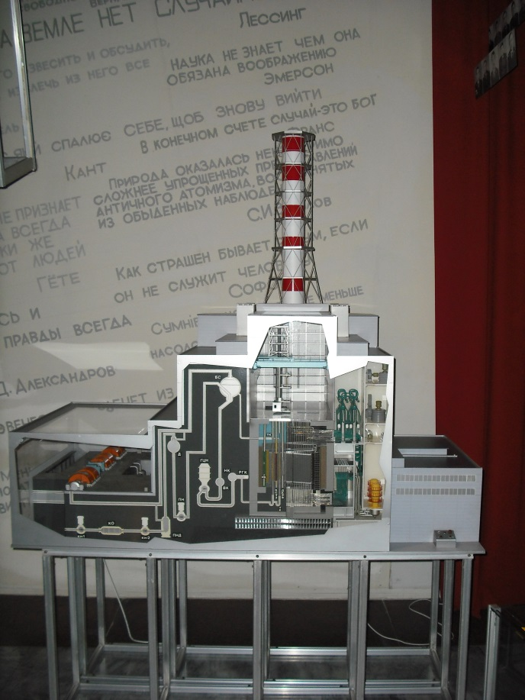
5. Nuclear Incidents
Section 5 – Nuclear Incidents
Chernobyl Reactor
On the 26th of April 1986 an RBMK-1000 reactor in Chernobyl, Ukraine was scheduled for a reactor shutdown test
The test was to see if power to the cooling system could be maintained until the backup systems took over
The operator turned off the emergency shutdown systems
Two explosions followed scattering radioactive material
© Vincent de Groot/Wikimedia Commons/CC-BY-SA-3.0

Slide 115
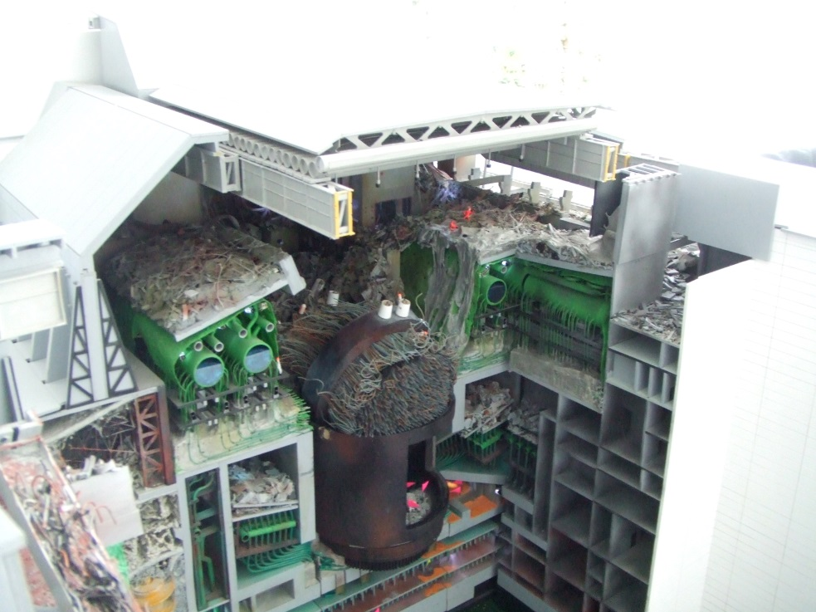
5. Nuclear Incidents
Section 5 – Nuclear Incidents
Chernobyl Reactor
It was estimated that the following amounts of materials were released:
  All the Xenon gas
  Half of the I-131 and Cs-137
  5% of the remaining radioactive material (out of the 192 tons of fuel)
Cs-137 became the main radiation threat
  I-131 has a half life of 8 days compared to Cs-137’s 30 years
© Stahlmandesign/http://www.flickr.com/photos/93823488@N00/457478318/CC-BY-SA-2.0

Slide 116
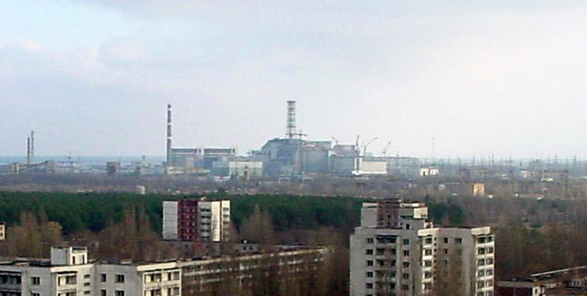
5. Nuclear Incidents
Section 5 – Nuclear Incidents
Chernobyl Reactor
Pripyat, a town of 45,000, was evacuated on the 27th of April
By the 14th of May 116,000 people from a 30 km radius had been relocated
According to a 2005 Chernobyl Forum Study (with participants from 8 UN countries) there is no significant health risk other than an increase in thyroid cancers
Jason Minshull/Wikimedia Commons/Public Domain

Slide 117
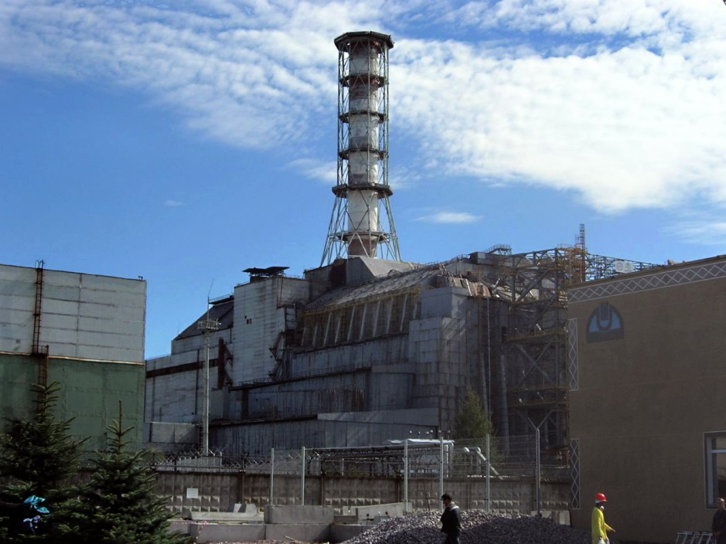
5. Nuclear Incidents
Section 5 – Nuclear Incidents
Chernobyl Reactor
In May 1986 work began on the so called “sarcophagus”
Construction was completed six months later
Concerns have been raised over how the radiation would affect the structure
A new structure is under construction that is designed to last at least 100 years
© Carl Montgomery/http://www.flickr.com/photos/83713082@N00/535916329/CC-BY-SA-2.0

Slide 118
5. Nuclear Incidents
Section 5 – Nuclear Incidents
Chernobyl Reactor – Lessons Learned
RBMK-1000 design had a positive void coefficient meaning if coolant water was lost or turns to steam the reaction would run out of control because water is a better moderator than steam
  New RBMK reactors have a negative void coefficient so this won’t happen
The void coefficient at the time of the accident was so high that it negated other factors that would have controlled the reactor
A new emphasis on safety in design and operation with cooperation between the east and west
Several design changes have been made since then:
  U-235 fuel has been enriched from 1.8% to 2.5%
  Neutron absorbers were added to the end of the control rods
  Emergency shutdown was made faster
  Automated inspection equipment was installed

Slide 119
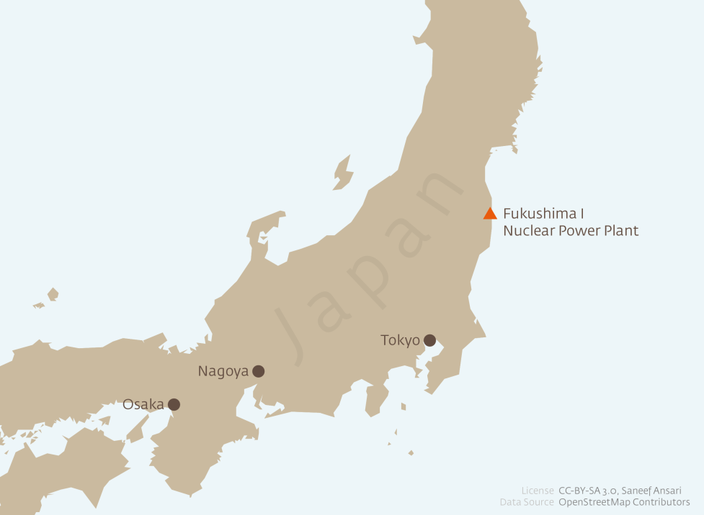
5. Nuclear Incidents
Section 5 – Nuclear Incidents
Fukushima Reactors
On the 3rd of March 2011 a tsunami hit the Fukushima nuclear power station
It flooded the station and disabled 12 of the 13 backup generators as well as the heat exchangers to waste reactor heat
Since heat couldn’t be removed the water in the pressure vessel turned to steam
  This created hydrogen gas from the steam interacting with the zirconium alloy fuel sheathing
© Saneef/Wikimedia Commons/CC-BY-SA-3.0

Slide 120
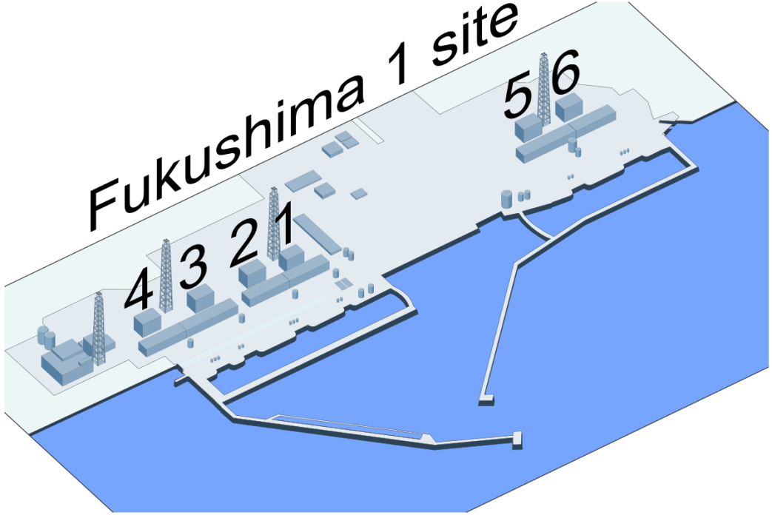
5. Nuclear Incidents
Section 5 – Nuclear Incidents
Fukushima Reactors
The steam and later the hydrogen gas was released into the containment building via safety valves
Water was injected into the reactor units to keep them cool
Radiation monitoring was problematic since 23 of the 24 tracking stations were disabled by the tsunami
© Shigeru23/Wikimedia Commons/CC-BY-SA-3.0

Slide 121
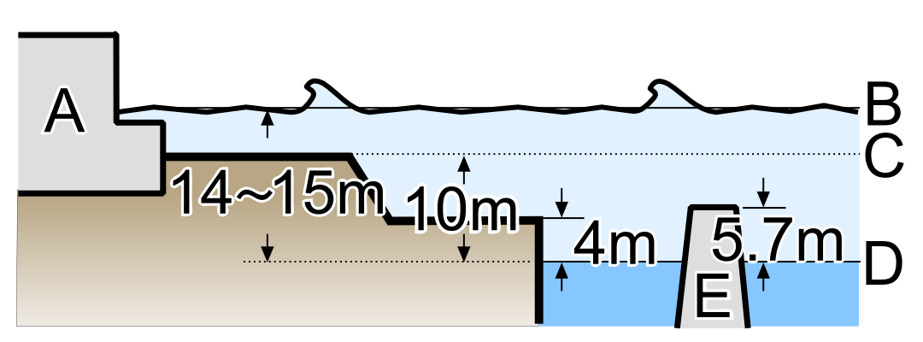
5. Nuclear Incidents
Section 5 – Nuclear Incidents
Fukushima Reactors
Two weeks after the tsunami reactors 1-3 were stable
By July 2011 the reactors were being cooled by recycled water from a near by treatment plant
On going work is being done to prevent radiation contamination of water
No deaths or incidents of radiation sickness have been reported
© Shigeru23/Wikimedia Commons/CC-BY-SA-3.0

Slide 122
5. Nuclear Incidents
Section 5 – Nuclear Incidents
Fukushima Reactors – Lessons Learned
The tsunami disabled both the internal and external power systems
Policies in the US are being put in place to ensure that if a power plant looses power, called SBO (Station Black Out), that the station will be able to function indefinitely
The lessons learned form the Fukushima reactors are divided into three tiers addressing:
  Training of personnel in incidents like the Fukushima incident
  Monitoring of the level of water in the spent fuel bay
  Inspecting the plant seismic and flood prevention systems,
  Adjustments to the size of the safety zone,
  Evaluation of current seismic activity
  Better emergency procedures
  Radiation containment
  Hydrogen containment

Slide 123
5. Nuclear Incidents
Section 5 – Quiz
The two bombs in Palomares released what type of radiation?
  Neutrons
  Alpha particles
  Beta particles
  Gamma rays

Slide 124
5. Nuclear Incidents
Section 5 – Quiz
The two bombs in Palomares released what type of radiation?
  Neutrons
  Alpha particles
  Beta particles
  Gamma rays

Slide 125
5. Nuclear Incidents
Section 5 – Quiz
The Chernobyl accident started as what?
  A control rod being displaced
  A refuelling
  A reactor repair
  A shutdown test

Slide 126
5. Nuclear Incidents
Section 5 – Quiz
The Chernobyl accident started as what?
  A control rod being displaced
  A refuelling
  A reactor repair
  A shutdown test

Slide 127
5. Nuclear Incidents
Section 5 – Quiz
The radiation source in the Goinia incident came from…?
  A nuclear reactor
  A radiation therapy unit
  A smoke detector
  An enrichment plant

Slide 128
5. Nuclear Incidents
Section 5 – Quiz
The radiation source in the Goinia incident came from…?
  A nuclear reactor
  A radiation therapy unit
  A smoke detector
  An enrichment plant

Slide 129
5. Nuclear Incidents
Section 5 – Quiz
Of the 13 backup generators at the Fukushima plant how many were knocked out by the tsunami?
  5
  8
  12
  13

Slide 130
5. Nuclear Incidents
Section 5 – Quiz
Of the 13 backup generators at the Fukushima plant how many were knocked out by the tsunami?
  5
  8
  12
  13

Slide 131
6.Review
Section 6 – Review
What is Radiation?
Radiation comes in two sorts:
  Ionizing
  Non-Ionizing
4 types of ionizing radiation exist:
  Alpha particles
  Beta particles
  Neutrons
  Gamma rays
3 different types of doses:
  Absorbed dose
  Equivalent dose
  Effective dose

Slide 132
6.Review
Section 6 – Review
Radiation Hazards
Hazards comes in two sorts:
  Radiation
  Contamination
Contamination hazards
  Carbon-14
  Iodine-131
  Activated noble gases
  Tritium
  Surface and liquid contamination
  Discrete radioactive particulates

Slide 133
6.Review
Section 6 – Review
Radiation Regulations
ALARA Principle
Use of measurement and managerial practices to keep exposure ALARA
Management must provide certain information to workers when starting a job involving radiation doses
  Workers must also provide information to employers
  Exceptions when radiation limits may be exceeded
Role of CNSC in radiation exposure

Slide 134
6.Review
Section 6 – Review
Reducing Radiation Exposure
Three source types
  Point
  Line
  Plane
Three principles of radiation protection
  Time
  Distance
  Shielding
Other protection measures taken
  Personal protective equipment
  Work practices
  Potassium iodide tablets

Slide 135
6.Review
Section 6 – Review
Radiation Incidents
Palomares B-52 crash
Goiania radiation therapy unit
Chernobyl Power Station
Fukushima

Slide 136
6.Review
Section 6 – Review
Acknowledgments
Bruce Power
Radiation Safety Institute of Canada
CNSC
Minerva Safety Management Education
MITACS Canada

Slide 137
6.Review
Section 6 – Review
Further Readings
http://www.iaea.org/newscenter/news/2008/goiania.html
http://www.nrc.gov/reactors/operating/ops-experience/japan-dashboard.html
http://www.world-nuclear.org/info/Safety-and-Security/Safety-of-Plants/Chernobyl-Accident/#.UjCKv8boaSo
http://www.dod.mil/pubs/foi/International_security_affairs/spain/844.pdf
http://www-pub.iaea.org/mtcd/publications/pdf/pub815_web.pdf
http://www.epa.gov/radiation/docs/futures/future_2025.pdf
http://laws-lois.justice.gc.ca/eng/acts/N-28.3/page-8.html#docCont
http://www.safetyoffice.uwaterloo.ca/hse/radiation/rad_laboratory/detection/gas_filled/gas_filled_detectors.htm
http://www.cnsc-ccsn.gc.ca/eng/readingroom/radiation/radiation_doses.cfm
http://www.nrc.gov/about-nrc/radiation/around-us/sources/man-made-sources.html
http://laws-lois.justice.gc.ca/eng/regulations/SOR-2000-203/page-10.html#docCont
http://www.ncrponline.org/PDFs/2012/DAS_DDM2_Athens_4-2012.pdf
http://www.world-nuclear.org/info/Safety-and-Security/Safety-of-Plants/Fukushima-Accident/#.Ul1_RFDoaSo
http://www.nrc.gov/reactors/operating/ops-experience/japan-dashboard/flooding.html
http://www.epa.gov/radiation/docs/futures/future_2025.pdf
http://www.safetymanagementeducation.com/

Slide 138
6.Review
Section 6 – Review
References
Bruce Power Radiation Protection Training Manual
http://www.radiationsafety.ca/
http://www.cnsc-ccsn.gc.ca/eng/readingroom/radiation/radiation_doses.cfm
http://agni.phys.iit.edu/~vpa/medical%20applications.htm
http://www.iaea.org/About/Policy/GC/GC56/GC56InfDocuments/English/gc56inf-3-att3_en.pdf
http://hps.org/publicinformation/ate/faqs/radiation.html
http://www.chem.wisc.edu/deptfiles/genchem/sstutorial/Text4/Tx45/tx45.html
http://www.des.umd.edu/rs/material/tmsg/rs6.html
http://www-bd.fnal.gov/ntf/
http://www.epa.gov/radiation/understand/alpha.html#exposure
http://ehs.uky.edu/radiation/isotopes/carbon.html
http://safety.uncc.edu/sites/safety.uncc.edu/files/Carbon%2014.pdf
http://www.epa.gov/radiation/understand/beta.html
http://www.epa.gov/radiation/radionuclides/iodine.html

Slide 139
6.Review
Section 6 – Review
References
http://www.epa.gov/radiation/understand/protection_basics.html
http://ehs.uky.edu/radiation/isotopes/tritium.html
https://www.jlab.org/div_dept/train/rad_guide/fund.html
http://www.world-nuclear.org/info/Safety-and-Security/Safety-of-Plants/Chernobyl-Accident/
http://www.world-nuclear.org/info/Safety-and-Security/Safety-of-Plants/Fukushima-Accident/#.Ul1_RFDoaSo
http://www.world-nuclear.org/info/Safety-and-Security/Safety-of-Plants/Fukushima-Accident/#.UmU55_noaSp
http://www.iaea.org/newscenter/news/2008/goiania.html
http://www.dod.mil/pubs/foi/International_security_affairs/spain/844.pdf
http://www.nrc.gov/reactors/operating/ops-experience/japan-dashboard/priorities.html#tier-02

