Slide 1


Chemical Process Quantitative Risk Assessment
April 6, 2015 (rev 4)

Slide 2
Concept Definitions
Hazard – An intrinsic chemical, physical, societal, economic or political condition that has the potential for causing damage to a risk receptor (people, property or the environment).
A hazardous event (undesirable event) requires an initiating event or failure and then either failure of or lack of safeguards to prevent the realisation of the hazardous event.
Examples of intrinsic hazards:
Toxicity and flammability – H₂S in sour natural gas
High pressure and temperature – steam drum
Potential energy – walking a tight rope
Notes:
When we talk about a hazard we are referring to a chemical or physical condition that has the potential to cause damage. This damage can be to a person, to property or to the environment. A hazard is a condition. We cannot quantitatively measure a hazard.

Slide 3
Concept Definitions
Risk – A measure of human injury, environmental damage or economic loss in terms of both the frequency and the magnitude of the loss or injury.
Risk = Consequence x Frequency
Notes:
In contrast, a risk is what we actually measure. When measure a risk, the first we are asking ourselves what is the measure of damage to a property, how badly did a person get hurt, what is the cost of damage/injury. After evaluating these consequences of a hazard, we then consider the likelihood or probability of this hazard. Risk can be expressed as the product of these two parameters of a hazard, consequence and likelihood.

Slide 4
Concept Definitions
Risk
Intrinsic Hazards
Undesirable Event
Consequences
Likelihood of Event
Likelihood of Consequences
Example
Storage tank with flammable material
Spill and Fire
Loss of life/ property,
Environmental damage,
Damage to reputation of facility
Notes:
In contrast, a risk is what we actually measure. When measure a risk, the first we are asking ourselves what is the measure of damage to a property, how badly did a person get hurt, what is the cost of damage/injury. After evaluating these consequences of a hazard, we then consider the likelihood or probability of this hazard. Risk can be expressed as the product of these two parameters of a hazard, consequence and likelihood.

Slide 5
Concept Definitions
Risk
Intrinsic Hazards
Undesirable Event
Consequences
Causes
Likelihood of Event
Likelihood of Consequences
Notes:
In contrast, a risk is what we actually measure. When measure a risk, the first we are asking ourselves what is the measure of damage to a property, how badly did a person get hurt, what is the cost of damage/injury. After evaluating these consequences of a hazard, we then consider the likelihood or probability of this hazard. Risk can be expressed as the product of these two parameters of a hazard, consequence and likelihood.

Slide 6
Concept Definitions
Layers of Protection are used to enhance the safe operation. Layers of Protection Analysis (LOPA) is used to determine if there are sufficient layers of protection for a predicted accident scenario. Can the risk of this scenario be tolerated?
Risk
Layers of Protection
Layers of Protection
Intrinsic Hazards
Undesirable Event
Consequences
Causes
Likelihood of Event
Likelihood of Consequences
Causes are also known as Initiating Events.
Prevention
Preparedness, Mitigation,
Land Use Planning, Response, Recovery
Notes:
In contrast, a risk is what we actually measure. When measure a risk, the first we are asking ourselves what is the measure of damage to a property, how badly did a person get hurt, what is the cost of damage/injury. After evaluating these consequences of a hazard, we then consider the likelihood or probability of this hazard. Risk can be expressed as the product of these two parameters of a hazard, consequence and likelihood.

Slide 7
Quantifying Risk
Risk – A measure of human injury, environmental damage or economic loss in terms of both the frequency and the magnitude of the loss or injury.
R_{h}
Risk from an
undesirable event, h
Consequence_{i,} of undesirable event, h
Frequency_{i,} of consequence i from event h
where i is each consequence

Slide 8
Quantifying Risk
If more than one type of receptor can be impacted by an event, then the
total risk from an undesirable event can be calculated as:
R_{h}
Risk from an
undesirable event, h
Consequence_{i,} of undesirable event, h
Frequency_{i,} of consequence i, from event h
where k is each receptor (ie. people, equipment, the environment, production)

Slide 9
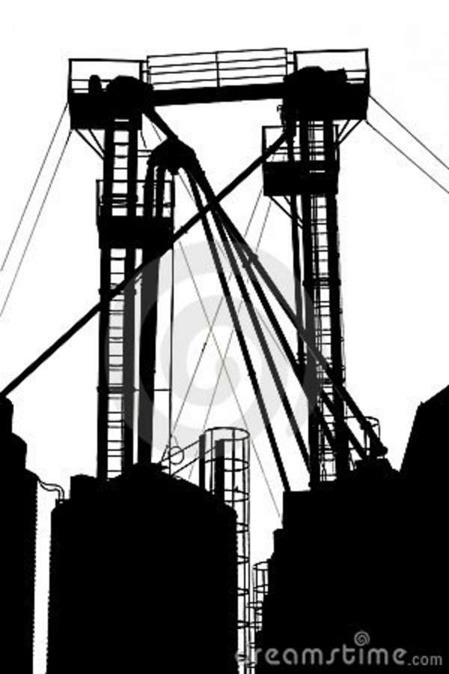

Types of Consequences
Locational Consequence – Outdoor IMMOVEABLE receptor that is maximally exposed.
Probability of
the consequence, P_{d}
(death, damage)
of an event
P_{d,h}(x) = Conditional probability of consequence (death, injury, building or equipment damage) for event h at distance x from the event location.
Event Location
Distance from Event, x

Slide 10
Types of Consequences
Locational Consequence – Outdoor IMMOVEABLE receptor that is maximally exposed.
Probability of
the consequence, P_{d}
(death, damage)
of an event
We can sum all the locational consequences at a set location, to calculate the total risk = facility risk.
The total risk includes the risk from all events that can occur in the facility.
Event Location
Distance from Event, x

Slide 11

Types of Consequences
Locational Consequence – Outdoor IMMOVEABLE receptor that is maximally exposed.
Probability of
the consequence, P_{d}
(death, damage)
of an event
Layers of Protection
Individual Consequence – An ability to escape and an indoor vs. outdoor exposure.
Event Location
Distance from Event, x

Slide 12

Aggregate Consequence – Outdoor IMMOVEABLE receptor.
Types of Consequences
Probability of
the consequence, P_{d}
(death, damage)
of an event
Event Location
dA
Distance from Event, x

Slide 13
Aggregate Consequence – Outdoor IMMOVEABLE receptor.
Types of Consequences
Layers of Protection
Societal Consequence – An ability to escape,
indoor vs. outdoor exposure and fraction of time the receptor at a location.
Probability of
the consequence, P_{d}
(death, damage)
of an event
Event Location
dA
Distance from Event, x

Slide 14
Define the System
Overview of Risk Assessment
Risk
Analysis
Hazard Identification
Identify hazardous materials and process conditions
Identify hazardous events
Analyse the consequences and frequency of events using:
  Qualitative Risk Assessment
  (Process Hazard Analysis using
  Risk Matrix techniques)
  - SLRA (screening level risk assessment)
  - What-if
  - HAZOP (Hazard & Operability study)
  - FMEA (failure modes and effects analysis)
Consequence
Analysis
Frequency
Analysis
Risk Evaluation
Risk Assessment

Slide 15
Define the System
Overview of Risk Assessment
Risk
Analysis
Hazard Identification
  ii. Semi-Quantitative Risk Assessment
  - Fault trees/ Event trees/ Bow-tie
  iii. Quantitative Risk Assessment
  - Mathematical models for hazard effents include explosion overpressure levels, thermal radiation levels
  - The consequences are determined from the hazardous effects
Consequence
Analysis
Frequency
Analysis
Risk Evaluation
Risk Assessment

Slide 16
Hazard effects can be caused by the release of hazardous material
Hazardous materials are typically contained in storage or process vessels
(as a gas, liquid or solid).
Depending on the location of the vessel, release may occur from a fixed facility or during transportation (truck, rail, ship, barge, pipeline) over land or water.

Slide 17
Release of Solid Hazardous Material
The release is significant if the solid is:
An unstable material such as an explosive
Flammable or combustible solid (petroleum coke)
Toxic or carcinogenic (either in bulk or as dust)
Soluble in water and spill occurs over water (dissolves into the water)
Dust (which can cause clouds and impact respiration)

Slide 18
Release of Liquids or Gases from Containment
Release from containment will result in:
an instantaneous release if there is a major failure
a semi-continuous release if a hole develops in a vessel

Slide 19
Release of Liquids or Gases from Containment
Mass discharge of a liquid [kg/s] through a hole can be calculated:
where
C_{d} – discharge coefficient (dimensionless – 0.6)
A – area of the hole (m²)
ρ – liquid density (kg/m³)
P - Liquid storage pressure (N/m²)
P_{a} – ambient pressure (N/m²)
g – gravitational constant (9.81 m/s²)
h – liquid height above the hole (m)

Slide 20
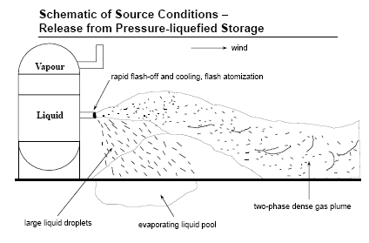
Liquid Release from a Pressurised Storage Tank
Pressurised storage tanks containing liquefied gas are of particular interest as their temperature is between the material’s boiling temperature at atmospheric pressure and its critical temperature. A release will cause:
- A rapid flash-off of material.
- The formation of a two-phase jet which could create a liquid pool around the tank. The pool will evaporate over time.
- Formation of small droplets which could form a cloud that is denser and cooler than the surrounding air. This is a heavy gas cloud which remains close to the ground and disperses slowly.

Slide 21


Liquid Release from a Pressurised Storage Tank
Wind
Outdoor Temperature > Normal Boiling Point of Liquid
Rapid Flash-off and Cooling
Two-phase Dense Gas Plume
Large Liquid Droplets
Evaporating Liquid Pool
Outdoor Temperature < Normal Boiling Point of Liquid

Slide 22
Consequences of Liquid Release from a Pressurised Storage Tank
Flammable Gas Release No Ignition = vapour cloud
Immediate ignition = jet fire
Delayed ignition = vapour cloud explosion
Flammable Liquid Release No ignition = toxic health issues
Immediate Ignition – pool fire
Pool fire under or near a pressure vessel can lead to a Boiling Liquid Expanding Vapour Explosion (BLEVE)

Slide 23
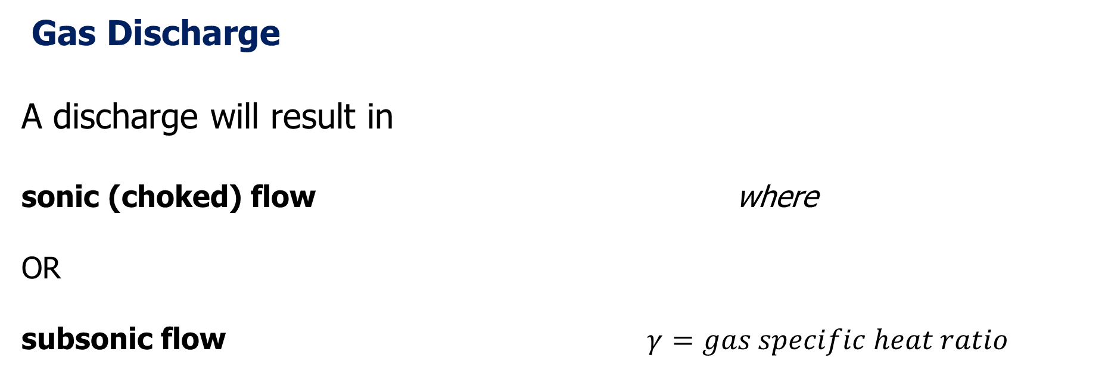
Gas Discharge
A discharge will result in
sonic (choked) flow where
OR
subsonic flow

Slide 24
Gas Discharge
Gas discharge rate can be calculated:
Subsonic Flows
Sonic (Choked) Flows
a_{o} – sonic velocity of the gas (m/s)
C_{d} – discharge coefficient (0.6)
A – area of hole (m²)
R – gas constant
T – upstream temperature (K)
M – gas molecular weight (kg/kmol)
Ψ – flow factor (dimensionless)

Slide 25
Hazardous Events and Concerns
Event Type | Event Mechanism | Hazard Concern
Fires Gas/Vapour Liquid Solids | - Jet fire, flash fire, fireball - Pool fire, tank fire, running fire, spray fire, fireball Bulk fire, smouldering fire | Thermal radiation, flame impingement, combustion products, initiation of further fires
Explosions Confined Unconfined | - Runaway reactions, combustion explosion, physical explosion, boiling liquid expanding vapour explosion (BLEVE) Vapour cloud explosion | Blast pressure waves, missiles, windage, thermal radiation, combustion products
Gas Clouds Heavy Gases Light Gases | Jets Evaporation, volatilisation, boil-off | Asphyxiation, toxicity, flammability, range of concentrations.

Slide 26
Modelling the Effects of a Hazardous Material Release
The type of material and containment conditions will govern source strength.
The type of hazard will determine hazard effect:
- Gas Clouds: concentration, C
- Fires: thermal radiation flux, I
- Explosions: overpressure, P_{o}
The probability of effect, P, can be calculated at a receptor.
We will focus on effect modelling for combustion sources: fires and explosions.

Slide 27
Combustion Basics
  Combustion is the rapid exothermic oxidation of an ignited fuel.
  Combustion will always occur in the vapour phase – liquids are volatised and solids are decomposed into vapour.

Slide 28
Essential Elements for Combustion
Fuel
Gases: acetylene, propane, carbon monoxide, hydrogen
Liquids: gasoline, acetone, ether, pentane
Solids: plastics, wood dust, fibres, metal particles
Oxidizer
Ignition Source
Gases: oxygen, fluorine, chlorine
Liquids: hydrogen peroxide, nitric acid, perchloric acid
Solids: metal peroxides, ammonium nitrate
Sparks, flames, static electricity, heat
  Examples: Wood, air, matches or
  Gasoline, air, spark

Slide 29
Essential Elements for Combustion
Fuel
Gases: acetylene, propane, carbon monoxide, hydrogen
Liquids: gasoline, acetone, ether, pentane
Solids: plastics, wood dust, fibres, metal particles
Oxidiser
Ignition Source
Gases: oxygen, fluorine, chlorine
Liquids: hydrogen peroxide, nitric acid, perchloric acid
Solids: metal peroxides, ammonium nitrate
Sparks, flames, static electricity, heat
  Methods for controlling combustion are focused on eliminating ignition sources AND preventing flammable mixtures.

Slide 30
Flammability
  Ignition – A flammable material may be ignited by the combination of a fuel and oxidant in contact with an ignition source. OR, if a flammable gas is sufficiently heated, the gas can ignite.
  Minimum Ignition Energy (MIE) – Smallest energy input needed to start combustion. Typical MIE of hydrocarbons is 0.25 mJ. To place this in perspective, the static discharge from walking across a carpet is 22 mJ; an automobile spark plug is 25 mJ!
  Auto-Ignition Temperature – The temperature threshold above which enough energy is available to act as an ignition source.
  Flash Point of a Liquid – The lowest temperature at which a liquid gives off sufficient vapour to form an ignitable mixture with air.

Slide 31
Combustion Definitions
  Explosion – Rapid expansion of gases resulting in a rapidly moving pressure or shock wave.
  Physical Explosion – Results from the sudden failure of a vessel containing high-pressure non-reactive gas.
  Confined Explosion – Occurs within a vessel, a building, or a confined space.
  Unconfined Explosion– Occurs in the open. Typically the result of a flammable gas release in a congested area.
  Boiling-Liquid Expanding-Vapour Explosions – Occurs if a vessel containing a liquid above its atmospheric pressure boiling point suddenly ruptures.
  Dust Explosion – Results from the rapid combustion of fine solid particles suspended in air.

Slide 32
More Combustion Definitions
  Shock Wave– An abrupt pressure wave moving through a gas. In open air, a shock wave is followed by a strong wind. The combination of a shock wave and winds can result in a blast pressure wave.
  Overpressure – The pressure of an explosion above atmospheric pressure; more specifically, the pressure on an object, resulting from the shock wave.

Slide 33
Types of Fire and Explosion Hazards
Fires
Pool Fires
- Contained (circular pools, channel fires)
- Uncontained (catastrophic failure, steady release)
Tank Fires
Jet Fires
- Vertical, tilted, horizontal discharge
Fireballs
Running Fires
Line Fires
Flash Fires
Explosions
Physical Explosions
- Boiling liquid expanding vapour explosions (BLEVEs)
- Rapid phase transitions (eg, water into hot oil)
- Compressed gas cylinder failure
Combustion Explosions
- Deflagrations: speed of reaction front< speed of sound
- Detonations: speed of reaction front> speed of sound
- Confined explosions
- Vapour cloud explosions
- Dust explosions

Slide 34
Fires vs. Explosion Hazards
  Combustion …
    Is an exothermic chemical reaction where energy is released following combination of a fuel and an oxidant
    Occurs in the vapour phase – liquids are volatilised, solids are decomposed to vapours
  Fires AND explosions involve combustion – physical explosions are an exception
  The rate of energy release is the major difference between fires and combustion
  Fires can cause explosions and explosions can cause fires

Slide 35
The Effects
Major Fires
Toxic concentrations from combustion emissions
Thermal radiation
Flame impingement
Ignition temperature
Explosions
Blast pressure levels
Thermal radiation
Missile trajectory
Ground shock
Crater
Explosions can cause a lung haemorrhage, eardrum damage, whole body translation.

Slide 36
Modelling Major Fires
  The goal of models is to…
    Assess the effects of thermal radiation on people, buildings and equipment – use the empirical radiation fraction method
    Estimate thermal radiation distribution around the fire
    Relate the intensity of thermal radiation to the damage – this can be done using the PROBIT technique or fixed-limit approach
  Modelling methods
    Determine the source term feeding the fire
    Estimate the size of the fire as a function of time
    Characterise the thermal radiation released from the combustion
    Estimate thermal radiation levels at a receptor
    Predict the consequence of the fire at a receptor

Slide 37
Modelling Major Fires
  Radiation Heat Transfer
  I_{s} = Incident Radiative Energy Flux at the Target
  Empirical Radiative Fraction Method
  I_{s} = τ E F where and
  τ – atmospheric transmissivity
  F – point source shape factor (S is the distance from the centre of the flame to the receptor)
  E – total rate of energy from the radiation
  f – radiative fraction of total combustion energy released
  Q – rate of total combustion energy released
  E = f Q
  F = (4πS²)⁻¹

Slide 38

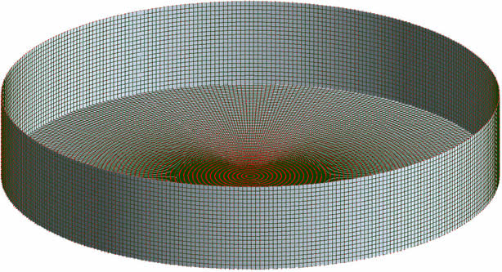
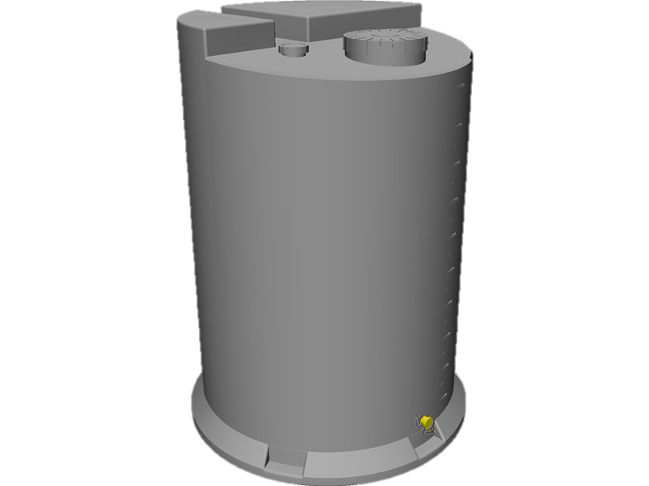
Pool Fires
  Heat radiation from flames
  Storage Tank
  Pool of flammable Liquid from tank
  Dyke

Slide 39
Pool Fires
  SIDE VIEW
  TOP VIEW
  First Degree Burns
  1% Fatalities Due to Heat Radiation
  100% Fatalities Due to Heat Radiation

Slide 40
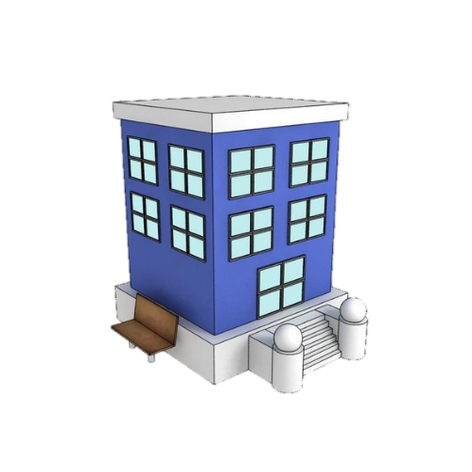
Modelling Pool Fires
  The heat load on buildings and objects outside a burning pool fire can be calculated using models. A pool fire is assumed to be a solid cylinder.
  The radiation intensity is dependent on the properties of the flammable liquid.
  Heat load is also influenced by:
    Distance from fire
    Relative humidity of the air
    Orientation of the object and the pool.
  X m

Slide 41

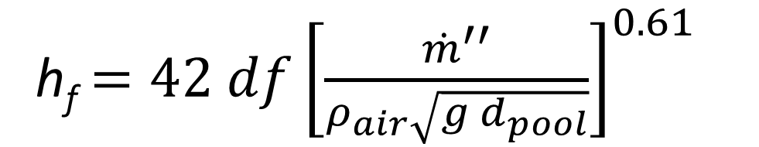
Height of Pool Fire Flame Model
  The height of a pool fire flame, h_{f}, can be calculated, assuming no wind:
    ${\dot{m}}^{′′}$ [kg/ (m²s] = mass burning flux
    d_{f} [m] – flame diameter
    d_{pool} [m] – pool diameter, assume equivalent to d_{pike}
    g [m/s²] – gravitational constant = 9.81
    ρ_{air} [kg/m³] – density of air
h_{f}$=42 df{\left[\frac{{\dot{m}}^{′′}}{ρ_{air}\sqrt{g{ d}_{pool}}}\right]}^{0.61}$
  h_{f} [m]

Slide 42
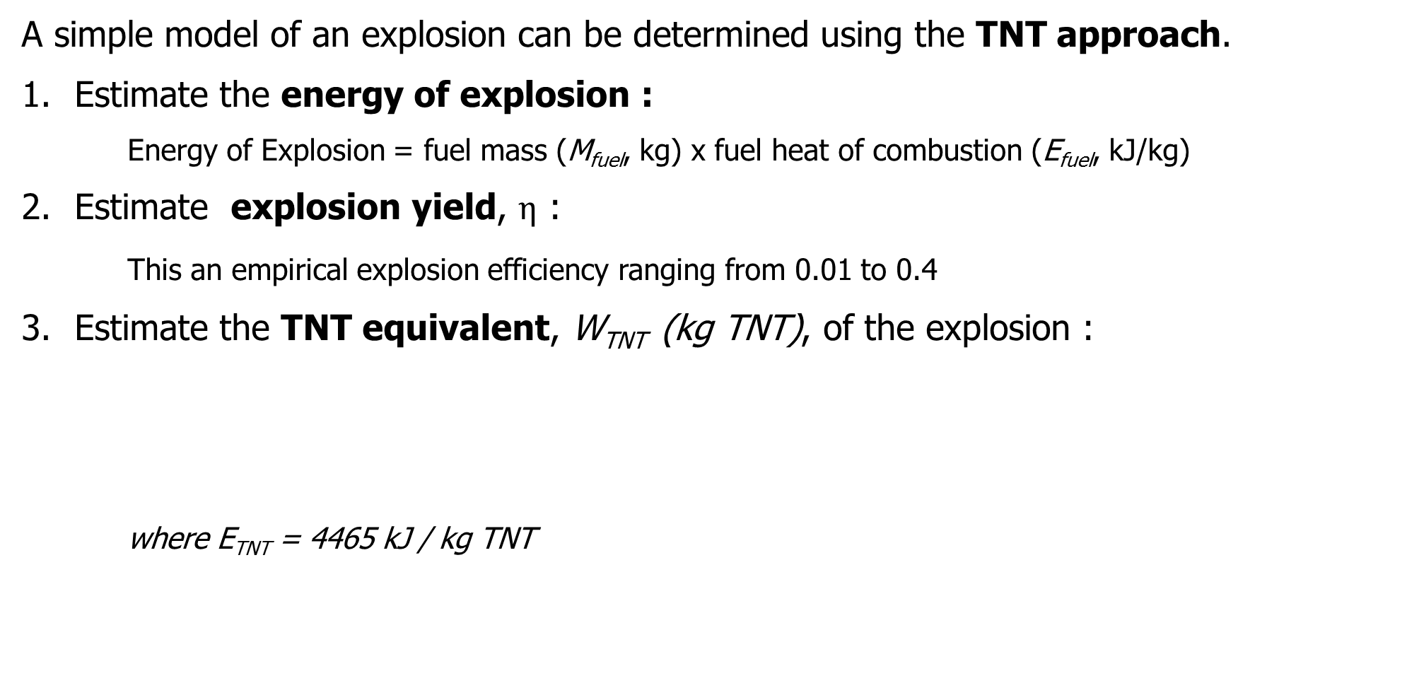

Explosion Modelling
  A simple model of an explosion can be determined using the TNT approach.
  Estimate the energy of explosion :
    Energy of Explosion = fuel mass (M_{fuel}, kg) x fuel heat of combustion (E_{fuel}, kJ/kg)
  Estimate explosion yield, $η$ :
    This an empirical explosion efficiency ranging from 0.01 to 0.4
  Estimate the TNT equivalent, W_{TNT} (kg TNT), of the explosion :
  where E_{TNT} = 4465 kJ / kg TNT
W_{TNT}$= \frac{η M_{fuel} E_{fuel}}{E_{TNT}}$

Slide 43
Explosion Modelling
  The results from the TNT approach can then be used to
  Predict the pressure profile vs distance for the explosion.
  Assess the consequences of the explosion on human health or objects
    PROBIT
    Damage effect methods

Slide 44
Classifying Hazards for Consequence Modelling
  In general, hazard effects associated with releases can be classified in to the following:
  Thermal Radiation – Radiation could affect a receptor positioned at some distance from a fire (pool, jet, fireball).
  Blast Pressure Wave – A receptor could be affected by pressure waves initiated by an explosion, vapour cloud explosion or boiling liquid expanding vapour explosion
  Missile Trajectory – This could result from ‘tub rocketing’.
  Gas Cloud Concentrations – Being physically present in the cloud would be the primary hazard.
  Surface/ Groundwater Contaminant Concentrations – Exposure to contaminated drinking water or other food chain receptors could adversely effect health

Slide 45
Consequence Models
  These models are used to estimate the extent of potential damage caused by a hazardous event. These consist of 3 parts:
  Source Term – The strength of source releases are estimated.
  Hazard Levels or Effects –Hazard level at receptor points can be estimated for an accident.
    Fire: A hazard model will estimate thermal radiation as a function of distance from the source.
    Explosion: A hazard model will estimate the extent of overpressure. NO concentrations of chemical are estimated.
  Consequences – Potential damage is estimated. Consequence of interest will be specific to each receptor type (humans, buildings, process equipment, glass).

Slide 46
Source Term for Hazardous Material Events
Source models describe the physical and chemical processes occurring during the release of a material. A release could be an outflow from a vessel, evaporation from a liquid pool, etc.
The strength of a source is characterised by the amount of material released.
A release may be:
- instantaneous: source strength is total mass released m [units: kg]
- continuous: source strength is rate of mass released [units: kg/s]
The physical state of the material (solid, liquid, gas) together with the containment pressure and temperature will govern source strength.

Slide 47
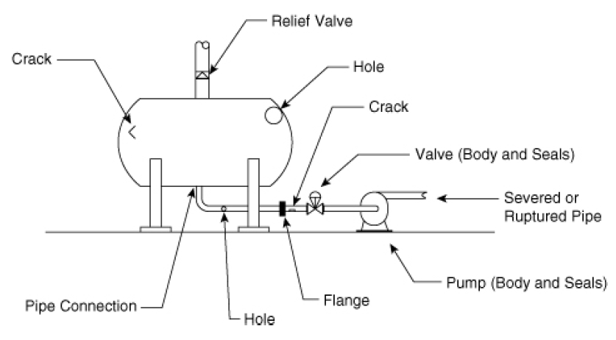
Release from Containment
  There are a number of possible release points from a chemical vessel.
Relief Valve
Crack
Hole
Crack
Valve
Severed or Ruptured Pipe
Pump seal
Pipe Connection
Flange
Hole

Slide 48
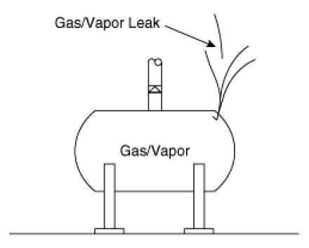
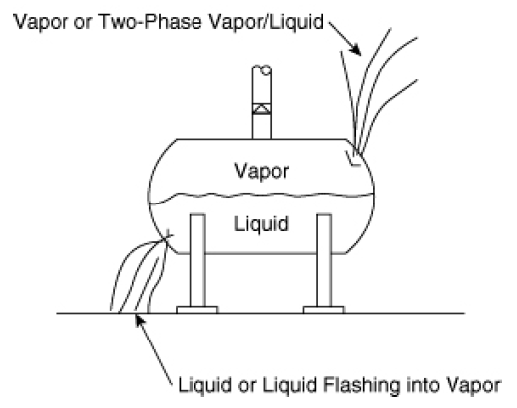
Physical State of a Material Influences Type of Release
Vapour OR Two Phase
Vapour/ Liquid Leak
Gas / Vapour Leak
Liquid OR Liquid Flashing into Vapour

Slide 49
Source Models Describing a Material Release
  Flow of Liquid through a hole
  Flow of Liquid through a hole in a tank
  Flow of Liquid through pipes
  Liquids flashing through a hole
  Liquid evaporating from a pool
  Flow of Gases through holes from vessels or pipes
  We are going to focus on the source models highlighted in red.

Slide 50
Liquid Flow Through a Hole
Ambient Conditions
  We can consider a tank that develops a hole. Pressure of the liquid contained in the tank is converted into kinetic energy as it drains from the hole. Frictional forces of the liquid draining through the hole convert some of the kinetic energy to thermal energy.
Liquid

Slide 51
Liquid Flow Through a Hole
where
Liquid
Ambient Conditions
P_{g} = gauge pressure
u = average fluid velocity (m/s)
Δz = height
W_{s} = shaft work
G = 9.81 m/s²
P = P_{g}
u_{tank} = 0
Δz = 0
W_{s} = 0
ρ = ρ_{liquid}
P = 1 atm
u_{ambient} = u
A = leak area (m²)

Slide 52
Liquid Flow Through a Hole
  Mass Flow of Liquid Through a Hole
Liquid
P = P_{g}
u_{tank} = 0
Δz = 0
W_{s} = 0
ρ = ρ_{liquid}
C_{o} is the discharge coefficient
For sharp-edged orifices, Re > 30,000 C_{o} = 0.61
For a well-rounded nozzle, C_{o} = 1
For a short pipe section attached to the vessel: C_{o} = 0.81
When the discharge coefficient is unknown: use C_{o} = 1

Slide 53
Liquid Flow Through a Hole - Example
  Consider a leak of benzene from 0.63 cm orifice-like hole in a pipeline. If the pressure in the pipe is 100 psig, how much benzene would be spilled in 90 minutes? The density of benzene is 879 kg/m³.
Benzene Pressurised in a Pipeline
  Area of Hole
  Volume of Spill
Area = π/4 D²
Area = (π/4 * 0.0063)²
Area = 3.12 x 10⁻⁵ m²
Volume = 2.07 kg/s * (90 min * 60 sec/min * 1/879 m³/kg = 12.7 m³

Slide 54



Liquid Flow Through a Hole In a Pressurized Tank
Ambient Conditions
Liquid Pressurised in a Tank
  We can consider a tank that develops a hole. Pressure of the liquid contained in the tank is converted into kinetic energy as it drains from the hole. Frictional forces of the liquid draining through the hole convert some of the kinetic energy to thermal energy.
U_{tank} = 0
$P=Pg$
$$∆z=0$$
ρ = ρ_{liquid}

Slide 55









Liquid Flow Through a Hole In A TANK
where
Ambient Conditions
Liquid Pressurised in a Tank
$$Pg$$
$$P=1 atm$$
Gauge Pressure
$$\overline{u}$$
Average Instantaneous Velocity of Fluid Flow [length/time]
u_{ambient} = u
$P=Pg$
$$hL$$
$$A=leak area$$
U_{tank} = 0
$$∆z$$
Height [length]
$$∆z=0$$
$$Ws=0$$
$$Ws$$
Shaft Work [force*length]
ρ = ρ_{liquid}
$$g$$
Gravitational Constant

Slide 56
Liquid Flow Through a Hole In a Tank
  Mass Flow of Liquid Through a Hole in a Tank
Liquid Pressurised in a Tank
$P=Pg$
$$hL$$
U_{tank} = 0
Where C_{o} is the discharge coefficient (0.61)
Assume Pg on the liquid surface is constant, which is valid for
Vessels which are padded with an inert gas to prevent an internal explosion, or if the tank is vented to the atmosphere
$$∆z=0$$
$$Ws=0$$
ρ = ρ_{liquid}

Slide 57
Evaporation from a Pool
The rate of evaporation from a pool depends on:
The liquid’s properties
The subsoil’s properties
It is also key to note if the liquid is released into a contained pool or not. For contained pools, the pool height = volume spilled/cross sectional area of the containment structure.
If the release is not contained then it is called a freely spreading pool. US EPA Offsite Consequence Analysis Guide recommends a pool depth of 1 cm.

Slide 58
Evaporation from a Pool
Non-boiling Liquids
The vapour above the pool is blown away by prevailing winds as a result of vapour diffusion. The amount of vapour removed through this process depends on:
The partial vapour pressure of the liquid
The prevailing wind velocity
The area of the pool

Slide 59
Evaporation from a Pool
  Mass Flow of Liquid Evaporating from a Pool
Q_{m} – Evaporation rate (kg/s)
MW – molecular weight (g/mol)
K – mass transfer coefficient (cm/s)
[ie, if unknown use K = 0.83 (18.01/MW)^{0.333} cm/s, which relates the mass transfer coefficient to that of water]
A – area of the pool (m²)
P_{sat} – saturation vapour pressure at T_{l}
R – ideal gas constant (J/mol K)
T_{l} – liquid temperature

Slide 60
Burn from a Pool
  Let’s now assume that the liquid that drained into the dyke is flammable and is ignited.
  We can consider the burn rate of this flammable liquid from the pool.

Slide 61
Burn Rate of a Flammable Liquid from a Pool
  Liquid Burn Rate from a Pool [m/s]
ΔH_{comb} = Heat of combustion (kJ/kg)
Δh_{vap} = Heat of vapourization (kJ/kg)
Cp = heat capacity (kJ/kg K)
T_{BP} = normal boiling point of the liquid (K)
T_{l} = liquid temperature (K)

Slide 62
Burn Rate of a Flammable Liquid from a Pool
  Liquid Burn Rate from a Pool
  Mass Burn Rate

Slide 63
Generation of Toxic Combustion Products
  Industrial fires can release toxic substances. Generation is dependent on availability of combustion mixture and oxygen supply.
  Combustion temperature determines the products generated – more complete combustion occurs at higher temperatures
  Toxic combustion products include:
Component in Burned Material | Combustion Product
Halogen | HCl, HF, Cl₂, COCl₂
Nitrogen | NO_{x}, HCN, NH₃
Sulphur | SO₂, H₂S, COS
Cyanide | HCN
Polychlorinated aromatics and biphenyls | HCl, PCDD, PCDF, Cl₂

Slide 64
Damages Caused by the Release of Toxic Combustion Products
Toxic combustion products can adversely effect many types of people (employees, emergency responders, residents) and the environment (air, groundwater, soil).
Based on past accidental releases, inhalation of toxic combustion products occurs in about 20% of cases. In about 25% of cases, evidence of environmental pollution has been noted.

Slide 65
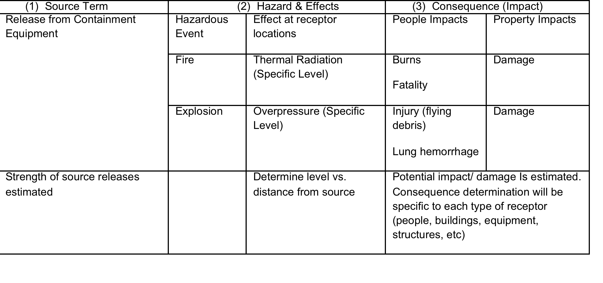
Consequence Models

Slide 66
Fundamentals of Transport and Dispersion
Hazardous material releases (from containment) can occur into/on:
1. Moving media (water, air)
– Transport is dependent on speed of currents and turbulence level
2. Stationary media (soil)
- Release can be carried away by rain – potential surface water contamination
- Release can slowly diffuse through the soil for potential groundwater contamination.
- Diffusion in the soil mediates movement into groundwater
The hazardous material is the contaminent
and the moving media is the carrying medium.
Spread of the release in the environment can occur by advection (transport over large scale), turbulence (dispersion over small scale) or diffusion. Diffusion is negligible compared to other routes.

Slide 67
Fundamentals of Transport and Dispersion
Releases into Air
Spread dependent on winds and turbulence
Relative density to air is critical
Contaminants can travel very large distances in a short time (km/h)
Difficult to contain or mitigate after release
Releases on Water
Spread dependent on current speeds
Miscibility/ solubility and evaporation is important
Spill will be confined to the width of a small river – easy to estimate the spread of the release
Spill likely not to reach sides of a large river
Containment is possible after release
Releases on Soil
Spread dependent on migration in soil
Miscibility/ solubility and evaporation is important
Contaminants travel VERY slowly [m/yr]

Slide 68
Fundaments of Transport and Dispersion
  Dispersion models must account for the density differences between the released substance and the medium into which it is released
    Oil spills on water
    Heavy gas releases into the atmosphere
Dispersion by nature is directional - the released material will travel in the direction of the flow of the carrying medium.

Slide 69
Hazard Modelling - Atmospheric Dispersion
When modelling dispersion, a distinction should be made between
Gases that are lighter than air, neutrally buoyant gases AND
Gases that are heavier than air
By understanding hazardous material concentrations as a function of distance from the release location is important for estimating whether an explosive gas cloud could form or if injuries could be caused by elevated exposure to toxic gases.
Pollutant dispersion in the atmosphere results from the movement of air. The major driver in air movement is heat flux.

Slide 70
Fundaments of Transport and Dispersion
Releases into the atmosphere are the most challenging to control, especially when there are frequent wind changes. Turbulent motions in the atmosphere can impose additional fluctuations in the concentration profile at a receptor.
Accidental releases of gases is particularly difficult. These releases are often violent and unsteady, resulting in rapid transient time variations of concentration levels at a receptor.

Slide 71
Concentration at a Receptor after an Unsteady Release
Exposure Duration at
Some Distance from the Release Location
Duration of Release
Instantaneous
Concentration
Average
Time From Release

Slide 72
Atmospheric Dispersion – Surface Heat Flux
Surface heat flux determines the stability of the atmosphere: stable, unstable or neutral.
Positive Heat Flux - Heat absorbed by the ground due to radiation from the sun
- Air masses are heated by heat transfer from the ground
Negative Heat Flux - Heat from ground is lost to space
- Air masses are cooled at the surface by heat transfer to the ground

Slide 73
Stable Atmospheric Conditions
Temperature
Free Atmosphere
Heat fluxes range from -5 to -30 W/m²
Occurs at night or with snow cover
Vertical movement is supressed
Turbulence is caused by the wind
Accumulation Layer
Wind
Profile
Mixing
Height
100 m
Turbulent Layer
Ground

Slide 74
Stable Atmospheric Conditions
Steady Winds
Elevation
Distance from Source
Concentration
Zero or Near Zero
Ground Level Concentrations

Slide 75
Stable Atmospheric Conditions
Fluctuating Winds
Elevation
Distance from Source
Concentration

Slide 76
Unstable Atmospheric Conditions
Free Atmosphere
Entrainment Layer
Heat fluxes range from 5 to
400 W/m²
Occurs during the day or with little cloud cover
Vertical movement is enhanced
Convective cell activity
Wind
Profile
Mixed
Layer
Mixing
Height
1500 m
Surface Layer
Ground

Slide 77
Unstable Atmospheric Conditions
Elevation
Distance from Source
Concentration

Slide 78
Neutral Atmospheric Conditions
Temperature
Free Atmosphere
Occurs under cloudy or windy conditions
There is a well-mixed boundary layer.
Vertical motions are not suppressed.
Turbulence is caused by the wind.
Wind
Profile
Mixing
Height
500 m
Turbulent Layer
Ground

Slide 79
Neutral Atmospheric Conditions
Elevation
Distance from Source
Concentration

Slide 80
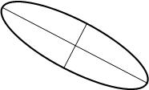


Plume Concentration - Gaussian Distribution Assumption
C(x,y,z,H) – average concentration (kg/m3)
G – release rate (kg/s)
σ_{x}, σ_{y}, σ_{z} – dispersion coefficients
(x – downwind, y – crosswind, z – vertical)
U – wind speed (m/s)
H – height above ground of the release
z
x
$$\overline{u}$$
H
y
h
where
$$H=h+ ∆h$$

Slide 81
Atmospheric Dispersion - Calculating Plume Height
Determine the stability of the atmosphere (A, B, C, D, E, F)
Surface Wind Speed, U [m/sec] | Day |  |  | Night
 | Incoming Solar Radiation |  |  | Thinly Overcast | Cloud Coverage
 | Strong | Moderate | Slight
<2 | A | A-B | B
2-3 | A-B | B | C | E | F
3-5 | B | B-C | C | D | E
5-6 | C | C-D | D | D | D
>6 | C | D | D | D | D

Slide 82
Atmospheric Dispersion - Calculating Plume Height
2. Determine the Flux Parameter
Buoyancy Flux Parameter
Momentum Flux
Parameter
3. For Buoyant Plumes, determine the flux parameter
Unstable or neutral (A, B, C, D)
where
and

Slide 83
Atmospheric Dispersion - Calculating Plume Height
4. Establish whether the plume is buoyancy or momentum dominated
If T_{s} – T_{a} ≥ ΔT_{c}, then the plume is buoyancy dominated
If T_{s} – T_{a} ≤ ΔT_{c}, then the plume is buoyancy dominated
For these equations
T_{a} – ambient temperature (K)
T_{s} – stack temperature (K)
u_{s} – stack exit velocity (m/s)
d_{s} – stack diameter (m)

Slide 84
Atmospheric Dispersion - Calculating Plume Height
5. Calculate the final plume rise, Δh
Atmospheric Condition
Unstable and Neutral
Stable
Buoyancy Dominated Plume
x* = distance at which atmospheric turbulence starts to dominate air entrainment into the plume;
x_{f} = distance from stack release to final plume rise (=3.5 x*)
Momentum Dominated Plume

Slide 85
Hazard Modelling - Heavy Gas Dispersion
Heavy gases are heavy by virtue of having large molecular weight relative to the surrounding atmosphere or by being cold.
These gases have the potential to travel far distances without dispersing to ‘safe’ levels.

Slide 86
Heavy Gas Dispersion – Release from Pressure-Liquefied Storage
Wind
If density of the gas is higher than air, the plume will spread radially because of gravity. This will result in a ‘gas pool’.
A heavy gas may collect in low lying areas, such as sewers, which could hamper rescue operations.
Rapid Flash-off and Cooling
Two-phase Dense Gas Plume
Large Liquid Droplets
Evaporating Liquid Pool

Slide 87

When is a Heavy Gas a “Heavy” Gas?
A heavy gas may not exhibit the characteristics of typical heavy gas behaviour under all conditions.
To establish if a release is behaving like a heavy gas, the release must first be characterised as a continuous or instantaneous release.
If r ≥ 2.5, then model as a continuous release
If r ≤ 0.6, then model as a instantaneous release
If 0.6 ≤ r ≤ 2.5, then try modelling both types and take the max concentration of the two
where
R_{d} = release duration [seconds]
$$x=downwind distance\left[m\right]$$

Slide 88
When is a Heavy Gas a “Heavy” Gas?
Calculate the non-dimensional density difference:
For a continuous release, if:
For a instantaneous release:
Then, the release will exhibit heavy gas behaviour at the source.
where
ρ_{o} = initial gas density
where
where

Slide 89
Calculating Heavy Gas Concentration (C_{m}) at Some Distance
Initial Concentration (volume fraction), C_{o}
Given Concentration (volume fraction), C_{m} , at some downwind distance, x
Procedure for determining concentration:
Calculate C_{m}/ C_{o}
Calculate the appropriate non-dimensional x-axis parameter, the chart at this x-axis value
Read the y-axis parameter value
Calculate the downwind distance, x

Slide 90
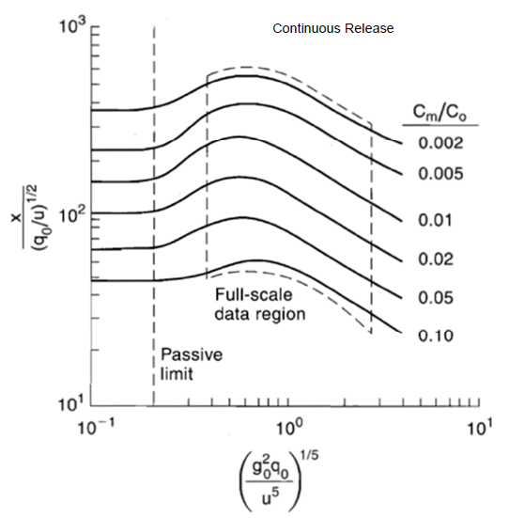
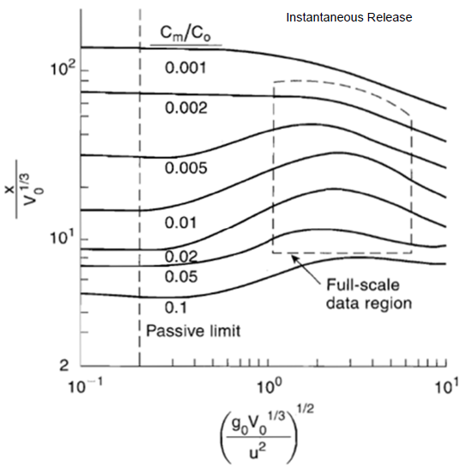
Calculating Heavy Gas Concentration (C_{m}) at Some Distance, x
Continuous Release
Instantaneous Release

Slide 91
Summary of Hazard Models
A hazardous release can be released into moving (air, water) or stationary (soil) media.
Atmospheric releases are of greatest concern due to the challenges in containing the release. These releases can occur into a stable, unstable or neutral atmosphere. The plume of the hazardous material release will differ for each.
Heavy gases released into the atmosphere are also of concern. Heavy gas behaviour, however, confines dispersion. When estimating downwind concentrations of heavy gas release, it is important to note if the release is continuous or instantaneous.

Slide 92
Consequence Models

Slide 93
Modelling the Consequences of a Hazardous Material Release
Consequence severity or potential damage, can be calculated at receptor locations. Recall that receptors can be differentiated between individual and societal consequences.
INDIVIDUAL CONSEQUENCES
Expressed in terms of a hazard or potential damage at a given receptor at a given location in relation to the location of the undesirable event.
Human receptor – consequence of hazard exposure = fatality, injury, etc.
Building receptor – consequence of hazard exposure = destruction, glass breakage, etc.
SOCIETAL CONSEQUENCES
Expressed as an aggregate of all the individual consequences for an event.
Add up all the individual receptors consequences (human, building, equipment) for total exposed area.

Slide 94
Modelling the EFFECT of a Hazardous Material Release
Receptors can be influenced by hazardous material through various transport media, including atmospheric dispersion, groundwater contamination, soil erosion, etc. Atmospheric transport is the most important in risk assessments.
Hazard effects for materials are:
CONCENTRATION (C) – used for toxic and carcinogenic materials and materials with systemic effects.
THERMAL RADIATION (I) – used for flammable materials.
OVERPRESSURE (P₀) – used for determining blast wave consequences such as deaths from lung haemorrhage or injuries from eardrum rupture.

Slide 95
Hazardous Material Dose Curve and Response
The response induced by exposure to hazardous materials/conditions (heat, pressure, radiation, impact, sound, chemicals) can be characterised by a dose-response curve.
A dose-response curve for a SINGLE exposure can be described with the probability unit (or PROBIT, Y).

Slide 96
PROBIT Method for Estimating Consequence Level
PROBIT equations are available for a specific health consequences as a function of exposure.
These equations were developed primarily using animal toxicity data. It is important to acknowledge that when animal population are used for toxicity testing, the population is typically genetically homogeneous – this is unlike human population exposed during a chemical accident. This is a source of uncertainty when using PROBIT equations.

Slide 97
PROBIT Method for Estimating Consequence Level
We need to gather the following information to estimate consequence level with the PROBIT method:
The quantity of material released
The hazard level at the receptor’s location
  Concentration (C) for a toxic cloud or plume
  Thermal Radiation Intensity (I) for a fire
  Overpressure (P₀) for an explosion
The duration of the exposure of the receptor to the hazard
The route of exposure of the receptor to the hazard

Slide 98
PROBIT Method for Estimating Consequence Level
This method is suitable for:
Many types of chemical and release types (short or long term).
Estimating the variation of responses from different members of the population (adults, children, seniors).
Determining consequence level for time varying concentrations and radiation intensities.
Events where a number of different chemical releases have occurred.

Slide 99
PROBITS for Various Hazardous Material Exposures
PROBIT can be calculated as
Where k₁ and k₂ are PROBIT parameters and V is the causative variable that is representative of the magnitude of the exposure.

Slide 100
PROBITS for Various Hazardous Material Exposures
Type of Injury/Damage | Causative Variable (V) | k₁ | k₂
FIRE Burn death from flash fire Burn death from pool fire | (t_{e} I_{e})^( (4/3)/10⁴) (t I)^( (4/3)/10⁴) | -14.9 -14.9 | 2.56 2.56
EXPLOSION Death from lung haemorrhage Eardrum rupture Death from impact Injuries from impact Injuries from flying fragments Structural Damage | P₀ P₀ J J J P⁰ | -77.1 -15.6 -46.1 -39.1 -27.1 -23.1 | 6.91 1.93 4.82 4.45 4.26 2.92
TOXIC RELEASE Carbon Monoxide death Chlorine death Nitrogen Dioxide death Sulphur Dioxide death Toluene death | ΣC¹T ΣC²T ΣC²T ΣC¹T ΣC^{2.5}T | -37.98 -8.29 -13.79 -15.67 -6.79 | 3.7 0.92 1.4 1.0 0.41
t_{e} – effective time duration [s]
I_{e} – effective radiation intensity [W m⁻²]
t – time duration of the pool fire [s]
I – radiation intensity from pool fire [W m⁻²]
P₀ – overpressure [N m⁻²]
J – impact [N s m⁻²]
C – concentration [ppm]
T – time interval [min]

Slide 101
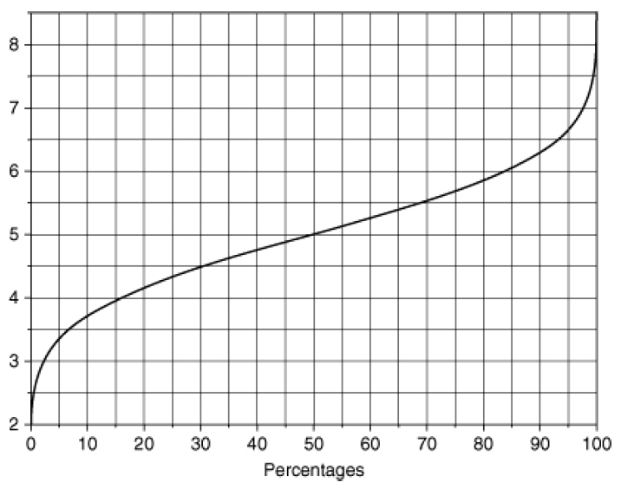
PROBIT and Probability
The relationship between
probability and PROBIT
is shown in the plot.
PROBIT
Percentage

Slide 102
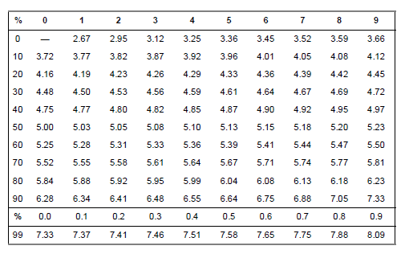
PROBIT and Probability
The sigmoid curve can be used to estimate probability or PROBIT. Alternatively, this table can be used.

Slide 103
PROBIT and Probability
PERCENTAGE
The sigmoid curve can be used to estimate probability or PROBIT. Alternatively, this table can be used.
PROBIT

Slide 104
PROBIT and Probability
PERCENTAGE
If the PROBIT is known as
Y = 5.10, then the associated percentage is 54.
OR
If the percentage is 12%, then the PROBIT is 3.82.
PROBIT

Slide 105
PROBIT and Probability
As an alternative to using the table to calculate percent probability, the conversion can also be calculated with the following equation:
Where erf is the error function.
PROBIT equations assumes exposure to the accident occurred in a distribution of adults, children and seniors. Variability in the response in different individuals is accounted for in the error function.

Slide 106
PROBIT and Probability – Example 1
Determine the percentage of people that will die from burns caused by a pool fire. The PROBIT value for this fire is 4.39.
Solution 1
Using the PROBIT table, the percentage is 27%.
Solution 2
Using the PROBIT equation, we can solve for P with Y=4.39. The error function can be found using spreadsheets available in the literature.

Slide 107
PROBIT and Probability – Example 2
Data has been reported on the effect of explosion overpressures on eardrum ruptures in humans.
Confirm the PROBIT variable for this exposure type.
Percent Affected | Peak Overpressure (N m⁻²)
1 | 16,500
10 | 19,300
50 | 43,500
90 | 84,300

Slide 108
PROBIT and Probability – Example 2
Solution
Convert the percentage to the PROBIT variable using the PROBIT table.
Percent Affected | Peak Overpressure (N m⁻²) | PROBIT
1 | 16,500 | 2.67
10 | 19,300 | 3.72
50 | 43,500 | 5.00
90 | 84,300 | 6.28

Slide 109
Damage Effect Estimates
The damage caused by exposure to hazardous material release can be estimated for various levels of overpressure or radiation intensity. These damage effects are summarised in tables.
It is important to note, damage effect estimates are NOT suitable for releases with rapid concentration fluctuations.

Slide 110
Damage Effect Estimates – Radiation Intensity
Radiation Intensity (kW m⁻²) | Observed Damage Effect
37.5 | Sufficient to cause damage to process equipment
25 | Minimum energy required to ignite wood at indefinitely long exposures
12.5 | Minimum energy required for piloted ignition of wood, melting of plastic tubing
9.5 | Pain threshold reached after 8 seconds; second degree burns after 20 seconds
4 | Sufficient to cause pain to personnel if unable to reach cover within 20 seconds; however, blistering of the skin is likely (second degree burn) ; 0% lethality
1.6 | Will cause no discomfort for long exposure

Slide 111
Overpressure |  | Observed Damage Effect
Psig | kPa
0.02 | 0.14 | Annoying noise (137 dB if of low frequency, 10–15 Hz)
0.03 | 0.21 | Occasional breaking of large glass windows already under
0.04 | 0.28 | Loud noise (143 dB), sonic boom, glass failure
0.1 | 0.69 | Breakage of small windows under strain
0.15 | 1.03 | Typical pressure for glass breakage
0.3 | 2.07 | “Safe distance” (probability 0.95 of no serious damage below this value); projectile limit; some damage to house ceilings; 10% window glass broken
0.4 | 2.76 | Limited minor structural damage
0.5–1.0 | 3.4–6.9 | Large and small windows usually shatter; occasional damage to window frames
0.7 | 4.8 | Minor damage to house structures
1 | 6.9 | Partial demolition of houses, made uninhabitable
1–2 | 6.9–13.8 | Corrugated asbestos shatters; corrugated steel or aluminum panels, fastenings fail, followed by buckling; wood panels (standard housing), fastenings fail, panels blow in
1.3 | 9 | Steel frame of clad building slightly distorted
2 | 13.8 | Partial collapse of walls and roofs of houses
2–3 | 13.8–20.7 | Concrete or cinder block walls, not reinforced, shatter
2.3 | 15.8 | Lower limit of serious structural damage
2.5 | 17.2 | 50% destruction of brickwork of houses
3 | 20.7 | Heavy machines (3000 lb) in industrial buildings suffer little damage; steel frame buildings distort and pull away from foundations
3–4 | 20.7–27.6 | Frameless, self-framing steel panel buildings demolished; rupture of oil storage tanks
4 | 27.6 | Cladding of light industrial buildings ruptures
5 | 34.5 | Wooden utility poles snap; tall hydraulic presses (40,000 lb) in buildings slightly damaged
5–7 | 34.5–48.2 | Nearly complete destruction of houses
7 | 48.2 | Loaded train wagons overturned
7–8 | 48.2–55.1 | Brick panels, 8–12 in thick, not reinforced, fail by shearing or flexure
9 | 62 | Loaded train boxcars completely demolished
10 | 68.9 | Probable total destruction of buildings; heavy machine tools (7000 lb) moved and badly damaged, very heavy machine tools (12,000 lb) survive
300 | 2068 | Limit of crater lip
Damage Effect Estimates –
Overpressure

Slide 112
Damage Effect Estimates - Example
One thousand kilograms of methane escapes from a storage vessel, mixes with air and then explodes. The overpressure resulting from this release is 25 kPa. What are the consequences of this accident?

Slide 113
Damage Effect Estimates - Example
One thousand kilograms of methane escapes from a storage vessel, mixes with air and then explodes. The overpressure resulting from this release is 25 kPa. What are the consequences of this accident?
Solution
Using the table on Observed Damage Effects table – an overpressure of 25 kPa will cause the steel panels of a building to be demolished.

Slide 114
Risk Assessment requires QUANTITATIVE frequency analysis.
Quantifying risk enables estimation of:
How often an undesirable initiating event may occur.
The probability of a hazard outcome after the initiating event.
The probability of a consequence severity level after the hazard outcome (i.e. fatalities, injuries, severity of economic loss).

Slide 115
Historical data can be used to calculate the frequency of initiating events, hazard outcomes and the severity of the consequence.
Analysis Techniques
Frequency modelling techniques
Common-cause failure analysis
Human reliability analysis
External events analysis
  Used

Slide 116
Data can be used to calculate the frequency of initiating events, hazard outcomes and the severity of the consequence.
Analysis Techniques
Frequency modelling techniques
Common-cause failure analysis
Human reliability analysis
External events analysis
  Used
Used to estimate frequencies or probabilities from basic data. Typically used when detailed historical data is not available.
i. EVENT TREES
ii. FAULT TREES

Slide 117
Data can be used to calculate the frequency of initiating events, hazard outcomes and the severity of the consequence.
Analysis Techniques
Frequency modelling techniques
Common-cause failure analysis
Human reliability analysis
External events analysis
  Used
Used to identify and analyse failures common to multiple components found in systems that can lead to a hazardous event.

Slide 118
Data can be used to calculate the frequency of initiating events, hazard outcomes and the severity of the consequence.
Analysis Techniques
Frequency modelling techniques
Common-cause failure analysis
Human reliability analysis
External events analysis
  Used
Used to provide quantitative estimates of human error probabilities.

Slide 119
Data can be used to calculate the frequency of initiating events, hazard outcomes and the severity of the consequence.
Analysis Techniques
Frequency modelling techniques
Common-cause failure analysis
Human reliability analysis
External events analysis
  Used
Used to identify and assess external events (i.e. plane crash, terrorist activities, earthquakes) to understand expected frequency of occurrence and/or consequence severity per occurence.

Slide 120
Data can be used to calculate the frequency of initiating events, hazard outcomes and the severity of the consequence.
Analysis Techniques
Frequency modelling techniques
Common-cause failure analysis
Human reliability analysis
External events analysis
  Used
Used to estimate frequencies or probabilities from basic data. Typically used when detailed historical data is not available.
i. EVENT TREES
ii. FAULT TREES
We will focus on event and fault trees as frequency modelling techniques.

Slide 121
Fault Trees Event Trees Bow-Tie
Fault Trees
  Fault trees are logic diagrams using and/or combinations.
  They are a deductive method to identify how hazards culminate from system failures.
  The analysis starts with a well-defined accident and works backwards towards the causes of the accident.

Slide 122
Fault Trees Event Trees Bow-Tie
Fault Trees – Typical Steps
  STEP 1 – Start with a major accident of hazardous event (release of toxic/ flammable material, vessel failure). This is called a TOP EVENT.
  STEP 2 – Identify the necessary and sufficient causes for the top event to occur.
  How can the top event happen?
  What are the causes of this event?
  STEP 3 – Continue working backwards and follow the series of events that would lead to the top event. Go backwards until a basic event with a known frequency is reached (pump failure, human error).

Slide 123
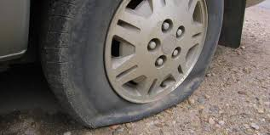
Fault Trees Event Trees Bow-Tie
Fault Trees – Simple Example
  Car Flat Tire
  (TOP EVENT)
  Driving over debris on the road
  Tire failure
  Defective Tire
  Worn Tire
  This is not an exhaustive list of failures.
  Failures could also include software, human and environmental factors.

Slide 124
Fault Trees Event Trees Bow-Tie
Fault Trees – Simple Example
  Car Flat Tire
  (TOP EVENT)
  Driving over debris on the road
  Tire failure
  INTERMEDIATE EVENT
  Defective Tire
  Worn Tire

Slide 125
Fault Trees Event Trees Bow-Tie
Fault Trees – Simple Example
  Car Flat Tire
  (TOP EVENT)
  Driving over debris on the road
  Tire failure
  BASIC
  EVENTS
  Defective Tire
  Worn Tire
  Let’s now format this tree as a fault tree logic diagram.

Slide 126
Fault Trees Event Trees Bow-Tie
Fault Trees – Simple Example, Logic Diagram
  TOP EVENT
  Car Flat Tire
  OR
  Tire failure
  Driving over debris on the road
  OR
  Defective Tire
  Worn Tire

Slide 127
Fault Trees Event Trees Bow-Tie
Fault Tree Logic Transfer Components
  BASIC EVENT
  This is fault event with a known frequency and needs no further definition.
  AND GATE
  Output event requires simultaneous occurrence of all input events
  INTERMEDIATE EVENT
  An event that results from the interaction of other events.
  OR GATE
  Output event requires the occurrence of any individual input event.
  UNDEVELOPED EVENT
  An event that cannot be developed further (lack of information), or for which no further development is needed.
  INHIBIT EVENT
  Output event will not occur if the input and the inhibit condition occur
  Inhibit Condition
  EXTERNAL EVENT
  An event that is a boundary condition to the fault tree.

Slide 128
Fault Trees Event Trees Bow-Tie
Fault Trees – BEFORE YOU START DRAWING THE TREE, Preliminary Steps
  STEP 1 – Precisely define the top event.
  STEP 2 – Define pre-cursor events.
  What conditions will be present when the top event occurs?
  STEP 3 – Define unlikely events.
  What events are unlikely to occur and are not being considered? Wiring failures, lightning, tornadoes, hurricanes.
  STEP 4 – Define physical bounds of the process.
  What components are considered in the fault tree?

Slide 129
Fault Trees Event Trees Bow-Tie
Fault Trees – BEFORE YOU START DRAWING THE TREE, Preliminary Steps
  STEP 5 – Define the equipment configuration.
  What valves are open or closed?
  What are liquid levels in tanks?
  Is there a normal operation state?
  STEP 6 – Define the level of resolution.
  Will the analysis consider only a valve or is it necessary to consider all valve components?

Slide 130
Fault Trees Event Trees Bow-Tie
Fault Trees – DRAWING THE TREE
  STEP 1 – Draw the top event at the top of the page.
  STEP 2 – Determine the major events (intermediate, basic, undeveloped or external events) that contribute to the top event.
  STEP 3 – Define these events using logic functions.
  a. AND gate – all events must occur in order for the top event to occur
  b. OR gate – any events can occur for the top event to occur
  c. Unsure? If the events are not related with the OR or AND gate, the event likely needs to be defined more precisely.
  STEP 4 – Repeat step 3 for all intermediate, undeveloped and external events. Continue until all branches end with a basic cause.

Slide 131
Fault Trees Event Trees Bow-Tie
Fault Trees – Chemical Reactor Shutdown Example
  A chemical reactor is fitted with a high pressure alarm to alert the operator in the event of dangerous reactor pressures. An reactor also has an automatic high-pressure shutoff system.
  The high pressure shutoff system also closes the reactor feed line through a solenoid valve.
  The alarm and feed shutdown systems are installed in parallel.

Slide 132
Fault Trees Event Trees Bow-Tie
Fault Trees – Chemical Reactor Shutdown Example
  Define the Problem
  TOP EVENT = Damage to the reactor by overpressure
  EXISTING CONDITION = Abnormal high process pressure
  IRRELEVANT EVENTS = Failure of mixer, electrical failures, wiring failures, tornadoes, hurricanes, electrical storms
  PHYSICAL BOUNDS = Process flow diagram (on left)
  EQUIPMENT CONFIG = Reactor feed flowing when solenoid valve open
  RESOLUTION = Equipment shown in process flow diagram

Slide 133
Fault Trees Event Trees Bow-Tie
  TOP EVENT
  Reactor Overpressure and Damage
  1. Start by writing out the top event on the top of the page in the middle.
Note that you can only have Reactor Overpressure, if “Reactor Pressure Increasing” is an intermediate or undefined condition; the system passes through pressure increasing to overpressure

Slide 134
Fault Trees Event Trees Bow-Tie
  TOP EVENT
  Reactor Overpressure
  AND
  A
  High Pressure Alarm Indicator Failure
  Emergency Shutdown failure
  2. The AND gate notes that two events must occur in parallel. These two events are intermediate events.

Slide 135
Fault Trees Event Trees Bow-Tie
  TOP EVENT
  Reactor Overpressure
  3. The OR gates define one of two events can occur.
  AND
  A
  Alarm Indicator Failure
  Emergency Shutdown Failure
  OR
  B
  OR
  C
  Pressure Switch 1 Failure
  Pressure Indicator Light Failure
  Pressure Switch 2 Failure
  Solenoid Valve
  Failure

Slide 136
Fault Trees Event Trees Bow-Tie
  TOP EVENT
  Reactor Overpressure
  4. We’ll give a number to each of the basic causes & basic events.
  AND
  A
  Alarm Indicator Failure
  Emergency Shutdown Failure
  OR
  B
  OR
  C
  Pressure Switch 1 Failure
  1
  Pressure Indicator Light Failure
  2
  Pressure Switch 2 Failure
  3
  Solenoid Valve
  Failure
  4

Slide 137
Fault Trees Event Trees Bow-Tie
Chemical Reactor Shutdown Example – Determining Minimal Cuts
  After drawing a fault tree, we can determine minimum cut sets which are sets of various unique event/condition combinations, without unnecessary additional events/conditions which can give rise to the top event.
  Each minimal cut set will be associated with a probability of occurring – human interaction is more likely to fail that hardware.
  It is of interest to understand sets that are more likely to fail using failure probability. Additional safety systems can then be installed at these points in the system.
  Example: The combination of A and B and C can lead to the Top Event. However, A and B alone can lead to the Top Event, and C is unnecesary

Slide 138
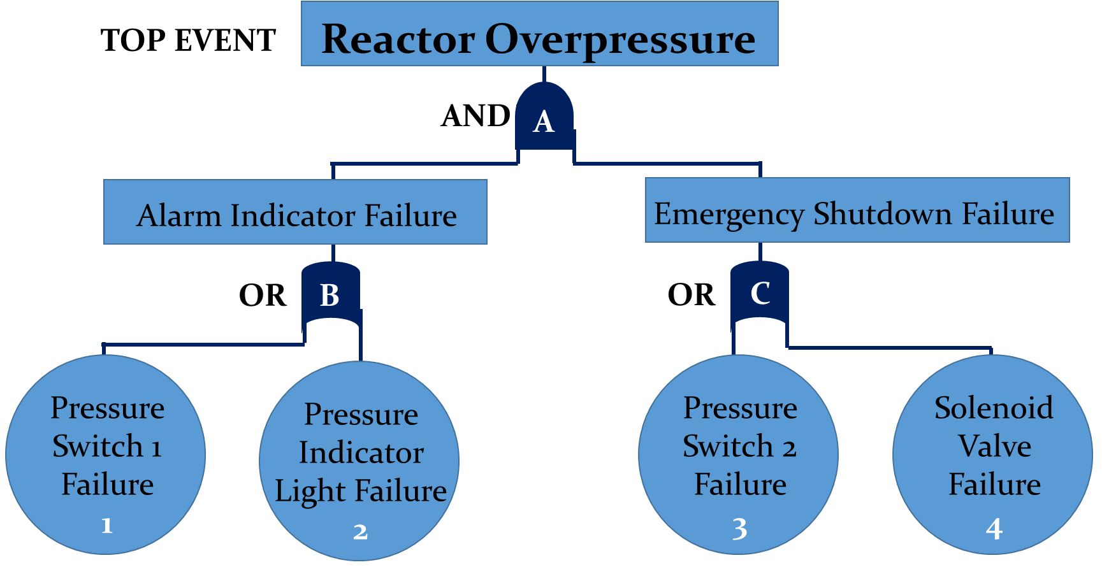
Fault Trees Event Trees Bow-Tie
Chemical Reactor Shutdown Example – Determining Minimal Cuts
  1. Write drop the first logic gate below the top event.
  A
  2. AND gates increase the number of events in the cut set. Gate A has two inputs: B and C. The AND gate is replaced by its two inputs.
  A B C

Slide 139
Fault Trees Event Trees Bow-Tie
Chemical Reactor Shutdown Example – Determining Minimal Cuts
  3. OR gates increase the number of sets. Gate B has inputs from events 1 and 2. Gate B is replaced by one input and another row is added with the second input.
  A B 1 C
  2 C
  4. Gate C has inputs from basic events 3 and 4. Replace gate C with its first input and additional rows are added with the second input.

Slide 140
Fault Trees Event Trees Bow-Tie
Chemical Reactor Shutdown Example – Determining Minimal Cuts
  4. Gate C has inputs from basic events 3 and 4. Replace gate C with its first input and additional rows are added with the second input. The second input from gate C are matched with gate B.
  A B 1 C 3
  2 C 3
  1 4
  2 4

Slide 141
Fault Trees Event Trees Bow-Tie
Chemical Reactor Shutdown Example – Determining Minimal Cuts
  5. The top event can occur following one of these cut sets:
  Events 1 and 3
  Events 2 and 3
  Events 1 and 4
  Events 2 and 4

Slide 142
Fault Trees Event Trees Bow-Tie
Quantifying the Probability of the Top Event
  Process equipment failures occur following interactions of individual components in a system. The type of component interaction dictates the probability of failure.
  A component in a system, on average, will fail after a certain time. This is called the average failure rate (µ, units: faults/time).
  Using the failure rate of a component, we can determine its reliability and probability of failure.
  Failure Rate
  Probability
  Reliability
  µ
  P(t)
  R(t)
1-P(t)
  Time, t
  Time, t
  Time, t

Slide 143
Fault Trees Event Trees Bow-Tie
Quantifying the Probability of the Top Event
  Failure Rate
  Reliability
  Probability
  µ
  R(t)
  P(t)
1-P(t)
  Time, t
  Time, t
  Time, t
P(t) = 1- R(t)

Slide 144
PFD_{avg} – Probability of failure on Demand, averaged over time
PFD at any given time, averaged over a period of time
Reliability, R(t), is the Probability of Success, averaged over a specified period of time

Slide 145
Fault Trees Event Trees Bow-Tie
Quantifying the Probability of the Top Event
  Failure data for typical process components can be obtained from published literature.
Component | Failure Rate, µ (faults/year) | R(t) | P(t)
Control Valve | 0.60 | 0.55 | 0.45
Flow Measurement Fluids Solids | 1.14 3.75 | 0.32 0.02 | 0.68 0.98
Flow Switch | 1.12 | 0.33 | 0.67
Hand Valve | 0.13 | 0.88 | 0.12
Indicator Lamp | 0.044 | 0.96 | 0.04
Level Measurement Liquids Solids | 1.70 6.86 | 0.18 0.001 | 0.82 0.999
pH Meter | 5.88 | 0.003 | 0.997
Pressure Measurement | 1.41 | 0.24 | 0.76
Pressure Relief Valve | 0.022 | 0.98 | 0.02
Pressure Switch | 0.14 | 0.87 | 0.13
Solenoid Valve | 0.42 | 0.66 | 0.34
Temperature Measurement Thermocouple Thermometer | 0.52 0.027 | 0.59 0.97 | 0.41 0.03

Slide 146
Fault Trees Event Trees Bow-Tie
Quantifying the Probability of the Top Event
  The failure probability and reliability of a component can be calculated from its known failure rate.
Component | Failure Rate, µ (faults/year) | R(t) | P(t)
Control Valve | 0.60 | 0.55 | 0.45
Flow Measurement Fluids Solids | 1.14 3.75 | 0.32 0.02 | 0.68 0.98
Flow Switch | 1.12 | 0.33 | 0.67
Hand Valve | 0.13 | 0.88 | 0.12
Indicator Lamp | 0.044 | 0.96 | 0.04
Level Measurement Liquids Solids | 1.70 6.86 | 0.18 0.001 | 0.82 0.999
pH Meter | 5.88 | 0.003 | 0.997
Pressure Measurement | 1.41 | 0.24 | 0.76
Pressure Relief Valve | 0.022 | 0.98 | 0.02
Pressure Switch | 0.14 | 0.87 | 0.13
Solenoid Valve | 0.42 | 0.66 | 0.34
Temperature Measurement Thermocouple Thermometer | 0.52 0.027 | 0.59 0.97 | 0.41 0.03

Slide 147





Fault Trees Event Trees Bow-Tie
Quantifying the Probability of the Top Event
  We’ve discussed the failure probability of individual components. Failures in chemical plants, result from the interaction of multiple components. We need to calculate the overall failure probability and reliability of these component interactions (R = 1 – P)
  Components in Parallel - AND gates
  Failure Probability Reliability
  Components in Series – OR gates
  Failure Probability Reliability
P$1$
R$1$
P
R
P₂
R₂
  n is the total number of components
  P_{i} is the failure probability of each component
  n is the total number of components
  R_{i} is the reliability of each component
P$1$
R$1$
P
R
P₂
R₂

Slide 148
Fault Trees Event Trees Bow-Tie
Quantifying the Probability of the Top Event
  Calculations for failure probability can be simplified for systems comprised of only two components
  Can be expanded to:
P(A or B) = P(A) + P(B) – P(A and B) = P(A) + P(B) – P(A)*P(B)
A
B
A
&
B
A and B at the same time
or

Slide 149
Fault Trees Event Trees Bow-Tie
Quantifying the Probability of the Top Event
  Two methods are available:
  The failure probability of all basic, external and undeveloped events are written on the fault tree diagram.
  The minimum cut sets can be used. As only the basic events are being evaluated in this case, the computed probabilities for all events will be larger than the actual probability.

Slide 150
Fault Trees Event Trees Bow-Tie
Reactor Example – Quantifying the Probability of the Top Event
  Fault Tree Diagram Method
  We must first compile the reliability and failure probabilities of each basic event from tables.
Component | Reliability, R | Failure Probability, P
Pressure Switch 1 | 0.87 | 0.13
Alarm Indicator | 0.96 | 0.04
Pressure Switch 2 | 0.87 | 0.13
Solenoid Valve | 0.66 | 0.34
System condition
“Reactor Pressure Increasing”
  Remember P = 1 - R

Slide 151
Fault Trees Event Trees Bow-Tie
Reactor Example – Quantifying the Probability of the Top Event
  Fault Tree Diagram Method
  AND gate A
  OR gate B
  OR gate C
  R =(0.87)(0.66)=0.574
  P = 1-0.574 = 0.426
The total failure probability is 0.0702.
  P = 0.13
  R = 0.87
  P = 0.04
  R = 0.96
  P = 0.13
  R = 0.87
  P = 0.34
  R = 0.66

Slide 152
Fault Trees Event Trees Bow-Tie
Reactor Example – Quantifying the Probability of the Top Event
  Direct Method

Slide 153
Fault Trees Event Trees Bow-Tie
Reactor Example – Quantifying the Probability of the Top Event
  Events 1 and 3 P(1 and 3) = (0.13)(0.13) = 0.0169
  Events 2 and 3 P(2 and 3) = (0.04)(0.13) = 0.0052
  Events 1 and 4 P(1 and 4) = (0.13)(0.34) = 0.0442
  Events 2 and 4 P(2 and 4) = (0.04)(0.34) = 0.0136
  TOTAL Failure Probability = 0.0799
  Minimum Cut Set Method
Note that the failure probability calculated using minimum cut sets is greater than using the actual fault tree.

Slide 154
Fault Trees Event Trees Bow-Tie
Words of Caution with Fault Trees
Fault trees can be very large if the process is complicated. A real-world system can include thousands of gates and intermediate events.
Care must be taken when estimating failure modes – best to get advice from experienced engineers when developing complicated fault trees. It is important to remember that fault trees can differ between engineers.
Failures in fault trees are complete failures – a failure will or will not failure, there cannot be a partial failure.

Slide 155
Fault Trees Event Trees Bow-Tie
Moving from Control Measures to Consequences
We can move from thinking about the basic events that will lead to a top event to the consequence that can follow the top event. This can be done using Event Trees.
Fault Tree Analysis starts with a top event and then works backward to identify various basic causes using “and/or” logic
Event Tree Analysis starts with an initiating event or cause and works forward to identify possible various defined outcomes

Slide 156
Fault Trees Event Trees Bow-Tie
Event Trees
Initiating Event (Cause)
- these have an associated frequency
Failures and Successes of Various Intervening Safety Systems/Actions
- These have an average Probability on Demand
Various Defined Final Outcomes
- These will have associated
frequencies
  When an accident occurs, safety systems can fail or succeed.
  Event trees provide information on how a failure can occur.

Slide 157
Fault Trees Event Trees Bow-Tie
Event Trees – Typical Steps
  Identify an initiating event
  Identify the safety functions designed to deal with the initiating event
  Construct the event tree
  Describe the resulting sequence of accident events.
  The procedure can be used to determine probability of certain event sequences. This can be use to decide if improvement to the system should be made.

Slide 158
Fault Trees Event Trees Bow-Tie
Event Trees – Chemical Reactor Example
What happens if there is a loss of coolant?
High Temperature Alarm

Slide 159
Fault Trees Event Trees Bow-Tie
Event Trees – Chemical Reactor Example
  Safety operations following the loss of coolant (the initiating event)
  High temp alarm alerts operator
  0.01 failures/demand
  Operator acknowledges alarm
  0.25 failures/demand
  Operator restarts cooling system
  0.25 failures/demand
  Operator shuts down reactor
  0.1 failures/demand
High Temperature Alarm

Slide 160
Fault Trees Event Trees Bow-Tie
Event Trees – Chemical Reactor Example
  Safety operations following the loss of coolant (the initiating event)
  High temp alarm alerts operator
  0.01 failures/demand
  Operator acknowledges alarm
  0.25 failures/demand
  Operator restarts cooling system
  0.25 failures/demand
  Operator shuts down reactor
  0.1 failures/demand
  We can note the probability of failure on demand of each safety function
High Temperature Alarm

Slide 161
Fault Trees Event Trees Bow-Tie
Event Trees – Chemical Reactor Example
  Safety operations following the loss of coolant (the initiating event)
  High temp alarm alerts operator [B]
  0.01 failures/demand
  Operator acknowledges alarm [C]
  0.25 failures/demand
  Operator restarts cooling system [D]
  0.25 failures/demand
  Operator shuts down reactor [E]
  0.1 failures/demand
  And assign an ID to each operation
High Temperature Alarm

Slide 162
Fault Trees Event Trees Bow-Tie
Event Trees – Chemical Reactor Example
  1. Start by writing out the initiating event on the left side of the page, in the middle.
  Loss of coolant (initiating event)

Slide 163
Fault Trees Event Trees Bow-Tie
Event Trees – Chemical Reactor Example
  Start by writing out the initiating event on the left side of the page.
  Note the frequency of this event (occurrences per year)
  Loss of coolant (initiating event)
  1 occurrence/year

Slide 164
Fault Trees Event Trees Bow-Tie
Event Trees – Chemical Reactor Example
  ID B (High Temp Alarm Alerts Operator)
  0.01 failures/demand
  3. We’ll call the initiating event A and also note the occurrence per year.
  4. Draw a line from the initiating event to the first safety function (ID B) – a straight line up indicates the results for a success in the safety function and a failure is represented by a line drawn down.
  5. We can assume the high temp alarm will fail to alert the operator 1% of the time when in demand OR 0.01 failure/demand.(This is a probability of failure on demand)
  Success
  of Safety Function B
  A
  1
  Failure
  of Safety Function B
  Loss of coolant (initiating event)
  1 occurrence/year

Slide 165
Fault Trees Event Trees Bow-Tie
Event Trees – Chemical Reactor Example
  Safety Function
  ID B (High Temp Alarm Alerts Operator)
  0.01 failures/demand
  7. Consider Safety Function B (operator alerted by temperature safety alarm). There are 0.01 failures/demand of this function.
  0.99
  Success
  of Safety Function B
  A
  1
  Success of Safety Function B
  = (1- 0.01)* 1 occurrence/year
  = 0.99 occurrence/year
  Failure
  of Safety Function B
  Loss of coolant (initiating event)
  1 occurrence/year
  Failure of Safety Function B
  = 0.01 * 1 occurrence/year
  = 0.01 occurrence/year
  0.01

Slide 166
Fault Trees Event Trees Bow-Tie
  ID C (Operator Acknowledges Alarm)
  0.25 failures/demand
  ID B
  Success
  Success of Safety Function C
  = (1-0.25 failures/demand)*0.01 occurrence/year
  = 0.0075 occurrence/year
  0.0075
  Success
  0.99
  Failure
  Failure of Safety Function C
  = 0.25 failures/demand *0.01 occurrence/year
  = 0.0025 occurrence/year
  0.0025
  A
  1
  Loss of coolant (initiating event)
  1 occurrence/year
  Failure
  0.01
  8. If the safety function does not apply for the scenario, the horizontal line continues through the function.

Slide 167
Fault Trees Event Trees Bow-Tie
  ID B
  ID C
  ID D (Cooling System Restarted)
  0.25 failures/demand
  Success of Safety Function D
  = (1- 0.25 failures/demand)* 0.99
  = 0.0075 occurrence/year
  0.7425
  0.0075
  0.2475
  Success
  Failure of Safety Function D
  = 0.25 failures/demand* 0.99
  = 0.0075 occurrence/year
  0.99
  A
  1
  0.0025
  Loss of coolant (initiating event)
  Failure
  Similar calculation for remaining scenarios.
  1 occurrence/year
  0.01

Slide 168
Fault Trees Event Trees Bow-Tie
  ID B
  ID C
  ID D
  ID E (System Shutdown)
  0.1 failures/demand
  Continue Operation
  0.7425
  0.0075
  0.2475
  0.2227
  Shutdown
  Success
  0.99
  0.02475
  Runway
  Runway
  A
  1
  0.0025
  Failure
  Runway
  0.01

Slide 169
Fault Trees Event Trees Bow-Tie
  ID B
  ID C
  ID D
  ID E (System Shutdown)
  0.1 failures/demand
  Sequence of Safety Function Failures
  Continue Operation
  A
  0.7425
  0.0075
  0.2475
  0.2227
  Shutdown
  AD
  Success
  0.99
  0.02475
  Runway
  ADE
  Runway
  AC
  A
  1
  0.0025
  Failure
  Runway
  AB
  0.01

Slide 170
Fault Trees Event Trees Bow-Tie
  Sequence of Safety Function Failures
  Occurrences/year
  Continue Operation
  A
  0.7425
  9. The initiating event is used to indicate by the first letter in the sequence (ie. A).
  10. The sequence ABE indicates an the initiating event A followed by failures in safety functions B and E.
  11. Using the data provided on the Initiating Event frequency and the Probability on Demand of Failure or Success for the safety functions, the overall runway and shutdown occurrences per year can be calculated.
  Shutdown
  AD
  0.2227
  Runway
  ADE
  0.02475
  Runway
  AC
  0.0025
  Runway
  AB
  0.01

Slide 171
Fault Trees Event Trees Bow-Tie
  Sequence of Safety Function Failures
  Occurrences/year
  Continue Operation
  A
  0.7425
  Total Shutdown
  Occurrences per year
  = 0.2227 occurrences/year
  = Once every 4.5 years
  Shutdown
  AD
  0.2227
  Runway
  ADE
  0.02475
  Total Runway
  Occurrences per year
  = 0.02475 + 0.0025 + 0.01
  = 0.03725 occurrences/year
  = Once every 26.8 years
  Runway
  AC
  0.0025
  Runway
  AB
  0.01

Slide 172
Fault Trees Event Trees Bow-Tie
Event Trees – Chemical Reactor Example
What is expected if there is an accident due to a loss of coolant?
  A system shutdown will occur one every 4.5 years.
  A runway will occur one every 28.6 years.
High Temperature Alarm

Slide 173
Fault Trees Event Trees Bow-Tie
Event Trees – Chemical Reactor Example
What happens if there is an accident due to a loss of coolant?
  A system shutdown will occur one every 4.5 years.
  A runway will occur one every 28.6 years.
  A runway reaction once every 30 years is considered to high! Installation of a high temperature automatic reactor shutdown function can decrease this occurrence rate.
High Temperature Alarm

Slide 174
Fault Trees Event Trees Bow-Tie
Summary of Event Trees
The objective is to identify important possible safety failures from an initiating event that could have a bearing on risk assessment.
Primary purpose is to modify the system design to improve safety.
Real systems are complex which can result in large event trees.
The risk analyst MUST know the order and magnitude of the potential event consequences in order to complete the event tree analysis.
The lack of certainty that a consequence will result from a selected failure is the major disadvantage of event trees.

Slide 175
Fault Trees Event Trees Bow-Tie
Event Trees and Fault Trees
  Control Measures
  Recovery Measures
  Event 1
  Occurrence 6
  Event 2
  Occurrence 5
  Initiating Events
  Fault Tree
  Critical Event
  Event Tree
  Occurrence 4
  Event 3
  Consequences
  Event 4
  Occurrence 3
  Event 5
  Occurrence 2
  Event 6
  Occurrence 1
  Working Backwards
  Deduction Process
  Working Forwards
  Induction Process

Slide 176

Fault Trees Event Trees Bow-Tie
Event Trees and Fault Trees = BOW-TIE
  Control Measures
  Recovery Measures
  Event 1
  Occurrence 6
  Event 2
  Occurrence 5
  Initiating Events
  Fault Tree
  Critical Event
  Event Tree
  Occurrence 4
  Event 3
  Consequences
  Event 4
  Occurrence 3
  Event 5
  Occurrence 2
  Event 6
  Occurrence 1
  Working Backwards
  Deduction Process
  Working Forwards
  Induction Process

Slide 177
System Definition
Define the system including controls and boundaries
RISK ASSESSMENT
Risk Analysis (Qualitative or Quantitative)
Hazard Identification
Consequence Analysis (Source, Hazard or Effect, Consequence)
Frequency Analysis
Risk Estimation/ Ranking
Risk Treatment
Add/ Modify Controls
YES
Risk Acceptability Determination
Does risk need to be reduced?
NO
Carry on with Existing Activity or Plan and Implement New Activity/ Controls
Review
Monitor Controlled Risks Implementation

Slide 178
R_{h}
Risk from an
undesirable event, h
Consequence _{i, h} of undesirable event, h
Frequency _{C, i, h} of consequence _{i, h} from event h

Slide 179
Location/ Individual Risk
The annual likelihood of a fatality due to a hazardous event at a location; in other words, the likelihood that a person living near a hazardous facility might die due to potential accidents in that facility
where P_{h} is the probability of the effect, Pp is the probability of being present (P_{p} = 1)
Societal Risk
Total expected number of fatalities in a year due to hazardous events.
where C_{h} is the consequence of the event involving one or more probability-factored fatalities per hazardous event

Slide 180
Calculating the Frequency of an Event
Frequency analysis can be performed using the following methods:
Historical records
Fault trees
Events trees
Common-cause event analysis
Human error analysis
External event analysis
The frequency of an event can be looked up in industry references, literature, plant operating history, etc.

Slide 181
Calculating the Probability of the Consequence of an Event
Consequence analysis can be performed using the following methods:
Fires – thermal radiation models
Explosions – overpressure models
Flammable gases – dispersion models
Toxic gases – dispersion models
Radiation, overpressure, and concentration effects can be related to the probability of a consequence using PROBIT or damage correlations.
The probability of a consequence due to a hazard effect from an event can usually be found in industry references or literature.

Slide 182
Calculating the Probability of a Consequence of an Event using Contours
For hazards from a fixed facility that are not sensitive to meteorological conditions or have any other directional dependencies.
0.01
0.1
0.5
0.9
Decreasing P_{e,h}
P_{o}’
Po’ is the probability of the risk source
P is the probability at the risk receptor

Slide 183
Calculating the Risk of an Event using Contours
For hazards from a fixed facility that are not sensitive to meteorological conditions or have any other directional dependencies.
0.01f_{h}
0.1f_{h}
0.5f_{h}
0.9f_{h}
P_{o}’
P
Po’ is the probability of the risk source
P is the probability at the risk receptor

Slide 184
Estimating TOTAL Risk of an Event at a Given Distance
To estimate the total risk associated with an event at some distance, x:
Identify the hazardous events
Estimate the frequency
Estimate how the probability of the consequence would vary with distance
Multiply the probability of the consequence with the frequency of the event
Sum the risk of each event to determine the total risk at a given distance

Slide 185
Define the System
Hazard Identification
Hazard identification answers the following:
What can go wrong? How? Why?

Slide 186
Define the System
Risk
Assessment
Hazard Identification
Risk assessment further answers :
What can go wrong? How? Why?
How often can these go wrong?
What are the consequences?
How likely are these consequences?
What is the risk?
Consequence
Analysis
Frequency
Analysis
Risk Estimation

Slide 187
Define the System
Risk
Assessment
Identify hazardous materials and process conditions
Identify hazardous events
Analyse the consequences and frequency of events using:
  Qualitative Risk Assessment
  (Hazard Identification tool coupled with a risk matrix)
  - SLRA (screening level risk assessment)
  - What-if
  - HAZOP
  - FMEA
  ii. Semi-Quantitative Risk Assessment
  - Fault trees/ Event trees/ Bow-tie
  iii. Quantitative Risk Assessment
  - Mathematical models (frequency and consequence analysis)
Hazard Identification
Consequence
Analysis
Frequency
Analysis
Risk Estimation
Risk Acceptance

Slide 188
End Products of Qualitative Hazard Analysis
  List of intrinsic hazards
  List of events that could go wrong:
    event scenarios
    existing safeguards
    possible additional safeguards
  List of possible consequences (injuries, death, damages)

Slide 189
End Products of Quantitative Hazard Analysis
  Consequence Modelling
    Source Term Models – the strength of the source release is estimated
    Hazard Effects Models – calculate hazard level (heat flux, overpressure) as a function of distance from the event location
    Consequence Determination Models – relate hazard effect level to severity of damage or injury
  Consequence Metrics
  Location Consequences – severity of damage at a point: probability of death, building damage as function of distance
  Aggregate Consequences – extent of damage in the whole area impacted by the event: number of people killed, number of buildings impacted and extent of damage

