Slide 1
Electrical Safety

Slide 2
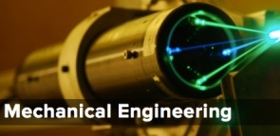
Introduction
Electric Shock
Arc and Blast
Other Safety Issues
Review
The Importance of Electricity
Engineers need to use electricity regardless of engineering discipline.
Imagine a world without electricity even not the batteries. Now make a list of things that you could still do to keep you living smooth. Such a list would be almost empty!
In today’s world, no matter what you do or where you are, electricity is essential.
Electricity

Slide 3
Introduction
Electric Shock
Arc and Blast
Other Safety Issues
Review
Do We Know the Danger of Electricity?
Electricity is such an important part in our life.
Have we ever thought about how dangerous it could be?
Do we know how much electricity we are handling at home or at workplaces and at what danger level?
Do we know what could go wrong in using electricity? Also, how and why that can happen.
Do we know how we can prevent accidents related to electricity?

Slide 4
Introduction
Electric Shock
Arc and Blast
Other Safety Issues
Review
Accidents Related to Electricity
In only one year there were 53,589 electricity related fires reported in Canada, which resulted in 304 deaths, 2,547 injuries and $1.49 billion in property losses [1]
In Ontario an average annual cost of electricity related injuries is $1.3 million [1]
In U.S., there is 43,900 electrical home fires each year, resulting in 438 deaths, 1,430 injuries and $1.47 billion in property damages [2]
Human factor is the most significant cause for electrical incidents
[1] 2001, 2002, 2011 Ontario Electrical Safety Report
[2] Electrical Safety Foundation International, 2013 National Electrical Safety Month
Notes:
41% of these fires occurred in residential structures. Previous research has found that the primary sources of residential fires are cooking, smoking cigarettes, heating equipment, or electrical malfunction [1].
Electrical-related fatalities include electrocution, electrocution burns and electrical fire with the electricity identified as the ignition source.
Electrical injuries are a result of electrical incidents that involve with electrical equipment.

Slide 5
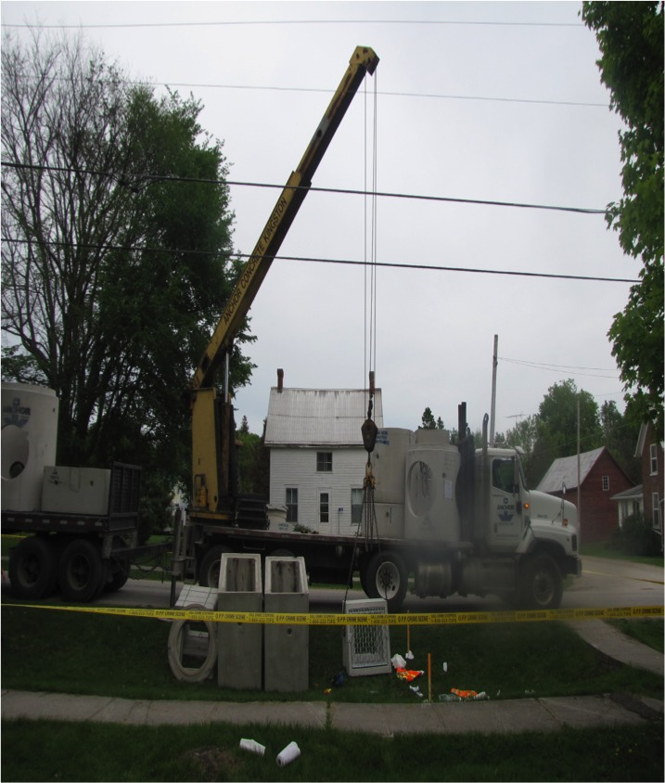
Introduction
Electric Shock
Arc and Blast
Other Safety Issues
Review
Electrical Incidents: Powerline Contact
May 18, 2010
A precast concrete company was making a delivery with a boom truck at a road rebuilding site
the victim helped guide the load by grabbing one of the legs of the sling suspending the load
The wire rope made contact with the powerline
The worker received a severe shock and fell to the ground convulsing

Slide 6
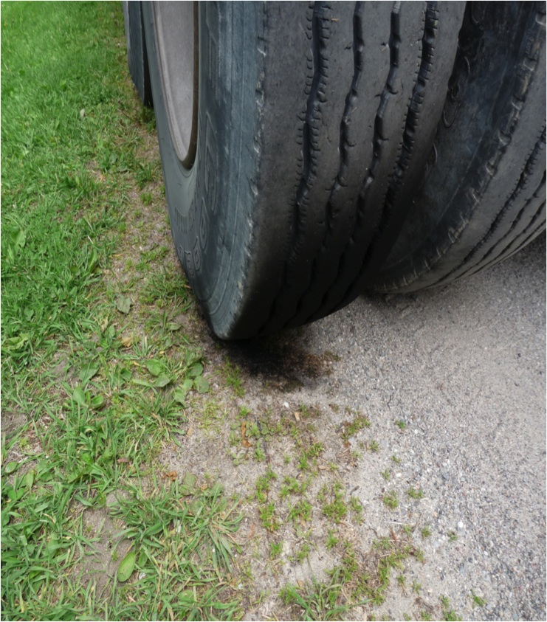
Introduction
Electric Shock
Arc and Blast
Other Safety Issues
Review
Electrical Incidents: Powerline Contact (continued …)
Approximately 14 months of investigation
No designated area for unloading
No signaller was used
The boom truck operator’s view might have been obstructed by the worker standing in front of him on the flatbed of the truck

Slide 7
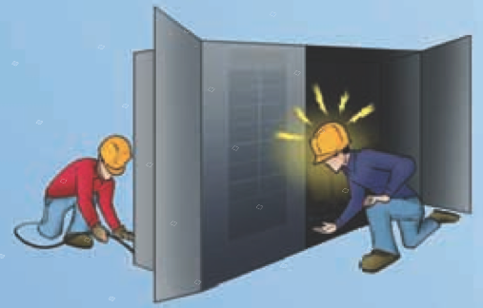
Introduction
Electric Shock
Arc and Blast
Other Safety Issues
Review
Electrical Incidents: Electrical Panel
October 3, 2007
Connection of temporary lighting cables to the electrical panel on a construction site
The apprentice entered the panel to pull up the cable and hook it into the power panel
Inadvertently, the apprentice came into contact with the exposed terminals

Slide 8
Introduction
Electric Shock
Arc and Blast
Other Safety Issues
Review
Electrical Incidents: Electrical Panel (continued …)
Approximately 11 months of investigation
The panel was left energized
No personal protective equipment was worn
Safety policies were not followed
No hazard assessment was conducted prior to performing the work
Contractor was fined $300,000 (Ruling July 8, 2009)

Slide 9
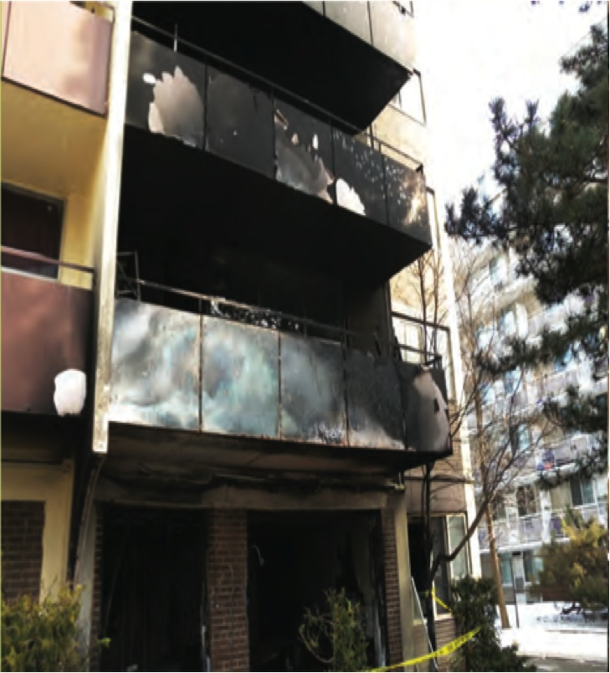
Introduction
Electric Shock
Arc and Blast
Other Safety Issues
Review
Electrical Incidents: Overloading
February 3, 2010
Portable space heater was connected to an extension cord which plugged into a wall receptacle
This connection was kept semi-permanently which is not the intended use for an extension cord

Slide 10
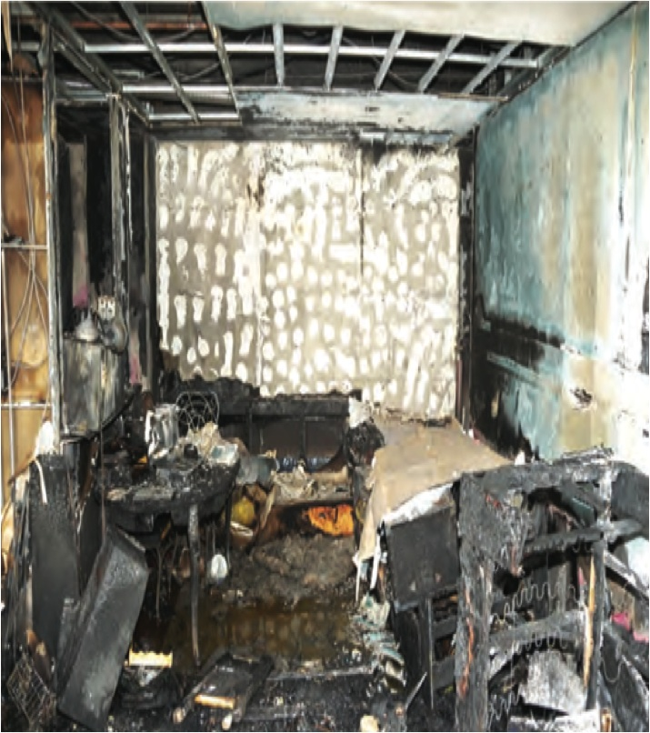
Introduction
Electric Shock
Arc and Blast
Other Safety Issues
Review
Electrical Incidents: Overloading (continued …)
The receptacle was nearby combustibles
Leaving the glass door open after escape provided oxygen for fire to continue
Charring and smoke stains all over the place
A serious injury and $30,000 in property damage

Slide 11
Introduction
Electric Shock
Arc and Blast
Other Safety Issues
Review
Why Health and Safety Matter to an Engineer
“Every one who undertakes, or has the authority, to direct how another person does work or performs a task is under a legal duty to take reasonable steps to prevent bodily harm to that person, or any other person, arising from that work or task.” – Federal Law in Canada (Bill C45), amended on March 31, 2004
An engineer directs other people to work through project design, supervision and decision making at various levels.

Slide 12
Introduction
Electric Shock
Arc and Blast
Other Safety Issues
Review
The Goal of Zero Fatality
Should enforcement be the only driving force?
Imagine a situation where you are a CEO of a giant construction company. Unfortunately, there are 20 deaths in a year due to work related accidents in your company. So, you have taken vigorous measures to reduce this number to half. Hurray! You have achieved the goal and it’s time to celebrate!
Aren’t you still celebrating for killing 10 people?
?
Celebration and coffin can’t go together.
The goal of health and safety management is to achieve ZERO injury.

Slide 13
Introduction
Electric Shock
Arc and Blast
Other Safety Issues
Review
SPIES Model
I believe it’s the only way
I feel strongly about the need
S
piritual
I understand its importance
E
motional
I do it to satisfy my boss
I
ntellectual
I do it to keep my job
P
olitical
S
elf
Notes:
Should ask students where are they in the SPICE model.

Slide 14
Introduction
Electric Shock
Arc and Blast
Other Safety Issues
Review
Major Electrical Hazards
Electric shock: a sudden physiological stimulation when human body is a part of an enclosed current loop.
Arc: the light and heat released from an electrical breakdown that is due to electrical current ionizing gases in the air.
Blast: an explosive or rapid expansion of air with tremendous pressure and temperature, which is caused by arcs sometimes.

Slide 15
Introduction
Electrical Shock
Arc and Blast
Other Safety Issues
Review
Factors Affecting Electrical Shock
The amount of current is a critical factor in determining the severity of electrical shock.
When current flows through an element, voltage cannot be zero (Ohm’s Law: V = RI). Thus, voltage is also a factor.
The current pathway and its resistance in the human body are important factors for electrical shock.
Power (P) = Voltage x Current = V x I ≠ 0
What matters the most is the amount of energy transferred from the electric power source to human body.
We know, Energy = Power x Time; or W = P x t. So, the duration of current flow is also important.

Slide 16
Introduction
Electrical Shock
Arc and Blast
Other Safety Issues
Review
Physiological Effects of Electricity
The human body must become a part of an electric circuit for a physiological effect to occur.
There must be a current flow from one point of the body to another point of the body, i.e., not an open circuit.
The magnitude of current is critical in determining the severity
Phenomenon:
Electric stimulation of excitable tissue
Resistive heating of tissue
Electrochemical burns and tissue damage for direct current and very high voltages

Slide 17
Introduction
Electrical Shock
Arc and Blast
Other Safety Issues
Review
Nominal Human Response to Current Magnitudes
Current (60 Hz) rms | Physiological Phenomena | Feeling or lethal incidence
< 1mA | None | Imperceptible
1 – 10 mA | Perception threshold | Mild to painful sensation
10 mA | Paralysis threshold of arms | Cannot release hand grip
30 mA | Respiratory paralysis | Stoppage of breathing, frequently fatal
75 mA | Fibrillation threshold 0.5% | Heart action discoordinated (probably fatal)
250 mA | Fibrillation threshold 99.5% | Heart action discoordinated (probably fatal)
4 A | Hearing paralysis threshold | Heart stops for duration of current passage
> 5A | Tissue burning
* This data is approximate and based on a 68 kg person
Ref: R. H. Lee,” The Other Electrical Hazard: Electric Arc Blast Burns,” IEEE Trans. Industrial Applications, 1A-18 (3): p246, 1982

Slide 18
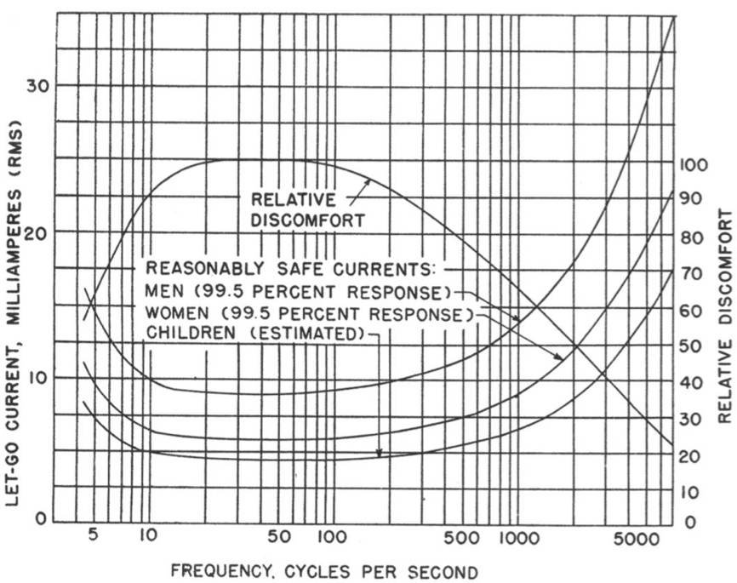
Introduction
Electrical Shock
Arc and Blast
Other Safety Issues
Review
Let-Go Current
Let-go current is the maximum current a person can tolerate when holding a current carrying conductor in one hand and yet let go of the conductor by using muscles directly affected by that current
Let-go current depends on frequency
Example: 60 mA current at 2000 Hz and at 5 Hz is safe for men but the same amount of current at 60Hz is not safe
Ref: C. F. Dalziel,” Let go current and voltages,” AIEE Transactions 75 (II): 49, 1956

Slide 19
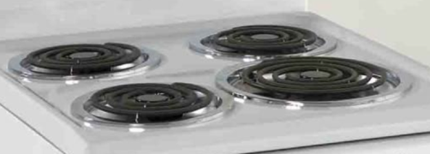
Introduction
Electrical Shock
Arc and Blast
Other Safety Issues
Review
How Much Current Are We Using at Home?
We use electricity in many different things at home. How much current flows through these devices and how dangerous these could be. See the following examples:
Assume (typical) an electric stove has two 2500 W
coils and two 1000 W coils
- If the 2500 W is turned on, it requires a current flow of 20.83 A
- If all four coils are in use, it requires a current of 58.33 A!
Typical current requirements: (Considering V = 120V in Canada)
Cloth dryer = 33.0 A Iron = 8.5 A
Dishwasher = 11.5 A Coffeemaker = 6.5 A
Microwave = 10.0 A Television = 1.6 A

Slide 20
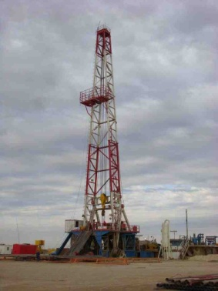
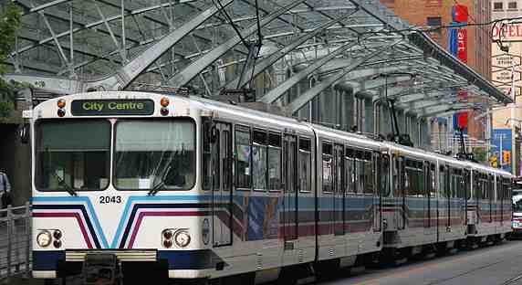
Introduction
Electrical Shock
Arc and Blast
Other Safety Issues
Review
How About At Nonresidential Places?
Workers often use various dangerous electrical equipment.
Also, people use things in public places which require high current.
An oilrig may require several megawatt of power, which may
have more than thousand amperes of current in it.
The list of heavy duty machines can be endless here.
All these machines require moderate to very high current.
A three-car transit train may require 300 A - 900 A
A ten passenger elevator may require 150 A
A 20 foot high escalator may require 100 A
The engineers who design these ensure that the workers, users and public will remain safe.

Slide 21
Introduction
Electrical Shock
Arc and Blast
Other Safety Issues
Review
Electrical Resistance of Human Body
The electrical resistance of the human body depends on various factors such as skin condition (dry, wet, type of gel or lotion used), parts of the body and even on gender.
Resistance between two points x and y of a human body is
Dry skin has higher resistivity than wet skin
Male usually have higher resistivity than female
Thicker skin has higher resistance than thinner skin
The resistivity of skin is much higher than that of muscle
Notes:
Why do the electrocardiogram technicians use gel?

Slide 22
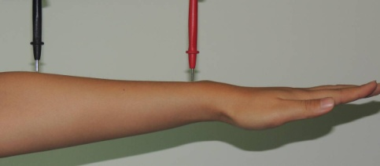
Introduction
Electrical Shock
Arc and Blast
Other Safety Issues
Review
Circuit Model of Electrical Resistance in Human Body
a
g
a
g
b
f
h
b
f
e
Skin
b
f
c
Muscle
d
c
e
Since,
and skin has higher resistance than muscle
The current path a-b-c-d-e-f has lower resistance than a-b-h-f-g.
Most of the current flows through the inside of the body rather than through the body surface (current path bhf) which is skin.
It is more likely for majority of the current to flow through important internal body organs such as heart and lung.
Notes:
The equivalent resistance of a high resistance in parallel with a low resistance is almost equal to the low resistance. Example: 1M//100K = 90.9K

Slide 23
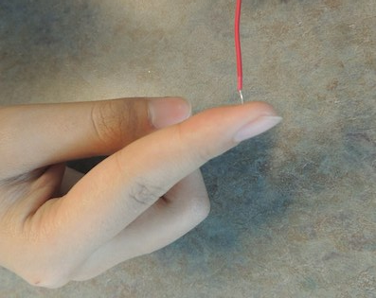
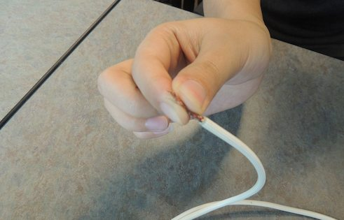
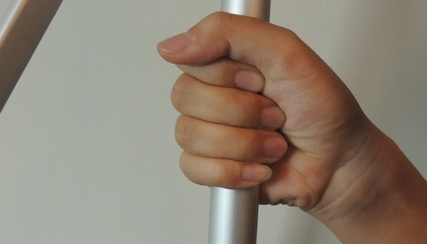
Introduction
Electrical Shock
Arc and Blast
Other Safety Issues
Review
Area of Contact Matters
Assume a person has accidentally touched a live line having 120 V. The higher the body resistance is the lower will be the current flow.
The body resistance mostly depends on R_{bc} and R_{ef} , i.e. the skin resistance in contact with the live line or object.
The resistances R_{bc} and R_{ef} become smaller for larger contact area (A on slide #14) which allows more current to flow.
The following pictures show different area of contacts.

Slide 24
Introduction
Electrical Shock
Arc and Blast
Other Safety Issues
Review
Nominal Resistance Values
Condition | Resistance
 | Dry skin | Wet skin
Finger touch | 4 kΩ – 1 MΩ | 4 kΩ – 15 kΩ
Hand holding wire | 10 kΩ – 50 kΩ | 3 kΩ – 6 kΩ
Finger-thumb grasp | 10 kΩ – 30 kΩ | 2 kΩ – 5 kΩ
Palm touch | 3 kΩ – 8 kΩ | 1 kΩ – 2 kΩ
Hand around 1.5” pipe | 0.5 kΩ – 1.5 kΩ | 250 Ω – 750 Ω
Hand immersed | – | 200 Ω – 500 Ω
Limb (excluding skin) | – | 200 Ω
Trunk (excluding skin) | – | 100 Ω
Limb to limb (excluding skin) | – | 500 Ω
Ref: Electricity Safety Handbook by J. Cadick, et al (data copied for noncommercial purpose)

Slide 25
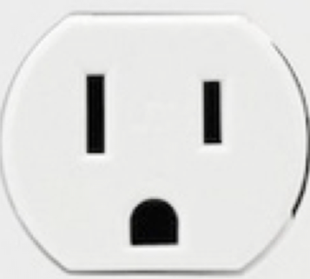
Introduction
Electrical Shock
Arc and Blast
Other Safety Issues
Review
Power Outlets
There are usually three ports in a residential (single phase) wall socket.
Neutral
Live or hot
Ground
Ground
Is there any standard color coding?
What is the need of the ground port when there is a neutral port?
Why is the size of the neutral and live ports are different?
This will be discussed in the following subsections.

Slide 26
Introduction
Electrical Shock
Arc and Blast
Other Safety Issues
Review
Color Coding: CSA Group Standards
CSA (Canadian Standards Association) Group has standards for electrical installations called Canadian Electrical Code. The CSA Group standard has the following recommend color-code:
For AC (alternating current)
Ground line: Green or green with one or more yellow stripes
Neutral line: White
Hot (1 phase): Black or red
Hot (3 phase): Red (phase A), black (phase B), blue (phase C)
For DC (direct current)
2 wire: Black and red
3 wire: Black, red and white

Slide 27
Introduction
Electrical Shock
Arc and Blast
Other Safety Issues
Review
Understanding the Electrocution Circuits
V_{S}
V_{S}
Conductor
Insulator
(a)
(b)
Closed circuit
In both cases the circuits are closed and the person becomes an element in the circuit.
In figures a and b, if the source is 120V and the body exhibits a resistance of 5 kΩ, the current through the body is 24 mA
Note that this type of electric shock can be fatal depending on the contact area, skin condition and duration of current flow
Standing on an insulator does not always help (figure b)

Slide 28
Introduction
Electrical Shock
Arc and Blast
Other Safety Issues
Review
Understanding the Electrocution Circuits
V_{S}
V_{S}
Insulator
Insulator
Conductor
(c)
(d)
Open circuit
In figure c, the resistance between hand and the ground is infinite (open circuit). The voltage across the body is V_{S} but the current through the body is zero (I = V_{S}/∞). The person remains safe in this situation. WARNING: Don’t do this experiment.
In figure d, both will be electrocuted because the circuit is closed through the second person standing on the ground.
What happens to the birds sitting on a 200 000 V live line? Similar to circuit c.

Slide 29
Introduction
Electrical Shock
Arc and Blast
Other Safety Issues
Review
The Need of a Ground Port
A typical electrical connection
The internal circuit is electrically insulated against the external body of the appliance.
The ground line is connected to the external body but not directly connected to the internal circuit.
Normally the current flows through the live and neutral lines.
The users are safe to touch these appliances under normal operation.
If the internal circuit accidently gets connected to the external body, the ground line helps keep the users SAFE.
Live
The internal circuit
Neutral
Ground

Slide 30
Introduction
Electrical Shock
Arc and Blast
Other Safety Issues
Review
The Need of a Ground Port (Continued …)
The equivalent circuit under normal operation
Live
V_{S}
R_{A}
R_{HB}
Ground
Neutral
The feet are electrically connected to the ground
The equivalent circuit under normal operation
R_{A} = equivalent impedance (resistance) of the appliance’s internal circuit
R_{HB} = body resistance of the person touching the appliance
Under normal operation, the person is not a part of the circuit
The person remains SAFE

Slide 31
Introduction
Electrical Shock
Arc and Blast
Other Safety Issues
Review
The Need of a Ground Port (Continued …)
Faulty connection
Assume the appliance’s body is connected to the live line
– a faulty connection
Live
Ground
R_{A}
V_{S}
R_{HB}
Neutral
The feet are electrically connected to ground
The equivalent circuit with the ground port under faulty condition
No current in R_{HB} – SAFE operation
V_{S}
R_{A}
R_{HB}
Assume the appliance’s external body is accidentally connected to the internal electric circuit.
Without the ground connection the body is part of the circuit and current flows through the person’s body
With the ground connection the current flows through the ground line bypassing the person’s body. Notice there is no voltage drop across the body.
The person remains SAFE.
The equivalent circuit without the ground port under faulty condition
Current flows through R_{HB} –
The person is electrocuted

Slide 32
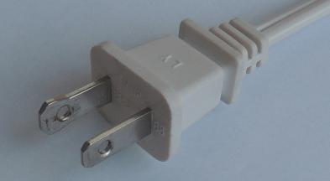
Introduction
Electrical Shock
Arc and Blast
Other Safety Issues
Review
Different Sizes of the Outlets and Color Code
To other ac powered devices
120 V ac line
N
L
The plug pins have different sizes.
S
The ground connection is not shown here.
The plug pins shown at the left need to be inserted into the plug socket to turn on the table lamp.
The switch S is placed somewhere between the plug pins and the light bulb holder.
The switch S can be connected to the live or neutral line depending on how the plug pins are inserted into the socket. In this diagram it is on the LIVE line.
Different sizes of the pins ensure that the switch always remains on the live line.
Assume the switch is OFF and someone is touching the bulb holder (not a good practice). No current flows through the person’s body and s/he remains SAFE.
Having a standard color helps easily identify the live line in an electric wiring.
Notes:
Did you (students) know that are connected in parallel

Slide 33
Introduction
Electrical Shock
Arc and Blast
Other Safety Issues
Review
Different Sizes of the Outlets and Color Code
To other ac powered devices
120 V ac line
S
N
L
The ground connection is not shown here.
Assume the pins of a plug have the same size and they can be inserted into the plug socket in either way. (Note that with different sizes there is only one way.)
This diagram shows that the plug is inserted in a way such that the switch S is now placed on the NEUTRAL line instead of being placed on the live line.
In this scenario current can flow through the person’s body even though the switch is OFF.
Thus, turning off the switch will not ensure electrical safety if the same size plug pins are used. Making the pin sizes different allows only ONE way of insertion.
Notes:
Did you (students) know that are connected in parallel

Slide 34
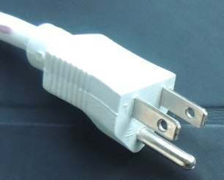
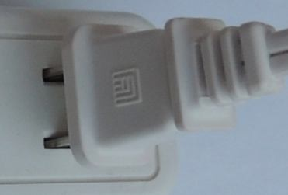
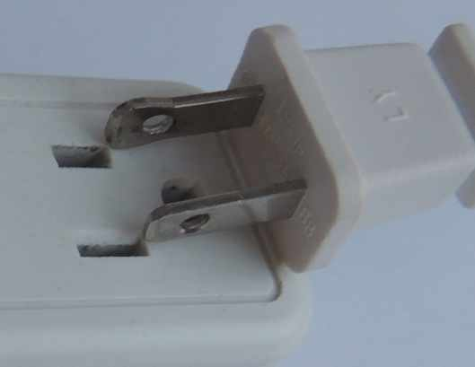
Introduction
Electrical Shock
Arc and Blast
Other Safety Issues
Review
Different Sizes of the Outlets
A 3-pin plug has only one way to be inserted
Wall socket
A plug with different pin sizes
It is an easy go as it fits with the right size
Does not fit because the larger pin cannot be inserted into the smaller hole
Notes:
Did you (students) know that are connected in parallel

Slide 35
Introduction
Electrical Shock
Arc and Blast
Other Safety Issues
Review
Static Electricity
We all experience static electricity, particularly on a dry winter day it can be painful.
Static electricity can be a fire/explosion hazard if
- static electric charge continues to generate and accumulate
- the air near the source has an ignitable mixture
Petroleum based fuels often develop static charge when they are carried in a metal container, poured or flow through hoses.
Higher temperature and higher altitude lower the flash point, which may enhance ignition.
Notes:
Flash point: The lowest temperature at which a liquid produces enough vapor to form an ignitable mixture. Liquids with low flash points pose the greatest danger.

Slide 36
Introduction
Electrical Shock
Arc and Blast
Other Safety Issues
Review
Static Electricity – Bonding
Hose
The dispensing and receiving metal containers are electrically bonded by a conductor.
The bonding must be done before pouring.
Since the two containers are electrically connected there is no voltage difference.
Some hoses have built-in bonding mechanism.
Metal bonding
Fuel drum
Bonding is not effective for containers that do not conduct electricity.
Bonding alone may not be sufficient to prevent static electricity.

Slide 37
Introduction
Electrical Shock
Arc and Blast
Other Safety Issues
Review
Static Electricity – Bonding and Grounding
Hose
Metal bonding
Grounded metal pipe
Metal bonding
Fuel drum
Both containers are bonded and one of them are grounded.
The ground is usually water or gas metal pipes.
Any accumulated charge will be completely discharged through the ground connection line.

Slide 38
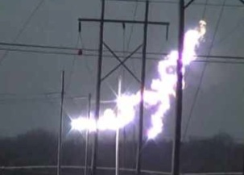
Introduction
Electric Shock
Arc and Blast
Other Safety Issues
Review
Arcing
Arcing occurs when electric current flows uncontrolled accompanied by ionization of the surrounding air from phase to ground, phase to neutral, and/or phase to phase.
Normally, air is an insulator.
Under certain circumstances air insulation may fail.
Insulation failure can result in short-circuit.
This releases an enormous amount of energy in a very short time.

Slide 39
Introduction
Electric Shock
Arc and Blast
Other Safety Issues
Review
Insulation Failure – Strong Electric Field
R
R = ∞ when air is an insulator. Arcing occurs when R = 0
The electric field between the two conductors is given by
Electric field = (voltage difference) / (distance between conductors)
Example: assume two conductors with a voltage difference
of 100 000 V and the distance between the conductors is 0.5 m
Thus, Electric field = 200000 V/m = 2000 V/cm. This is a strong electric field and may cause the air insulation failure under favorable condition.

Slide 40
Introduction
Electric Shock
Arc and Blast
Other Safety Issues
Review
Insulation Failure – Factors Influencing
R
Arcing can be influenced and/or caused by the following factors:
Defective or aging insulation material
Poor or incorrect maintenance
Moisture or vermin and human errors
A tool slipping and touching live conductors
Environmental factors such as geography, altitude, humidity and geology
Meteorological factors such as ambient pressure, temperature,
and wind

Slide 41
Introduction
Electric Shock
Arc and Blast
Other Safety Issues
Review
Arcing Hazards
Arcing
Fire
Blast
Light
Burn
Pressure Wave
Sound

Slide 42
Introduction
Electric Shock
Arc and Blast
Other Safety Issues
Review
Arcing Hazard – Fire and Burns
Arcing results in fierce fire and the temperature of this fire can be as high as 20 000 C.
This arcing temperature is four times as hot as the sun’s surface.
No material, known on the earth, can withstand this temperature. They will be vaporized.
Burns from electric arc do not need a direct contact to fire.
With temperatures rising in and around an arc, burn hazard is present from ohmic heating; ignition and combustion of nearby materials, notably including worn clothing and adjacent equipment; and sprayed or blown hot or melting installation elements.
A person standing several feet away from an arc can be a victim of massive burns. Thus, distance matters.

Slide 43
Introduction
Electric Shock
Arc and Blast
Other Safety Issues
Review
Arcing Hazard – Light
The intense light generated by arc flash emits dangerous ultraviolet and infrared.
Without proper protection the ultraviolet may cause temporary or permanent blindness.
The most common injury from infrared radiation exposure is eye injury to cornea, with the formation of cataracts, retinal burns and corneal burns.
People normally avoid too intense visible light. However, it takes about 0.25 second to close the eyes with an aversion response.

Slide 44
Introduction
Electric Shock
Arc and Blast
Other Safety Issues
Review
Arc Flash Boundaries
Any point on an exposed, energized or circuit part
Prohibited space is considered as equivalent to direct contact. Required: appropriate PPE, training, work permit, risk assessment
Prohibited
Space boundary
Restricted space – appropriate PPE, training, work permit, risk assessment are required to enter this region.
Limited space – Unqualified persons must be accompanied by a qualified person. Appropriate PPE, training on the task to be performed and risk assessment are required.
Flash protection boundary is defined as the distance at which a person can be exposed to 1.2 cal/cm² of incident energy. PPE must be worn to prevent 2nd degree or greater burns. Unqualified person must be accompanied by a qualified worker.
Restricted
space boundary
Limited space boundary
Flash protection boundary
Notes:
PPE: Personal Protection Equipment

Slide 45
Introduction
Electric Shock
Arc and Blast
Other Safety Issues
Review
Arcing Hazard – Blast
During an arc flash, the rapidly expanding gases and heated air may cause blasts, pressure waves or explosions.
Blast pressures may exceed 10 ton/m², knocking workers off ladders or collapsing workers’ lung.
These events occur very rapidly with speeds exceeding 1100 km/h, making it impossible for a worker to get out of the way.
The gasses expelled from the blast also carry the products of the arc with them including droplets of molten metal similar to buckshot.
The sound level from blasts and pressure waves can be as high as 160 dB at a distance of several feet, where the sound from a jet engine at 200 feet is about 130 dB.
Hearing protections are required for above 85 dB.

Slide 46
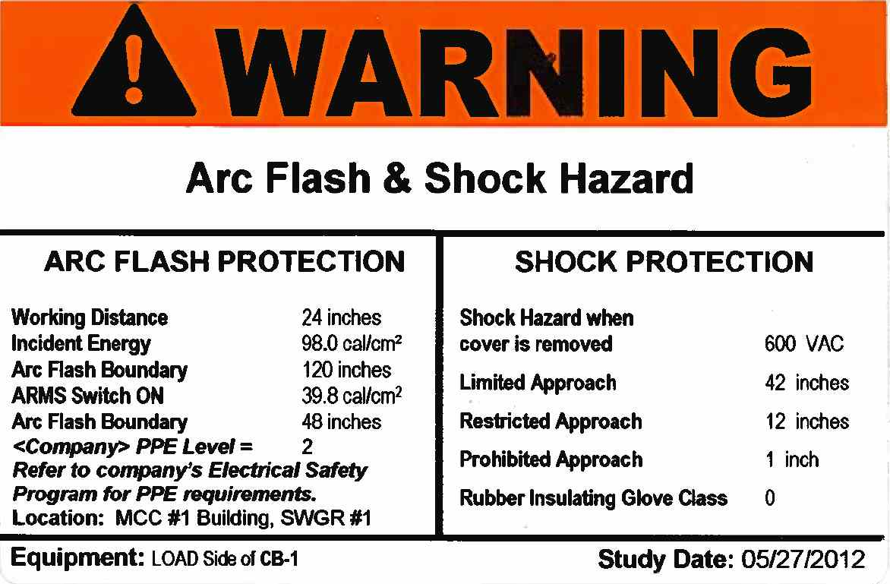
Introduction
Electric Shock
Arc and Blast
Other Safety Issues
Review
Arc Flash Hazard Calculation
Widely accepted standards for calculating arc flash hazard:
IEEE 1584-2002 and
Appendix D of NFPA 70E-2012 (NFPA: National Fire Protection Association)
A sample warning label
* This warning label is copied from ESPS.

Slide 47
Introduction
Electric Shock
Arc and Blast
Other Safety Issues
Review
A Natural Arcing – Lightening
Lightening is a natural arcing

Slide 48
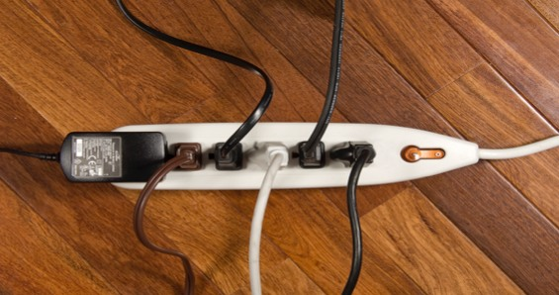
Introduction
Electric Shock
Arc and Blast
Other Safety Issues
Review
SAFE Limit of Current Through a Wire
Is there a SAFE limit on number of devices that can be connected to a multiplug? Is it just the number of devices or the amount of current that sets the limit?
Equivalent circuit of a multiplug when connected to multiple devices
I
120 V ac line,
Input to the multiplug
Device-1
Device-2
Device-3
Device-4
Device-5
I₁
I₂
I₃
I₄
I₅
By KCL, I = I₁ + I₂ + I₃ + I₄ + I₅
I is the total current that the multiplug is receiving from the wall socket. This current depends on the individual current demanded by each device connected to it.

Slide 49
Introduction
Electric Shock
Arc and Blast
Other Safety Issues
Review
SAFE Limit of Current Through a Wire (continued …)
Electric wires have limits of maximum current flow, called ampacity
When current flows through a wire, it produces heat
Joule Heat = (Current)² x (Resistance of the wire)
Excessive heat may damage wire material and its insulation
Such damages may cause short circuit, severe electric shock, burn, etc.
Higher diameter is required for larger current to flow safely
A
l
R = Resistance ρ = Resistivity
l = length A = Area
CSA Group has standards for ampacity where the diameter is expressed in terms of AWG (American Wire Gauge)

Slide 50
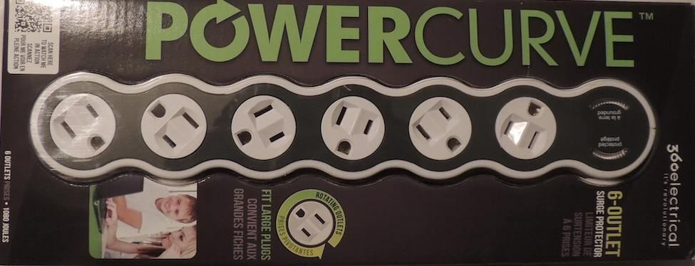
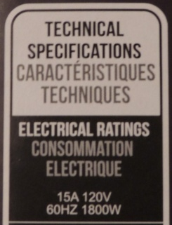
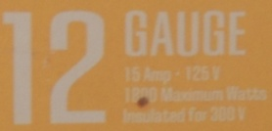
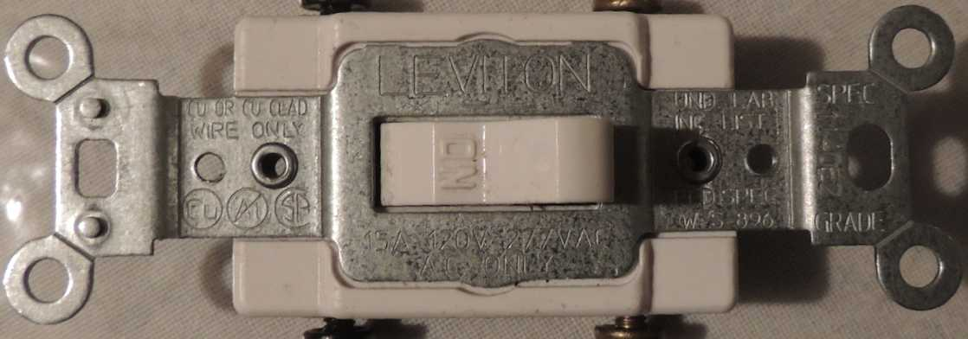
Introduction
Electric Shock
Arc and Blast
Other Safety Issues
Review
SAFE Limit of Current Through a Wire (continued …)
Electric wires, plugs, sockets, etc. have well defined current limit.
The users should never exceed these current limits.
15 A

Slide 51
Introduction
Electric Shock
Arc and Blast
Other Safety Issues
Review
Short Circuit and Ground Fault
Short circuit
Short Circuit: A short circuit occurs when a live line and neutral line actually touch each other.
Live or hot
Neutral
Ground
Ground fault
Ground Fault: A ground fault occurs when the live line comes into contact with the ground line or a grounded portion of a junction box or grounded part of an appliance or a device.
Live or hot
Neutral
Ground
A large amount of current flows in both cases.

Slide 52
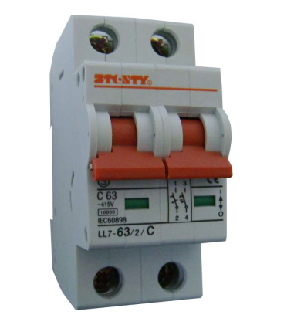
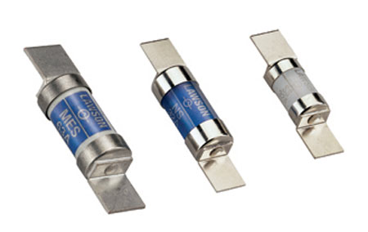
Introduction
Electric Shock
Arc and Blast
Other Safety Issues
Review
An Ordinary Over-limit Protector
If current flows over the rated (or safe) limit in a circuit, the over-limit protection devices break the circuit. This can be done by blowing a fuse or by tripping a circuit breaker.
Fuses
Circuit breaker
Assume an appliance is supposed to draw a maximum of 15A current at 120 V. A fuse or circuit breaker rated 15 A is connected to the line. A person accidentally touches the live line. The over-limit protection device will not break the circuit until the current exceeds 15 A. But current levels as low as 10 to 30 mA can be fatal to human beings. Thus, such an ordinary over-limit protector cannot save the users in this situation although it protects the appliance.

Slide 53
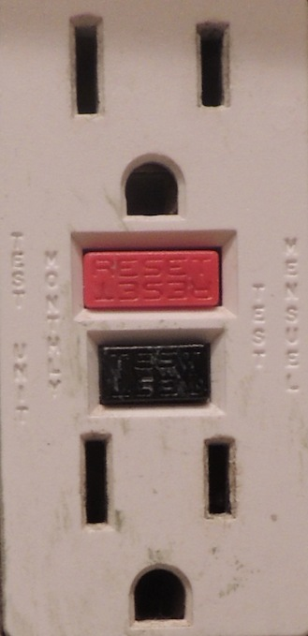
Introduction
Electric Shock
Arc and Blast
Other Safety Issues
Review
Ground-Fault Circuit Interrupter (GFCI)
GFCIs interrupts a circuit when there is a difference in the currents in the live and neutral lines. Such a difference indicates an abnormal diversion of current either through the ground line or through a person’s body who has come into contact with the live line and is being electrocuted. The device activates with a minimum current difference of 5 mA. This keeps the person safe. When a circuit functions normally, the difference in current is always zero.
GFCIs are required to be used in bathrooms, swimming pools, and in some kitchen receptacles. The GFCIs have a “Test” button which causes a small difference between the live and neutral line.

Slide 54
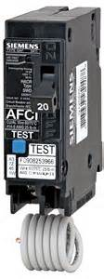
Introduction
Electric Shock
Arc and Blast
Other Safety Issues
Review
Arc-Fault Circuit Interrupter (AFCI)
AFCI is a device intended to provide protection from the effects of arc faults by recognizing characteristics unique to arcing and by functioning to de-energize the circuit when an arc fault has occurred. AFCIs use integrated processors which recognizes the unique current and/or voltage signatures associated with arcing faults. It clears the fault in a very short time. For 60 Hz ac power system, the clearing time is less than 8.3 milliseconds. It is recommended that AFCIs should be used in most rooms and other places in new construction.

Slide 55
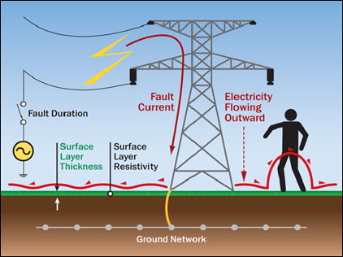
Introduction
Electric Shock
Arc and Blast
Other Safety Issues
Review
Step Potential
In case of a fault at a tower, the current will flow through the ground.
If the fault current for a high-voltage tower is 7000 A and the resistance to ground of the grounding system is 5 Ω, the ground potential rise will be 35000 V.
A person walking nearby is likely to experience a large voltage difference between the feet.
A current will flow through the person’s body causing an electrical shock although there is no direct contact.

Slide 56
Introduction
Electric Shock
Arc and Blast
Other Safety Issues
Review
The Common Personal Protection Equipment (PPE)
The most common types of PPE include:
Nonconductive flame-resistant head, face, and chin protection (hard hats, full face shields, switching hoods, etc.)
Eye protection (face shields, safety glasses, goggles)
Body protection resistant to flash flame (shirts, pants, jackets, coveralls)
Hand and arms protection (insulating gloves and sleeves with leather protectors)
Foot and leg protection (insulated leg and footwear)
Insulating blankets or mats

Slide 57
Introduction
Electric Shock
Arc and Blast
Other Safety Issues
Review
Arc Resistant (Also known as Fire Resistant) Cloths
PPE Requirements |  | Typical Protective Clothing Systems Clothing Description | Minimum Flash Protection Boundary (in)
Hazard Risk Category | Required Minimum Arc Rating of PPE (cal/cm²)
0 | N/A | 1 layer of non-melting, flammable fabric with weight of at least 4.5 oz/yd² | 6
1 | 4 | 1 layer of AR shirt and AR pants or AR coverall | 15
2 | 8 | 1 or 2 layers of AR shirt and AR pants with conventional cotton underwear | 45
3 | 25 | 2 or 3 layers of AR shirt, AR pants plus AR coverall cotton underwear | 60
4 | 40 | 3 or more layers of AR shirt, AR pants plus multi-layer flash suit | ~ 120

Slide 58
Introduction
Electric Shock
Arc and Blast
Other Safety Issues
Review
Best Practices
Recommendations for circuit designers and electrical maintenance engineers
Make sure that the design is safe
Use current-limiting overcurrent protective devices
Implement an electrical safety program
Observe safe work practices
Use appropriate personal protective equipment (PPE)
Use warning labels
Use an energized electrical work permit if necessary
Avoid hazards of improperly selected or maintained overcurrent protective devices
Achieve or increase selective coordination

Slide 59
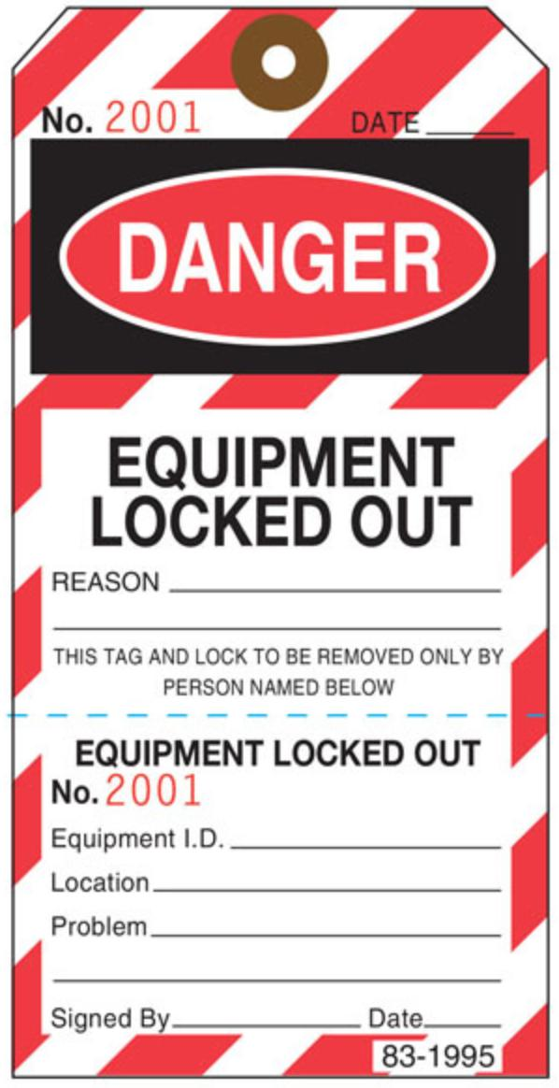
Introduction
Electric Shock
Arc and Blast
Other Safety Issues
Review
Lockout and Tag out
Energy sources including electrical, mechanical, hydraulic, pneumatic, chemical, thermal or other sources in machines and equipment can be hazardous to workers. During the servicing and maintenance of machines and equipment, the unexpected startup or release of stored energy could cause injury to employees.
Lockout is the process of physically neutralizing all energies in a piece of equipment. The equipment must be tagged out after it has been locked out.
Proper procedures must be developed specific to an industry or equipment.

Slide 60
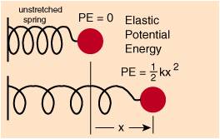
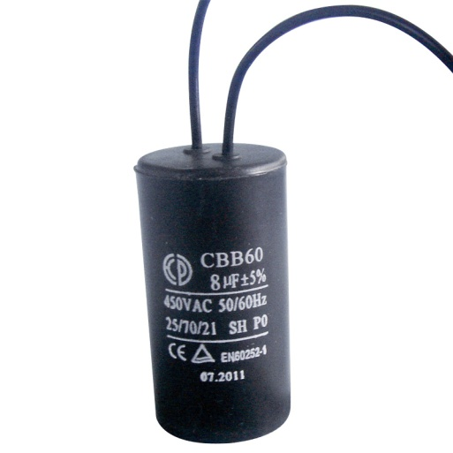
Introduction
Electric Shock
Arc and Blast
Other Safety Issues
Review
Lockout and Tag out (Continued …)
Disconnecting the electrical power line may not ensure the complete release of all sources of energies. Examples:
A mechanical spring in a piece of equipment may store high potential energy which can be released during the maintenance work and cause harm.
Electrical energy can be stored in a capacitor inside an equipment. Shutting down the equipment may not release the energy. A sudden release of this stored energy may cause serious injury.

Slide 61
Introduction
Electric Shock
Arc and Blast
Other Safety Issues
Review
Major Regulatory Bodies
Law: the system of rules set by the federal government and/or provincial government.
Standard: A required or agreed level of quality or attainment. These are usually set and suggested by various regulatory bodies.
Canadian Advisory Council on Electrical Safety (CACES)
Canadian Standards Association (CSA) Group
Canadian Centre for Occupational Health & Safety (CCOHS)
Provincial Authorities such as
Alberta Safety Council
Ontario Electrical Safety Authority
Institute for Electrical and Electronic Engineers (IEEE)
Occupational Safety & Health Administration (OSHA)
American National Standards Institute (ANSI)

