Slide 1


Hazard and Risk
Identification
July 1, 2014

Slide 2
Getting | Hazards | Hazards from | Risk | Hazard & Risk | Final
Started | Identification | Human Error | Analysis | – Case Studies | Thoughts
Concept Definitions
Hazard – An intrinsic chemical, physical, societal, economic or political condition that has the potential for causing damage to a risk receptor (people, property or the environment).
A hazardous event requires an initiating event or failure and then either failure of or lack of safeguards to prevent the realisation of the hazardous event.
Examples of intrinsic hazards:
Toxicity and flammability – H₂S in sour natural gas
High pressure and temperature – steam drum
Potential energy – walking a tight rope

Slide 3
Concept Definitions
Getting | Hazards | Hazards from | Risk | Hazard & Risk | Final
Started | Identification | Human Error | Analysis | – Case Studies | Thoughts
Risk – A measure of human injury, environmental damage or economic loss in terms of both the frequency and the magnitude of the loss or injury.
Risk = Consequence x Frequency

Slide 4
Getting | Hazards | Hazards from | Risk | Hazard & Risk | Final
Started | Identification | Human Error | Analysis | – Case Studies | Thoughts
Concept Definitions
Risk
Intrinsic Hazards
Undesirable Event
Likelihood
of Event
Consequences
Likelihood of
Consequences
Example
Storage tank with flammable material
Loss of life/ property, Environmental damage, Damage to reputation of facility
Spill and Fire

Slide 5
Getting | Hazards | Hazards from | Risk | Hazard & Risk | Final
Started | Identification | Human Error | Analysis | – Case Studies | Thoughts
Concept Definitions
Risk
Intrinsic Hazards
Undesirable Event
Likelihood
of Event
Consequences
Likelihood of
Consequences
Causes

Slide 6
Getting | Hazards | Hazards from | Risk | Hazard & Risk | Final
Started | Identification | Human Error | Analysis | – Case Studies | Thoughts
Concept Definitions
Risk
Layers of Protection
Layers of Protection
Intrinsic Hazards
Undesirable Event
Likelihood
of Event
Consequences
Likelihood of
Consequences
Causes
Preparedness, Mitigation,
Land Use Planning,
Response, Recovery
Prevention

Slide 7
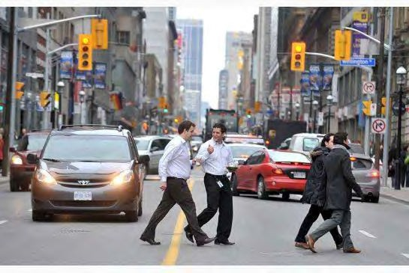
Risky Activity: Jaywalking
Getting | Hazards | Hazards from | Risk | Hazard & Risk | Final
Started | Identification | Human Error | Analysis | – Case Studies | Thoughts
Toronto Star

Slide 8
Risky Activity: Jaywalking
Getting | Hazards | Hazards from | Risk | Hazard & Risk | Final
Started | Identification | Human Error | Analysis | – Case Studies | Thoughts
Intrinsic Hazard
Vehicles on road
Speed of these vehicles
Cause
Crossing the Road
Event
Collision
Layer of Protection
Cross walk
Toronto Star

Slide 9
Risky Activity: Jaywalking
Getting | Hazards | Hazards from | Risk | Hazard & Risk | Final
Started | Identification | Human Error | Analysis | – Case Studies | Thoughts
Consequences of the Event
Death
Severe Injury
Broken Bones
Fractured Bones
Scratches
No Injury
Frequency of the Event
Every Day,
Once a week
Once a month
Once a year
Never
Toronto Star

Slide 10
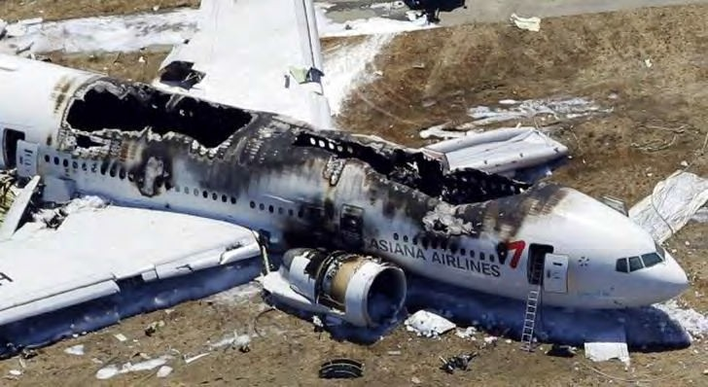
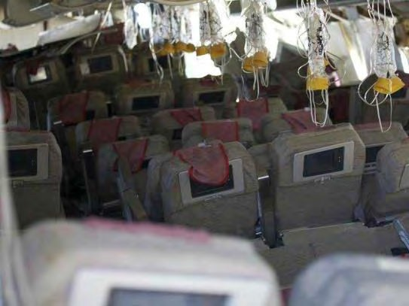

Risky Activity: Plane Landing
Getting | Hazards | Hazards from | Risk | Hazard & Risk | Final
Started | Identification | Human Error | Analysis | – Case Studies | Thoughts
Asiana Airlines Boeing 777 crash on July 6, 2013 at
San Francisco International Airport
8 deaths and 180 injuries

Slide 11


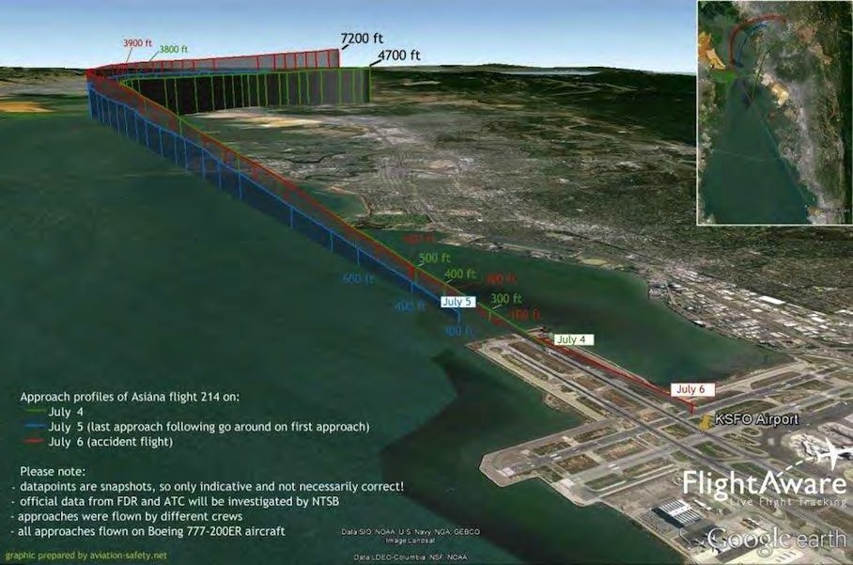

Risky Activity: Plane Landing
Getting | Hazards | Hazards from | Risk | Hazard & Risk | Final
Started | Identification | Human Error | Analysis | – Case Studies | Thoughts

Slide 12
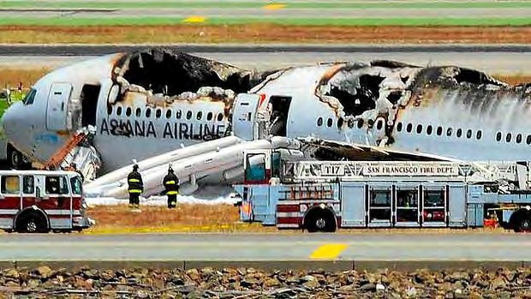
Risky Activity: Plane Landing
Getting | Hazards | Hazards from | Risk | Hazard & Risk | Final
Started | Identification | Human Error | Analysis | – Case Studies | Thoughts
Hazard
Plane flight
Cause
Potentially human error
during runway approach
Event
Crash during landing
Consequence
Deaths

Slide 13


Risky Activity: Plane Landing
Getting | Hazards | Hazards from | Risk | Hazard & Risk | Final
Started | Identification | Human Error | Analysis | – Case Studies | Thoughts
Hazard
Plane flight
Cause
Potentially human error
during runway approach
Event
Crash during landing
If the frequency of the consequence is known, risk can be calculated.
Consequence
Deaths
Risk = Consequence x Frequency
13

Slide 14
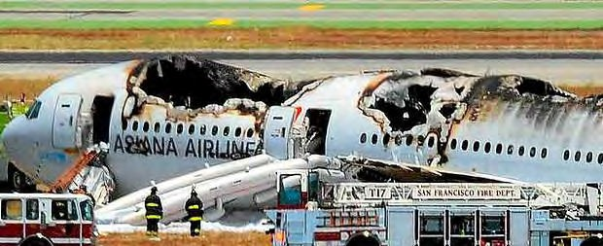
Risky Activity: Plane Landing
Getting | Hazards | Hazards from | Risk | Hazard & Risk | Final
Started | Identification | Human Error | Analysis | – Case Studies | Thoughts
Multiple Consequences can result from a crash during plane landing:
Deaths
Permanent Disability
Injury Requiring Hospitalisation
First Air
^{𝑹࢏࢙𝒌}ࢉ࢘𝒂࢙ࢎ
= ࢏
𝑪࢕࢔࢙ࢋࢗ𝒖ࢋ࢔ࢉࢋ_{࢏,ࢉ࢘𝒂࢙ࢎ}
࢞ 𝑭࢘ࢋࢗ𝒖ࢋ࢔ࢉ࢟ ࢕ࢌ 𝑪࢕࢔࢙ࢋࢗ𝒖ࢋ࢔ࢉࢋ_{࢏,ࢉ࢘𝒂࢙ࢎ}
All consequences must be expressed in
the same units to calculate total risk.
14

Slide 15

Concept Definitions
Getting | Hazards | Hazards from | Risk | Hazard & Risk | Final
Started | Identification | Human Error | Analysis | – Case Studies | Thoughts
Risk – A measure of human injury, environmental damage or economic loss in terms of both the frequency and the magnitude of the loss or injury.
Risk
Source
Impact
Risk Receptor
An individual
A community
An environment
A property
A corporation
Employees
Shareholders
Society
Area where undesirable events can occur:
Industrial facilities – resource extraction, processing, manufacturing, disposal, energy generation, transportation
Third party environments – legislative, political, societal
15

Slide 16
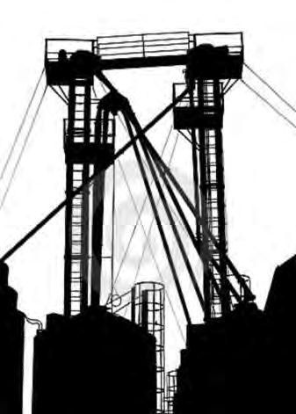

Types of Consequences
Locational Consequence – Outdoor IMMOVEABLE receptor that is maximally exposed.
Getting | Hazards | Hazards from | Risk | Hazard & Risk | Final
Started | Identification | Human Error | Analysis | – Case Studies | Thoughts
Probability of the effect, P_{d} (death, damage)
of an event
We can sum all the locational consequences at a set location, to calculate the total risk = facility risk.
Event Location
Distance from Event, x

Slide 17


Types of Consequences
Locational Consequence – Outdoor IMMOVEABLE receptor that is maximally exposed.
Getting | Hazards | Hazards from | Risk | Hazard & Risk | Final
Started | Identification | Human Error | Analysis | – Case Studies | Thoughts
Probability of the effect, P_{d} (death, damage)
of an event
Layers of Protection
Individual Consequence – An ability to escape and an indoor vs. outdoor exposure.
Event Location
Distance from Event, x

Slide 18


Getting | Hazards | Hazards from | Risk | Hazard & Risk | Final
Started | Identification | Human Error | Analysis | – Case Studies | Thoughts
Aggregate Consequence – Outdoor IMMOVEABLE
receptor.
ρ P_{d} (death, damage) of an event
𝐶ௗ = 𝐴ݎ݁𝑎 𝑈݊݀݁ݎ 𝐶ݑݎݒ݁
=
𝐸𝑥௣௢௦௘ௗ
𝑷_{ࢊ} 𝜌 ݀𝐴
𝐺௘௢𝑔௥𝑎௣ℎ𝑖௖𝑎𝑙
𝐴௥௘𝑎
ρ = Population Density,
Risk receptors per unit
area
Event Location
dA
Distance from Event, x

Slide 19

Getting | Hazards | Hazards from | Risk | Hazard & Risk | Final
Started | Identification | Human Error | Analysis | – Case Studies | Thoughts
Aggregate Consequence – Outdoor IMMOVEABLE
receptor.
Layers of Protection
ρ P_{d} (death, damage) of an event
Societal Consequence – An ability to escape, indoor vs. outdoor exposure and fraction of time the receptor are at a location.
𝐶ௗ = 𝐴ݎ݁𝑎 𝑈݊݀݁ݎ 𝐶ݑݎݒ݁
=
𝐸𝑥௣௢௦௘ௗ
𝑷_{ࢊ} 𝜌 ݀𝐴
𝐺௘௢𝑔௥𝑎௣ℎ𝑖௖𝑎𝑙
𝐴௥௘𝑎
ρ = Population Density,
Risk receptors per unit
area
Event Location
dA
Distance from Event, x

Slide 20
Different Types of Risk
Getting | Hazards | Hazards from | Risk | Hazard & Risk | Final
Started | Identification | Human Error | Analysis | – Case Studies | Thoughts
Risk – A measure of human injury, environmental damage or economic loss in terms of both the frequency and the magnitude of the loss or injury.
Risk of harm can results from different types of activities:
Case 1 –A repeated or planned activity to a unique risk receptor.
Case 2 –Repeated or planned activities to a broad population. Case 3 –Random failure events.

Slide 21
Different Types of Risk
Getting | Hazards | Hazards from | Risk | Hazard & Risk | Final
Started | Identification | Human Error | Analysis | – Case Studies | Thoughts
CASE 1 - Risk of harm from a repeated or planned activity
to a unique risk receptor.
This can be risk of death from a medical procedure for the
patient.
The patient may be told there is a 2% chance of death from an operation. This statistic is based on the total number of operations performed over some period and the fraction of operations that result in death.
Risk of death from the operation =
likelihood * consequence

Slide 22
Different Types of Risk
Getting | Hazards | Hazards from | Risk | Hazard & Risk | Final
Started | Identification | Human Error | Analysis | – Case Studies | Thoughts
CASE 2 - Risk of harm from a repeated or planned activity
to a broad population.
If we can extend the operation example further but now let’s go beyond the one patient – consider the annual frequency of death from this operation across Canada.
Re-evaluate the previous statistic: in Canada, 2 out of 100 patients die annually from an operation.
Frequency replaces likelihood because we are considering the occurrence of an event per year.
Risk [death annually from the operation] =
frequency [operation per year] * consequence [deaths per operation]

Slide 23
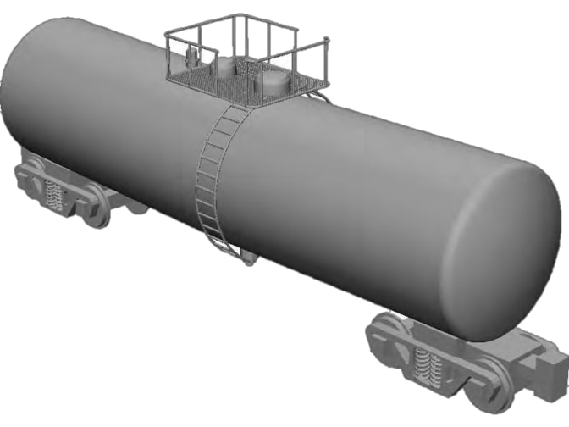
Different Types of Risk
Getting | Hazards | Hazards from | Risk | Hazard & Risk | Final
Started | Identification | Human Error | Analysis | – Case Studies | Thoughts
CASE 2 - Risk of harm from a repeated or planned activity
to a broad population.
Example – Unloading a rail tank car
A company transforms the risks of repeated
activities from a broad population to their cohort
of operators – it is important to note that a company will not assess risk for a specific operator.
Hazard – Unloading a rail tank car
Event – Ignition of spilled chemical
Cause – Human error when uncoupling hoses
Consequence – 3rd degree burn to an operator
Risk = 1 in 100 chance per year an operator gets a 3rd degree burn

Slide 24
Different Types of Risk
Getting | Hazards | Hazards from | Risk | Hazard & Risk | Final
Started | Identification | Human Error | Analysis | – Case Studies | Thoughts
Example – Unloading a rail tank car
Let’s break down how we arrived at the risk.
Unloading rail tank car = 1000/year
Probability of human error when uncoupling
hoses such that some chemical is released = 1 in 1000 opportunities
Probability that a significant amount is spilled = 1 in 10
Probability of some ignition source = 1 in 10
Probability of people being present = 1 (i.e. everytime)
Probability of not escaping a fire once ignited = 1
Expected consequence = 3rd degree burns if exposed to fire
Risk of 3rd degree burns to any operator unloading rail tank cars
= frequency x consequence
= 1000/yr x (1/1000) x (1/10) x (1/10) x 1 x 1
= 0.01 per year or once every 100 years

Slide 25
Different Types of Risk
Getting | Hazards | Hazards from | Risk | Hazard & Risk | Final
Started | Identification | Human Error | Analysis | – Case Studies | Thoughts
CASE 3 - Risk of harm from random failure events.
Random failure events can be from driving a car.
In Ontario, there are 2000 deaths per year due to car accidents.
Again we evaluate the occurrence of these events over a
standardised period - per year.
Risk [death annually per car accident in Ontario] =
frequency [car accidents per year]
* consequence [deaths per car accidents]
Units: Risk - consequence/ year Frequency – events/ year Consequence – consequence/ event

Slide 26
Risk: Jaywalking – Individual vs. Decision Maker
Getting | Hazards | Hazards from | Risk | Hazard & Risk | Final
Started | Identification | Human Error | Analysis | – Case Studies | Thoughts
Toronto Star

Slide 27
Concerns about Hazards - Points of View
Getting | Hazards | Hazards from | Risk | Hazard & Risk | Final
Started | Identification | Human Error | Analysis | – Case Studies | Thoughts
Individual Receptor
Consequence – What can happen to me as a result of an undesirable event?
  Could I die? Could I get injured? Could I be inconvenienced?
  Could my property be damaged? What would be level and type of problem damage, income loss and cost of the repairs?
Likelihood – What are the chances?
  That I could die? That I could get injured? That I could be inconvenienced?
  That my property could be damaged?
Risk – Measurement of the combined importance of the consequences and likelihood of those consequences.
– This will be used to make judgements of about the acceptability of the
individual risk.

Slide 28
Concerns about Hazards - Points of View
Getting | Hazards | Hazards from | Risk | Hazard & Risk | Final
Started | Identification | Human Error | Analysis | – Case Studies | Thoughts
Safety Decision Maker - Societal or Aggregate View
Consequence – What can happen to the individual receptors
exposed to the risk source?
  Could anyone die, get injured, be inconvenienced? How many?
  Could there be any property damage or production loss?
  Could there be any environmental damage? How much?
Likelihood – What are the chances?
  That anyone could die, get injured, be inconvenienced?
  That any property could be damaged?
  That there will be any environmental damage?
Risk – Measurement of the combined importance of the consequences and likelihood of those consequences.
– This will be used to make judgements of about the acceptability of the
societal risk.

Slide 29
Concept Definitions
Getting | Hazards | Hazards from | Risk | Hazard & Risk | Final
Started | Identification | Human Error | Analysis | – Case Studies | Thoughts
Risk Analysis– The development of a quantitative risk estimate based on an engineering evaluation of incident consequences and frequency.

Slide 30
Risk Analysis: Plane Crash
Getting | Hazards | Hazards from | Risk | Hazard & Risk | Final
Started | Identification | Human Error | Analysis | – Case Studies | Thoughts
Societal Risk (fatality) = Number of fatalities per incidents
x Number of incidents per year
Societal Risk (financial) = Cost per incidents
x Number of incidents per year

Slide 31
Getting | Hazards | Hazards from | Risk | Hazard & Risk | Final
Started | Identification | Human Error | Analysis | – Case Studies | Thoughts
Concept Definitions
Safety – Relative protection from the exposure to hazards that lead to severe and sudden outcomes. Safety is a measure and is achieved if risk are judged to be acceptable.
People are not completely logical when it comes to analysing risk
versus the cost of safety.

Slide 32

Getting | Hazards | Hazards from | Risk | Hazard & Risk | Final
Started | Identification | Human Error | Analysis | – Case Studies | Thoughts
Health – Relative protection from the exposure to hazards that lead to illness or disease. This measure deals with adverse reactions to exposure over prolonged periods to hazards that are usually less severe but still dangerous.

Slide 33
Types of Acceptable Risk
Getting | Hazards | Hazards from | Risk | Hazard & Risk | Final
Started | Identification | Human Error | Analysis | – Case Studies | Thoughts
Voluntary Risk vs.
Mountain Climber
Involuntary Risk
Assembly Line Worker
Commercial Flight
Societal Risk
Plane Flight
Driving
Individual Risk
Motorcycle Crash
vs.
Each person has a level of individual and voluntary risk they will tolerate for their own safety. However, when considering involuntary and societal risk, we must accept a standardised level of risk.

Slide 34
Acceptable Risk Criteria
Getting | Hazards | Hazards from | Risk | Hazard & Risk | Final
Started | Identification | Human Error | Analysis | – Case Studies | Thoughts
In Canada, there is no specific legislative number criterion for protecting workers or the public. The Canadian Society of Chemical Engineers suggested acceptable risk criteria for land use planning when considering process hazards from a processing facility.
The United Kingdom and the Netherlands are the only countries to have specific risk criteria for protecting the public regarding land use planning. HOWEVER, no specific number criteria for protecting workers exists.

Slide 35
Acceptable Risk Criteria
Getting | Hazards | Hazards from | Risk | Hazard & Risk | Final
Started | Identification | Human Error | Analysis | – Case Studies | Thoughts
Given the lack of national standards for worker’s acceptable risk criteria, each company establishes their own specific risk acceptability criteria.
A company will set their acceptable risk criteria relative to other risks that society has already accepted (i.e. benchmark) such as the risk of death from driving to work, risk death from a fire at home.
Criteria will hopefully be influenced by employees, peers, society and government – if the company’s standards are not adequate, someone will eventually tell them.

Slide 36


What is Acceptable Risk?
Getting | Hazards | Hazards from | Risk | Hazard & Risk | Final
Started | Identification | Human Error | Analysis | – Case Studies | Thoughts
Judgement Zone
Risk
De Minimus
De Maximis
A risk that is too small to generate concern
A risk that is too large and generates concern
ACCEPTABLE RISK
1 x 10⁻⁶
deaths/year in a
community
UNACCEPTABLE RISK
1 x 10⁻³
deaths/year in a
community
36

Slide 37
What is Acceptable Risk?
Getting | Hazards | Hazards from | Risk | Hazard & Risk | Final
Started | Identification | Human Error | Analysis | – Case Studies | Thoughts
Judgement Zone
Risk
De Minimus
De Maximis
A risk that is too small to generate concern
A risk that is too large and generates concern
Toronto’s Population = 3 million
Deaths per
<3
>3000
Unacceptable
year
Acceptable

Slide 38
Acceptable Risk: Car Accidents
Getting | Hazards | Hazards from | Risk | Hazard & Risk | Final
Started | Identification | Human Error | Analysis | – Case Studies | Thoughts
In 2010, there were 2,000 car accidents with 2227 victims.
The Canada-wide risk can be determined by accounting for the population of the nation (34 million)
ʹʹʹ͹ ݂𝑎ݐ𝑎݈𝑖ݐ𝑖݁ݏ ݌݁ݎ ݕ݁𝑎ݎ
𝐶𝑎݊𝑎݀𝑎 − ݓ𝑖݀݁ 𝑅𝑖ݏ݇ =
͵Ͷ ݉𝑖݈݈𝑖݋݊ ݌݋݌ݑ݈𝑎ݐ𝑖݋݊
= ͸ͷ ݔ ͳͲ⁻⁶ ݀݁𝑎ݐℎݏ ݌݁ݎ ݕ݁𝑎ݎ
ACCEPTABLE RISK ON A PER PERSON BASIS

Slide 39
Acceptable Risk: Ontario Workplace Injuries
Getting | Hazards | Hazards from | Risk | Hazard & Risk | Final
Started | Identification | Human Error | Analysis | – Case Studies | Thoughts
In 2010, there were 184,099 people injured such that they could
not go to work the next day.
There were 6.82 million workers in Ontario in 2010. Ontario Injury Risk = 3 injures per year per 100 workers Is this acceptable?

Slide 40
Who is responsible for risk?
Getting | Hazards | Hazards from | Risk | Hazard & Risk | Final
Started | Identification | Human Error | Analysis | – Case Studies | Thoughts
The stakeholders responsible for identifying and managing risk include:
Employers
Employees
Government and other regulatory authorities
Compensation and insurance provides
The public
In an organization, occupational health and safety involves everyone, from the chief executive officer to the worker. Employees and employers often are jointly responsible for occupational health and safety and employers are accountable for non-compliance.

Slide 41
Why bother with identifying hazards and risks?
Getting | Hazards | Hazards from | Risk | Hazard & Risk | Final
Started | Identification | Human Error | Analysis | – Case Studies | Thoughts
Economics
Legality
Morality
Corporate image
Employee and employer well-being
Liability
Insurance
Professional Ethics
Good corporate moral
Employee recruitment

Slide 42
Why bother with identifying hazards and risks?
Morality
Getting | Hazards | Hazards from | Risk | Hazard & Risk | Final
Started | Identification | Human Error | Analysis | – Case Studies | Thoughts
It is generally accepted that employers have moral responsibility their employees in providing a safe working environment
Economics
The indirect and direct economic costs of workplace accidents and illnesses are significant. Costs can be associated with the time lost from work, human pain and suffering, and the subsequent loss of moral and decline in worker efficiency and productivity.

Slide 43
Why bother with identifying hazards and risks?
Legality
Getting | Hazards | Hazards from | Risk | Hazard & Risk | Final
Started | Identification | Human Error | Analysis | – Case Studies | Thoughts
Governmental legislation on occupation health and safety provides workers with the right to a safe work environment. In protecting workers, employers must exercise due diligence. For example, employers must take reasonable precautions appropriate for the circumstances. There are significant legal penalties for violating health and safety legislation; they can civil lawsuits and criminal prosecutions.

Slide 44
Getting | Hazards | Hazards from | Risk | Hazard & Risk | Final
Started | Identification | Human Error | Analysis | – Case Studies | Thoughts
Checkpoint
This is a condition:
Health
Safety
Risk
Hazard
Answer: D

Slide 45
Getting | Hazards | Hazards from | Risk | Hazard & Risk | Final
Started | Identification | Human Error | Analysis | – Case Studies | Thoughts
Checkpoint
This is considered to be an acceptable level of risk for societal or voluntary activities:
1 in 10,000 deaths
1 in 100,000 deaths
1 in 1,000,000 deaths
D. 1 in 10,000,000 deaths
Answer: C

Slide 46
Getting | Hazards | Hazards from | Risk | Hazard & Risk | Final
Started | Identification | Human Error | Analysis | – Case Studies | Thoughts
Checkpoint
This is the unit of risk analysis:
Cost per event
Fatalities per event
Fatalities per year
Extent of Injury per event
Answer: C

Slide 47
Getting | Hazards | Hazards from | Risk | Hazard & Risk | Final
Started | Identification | Human Error | Analysis | – Case Studies | Thoughts
Checkpoint
Which of the following is a reason for a company to be interested in workplace safety?
Employee and employer well-being
Insurance
Corporate Image
Economics
All of the above
Answer: E

Slide 48
Getting | Hazards | Hazards from | Risk | Hazard & Risk | Final
Started | Identification | Human Error | Analysis | – Case Studies | Thoughts
Checkpoint
Which of the following is a reason for a company to be interested in workplace safety?
Employee and employer well-being
Insurance
Corporate Image
Economics
All of the above
Answer: E

Slide 49



























How do all these concepts fit together?
Getting | Hazards | Hazards from | Risk | Hazard & Risk | Final
Started | Identification | Human Error | Analysis | – Case Studies | Thoughts
Risks
Risk Assessment
Safety
Health
Stakeholders
Frequency
Risk Acceptability
Consequence
49

Slide 50











Hazard and Risk Framework
Getting | Hazards | Hazards from | Risk | Hazard & Risk | Final
Started | Identification | Human Error | Analysis | – Case Studies | Thoughts
System Definition
Risk Assessment
Risk Analysis
Hazard Identification
Consequence Analysis
Frequency Analysis
Stakeholder
Participation
Risk Estimation
Risk Acceptability
50

Slide 51
Hazard and Risk Framework
Getting | Hazards | Hazards from | Risk | Hazard & Risk | Final
Started | Identification | Human Error | Analysis | – Case Studies | Thoughts
System Definition
Risk Assessment
Risk Analysis
Hazard Identification
Consequence Analysis
Frequency Analysis
Stakeholder
Participation
Risk Estimation
Risk Acceptability
51

Slide 52
Hazard and Risk Framework
Getting | Hazards | Hazards from | Risk | Hazard & Risk | Final
Started | Identification | Human Error | Analysis | – Case Studies | Thoughts
System Definition
Risk Assessment
Risk Analysis
Hazard Identification
Consequence Analysis
Frequency Analysis
Stakeholder
Participation
Risk Estimation
Risk Acceptability
52

Slide 53

Hazard Identification
Getting | Hazards | Hazards from | Risk | Hazard & Risk | Final
Started | Identification | Human Error | Analysis | – Case Studies | Thoughts
Hazard identification is conducted with a aim of understanding the intrinsic hazards associated with any given situation and their potential to cause damage.
Identify intrinsic hazards
Think through hazard event scenarios
Recognise the consequences of these hazard
event scenarios and their severity
53

Slide 54
Let’s get the hazard terminology right
Getting | Hazards | Hazards from | Risk | Hazard & Risk | Final
Started | Identification | Human Error | Analysis | – Case Studies | Thoughts
Identified Intrinsic Hazards
Undesirable Hazardous Event
Hazard
Effects
Storage tank with flammable material
Spill resulting in an explosion and fire
Thermal radiation and explosion overpressure
Fires produce thermal radiation flux and explosions produce overpressure as well as projectiles. It is these conditions that can result in harm to people and property. It is important to be able to distinguish the events and effects of a hazard.
54

Slide 55
Where do we find hazards?
Getting | Hazards | Hazards from | Risk | Hazard & Risk | Final
Started | Identification | Human Error | Analysis | – Case Studies | Thoughts
Hazards are often related to energy, most often potential energies.
Kinetic Energy
  Involved with moving equipment
  Momentum is proportional to velocity squared. Equipment moving with higher speeds pose greater consequence. A car moving collision at a high speed will cause more damage.
  Machine guards are good safeguards to keep people away from equipment with moving parts.
Potential Energy
  Associated with changes in elevation (a box placed on a high shelf ) or pressure (a vacuum system).
  Pipeline are typically elevated in chemical facilities which places liquids
in tanks and vessels 5 – 20 m above ground.
55

Slide 56
Where do we find hazards?
Getting | Hazards | Hazards from | Risk | Hazard & Risk | Final
Started | Identification | Human Error | Analysis | – Case Studies | Thoughts
Hazards are often related to energy, which can also include:
Heat
  Released from chemical reactions – unreacted molecules are a source of potential energy, when reacted heat is released.
  Hot surfaces can initiate fires and explosions which can cause severe
burn.
Electricity
  Hazards can result from electric shock, arcing incidents or electrical
fires
  Shocks are the most common and may occur through direct contact of an energised conductor or contacting two points at different electrical potentials. Shock can cause fatalities.
56

Slide 57



Hazards on different scales
Getting | Hazards | Hazards from | Risk | Hazard & Risk | Final
Started | Identification | Human Error | Analysis | – Case Studies | Thoughts
Individual
Workers
Facility
Community
57

Slide 58

Hazards on different scales
Getting | Hazards | Hazards from | Risk | Hazard & Risk | Final
Started | Identification | Human Error | Analysis | – Case Studies | Thoughts
Individual
Workers
Facility
Community
58

Slide 59














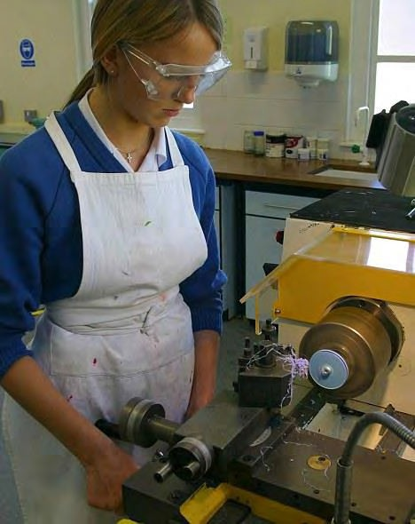


University Lab Injuries
Injuries that can involve you
Michele Dufault, a final year Yale undergrad student, died when her hair got caught in a lathe when working alone in the Chemistry workshop at 2:30am.

Slide 60

Hazards on different scales
Getting | Hazards | Hazards from | Risk | Hazard & Risk | Final
Started | Identification | Human Error | Analysis | – Case Studies | Thoughts
Individual
Workers
Facility
Community
60

Slide 61
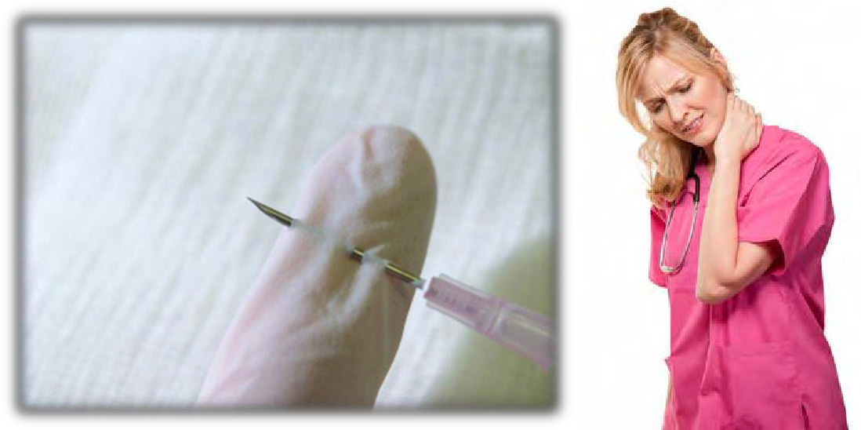


Health Care Industry
Worker Injuries
Healthcare workers have the greatest risk of workplace injuries and mental health problems than any other occupational group.
Back injuries are the biggest worker injury issue
3.7 injuries per 100 full time employees

Slide 62
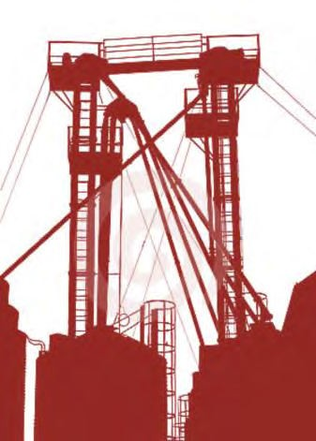
Hazards on different scales
Getting | Hazards | Hazards from | Risk | Hazard & Risk | Final
Started | Identification | Human Error | Analysis | – Case Studies | Thoughts
Individual
Workers
Facility
Community
62

Slide 63
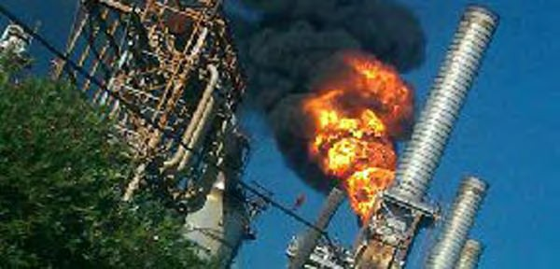
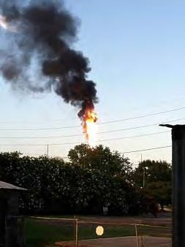

Norco, Louisiana
1988 – Shell Oil Refinery Explosion
Reuters
La bucket brigade
Resulted from an equipment failure
Large releases of benzene, hydrogen sulphide, butadiene
7 deaths, 42 injuries and $400 million in damages

Slide 64

Hazards on different scales
Getting | Hazards | Hazards from | Risk | Hazard & Risk | Final
Started | Identification | Human Error | Analysis | – Case Studies | Thoughts
Individual
Workers
Facility
Community
64

Slide 65
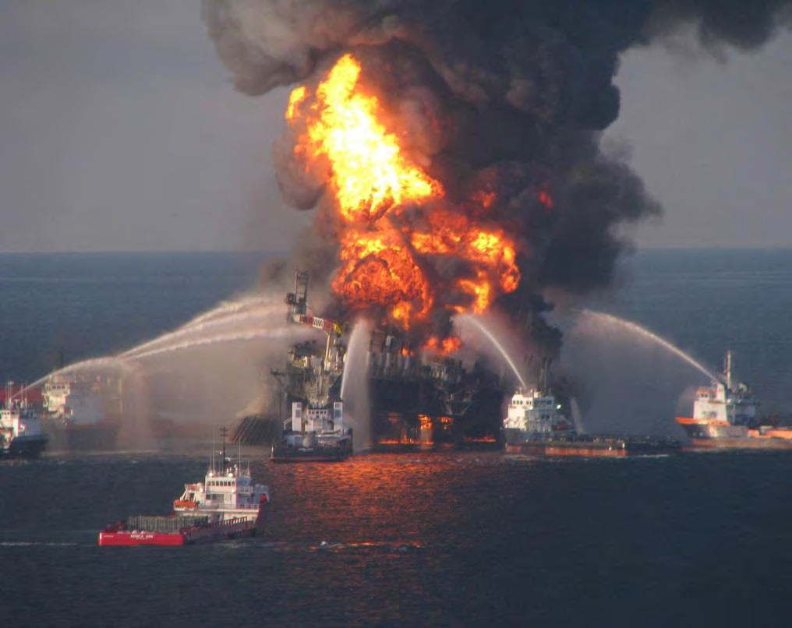
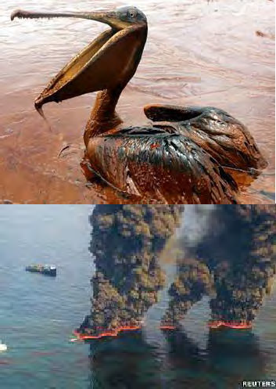
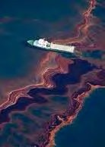
Gulf of Mexico, US
2010 – BP Deepwater Horizon Oil Rig Spill
Getting | Hazards | Hazards from | Risk | Hazard & Risk | Final
Started | Identification | Human Error | Analysis | – Case Studies | Thoughts
BBC
The Guardian BBC
PR Web
High pressure methane gas explosion
4.9 millions of barrels of oil spilled in gulf (780,000 m³)
11 deaths, significant injury and deaths in wildlife population
65

Slide 66
Hazard Identification
Getting | Hazards | Hazards from | Risk | Hazard & Risk | Final
Started | Identification | Human Error | Analysis | – Case Studies | Thoughts
Start to looking for energy sources or release mechanisms.
Energy Sources
Leak from a flammable gas vessel into the air can create an ignitable mixture.
This hazard can be minimised by using proper construction materials,
regular leak testing and installing explosion proof electrical connections.
These safeguards reduce the risk the likelihood of the hazard but cannot eliminate it.
Release Mechanisms
Large reactors and vessels can be major problems given the volume of material stored.
As tank size increases, surface area to volume ratios decrease. The ability for tanks to release heat is proportional to the surface area (d²) and the energy content is proportional to the volume (d³).
66

Slide 67

Hazard Identification – Primary Tools
Getting | Hazards | Hazards from | Risk | Hazard & Risk | Final
Started | Identification | Human Error | Analysis | – Case Studies | Thoughts
Common Sense
Open mind
Good understanding of physics, chemistry and thermodynamics
Experience – first hand or access to historical data
Process Hazard Analysis
Screening Level
Checklist
What-if
Failure Modes and Effects Analysis (FMEA)
Hazard and Operability Study (HAZOP)
Qualitative Techniques
All techniques seek to understand the physical components of the system, the operation and the factors influencing failure frequency.
67

Slide 68
Getting | Hazards | Hazards from | Risk | Hazard & Risk | Final
Started | Identification | Human Error | Analysis | – Case Studies | Thoughts
Process Hazard Analysis techniques present a pro-active and systematic approach for the identification, mitigation or prevention of hazards from a process, materials, equipment or human error.
68

Slide 69
The purpose of Process Hazard Analysis :
Getting | Hazards | Hazards from | Risk | Hazard & Risk | Final
Started | Identification | Human Error | Analysis | – Case Studies | Thoughts
Determine the location of the potential safety problem
Prevent or mitigate the improvement of safety measures of a problem
Pre-plan emergency actions that should be taken if the safety controls
fail
Process Hazard Analysis methods address:
Any hazards in an process
Previous incidents which could have resulted in catastrophic outcomes
Engineering controls that can be used to prevent or mitigate hazards
Consequences of hazards
Human factors that could cause hazards
69

Slide 70
Process Hazard Analysis can miss some hazards…
Getting | Hazards | Hazards from | Risk | Hazard & Risk | Final
Started | Identification | Human Error | Analysis | – Case Studies | Thoughts
No method is capable of identifying all hazards in a system
It is feasible for a hazard to be excluded from the scope if the
engineering team is unaware of a hazard event scenario
It is essential that the team seriously consider all hazard event
scenarios
70

Slide 71
Hazard Identification – So many techniques,
which one to choose?
Getting | Hazards | Hazards from | Risk | Hazard & Risk | Final
Started | Identification | Human Error | Analysis | – Case Studies | Thoughts
Selecting a hazard identification technique is typically influenced
by the following factors:
Motivation
Type of result needed
Type of information available to perform the study
Characteristic of the analysis problem
Perceived risk associated with the subject process or activity
Resource availability and preference of the analyst
71

Slide 72







Hazard Identification – Common Technique Application
Getting | Hazards | Hazards from | Risk | Hazard & Risk | Final
Started | Identification | Human Error | Analysis | – Case Studies | Thoughts
Research & Development Conceptual Design
Pilot Plant Operation
Detailed Engineering Construction Routine Operation Plant Expansion or
Modification
Incident Investigation
Decommissioning
72

Slide 73
Hazard Identification – Qualitative Techniques
Getting | Hazards | Hazards from | Risk | Hazard & Risk | Final
Started | Identification | Human Error | Analysis | – Case Studies | Thoughts
Screening Level is the recommended starting point to through evaluation of all significant hazards
This screening level technique should be immediately followed by more detailed analysis for identified hazards that warrant further examination.
When all significant potential undesirable events are identified then their consequence and frequency will be investigated.
Risk evaluation then produces a risk ranking list which allows management to set priorities and define alternative risk control measures.
73

Slide 74
Hazard Identification – Moving beyond
Screening Level
Getting | Hazards | Hazards from | Risk | Hazard & Risk | Final
Started | Identification | Human Error | Analysis | – Case Studies | Thoughts
Once a Screen Level is complete then other more detailed methods can be applied
Hazard and Operability Study (HAZOP) is recommended as the second analysis stage of process systems
Failure Modes and Effects Analysis (FMEA) is recommended for the second, more detailed qualitative analysis complex equipment or machinery.
Letǯs now discuss each of the qualitative hazard
identification methods in more detail.
74

Slide 75
Getting | Hazards | Hazards from | Risk | Hazard & Risk | Final
Started | Identification | Human Error | Analysis | – Case Studies | Thoughts
Screening Level Checklist What-if FMEA
Screening Level For Hazard and Risks Identification
HAZOP
Focus on identifying major hazards that could lead to severe
consequences.
This technique can be applied to:
  Existing permanent and temporary processes, equipment and machinery during the implementation phase of a Process Safety/ Risk Management Programme
  New facilities during their conceptual design and detailed engineering phases
  Major modification to existing facilities
75

Slide 76
Getting | Hazards | Hazards from | Risk | Hazard & Risk | Final
Started | Identification | Human Error | Analysis | – Case Studies | Thoughts
Screening Level
Checklist
What-if
FMEA
HAZOP
This PHA technique…
Uses a process-focused protocol to identify potential undesirable events
Relies on participation of front-line personnel through physical
inspections
Weǯll now walk through the individual
steps of performing screen level.
76

Slide 77
Getting | Hazards | Hazards from | Risk | Hazard & Risk | Final
Started | Identification | Human Error | Analysis | – Case Studies | Thoughts
Screening Level Checklist What-if
Overview of the Procedure
FMEA
HAZOP
Collect and review information about the facility
Divide the facility into process sections
Compile a list of intrinsic hazards for each process section (ie. chemical, equipment and external events).
Identify hazardous events in each process section
Evaluate the potential causes.
77

Slide 78
Getting | Hazards | Hazards from | Risk | Hazard & Risk | Final
Started | Identification | Human Error | Analysis | – Case Studies | Thoughts
Screening Level
Checklist
What-if
FMEA
HAZOP
STEP 1
Collect general information about the engineering facility:
Facility plan, equipment layout, map, transportation routes
Equipment and process descriptions
Chemicals handled
Spill containment and emergency response systems
Environmental, occupational health and safety, process safety, loss control quality management systems
Incident history
78

Slide 79
Getting | Hazards | Hazards from | Risk | Hazard & Risk | Final
Started | Identification | Human Error | Analysis | – Case Studies | Thoughts
Screening Level
Checklist
What-if
FMEA
HAZOP
STEP 2
Divide the facility into process sections. This will enable consideration of the all process areas, auxiliary services including transportation and distribution facilities.
Let’s consider an example of process sections at a product
distribution business:
At the company site External to the company site
Storage
Loading
Electrical supply
Wastewater treatment system
Firewater protection system
Shops building
Fuel depot
Rail transport
Truck transport
Marine transport
Distribution terminals
Customer sites
79

Slide 80
Getting | Hazards | Hazards from | Risk | Hazard & Risk | Final
Started | Identification | Human Error | Analysis | – Case Studies | Thoughts
Screening Level
Checklist
What-if
FMEA
HAZOP
STEP 3
List potential inherently hazardous items for each process section. Ask
yourself what can go wrong?
Equipment
Chemicals
Electrical systems
Facilityǯs building structure
This information can be collected by interviewing operators and engineer designers, reviewing previous hazard studies and by inspecting each of the process sections.
80

Slide 81
Getting | Hazards | Hazards from | Risk | Hazard & Risk | Final
Started | Identification | Human Error | Analysis | – Case Studies | Thoughts
Screening Level
Checklist
What-if
FMEA
HAZOP
Hazard identification in a screening level involves
consideration of:
The hazards of each process section
Previous hazardous incidents
Engineering and administrative controls
The consequences of engineering and administrative control
failure
Human failure
Maintenance programmes
Process safety, safety and loss control programmes
81

Slide 82
There are some helpful tools for identifying hazards associated with each process section:
Getting | Hazards | Hazards from | Risk | Hazard & Risk | Final
Started | Identification | Human Error | Analysis | – Case Studies | Thoughts
Screening Level Checklist What-if FMEA HAZOP
HazMat checklist – properties of the chemical and material
hazards
Compatibility matrix – consequences of interaction between chemical or materials
Equipment Hazard checklist – overview of potential
operating failures
External Initiating Factors checklist – events induced by adjacent facilities or natural causes
82

Slide 83
Getting | Hazards | Hazards from | Risk | Hazard & Risk | Final
Started | Identification | Human Error | Analysis | – Case Studies | Thoughts
Screening Level Checklist What-if FMEA HAZOP
A HazMat checklist is a useful tool for rigorously understanding the
hazards and potential consequences of materials.
Company: | Participants: | By:
Location:
Date: Hazard Review Section:
Materials, Chemicals or Components | Physical State (Liquid, solid, powders) | Quantity (Throughput or inventory) | Operating Pressure | Operating Temperature | Compressed or Liquefied Gas | Fire | Explosion | Oxidiser | Corrosive | Reactive | Radiation | Air or Water Pollutants | Smells/Fumes | Toxic – Acute /Chronic | Detonation | Ground Contaminant
83

Slide 84
Getting | Hazards | Hazards from | Risk | Hazard & Risk | Final
Started | Identification | Human Error | Analysis | – Case Studies | Thoughts
Screening Level Checklist What-if FMEA HAZOP
It is also useful to consider how materials in each process section will interact. A compatibility matrix is a useful tool.
 | Chemical 1 | Chemical 2 | Chemical 3 | Chemical 4 | Chemical 5 | Chemical 6 | Chemical 7 | Chemical 8 | Chemical 9 | Chemical 10
Chemical 1
Chemical 2
Chemical 3
Chemical 4
Chemical 5
Chemical 6
Chemical 7
Chemical 8
Chemical 9
Chemical 10
84

Slide 85
Getting | Hazards | Hazards from | Risk | Hazard & Risk | Final
Started | Identification | Human Error | Analysis | – Case Studies | Thoughts
Screening Level Checklist What-if FMEA HAZOP
An Equipment Hazard checklist is a useful tool for rigorously understanding the hazards and significant losses associated with equipment in each section.
Company: | Participants: | By:
Date:
Location: Hazard Review Section:
Equipment or Workspace | Stationary or Mobile | Operating Pressure | Mechanical Energy | Pressurised Systems | Heat | Extreme Cold | Electrical Energy | Impact/ Collision | Falling/ Flying Objects | Radioactive | Confined Space | Noise | Sharps | Seismic | Rock/ Mud Flow | Capital Value >$500k | Production Value >25%
85

Slide 86
Getting | Hazards | Hazards from | Risk | Hazard & Risk | Final
Started | Identification | Human Error | Analysis | – Case Studies | Thoughts
Screening Level Checklist What-if FMEA HAZOP
An External Initiating Factors checklist is a useful for understanding hazards from adjacent facilities or environments in additional to natural events.
Company: | Participants: | By: | Date:
Location: | Hazard Review Section:
Process Area | Geotechnical Events |  |  |  |  |  |  | Other External Events |  |  |  |  |  |  |  | Operating Events
 | Seismic Activity | Avalanche/ Landslide | Soil Shrinkage/ Consolidation | Erosion | Waves | Flows and Drainage | Containment (normal, surge) | Drought | Flooding/ Rain/ Snow Melt | Extreme Cold/ Ice Cover | Extreme Heat | Extreme Winds | Fog | Forest Fire | Hail | Internal Flooding | Maintenance Activity | Construction | Sabotage/ Vandalism | Night Work | Power Failure
86

Slide 87
Getting | Hazards | Hazards from | Risk | Hazard & Risk | Final
Started | Identification | Human Error | Analysis | – Case Studies | Thoughts
Screening Level
Checklist
What-if
FMEA
HAZOP
STEP 4
Pair each inherent hazard (chemical, material, equipment, initiating factor) with an action to develop a list of hazardous events.
Release
Fire
Exposure
Failure
87

Slide 88
Getting | Hazards | Hazards from | Risk | Hazard & Risk | Final
Started | Identification | Human Error | Analysis | – Case Studies | Thoughts
Screening Level Checklist What-if FMEA HAZOP
Here is an example of a selection of hazardous event list for a
chemical plant:
Process Section | Hazardous Event
Natural Gas Supply | Jet Flame
Process Steam Supply | Boiler Explosion
Feed Gas Preparation | Spent Catalyst Bed
Reformer Unit | Firebox Explosion
Shops Building | Drum Spillage
Fuel Depot | Gasoline Leak from Tanks
Carbon Dioxide Injection System | Liquid Spill
Methanol Separator | Gas Release and Fire
Distillation Section | Pool Fire
Electrical Supply | Pool Fire
Cooling Tower | Carryover Emission
88

Slide 89
Getting | Hazards | Hazards from | Risk | Hazard & Risk | Final
Started | Identification | Human Error | Analysis | – Case Studies | Thoughts
Screening Level
Checklist
What-if
FMEA
HAZOP
STEP 5
List all major potential causes of identified hazardous events. Use checklists to organise the causes into 5 categories:
Open-ended loss of containment – drains, vents, relief valves, etc.
Internal agency – disintegration of rotating machinery, blockage, etc.
External agency – collision, weather, seismic, etc.
Equipment failure while operating within design conditions due to deterioration, faulty maintenance or improper replacement of materials.
Equipment failure by exceeding design limits on pressure, temperature and composition
89

Slide 90
Getting | Hazards | Hazards from | Risk | Hazard & Risk | Final
Started | Identification | Human Error | Analysis | – Case Studies | Thoughts
Screening Level Checklist What-if
Finishing up a Screening Level
FMEA
HAZOP
Develop a scope for a more detailed hazard identification analysis
(i.e. HAZOP).
Identify opportunities for improvement:
  Physical plant (design, maintenance, technology)
  Employee training
  Management systems/ integration
  Emergency response
Assign priorities to improvement opportunities based on the
priority of the risk they are designed to address
Assign responsibility
Follow up
90

Slide 91
Getting | Hazards | Hazards from | Risk | Hazard & Risk | Final
Started | Identification | Human Error | Analysis | – Case Studies | Thoughts
Screening Level
Checklist
What-if
FMEA
HAZOP
Checklists
A checklist is a detailed lists of known intrinsic hazards or hazardous events compiled based on past experience facility design and operation.
Questions are answered with a ǮYesǯ or ǮNoǯ
Hazards are identified through compliance with established
standards
It is essential that checklists be validated for system before use.
91

Slide 92
Getting | Hazards | Hazards from | Risk | Hazard & Risk | Final
Started | Identification | Human Error | Analysis | – Case Studies | Thoughts
Screening Level
Checklist
What-if
FMEA
HAZOP
Checklists
Purpose
Identify hazards
Check compliance with a set of standard procedures
Reviews
Existing systems – tours, inspections, interview
New process – team member review of process drawings
Results
Responses to standard checklist questions
List of hazards and suggested corrective action
92

Slide 93
Getting | Hazards | Hazards from | Risk | Hazard & Risk | Final
Started | Identification | Human Error | Analysis | – Case Studies | Thoughts
Screening Level Checklist What-if FMEA
HAZOP
Categories and Questions
Causes of Accidents
Process equipment, human error, external events
  Is the process equipment properly supported?
  Is equipment properly identified?
  Is the system designed to withstand a tsunami?
Facility Functions
Documentation and training, instrumentation, construction materials, piping, pumps, vessels, control systems, alarms, etc. o Is it possible to distinguish between different alarms?
  Is pressure relief provided?
  Is the vessel free from external corrosion?
  Are sources of ignition controlled?
93

Slide 94
Getting | Hazards | Hazards from | Risk | Hazard & Risk | Final
Started | Identification | Human Error | Analysis | – Case Studies | Thoughts
Screening Level
Checklist
What-if FMEA
Disadvantages
HAZOP
Advantages
Can be used by non- system experts
Capture a wide range of historical experience and knowledge
Ensures common or obvious problems are not overlooked
Limited application to new systems
Inhibits creative thinking about new hazard identification
Overview hazards that have not been previously identified
94

Slide 95
Getting | Hazards | Hazards from | Risk | Hazard & Risk | Final
Started | Identification | Human Error | Analysis | – Case Studies | Thoughts
Screening Level Checklist What-if FMEA
Final details of the Checklist procedure
HAZOP
The simplest process hazard analysis techniques
Provides quick results and communicates information wells
Good way to account for learned lessons
NOT a good method for identifying new or unrecognised hazards
Application requires good knowledge of the system and standard operating procedures
Requires regular updating and auditing
95

Slide 96
Getting | Hazards | Hazards from | Risk | Hazard & Risk | Final
Started | Identification | Human Error | Analysis | – Case Studies | Thoughts
Screening Level
Checklist
What-if
FMEA
HAZOP
What-if analysis
Experienced personnel brainstorm a series of ǮWhat if ǯ
questions.
Each question represents a potential failure or hazard in the facility
If it is possible for a hazard to occur then the safeguards must be evaluated for the severity of the consequence
Examples
Equipment failures – What if … a pump fails?
Human error – What if … an operator fails to clean up a chemical spill?
External events – What if … there is a rapid snow melt?
96

Slide 97
Getting | Hazards | Hazards from | Risk | Hazard & Risk | Final
Started | Identification | Human Error | Analysis | – Case Studies | Thoughts
Screening Level
Checklist
What-if
FMEA
HAZOP
What-if analysis
Purpose
Identify hazards and consequence to develop risk mitigation strategies
Requirements
Process descriptions, drawings and operating procedure
Preliminary list of what-if questions
Analysis Procedure
Go through the system process, starting with the introduction of the feed until the end of the process
Ask Ǯwhat-ifǯ at each process stage
Results
Recommendations on the effects of removing hazards
97

Slide 98
Getting | Hazards | Hazards from | Risk | Hazard & Risk | Final
Started | Identification | Human Error | Analysis | – Case Studies | Thoughts
Screening Level Checklist What-if
Overview of the procedure
FMEA
HAZOP
Collect and review information about the facility
Divide the facility into process sections
Select a question and identify:
  Hazards
  Consequences
  Severity
  Likelihood
  Recommendations
Repeat Steps 4 – 6 until process is complete
98

Slide 99
Getting | Hazards | Hazards from | Risk | Hazard & Risk | Final
Started | Identification | Human Error | Analysis | – Case Studies | Thoughts
Screening Level Checklist What-if FMEA
HAZOP
Here is an example of what-if questions for a plant:
Area | What-if | Hazard and Consequence | Previously Addressed | Safeguard | Recommendations?
Chemical 1 | Connects to the wrong line when loading off truck? | Released into the air - an explosion is possible Gets wet - bacteria will grow and become useless. | No | Lines are sized differently Labelled Colour coded Use a reliable vendor | Vacuum system to remove dust Perform a moisture test
 | Truck’s ignition is on while unloading? | Exhaust fumes – adverse health effects | No | None | Turn engine off Local ventilation system
 | The dust collector fails? | Dust accumulation – adverse health effects | No | None | 1) Place an alarm with lights and horns in the truck unloading area.
99

Slide 100
Getting | Hazards | Hazards from | Risk | Hazard & Risk | Final
Started | Identification | Human Error | Analysis | – Case Studies | Thoughts
Screening Level Checklist What-if FMEA
Final details of the What-if procedure
HAZOP
One of the most commonly used process hazard analysis techniques
One of the least structured techniques
  Applicable to a large range of systems
  The experience of the analyst determines if the technique will be successful
Useful when making a change to a process section
Can be applied to a system at any point in its life cycle
100

Slide 101
Getting | Hazards | Hazards from | Risk | Hazard & Risk | Final
Started | Identification | Human Error | Analysis | – Case Studies | Thoughts
Screening Level Checklist What-if
Failure Modes and Effect Analysis
FMEA
HAZOP
Lists ways equipment can fail and the effect on the system.
Bottom-up analysis
Uses a spreadsheet to detail each hazard, cause, frequency,
consequence and proposed safeguard
101

Slide 102
Getting | Hazards | Hazards from | Risk | Hazard & Risk | Final
Started | Identification | Human Error | Analysis | – Case Studies | Thoughts
Screening Level Checklist What-if
Failure Modes and Effect Analysis
Purpose
FMEA
HAZOP
Assess component failures and the hazards caused
Develop recommendations for better equipment reliability
Requirements
Process descriptions, drawings and operating procedure
Analysis Procedure
Go through the system process, starting with the introduction of the feed
until the end of the process
Complete the FMEA table
Results
Recommendations on safeguards to avoid hazards associated with
equipment failures
102

Slide 103
Getting | Hazards | Hazards from | Risk | Hazard & Risk | Final
Started | Identification | Human Error | Analysis | – Case Studies | Thoughts
Screening Level Checklist What-if
Keywords for FMEA analysis
FMEA
HAZOP
Crack
Rupture
Plugged
Leak
False start or stop
Loss of function
High or low pressure
High or low temperature
Overfilling
Failure to open or close
•
Failure to start or stop
103

Slide 104

Getting | Hazards | Hazards from | Risk | Hazard & Risk | Final
Started | Identification | Human Error | Analysis | – Case Studies | Thoughts
Screening Level
Checklist
What-if
FMEA
HAZOP
What are some point of failures in this chemical system?
Chemical A
Chemical B
PT
PT
Reactor
Storage Tank
104

Slide 105
Getting | Hazards | Hazards from | Risk | Hazard & Risk | Final
Started | Identification | Human Error | Analysis | – Case Studies | Thoughts
Screening Level
Checklist
What-if
FMEA
HAZOP
What are some point of failures in this chemical system?
Chemical A
Chemical B
PT
PT
What are the hazardous events that would arise if this valve failed?
Reactor
Storage Tank
105

Slide 106
Getting | Hazards | Hazards from | Risk | Hazard & Risk | Final
Started | Identification | Human Error | Analysis | – Case Studies | Thoughts
Screening Level Checklist What-if FMEA HAZOP
Here is a FMEA example for valve failure on chemical B:
Date: October 15, 2013 Plant: Chemical Toronto System: Reaction System
Page: 7 of 25 By: Minerva
Item | Identification | Description | Failure Modes | Effects | Safeguards | Actions
3.1 | Valve on the chemical B solution line | Motor- operated and normally open for chemical B service | Fails closed | No flow of chemical B Carryover of chemical A to the storage and released in the enclosed work area | Flow indicator on chemical B line Chemical A detector and alarm | Consider alarm/ shutdown of system for low chemical B flow Consider using a closed storage tank or ensure adequate ventilation of enclosed work area
106

Slide 107
Getting | Hazards | Hazards from | Risk | Hazard & Risk | Final
Started | Identification | Human Error | Analysis | – Case Studies | Thoughts
Screening Level
Checklist
What-if
FMEA
HAZOP
Very structured process hazard analysis technique that
is reliable for evaluating systems
Easy to learn and apply the technique
Can be time-consuming and expensive as the technique doesn’t directly identify process sections where multiple faults could occur
The technique may not identify areas of human error in
process sections
Procedural review is not easy
107

Slide 108
Getting | Hazards | Hazards from | Risk | Hazard & Risk | Final
Started | Identification | Human Error | Analysis | – Case Studies | Thoughts
Screening Level
Checklist
What-if
FMEA
HAZOP
Structured brainstorm using guide words to identify hazards
(health, safety and environmental) and operations in a system.
Purpose
Systematic identification of hazards
Requirements
Process descriptions, drawings and operating procedure
Analysis Procedure
Evaluate deviations from normal operation as potential hazards
Results
Understand hazards and consequences for process sections
Recommendations of safeguards as a protection against the hazards
108

Slide 109
Getting | Hazards | Hazards from | Risk | Hazard & Risk | Final
Started | Identification | Human Error | Analysis | – Case Studies | Thoughts
Screening Level Checklist What-if FMEA
Before going through details of the HAZOP procedure,
let’s review some relevant terminology:
HAZOP
Intentions How the process operations are expected to occur
Hazard Departures from the design intentions
Causes Ways the hazard might occur Consequences Results of the hazard
Safeguards
Provisions for reducing the frequency or decrease the severity of the consequence of the hazard
Actions
Suggestions for the procedural changes, design changes
or further study
109

Slide 110
Getting | Hazards | Hazards from | Risk | Hazard & Risk | Final
Started | Identification | Human Error | Analysis | – Case Studies | Thoughts
Screening Level
Checklist
What-if
FMEA
HAZOP
When performing a HAZOP there are several general hazard
types of you should focus on:
Leak
Rupture
Reaction
Static
Corrosion or Erosion
Relief
Sampling
Testing
Maintenance
Start-up
Shutdown
Service Failure
110

Slide 111












Getting | Hazards | Hazards from | Risk | Hazard & Risk | Final
Started | Identification | Human Error | Analysis | – Case Studies | Thoughts
Screening Level Checklist What-if
Over view of the Procedure
FMEA
HAZOP
Define a system
Explain design intension of the process section
Repeat process sections
Select a process variable
Repeat process for all process variables
Apply guide words to the process variable to develop a meaningful hazard
Repeat process for all guide words
Examine the consequence of the hazard assuming all protection fails
Develop action items
List possible causes of the hazard
Assess acceptability of risk based on consequence, causes and protection
Identify existing safeguards to prevent hazard
111

Slide 112
Getting | Hazards | Hazards from | Risk | Hazard & Risk | Final
Started | Identification | Human Error | Analysis | – Case Studies | Thoughts
Screening Level
Checklist
What-if
FMEA
HAZOP
What is meant by process variables?
Flow
Pressure
Temperature
Level
Time
Composition
pH
Speed
Frequency
Viscosity
Voltage
Mixing
Addition
Separation
Reaction
Be aware not all combinations make sense!
112

Slide 113
Getting | Hazards | Hazards from | Risk | Hazard & Risk | Final
Started | Identification | Human Error | Analysis | – Case Studies | Thoughts
Screening Level
Checklist
What-if
FMEA
HAZOP
HAZOP uses guide words to identify process deviations which
could lead to hazards:
Guide Words | Meaning
No, not | Not doing what was intended
More (high, long, …) Less (low, short, …) | Doing more, or less, of what is intended, quantitative increase or decrease
Part of, As well as | Doing it differently; qualitative decease or increase
Reverse | Doing something else; logical opposite of the intent
Other Than | Doing something else; complete substitution
Guide Word + Process Parameter = Process Deviation
Example: Less Flow No reaction
113

Slide 114
Getting | Hazards | Hazards from | Risk | Hazard & Risk | Final
Started | Identification | Human Error | Analysis | – Case Studies | Thoughts
Screening Level Checklist What-if FMEA HAZOP
Example of hazards resulting from process deviations
Chemical A
Chemical B
Process Variables
Flow, Temperature, Pressure
PT
PT
Guideword + Process Variable Combinations
No Flow of Chemical A
= No reaction
High Temperature in reactor
= degradation of product
Low pressure in storage tank
= flow out of reactor accelerated
Reactor
Storage Tank
114

Slide 115
Getting | Hazards | Hazards from | Risk | Hazard & Risk | Final
Started | Identification | Human Error | Analysis | – Case Studies | Thoughts
Screening Level Checklist What-if FMEA
This technique makes some inherent
assumptions…
HAZOP
Hazards are detectable with careful review
Engineering facilities are designed and operated to appropriate standards
Hazards can be controlled by a combination of equipment, procedures
This technique is conducted with openness and good faith by
competent analysts
115

Slide 116
Getting | Hazards | Hazards from | Risk | Hazard & Risk | Final
Started | Identification | Human Error | Analysis | – Case Studies | Thoughts
Screening Level
Checklist
What-if
FMEA
HAZOP
This identification procedure has
limitations:
Requires a well-defined system
It is time consuming
Provides no numeric ranking of hazards
Requires trained personnel to conduct
Focuses on one-event failures
116

Slide 117
Getting | Hazards | Hazards from | Risk | Hazard & Risk | Final
Started | Identification | Human Error | Analysis | – Case Studies | Thoughts
Screening Level
Checklist
What-if FMEA
Disadvantages
HAZOP
Advantages
Creative and open-ended
Rigorous and structured
procedure
Very versatile
Identifies both safety and
operational hazards
Can be time-consuming
Critical that experienced analysts are involved in the process
No distinction between low and high probability and consequence hazards
The aim of a HAZOP is to identify the cause of the process deviation which could lead to hazards.
117

Slide 118
Getting | Hazards | Hazards from | Risk | Hazard & Risk | Final
Started | Identification | Human Error | Analysis | – Case Studies | Thoughts
Screening Level Checklist What-if FMEA HAZOP
Summary of Hazard Identification Techniques
What are the end products?
A list of intrinsic hazards
A list of hazardous events and existing/ potential prevent/mitigation strategies:
  Event scenarios
  Their potential causes
  Existing safeguards
  Possible additional safeguards
A list of potential consequences and their frequency
  Low chance of burn injuries or death,
  Moderate change of damage to process equipment,
o
Low change of injury or death from toxic gas inhalation
118

Slide 119
Getting | Hazards | Hazards from | Risk | Hazard & Risk | Final
Started | Identification | Human Error | Analysis | – Case Studies | Thoughts
Screening Level Checklist What-if FMEA HAZOP
Summary of Hazard Identification Techniques
How are these techniques conducted?
Checklists are often completed by a knowledgeable individual
such as a design engineer.
What-if, FMEA and HAZOP hazard reviews are done in teams involvement at minimum a facilitator, design engineer and representatives from the operations team (engineer, coordinator).
It is always a good idea to review the results of any hazard review with representatives from the operations team and/or asset
owners.
119

Slide 120
Getting
Started
Hazards
Identification
Hazards from
Human Error
Risk
Analysis
Hazard & Risk
– Case Studies
Final
Thoughts
Checkpoint
Process Hazard Analysis presents
techniques what purpose:
Identification of hazards
Mitigation of hazards
Prevention of hazards
A , B and C
A and C
Answer: D

Slide 121
Getting
Started
Hazards
Identification
Hazards from
Human Error
Risk
Analysis
Hazard & Risk
– Case Studies
Final
Thoughts
Checkpoint
Process Hazard Analysis should be
conducted in parallel with:
Common sense
An open mind
A good understanding of physics, chemistry
and thermodynamics
All of the above
None of the above
Answer: D

Slide 122
Getting
Started
Hazards
Identification
Hazards from
Human Error
Risk
Analysis
Hazard & Risk
– Case Studies
Final
Thoughts
Checkpoint
For routine plant operation, which Process
Hazard Analysis tool is the best to use?
Screening Level followed by FMEA
Checklist followed by HAZOP
Checklist and What-if
Screening Level, What-if or HAZOP
Screening Level, Checklist, What-if, FMEA or HAZOP
Answer: E

Slide 123
Getting
Started
Hazards
Identification
Hazards from
Human Error
Risk
Analysis
Hazard & Risk
– Case Studies
Final
Thoughts
Checkpoint
Which of the follow is false about checklists
as a hazard identification technique?
The method is applicable to new systems
It is possible to capture a range of historical
system knowledge
Ensures that common problems are not overlooked
New users are able to use the approach
Answer: A

Slide 124
Getting
Started
Hazards
Identification
Hazards from
Human Error
Risk
Analysis
Hazard & Risk
– Case Studies
Final
Thoughts
Checkpoint
Which best describes a failure modes and
effect analysis approach?
Bottom-up analysis
Top-down analysis
Answer: A

Slide 125
Hazards caused by Human Error
Getting | Hazards | Hazards from | Risk | Hazard & Risk | Final
Started | Identification | Human Error | Analysis | – Case Studies | Thoughts
Materials, equipment and electrical components in a process can be attributed to hazards. However, human factors can also cause errors which lead to hazardous events.
What causes workplace injuries?
4% are due to unsafe work conditions
96% result from unsafe worker actions
Unsafe behaviours are often repeated when observed as being
ǲsafeǳ (ie not injured).

Slide 126
Getting | Hazards | Hazards from | Risk | Hazard & Risk | Final
Started | Identification | Human Error | Analysis | – Case Studies | Thoughts
John Foster (Dupont)
Rail crossing Video – first time no injury, second attempt near miss

Slide 127

The Safety Iceberg
Getting | Hazards | Hazards from | Risk | Hazard & Risk | Final
Started | Identification | Human Error | Analysis | – Case Studies | Thoughts
What lies below the water?
Major Facility Accidents (BP Oil Spill) Medical treatment
First aid care
Near miss incidents
Most errors happen below the water, they are small and often go unnoticed by upper management. It is essential to focus on this level of hazards as they commonly propagate into larger hazards over time.

Slide 128
Understanding Human Limitations
Getting | Hazards | Hazards from | Risk | Hazard & Risk | Final
Started | Identification | Human Error | Analysis | – Case Studies | Thoughts
Human error can be best prevent by understanding the main factors
which mediate the limitations of human behaviour:
Attention
Perception
Memory
Logical Reasoning

Slide 129
Understanding Human Limitations
Getting | Hazards | Hazards from | Risk | Hazard & Risk | Final
Started | Identification | Human Error | Analysis | – Case Studies | Thoughts
Attention
Huge amounts of information overloads humans in the workplace and attention on a task can only be sustained for short time, about 20 minutes.
Workers are prone to fatigue and errors when their attention is not focused.
  Information Bottleneck – attention can only be focused on a small number of tasks.
  Habit Forming – If a task if repeated often then we tend to completed it without any conscious supervision. Regular, repetitive behaviours can cause mistakes.
Are you still focused on hazard identification?
Take a quick stretch.
129

Slide 130

Understanding Human Limitations
Getting | Hazards | Hazards from | Risk | Hazard & Risk | Final
Started | Identification | Human Error | Analysis | – Case Studies | Thoughts
Perception
Safe interaction in the workplace requires correct perception of
hazards – information can be easily misinterpreted.
  Interpreting the senses – we interpret information we sense rather than perceiving it directly. Errors can be minimised by making information more visual.
  Signal Detection – More intense stimuli cause more powerful responses. Danger signs in the workplace are purposely designed to provoked a response.
Traffic lights signal to stop with a red light (most dangerous) then yellow and finally green to go (no danger).

Slide 131
Understanding Human Limitations
Getting | Hazards | Hazards from | Risk | Hazard & Risk | Final
Started | Identification | Human Error | Analysis | – Case Studies | Thoughts
Memory
The amount of information expected that workers remember can
cause great stress.
  Capacity – Short-term memory has very limited capacity.
  Accessibility – It can be difficult to access details stored in our memory.
  Levels of processing – Learning material at great depth helps us more reliability remember information.

Slide 132
Understanding Human Limitations
Getting | Hazards | Hazards from | Risk | Hazard & Risk | Final
Started | Identification | Human Error | Analysis | – Case Studies | Thoughts
Memory
Take a look at these risk related terms.
Quantitative Analysis
Effect Modelling
Risk Management
Bow-tie
Probit
Continual Improvement
Layers of Protection
Fixed Limit
Stakeholders
ALOHA
Toxicity
Learning Loop

Slide 133
Understanding Human Limitations
Getting | Hazards | Hazards from | Risk | Hazard & Risk | Final
Started | Identification | Human Error | Analysis | – Case Studies | Thoughts
Memory
How many of those risk terms can you remember?

Slide 134
Understanding Human Limitations
Getting | Hazards | Hazards from | Risk | Hazard & Risk | Final
Started | Identification | Human Error | Analysis | – Case Studies | Thoughts
Memory
On average, people can remember no more than 7 individual items at one time.
If you were told these terms were grouped into three topics, it is
likely your retention of this information would have been improved:
Quantitative Analysis
Bow-tie
Layers of Protection
Effect Modelling
Probit
Fixed Limit
Risk Management
Continual Improvement
Stakeholders
ALOHA
Toxicity
Learning Loop

Slide 135
Understanding Human Limitations
Getting | Hazards | Hazards from | Risk | Hazard & Risk | Final
Started | Identification | Human Error | Analysis | – Case Studies | Thoughts
Logical Reasoning
Not all people are good at logical thinking but technical
situations require logical procedures.
Severe implications can result from failures in reasoning and
decision making in engineering facilities.

Slide 136
Design Principles for a Good System
Getting | Hazards | Hazards from | Risk | Hazard & Risk | Final
Started | Identification | Human Error | Analysis | – Case Studies | Thoughts
To prevent hazards caused by human error, it is essential that a
system inhibit people from making mistakes easily.
There are 6 design principles for creating a good system:
User-centred Design
Managing Information
Reducing Complexity
Visibility
Constraining Behaviour
Design for Errors

Slide 137
Design Principles for a Good System
Getting | Hazards | Hazards from | Risk | Hazard & Risk | Final
Started | Identification | Human Error | Analysis | – Case Studies | Thoughts
User-centred Design
There is often a difference in how the user thinks about the system and the system itself. This discrepancy happens because the system designer rarely becomes the system user.
The design needs to think about the expectations and intentions
of the user.

Slide 138
Design Principles for a Good System
Getting | Hazards | Hazards from | Risk | Hazard & Risk | Final
Started | Identification | Human Error | Analysis | – Case Studies | Thoughts
Managing Information
We are easily distracted which cause us to forget essential
tasks.
Maintenance tasks are an example of easily omitted tasks:
  At home – How large is your pile of laundry or dishes by
the sink?
  At an engineering facility the same issues arise. When workers are under time pressure, replacing worn gaskets can be overlooked.
  A simple solution to both examples would be to include these maintenance items on a daily checklist or put them into your calendar.

Slide 139
Design Principles for a Good System
Getting | Hazards | Hazards from | Risk | Hazard & Risk | Final
Started | Identification | Human Error | Analysis | – Case Studies | Thoughts
Reducing Complexity
The more complicated a task, the more likely there will be
human error.
By structuring tasks to be as simple as possible, our ability to manage information is improved.
For example, this online module was organised into 6 sections that were placed in a logical sequence. This was done to reduce complexity of the material and facilitate the learning process.

Slide 140
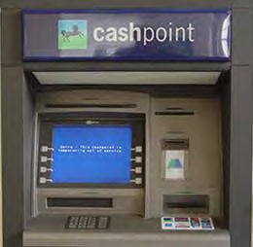
Design Principles for a Good System
Getting | Hazards | Hazards from | Risk | Hazard & Risk | Final
Started | Identification | Human Error | Analysis | – Case Studies | Thoughts
Constraining Behaviour
If it were possible for a system to inhibit a user from performing any dangerous actions then there would be no accidents. This is impossible as the real world is too complicated!
ǮForcing functionsǯ is a concept that is useful when trying to
push users to follow a series of steps.
An example of constrained behaviour is a
cash machine.
- Before you can walk away with your cash, the machine prompts you with lights and a sound to first remove your cash card. This prevents the user from walking away without
their card.

Slide 141
Design Principles for a Good System
Getting | Hazards | Hazards from | Risk | Hazard & Risk | Final
Started | Identification | Human Error | Analysis | – Case Studies | Thoughts
Design for Errors
When a system is designed, you must assume that mistakes will happen. When these mistakes happen, it is necessary that essential systems be designed to recovery from these human errors.
It should be difficult for the user to proceed with actions that are non-reversible.

Slide 142
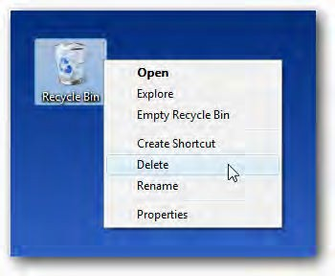
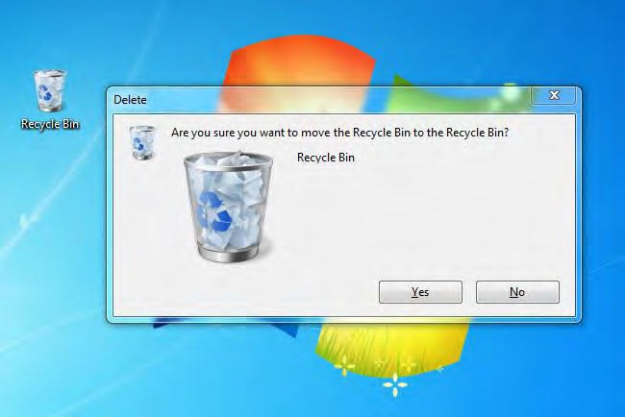
Design Principles for a Good System
Getting | Hazards | Hazards from | Risk | Hazard & Risk | Final
Started | Identification | Human Error | Analysis | – Case Studies | Thoughts
Design for Errors
Before permanently deleting files from your computer, you are prompted asking if you are sure you want proceed.

Slide 143
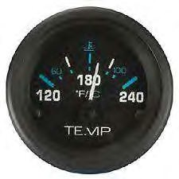
Getting | Hazards | Hazards from | Risk | Hazard & Risk | Final
Started | Identification | Human Error | Analysis | – Case Studies | Thoughts
Visibility
o When the user is able to perceived how their actions will influence
the system, there are fewer human errors.
Prior to the nuclear incident at Three Mile Island, an example of poor user visibility was reported. Experienced operators were not able to comprehend the implications of elevated reactor temperatures. Their inability to perceive the negative feedback that reactors elevated temperatures would have on the plant lead them to underestimate the situation’s severity.

Slide 144
A Culture of Safety
Getting | Hazards | Hazards from | Risk | Hazard & Risk | Final
Started | Identification | Human Error | Analysis | – Case Studies | Thoughts
Human error cannot be blamed solely on the worker.
The management team in an organisation play an important role in the overall safety at the facility. Decisions at this level are key to fostering a culture of safety – this thinking lays the foundation for accident prevention.
A safety culture represents the values, attitudes, competencies and behaviour patterns of the workers and management team. This actions and beliefs drive quality of the organisationǯs health and safety programmes.

Slide 145
A Culture of Safety
Getting | Hazards | Hazards from | Risk | Hazard & Risk | Final
Started | Identification | Human Error | Analysis | – Case Studies | Thoughts
A shared perspective about the importance of safety and preventative measurements at all levels of an organisation is central to a positive safety culture.
Factors that contribute to a positive safety culture:
Felt Leadership
  Commitment from the CEO and management
Policies and principles of safety
  All illnesses and injuries can be prevented – the goal is zero
  Management is responsible for safety
  Adherence to safety is a condition of employment
  Employee involvement is essential

Slide 146

A Culture of Safety
Getting | Hazards | Hazards from | Risk | Hazard & Risk | Final
Started | Identification | Human Error | Analysis | – Case Studies | Thoughts
Factors that contribute to a positive safety culture:
Follow safe procedures – be seen doing it – believe it
This thinking influences employee through:
  Strong personal involvement
  Setting an example
  Building commitment to urgency, accountability, willingness
  Setting high standards and expecting no less from others
Behaviour based safety through peer observation
Hi!
I see that you have your proper personal protection
equipment for the job you are doing; thatǯs good.
I am however concerned about how you are lifting the equipment, you could hurt yourself. May I suggest an alternative approach to lifting.
Stop Programme

Slide 147
A Culture of Safety
Getting | Hazards | Hazards from | Risk | Hazard & Risk | Final
Started | Identification | Human Error | Analysis | – Case Studies | Thoughts
Factors that contribute to a positive safety culture:
Tools to get the job done
  Expertise in safety resources
  Procedures and development
  Communication and motivation
  Audits and investigations
  Rituals

Slide 148
A Culture of Safety
Getting | Hazards | Hazards from | Risk | Hazard & Risk | Final
Started | Identification | Human Error | Analysis | – Case Studies | Thoughts
Factors that contribute to a positive safety culture:
Good communication and shared goals that extend beyond the workplace
  Instilled values and believes will be practiced by workers irrespective of what work they are doing, where they are doing it or who is watching.
  Practicing safe practices at home is important as off- the-job injuries cause personal suffering to the injured person and their family.

Slide 149
Summary
Getting | Hazards | Hazards from | Risk | Hazard & Risk | Final
Started | Identification | Human Error | Analysis | – Case Studies | Thoughts
Hazards generated by human error can be understood through the factors governing the limitations of human behaviour: attention, perception, memory, logical reasoning.
Designing a good system to prevent human error can be achieved following key principles: user-centred design, managing information, reducing complexity, visibility, constraining behaviour, and designing for errors.
Once a good system is designed, instilling a culture of safety is essential to developing an organisation. In this culture, each employee exhibits a mindset and behaviour that ensures that their well-being leaving the workplace is the same or better than when they arrived – a commitment to zero injuries.

Slide 150
Getting | Hazards | Hazards from | Risk | Hazard & Risk | Final
Started | Identification | Human Error | Analysis | – Case Studies | Thoughts
Checkpoint
What is the percentage of occurrences that unsafe worker actions the cause of workplace injuries?
<5% of occurrences
>15% of occurrences
>50% of occurrences
>75 of occurrences
>95% of occurrences
Answer: E

Slide 151
Getting | Hazards | Hazards from | Risk | Hazard & Risk | Final
Started | Identification | Human Error | Analysis | – Case Studies | Thoughts
Checkpoint
Human error can be blamed solely on the
worker:
True
False
Answer: B

Slide 152
Getting | Hazards | Hazards from | Risk | Hazard & Risk | Final
Started | Identification | Human Error | Analysis | – Case Studies | Thoughts
Checkpoint
What are factors that contribute to
limitations of human memory?
Capacity, processing levels and accessibility
Capacity, aptitude and processing level
Capacity and interest level
Answer: A

Slide 153
Getting | Hazards | Hazards from | Risk | Hazard & Risk | Final
Started | Identification | Human Error | Analysis | – Case Studies | Thoughts
Checkpoint
Designing a system for errors is defined as:
Inclusion of safeguards to prevent hazardous
events caused by human error
Inclusion of safeguards to mitigate hazardous events caused by human error
It should be difficult for the user to be proceed with actions that are non-reversible
Essential systems affected by inevitable mistakes
from human error should be designed to recover
Answer: C

Slide 154
Getting | Hazards | Hazards from | Risk | Hazard & Risk | Final
Started | Identification | Human Error | Analysis | – Case Studies | Thoughts
Checkpoint
What is meant by a ǲcommitment-to-
zeroǳ?
Zero worker sick days
Zero worker accidents
Zero workplace hazards
Answer: B

Slide 155




Hazard and Risk Framework
Getting | Hazards | Hazards from | Risk | Hazard & Risk | Final
Started | Identification | Human Error | Analysis | – Case Studies | Thoughts
System Definition
Risk Assessment
Risk Analysis
Hazard Identification
Stakeholder
Participation
Consequence Analysis
Frequency Analysis
Risk Estimation
Risk Acceptability

Slide 156
Getting | Hazards | Hazards from | Risk | Hazard & Risk | Final
Started | Identification | Human Error | Analysis | – Case Studies | Thoughts
Review of the end product from Process Hazard
Analysis
A list of intrinsic hazards
A list of hazardous events and existing/ potential
prevent/mitigation strategies:
  Event scenarios
  Their potential causes
  Existing safeguards
  Possible additional safeguards
Some analysis techniques may also generate a list of potential consequences and their frequency
  Low chance of burn injuries or death,
  Moderate change of damage to process equipment,
o Low change of injury or death from toxic gas inhalation

Slide 157
Overview of the Procedure
Getting | Hazards | Hazards from | Risk | Hazard & Risk | Final
Started | Identification | Human Error | Analysis | – Case Studies | Thoughts
Identify the consequence of each hazard
Categorise each consequence
Evaluate the frequency of each consequence
Categorise these frequencies
Prioritise hazards based on categorised consequences and
frequencies using a risk matrix
Use the risk matrix to rank risks from each hazard
Develop action plans for high-risk events

Slide 158
Getting | Hazards | Hazards from | Risk | Hazard & Risk | Final
Started | Identification | Human Error | Analysis | – Case Studies | Thoughts
STEP 1
Identify consequences of each hazardous event and classify each with
respect to relevant risk receptors:
Employee safety and health
Public safety and health
The environment
Production
Equipment and machinery
Company reputation and market share
STEP 2
Categorise consequences according the level of event severity.

Slide 159
Getting | Hazards | Hazards from | Risk | Hazard & Risk | Final
Started | Identification | Human Error | Analysis | – Case Studies | Thoughts
Categorise hazard consequences with these tables:
Category | Consequences to the Public | Consequence to Employees
1 | No injury or health effects | No injury or occupational safety impact
2 | Minor injury or health effects | Minor injury or occupational safety impact
3 | Injury or moderate health effects | Injury or moderate occupational illness
4 | Death or severe health effects | Death or severe occupational illness
Category | Consequences to Capital Loss, Facility/Equipment Damage
1 | < $100,000
2 | $100,000 - $1,000,000
3 | $1,000,000 - $10,000,000
4 | > $10,000,000
Category | Environment Consequences | Consequence to Production Loss | Consequence to Market Share Loss
1 | < $1,000 | < 1 week | < 1 week
2 | $1,000 - $10,000 | 1 week – 1 month | 1 week – 1 month
3 | $10,000 - $100,000 | 1 – 6 months | 1 – 6 months
4 | > $100,000 | > 6 months | > 6 months

Slide 160
Getting | Hazards | Hazards from | Risk | Hazard & Risk | Final
Started | Identification | Human Error | Analysis | – Case Studies | Thoughts
STEP 3
Estimate the frequency range of each consequence.
How many times per year will this hazard consequence happen?
STEP 4
Categorise consequences according the level of event severity.
Three levels of severity can be selected:
Least stringent
More stringent
Most stringent

Slide 161


Getting | Hazards | Hazards from | Risk | Hazard & Risk | Final
Started | Identification | Human Error | Analysis | – Case Studies | Thoughts
Categorise the frequency of hazard consequences with these tables – pick least, more and most stringent cases:
Category | Frequency Range | Description
1 | < 0.02 / year | Not expected to occur during the facility’s lifetime (about 50 years), but possible
2 | 0.02 – 0.05 / year | Expected to occur no more than once during the facility’s lifetime
3 | 0.05 – 1 / year | Expected to occur several times during the facility’s lifetime
4 | > 1 / year | Expected to occur more than once a year

Slide 162

Getting | Hazards | Hazards from | Risk | Hazard & Risk | Final
Started | Identification | Human Error | Analysis | – Case Studies | Thoughts
Categorise the frequency of hazard consequences with these tables – pick least, more and most stringent cases:
Category | Frequency Range | Description
1 | < 0.001 / year | Remote – A series of failures, with a low probability of occurring within the facility’s lifetime
2 | 0.001 – 0.01 / year | Unlikely – A failure with a low probability of occurring within the facility’s lifetime
3 | 0.01 – 0.1 / year | Probable – A failure which can reasonably be expected to occur once within the expected lifetime of the plant.
4 | > 0.1 / year | Frequent – A failure which can reasonably be expected to occur more than once within the facility’s lifetime.

Slide 163

Getting | Hazards | Hazards from | Risk | Hazard & Risk | Final
Started | Identification | Human Error | Analysis | – Case Studies | Thoughts
Categorise the frequency of hazard consequences with these tables – pick least, more and most stringent cases:
Category | Frequency Range | Description
1 | < 10⁻⁶ / year | Remote – A series of failures, with a low probability of occurring within the facility’s lifetime
2 | 10⁻⁶ – 10⁻⁴ / year | Unlikely – A failure with a low probability of occurring within the facility’s lifetime
3 | 10⁻⁴ – 0.01 / year | Probable – A failure which can reasonably be expected to occur once within the expected lifetime of the plant.
4 | > 0.01 / year | Frequent – A failure which can reasonably be expected to occur more than once within the facility’s lifetime.

Slide 164


STEP 5
Getting | Hazards | Hazards from | Risk | Hazard & Risk | Final
Started | Identification | Human Error | Analysis | – Case Studies | Thoughts
Rank each hazardous event with a risk matrix.
Frequency Category
High
Medium
Low
Very Low
Consequence Category

Slide 165
Getting | Hazards | Hazards from | Risk | Hazard & Risk | Final
Started | Identification | Human Error | Analysis | – Case Studies | Thoughts
Hazardous event categories in the risk ranking matrix.
High (H) | Should be mitigated with engineering and/ or administrative controls to a risk ranking of LOW or VERY LOW within a specified time frame (i.e. 6 months).
Medium (M) | Should be mitigated with engineering and/ or administrative controls to a risk ranking or LOW or VERY LOW within a specified time frame (i.e. 12 months).
Low (L) | Should be verified on a continuous basis to ensure procedures or controls are in place.
Very Low (VL) | No mitigation required.

Slide 166
Getting | Hazards | Hazards from | Risk | Hazard & Risk | Final
Started | Identification | Human Error | Analysis | – Case Studies | Thoughts
STEP 6 - Rank the risk association with each hazard
Process Area | Hazardous Event | Potential Cause | Existing Safeguards to Prevent Event | Expected Future Frequency (#/year) | Risk Receptors |  |  |  |  |  | Maximum Event Risk Score | Comments | Recommended Actions
 |  |  |  |  | Public |  |  | Employee
 |  |  |  |  | Consequence Score | Frequency Score | Risk Score | Consequence Score | Frequency Score | Risk Score
Natural Gas Supply | Fireball and jet flame from transmission line | Above ground pipeline rupture from impact of heavy machinery | None | 1/20 | 4 | 1 | L | 4 | 3 | H | H | No physical impact protection where pipe comes out of the ground | Install collision protection at main inlet to plant process area; Improve line labelling and develop unique colour coding for piping.
Natural Gas Supply | Gas release with H₂S traces | Upstream failure to treat gas at source | None | 1 | 2 | 1 | VL | 2 | 1 | VL | VL | None | Check H₂S in gas supply.
Note: This is risk matrix is simplified. A complete matrix includes risk score for all risk
receptors (public, environment, employees, production, capital equipment and market share).
166

Slide 167
STEP 7
Getting | Hazards | Hazards from | Risk | Hazard & Risk | Final
Started | Identification | Human Error | Analysis | – Case Studies | Thoughts
For each hazardous event, develop safeguards, including action plans for any interactions between adjacent units and the emergency response on site.

Slide 168
Summary
Getting | Hazards | Hazards from | Risk | Hazard & Risk | Final
Started | Identification | Human Error | Analysis | – Case Studies | Thoughts
Risk analysis estimates the risk from hazards to individuals,
populations, property or the environment.
This analysis follows the two steps:
Hazard identification
  Definition of undesirable events and the type of potential damage
Risk estimation
  Measure of the level of health, property or environmental risks
  Consequence and frequency analyses
It is important that no value judgements be included from risk analysis.

Slide 169
Getting | Hazards | Hazards from | Risk | Hazard & Risk | Final
Started | Identification | Human Error | Analysis | – Case Studies | Thoughts
Checkpoint
Risk Analysis is best described as:
Consequence and frequency analyses
Hazard identification and risk estimation
Hazard identification and risk acceptability
Hazard identification, risk estimation and risk acceptability
Answer: B

Slide 170
Getting | Hazards | Hazards from | Risk | Hazard & Risk | Final
Started | Identification | Human Error | Analysis | – Case Studies | Thoughts
Checkpoint
Once hazards are identified, how is risk analysed?
Consequences and frequencies are identified and evaluated through a risk matrix
Consequences and frequencies are identified and evaluated through a risk matrix followed by a ranking procedure
Consequences and frequencies are identified and evaluated through a risk matrix followed by a ranking procedure and development of action plans
Answer: C

Slide 171
Getting | Hazards | Hazards from | Risk | Hazard & Risk | Final
Started | Identification | Human Error | Analysis | – Case Studies | Thoughts
Checkpoint
Hazard consequences are categorised with tables. Which of the following is not a standard table?
Consequences to the public
Consequences to the worker
Consequences to management
Consequences to capital loss
Consequences to market share
Answer: C

Slide 172
Getting | Hazards | Hazards from | Risk | Hazard & Risk | Final
Started | Identification | Human Error | Analysis | – Case Studies | Thoughts
Checkpoint
Hazardous events classed as medium risks should be managed in the following manner:
No mitigation required, redesign system to ensure hazard
prevention
Should be verified on a continuous basis to ensure that procedures and controls are in place
Should be mitigated with engineering and/ or administrative controls to achieve a lower risk ranking with 12 months
Should be mitigated with engineering and/ or administrative controls to achieve a lower risk ranking with 6 months
Answer: C

Slide 173
Getting | Hazards | Hazards from | Risk | Hazard & Risk | Final
Started | Identification | Human Error | Analysis | – Case Studies | Thoughts
Checkpoint
Value judgements are a key component
to the risk estimation procedure?
True
False
Answer: B

Slide 174
Automotive Case Study – Health Hazards
Getting | Hazards | Hazards from | Risk | Hazard & Risk | Final
Started | Identification | Human Error | Analysis | – Case Studies | Thoughts
In a Canadian manufacturing plant of a global automotive company, many engineering activities are conducted in design, part production, assembly, testing and quality assurance areas. The plant produces and assembles vehicle parts including engines, pumps, fans and electronics.
The manufacturing processes by 400 plant employees and some are performed using automated technologies and equipment. Use of people or machines to perform tasks is dependent on cost, time, quality and worker health and safety.
The plant operates 3 shifts per day. There are production lines including machining equipment, conveyers and overhead cranes,
punch presses and paint-spray booths.

Slide 175
Automotive Case Study – Health Hazards
Getting | Hazards | Hazards from | Risk | Hazard & Risk | Final
Started | Identification | Human Error | Analysis | – Case Studies | Thoughts
Workers at the plant have reported several different health problems. The following information has been received by the head engineer:
1. In a recently installed assembly area, workers have to bend to the ground throughout the day to attach several small parts onto a vehicle chassis. Some works developed lower back pain, likely due to repetitive bending. For one of the workers, the problem is so severe that he was advised by his doctor to stay off work for two weeks so his back can recover.
The manufacturing engineers who designed the assembly operation had wanted to use an automated system but this option was not deemed to be economic. A manual operation was used but industrial ergonomics was not taken into account because of a lack of expertise.

Slide 176
Automotive Case Study – Health Hazards
Getting | Hazards | Hazards from | Risk | Hazard & Risk | Final
Started | Identification | Human Error | Analysis | – Case Studies | Thoughts
Workers at the plant have reported several different health problems. The following information has been received by the head engineer:
2. An increased incidence of respiratory illness has been reported over past month by workers operating near the paint-spray booths. Many of the paints and solvents used in the booths are known to be the cause of respiratory illnesses. Works are not supposed to be exposed to these substances because the paint-spray booths were designed to be ensured all materials exit the paint through a high-capacity ventilation system. No tests have been carried out on the ventilation system or the plant air quality so it is uncertain whether or not there have been any paint-spray booth leaks.

Slide 177
Automotive Case Study – Health Hazards
Getting | Hazards | Hazards from | Risk | Hazard & Risk | Final
Started | Identification | Human Error | Analysis | – Case Studies | Thoughts
Workers at the plant have reported several different health problems. The following information has been received by the head engineer:
3. In an area of the plant where metal cutting occurs, works are required to wear protective eyewear. However, workers operating in this area have started to report minor eye injuries. It is common knowledge that workers do not routinely use the protective equipment; the eyewear is frequently observed to be hanging on nearby hooks or loosely hanging around workers’ necks. Workers complain that they find the protective eyewear to be uncomfortable and do not think it is needed or important. The plant manager knows of this behaviour but overlooks it since enforcing the eyewear use seems to make workers unhappy and less productive.

Slide 178
Getting | Hazards | Hazards from | Risk | Hazard & Risk | Final
Started | Identification | Human Error | Analysis | – Case Studies | Thoughts
Automotive Case Study – Safety
Letǯs consider the same automotive facility again but this time weǯll look at a safety related concerns.
185

Slide 179
Automotive Case Study – Safety
Getting | Hazards | Hazards from | Risk | Hazard & Risk | Final
Started | Identification | Human Error | Analysis | – Case Studies | Thoughts
The head engineer wants to ensure that plant provides a safe and healthy environment. An engineering health and safety consulting company was hired to do a health and safety audit of the plant. The consulting companies report included the following issues:
1. An expert on fires and explosions notes the extensive use of natural gas in the plant could lead to an explosion in some circumstances. The potential for an explosion could develop if a sufficient natural gas leak. Which could lead to severe worker injuries or deaths. Detection of natural gas concentrations in the plant is monitored by sensors. Only one sensor is installed in the plant but not in the main area where accumulation of natural gas would be likely to occur. In addition to the concern for the only having the single sensor installed, the expert noted the sensor was not connected to an automated natural gas shut-off system. Without a shut-off feature, the severity of
an incident would increase.

Slide 180
Automotive Case Study – Safety
Getting | Hazards | Hazards from | Risk | Hazard & Risk | Final
Started | Identification | Human Error | Analysis | – Case Studies | Thoughts
The head engineer wants to ensure that plant provides a safe and healthy environment. An engineering health and safety consulting company was hired to do a health and safety audit of the plant. The consulting companies report included the following issues:
2. Gas line maintenance is required every quarter; no evidence of maintenance had been found since the gas lines were installed four years ago. This maintenance procedure involves checking for and fixing gas leaks. Workers also require training on procedures to prevent an explosion; this training had not been conducted and workers were not aware of the potential explosion hazard. No written procedure relating to explosions were found within the plant.

Slide 181
Automotive Case Study – Safety
Getting | Hazards | Hazards from | Risk | Hazard & Risk | Final
Started | Identification | Human Error | Analysis | – Case Studies | Thoughts
The head engineer wants to ensure that plant provides a safe and healthy environment. An engineering health and safety consulting company was hired to do a health and safety audit of the plant. The consulting companies report included the following issues:
3. The plant was found to contain toxic materials that can harm the health of people and animals. The storage area for these hazardous substances was not found to be sufficient in containing the chemicals in the event of an explosion. Release of these substances could lead to illness or deaths among members of the public and could also harm the environment.

Slide 182
Getting | Hazards | Hazards from | Risk | Hazard & Risk | Final
Started | Identification | Human Error | Analysis | – Case Studies | Thoughts
Hazard and Risk identification answers the following questions:
What can go wrong? How? Why? What are the consequences?
How likely are these consequences?
What is the risk?

Slide 183
Finding Hazards
Getting | Hazards | Hazards from | Risk | Hazard & Risk | Final
Started | Identification | Human Error | Analysis | – Case Studies | Thoughts
Hazards are commonly related to energy:
Human error
Kinetic energy
Potential energy
Heat
Electricity
In addition to energy sources, human error can be attributed to
most workplace accidents.
96% of workplace injuries are caused by unsafe worker actions

Slide 184
Human Error as a Cause of Hazards
Getting | Hazards | Hazards from | Risk | Hazard & Risk | Final
Started | Identification | Human Error | Analysis | – Case Studies | Thoughts
As engineers designing a facility, we must be aware of the limitation of human behaviour. This includes a workers or operatorǯs attention span, perception, memory and logical reasoning abilities.
When human error is identified as a hazard in a process, we must acknowledge that the worker cannot be solely blamed. An organisationǯs management team plays a key part in overall safety.
Instilling a safety culture in an organisation is essential to
reducing the number of worker caused accidents to zero.

Slide 185
Hazards, Risk, Sources and Receptors
Getting | Hazards | Hazards from | Risk | Hazard & Risk | Final
Started | Identification | Human Error | Analysis | – Case Studies | Thoughts
A hazard connects risk sources with risk receptors. These
system components include:
Risk sources
  Industrial facilities
  Roadways
  University laboratories
Risk receptors
  Plant Operators and workers
  Students at a University
  Shareholders o Community o Environment o Regulators

Slide 186
Hazard Identification Methods
Getting | Hazards | Hazards from | Risk | Hazard & Risk | Final
Started | Identification | Human Error | Analysis | – Case Studies | Thoughts
Process Hazard Analysis techniques are used to identify
hazards. Qualitative methods we discussed include:
Screening Level analysis
Checklists
What-if analysis
Failure Modes and Effects Analysis (FMEA)
Hazard and Operability Study (HAZOP)
These techniques present a pro-active and systematic approach for the identification, mitigation or prevention of hazards from a process, materials, equipment or human error.

Slide 187
Generalised Process Hazard Analysis Procedure
Getting | Hazards | Hazards from | Risk | Hazard & Risk | Final
Started | Identification | Human Error | Analysis | – Case Studies | Thoughts
Break down the system into process sections
Identify the intrinsic hazards in each section (chemical, material, equipment, human)
Evaluate the cause of each hazard to develop a hazardous event
Additional steps for What-if, FMEA and HAZOPs
Determine the consequence of each hazardous event
Estimate the frequency of each hazard consequence

Slide 188
Estimating Risk
Getting | Hazards | Hazards from | Risk | Hazard & Risk | Final
Started | Identification | Human Error | Analysis | – Case Studies | Thoughts
We can use hazard-related frequency and consequence
information to determine the associated risk.
Consequences and their frequency can be ranked in a matrix
to estimate risk.
Risk = Estimated consequences of a hazardous event x
Frequency of the event’s occurrence
Risks are ranked as very low, low, medium and high
200

Slide 189
Risk analysis
Getting | Hazards | Hazards from | Risk | Hazard & Risk | Final
Started | Identification | Human Error | Analysis | – Case Studies | Thoughts
Provides an objective basis for comparing hazards,
alternatives and risk control measurements
This analysis procedure is also of great importance for
response planning for emergencies
There many types of risks that may be identified:
Event Risk
Facility Risk
Individual Risk
Societal Risk
Voluntary Risk
Imposed Risk
Safety Risk Environmental
Risk
Equipment Risk
Shareholder Risk
201

Slide 190






Hazard and Risk Framework
Getting | Hazards | Hazards from | Risk | Hazard & Risk | Final
Started | Identification | Human Error | Analysis | – Case Studies | Thoughts
System Definition
Risk Assessment
Risk Analysis
Hazard Identification
Stakeholder
Participation
Consequence Analysis
Frequency Analysis
Risk Estimation
Risk Acceptability
202

