Slide 1



Field Safety Considerations and its Design Implications — Introduction to Workplace Health and Safety

Slide 2
Introduction
Workplace Hazards
Hazard Control
Decision Making
Risk Assessment
Review
Purpose
The purpose of this safety module is to provide graduate engineers with some information on common safety considerations in the workplace.
This module contains information on workplace hazards and precautions to mitigate those hazards.
Some short quizzes, case scenarios and an exam is included to test the audience’s knowledge.

Slide 3
Introduction
Workplace Hazards
Hazard Control
Decision Making
Risk Assessment
Review
Learning Objectives
Learn and apply legislative requirements, industry standards, and best practices in a variety of workplaces.
Apply risk management methods to identify, anticipate, manage, and control workplace hazards.
Collect and merge data to identify the current safety issues within the workplace.
Have a solid understanding of health and safety management at workplace and able to pass along sufficient information to others in potential risk.
Apply solutions, prevention and basic assessments to the hazards created by other coworkers.
Practice safety procedures and employ ethical standards in all aspects at workplace.

Slide 4

Introduction
Workplace Hazards
Hazard Control
Decision Making
Risk Assessment
Review
History of Workplace Injuries and Fatalities
The safety of workers is a critical priority for employers, often taking precedence over production and quality.
The safety culture of an organization is the product of individual and group values, attitudes, perceptions, competencies and patterns of behavior that determine the commitment to, and the style and proficiency of, an organization’s health and safety management.

Slide 5

Introduction
Workplace Hazards
Hazard Control
Decision Making
Risk Assessment
Review
History of Workplace Injuries and Fatalities
Creating a positive culture for safety helps workers to understand and follow good safety habits.
Thinking safety and acting accordingly has been effective for many years and the results are significantly different from the early years of industrial developments.
Ref: Signs of workplace safety culture, Annemarie communicates insurance

Slide 6


Introduction
Workplace Hazards
Hazard Control
Decision Making
Risk Assessment
Review
History of Workplace Injuries and Fatalities
However, there are still reports of injuries and fatalities throughout workplaces around the world. While unsafe conditions and processes contribute to these injuries, some of these are caused due to human errors. That is why the safety culture is extremely important in preventing injuries and fatalities.
Employers and workers are required to follow the occupational health and safety regulations. The duties of employers and workers are detailed in the health and safety regulations.

Slide 7
Introduction
Workplace Hazards
Hazard Control
Decision Making
Risk Assessment
Review
History of Workplace Injuries and Fatalities
The Association of Workers' Compensation Boards of Canada (AWCBC) is the responsible organization for statistical analysis of workplaces injuries and fatalities in Canada.
According to AWCBC’s data for 2013, there were 241,933 lost time injuries/diseases in Canada. Lost time injuries are injuries to the employee that will result in the loss of productive work whether in form of delays or absenteeism.
Nearly a quarter million Canadian workers suffer Lost Time Injuries (LTI)

Slide 8
Introduction
Workplace Hazards
Hazard Control
Decision Making
Risk Assessment
Review
History of Workplace Injuries and Fatalities
According to AWCBC’s report for 2013, there were 241,933 lost time injuries/diseases in Canada. Lost time injuries are injuries to the employee that will result in the loss of productive work whether in form of delays or absenteeism.
In the same report, health and social service industries were leading in the number of lost time injuries/diseases compared to other industries.

Slide 9
Introduction
Workplace Hazards
Hazard Control
Decision Making
Risk Assessment
Review
History of Workplace Injuries and Fatalities
Total lost time injuries for all regions by gender according to AWCBC’s analysis.

Slide 10
Introduction
Workplace Hazards
Hazard Control
Decision Making
Risk Assessment
Review
History of Workplace Injuries and Fatalities
Their statistics show that the highest number of injuries occurred for workers between 45 to 54 years old with a total number of 63,417 injuries.
Why do you think more males are injured than females?
Why do you think workers between 45 to 54 years old had the most injuries?

Slide 11
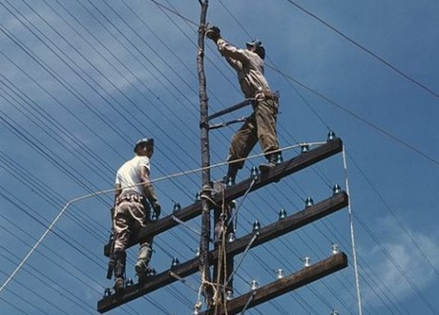

Introduction
Workplace Hazards
Hazard Control
Decision Making
Risk Assessment
Review
History of Workplace Injuries and Fatalities
According to statistics results, men are most likely to be injured in workplaces. But does this mean that any type of job put men in danger?
Clearly, the answer is No as it seems that there are more men working in hazardous work environments than women.
Therefore, the chance of men getting injured in those environments is higher.
What other reasons can cause men to have a higher injury rates?

Slide 12

Introduction
Workplace Hazards
Hazard Control
Decision Making
Risk Assessment
Review
History of Workplace Injuries and Fatalities
Individual Canadian provinces have different injury rates depending on the resources and the type of jobs there.
Which provinces do you think have the highest injury rates?

Slide 13
Introduction
Workplace Hazards
Hazard Control
Decision Making
Risk Assessment
Review
History of Workplace Injuries and Fatalities
The AWCBC report indicates that provinces with higher populations such as Quebec, Ontario, British Columbia , Alberta and Manitoba have the most injuries each year.
This study was conducted for the years of 2011, 2012 and 2013. Which three provinces do you think accounted for most injuries?
For the mentioned years. Quebec had the most injury rates followed by Ontario and British Colombia.

Slide 14
Introduction
Workplace Hazards
Hazard Control
Decision Making
Risk Assessment
Review
History of Workplace Injuries and Fatalities
Let’s look at a case study…

Slide 15

Case Study
On November 3, 2001, a 19-year-old male, Nick, who was a forklift operator was injured.
On that day, he was supposed to move a stack of 42 loose sheets of lumber that weighed over 1200 kg.
He lifted the load with a forklift and backed it away from the shed. As he reversed, the load shifted a little bit and started to slip off the forks, so he decided to get off and push the boards back on. His co-worker hopped on the forklift to help, and Nick told him to lower the forks.
Just as he turned away from the forklift, the entire load suddenly slid off the forks and smashed onto his back, driving him to the ground and doubling him forward at the waist.

Slide 16

Case Study
Nick was then rushed to hospital and transferred to Vancouver where he had 13 ½ hours of surgery. Part of his spine was reconstructed and a corner of one of his ribs was grafted into his back. He spent three weeks in hospital followed by three months in rehabilitation at GF Strong before returning home to Victoria.

Slide 17

Case Study
Nick mentioned that his only training to operate a forklift was learning where the brake and gas pedals are in addition to lifting handle.
It is the responsibility of employers to make sure the workers have all the required trainings for operating and/or using work-related equipment.
It is also within the safety culture that more experienced staff to prevent such tragedies to happen by informing the person about the hazards of the job he/she is about to do.

Slide 18

Case Study
What did Nick do wrong?
What would have you done if you were Nick?
If you were his co-worker, what would have you done to prevent him from getting injured?

Slide 19
Introduction
Workplace Hazards
Hazard Control
Decision Making
Risk Assessment
Review
Regulatory Information
In relevant to Nick’s story, let’s state some of the regulatory information under the occupational health and safety act in Ontario.
As a minimum, employers should ensure that the following existing regulatory requirements are complied with
no part of a load must pass over any worker
a lift truck left unattended must be immobilized and secured against accidental movement and forks, buckets or other attachments must be in the lowered position or firmly supported
no load may exceed the maximum rated load and loads must be handled in accordance with the height and weight restrictions on the vehicle's load chart
when a load is in the raised position, the controls must be attended by an operator

Slide 20
Introduction
Workplace Hazards
Hazard Control
Decision Making
Risk Assessment
Review
Regulatory Information
If an operator does not have a clear view, a signaler who has been instructed in a code of signals for managing traffic in the workplace must be used.
Loads must be carried as close to the ground or floor as the situation permits.
Loads that may tip or fall and endanger a worker must be secured;
Where a lift truck is required to enter or exit a vehicle to load or unload, That vehicle must be immobilized and secured against accidental movement.
A lift truck must not be used to support, raise or lower a worker on a construction site and must only be so used in an industrial establishment if the work is carried out in accordance with Regulation 851 (Section 52).
Barriers, warning signs, designated walkways or other safeguards must be provided where pedestrians are exposed to the risk of collision.

Slide 21
Introduction
Workplace Hazards
Hazard Control
Decision Making
Risk Assessment
Review
Regulatory Information
Occupational Health and Safety Act (OHSA) is a set of regulations that protects everyone at workplaces and should be followed by all.
The OHSA does not apply to the following:
  Work done by the owner or occupant, or a servant, in a private residence or in the lands and appurtenances used in connection with the private residence [subsection 3(1)]
  Workplaces under federal jurisdiction, such as:
    post offices
    airlines and airports
    banks
    some grain elevators
    telecommunication companies, and
    interprovincial trucking, shipping, railway and bus companies
  Federal jurisdiction are covered under Canada Labour Code

Slide 22
Introduction
Workplace Hazards
Hazard Control
Decision Making
Risk Assessment
Review
Regulatory Information
Under the law, workers have the right to refuse work if the type of work puts themselves and other workers in danger.
This right is only limited to the following:
  “police officers
  firefighters
  workers employed in the operation of correctional institutions and similar institutions/facilities
  health care workers and persons employed in workplaces like hospitals, nursing homes, sanatoriums, homes for the aged, psychiatric institutions, mental health centres or rehabilitation facilities, residential group homes for persons with behavioural or emotional problems or a physical, mental or developmental disability, ambulance services, first aid clinics, licensed laboratories—or in any laundry, food service, power plant or technical service used by one of the above [subsection 43(2)].”
Ref: Ontario Ministry of Labour

Slide 23

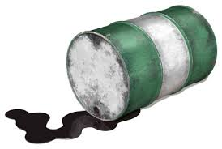
Fatality Story
November 1994 was the last month for the 19-year-old male, Sean, in Brampton, Ontario.
It was only his third day on the job when he was pouring highly flammable chemical from one ungrounded drum to another.
The chemical in the drum suddenly exploded and ignited and caused Sean to suffer from third degree burns.
Sean died the following day from third-degree burns.
Sean was not told what he was doing was dangerous and necessary precautions are required.

Slide 24
Introduction
Workplace Hazards
Hazard Control
Decision Making
Risk Assessment
Review
Discussion
We have seen how equipment (fork truck) and chemicals (flammable solvent) can cause fatalities or serious injuries.
Can you think of some other workplace hazards?

Slide 25




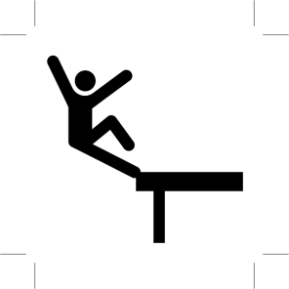
Introduction
Workplace Hazards
Hazard Control
Decision Making
Risk Assessment
Review
Workplace Hazards
Hazard is a potential source of danger that can result in death or injuries when it is active.
Ergonomic
Psychosocial
Physical
Chemical
Biological
Safety
High Risk Activities

Slide 26
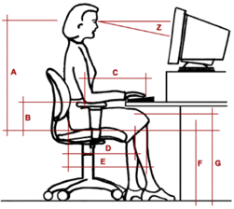
Introduction
Workplace Hazards
Hazard Control
Decision Making
Risk Assessment
Review
Workplace Hazards – Ergonomics
This is a common type that occurs due to improper performance of conducting work duties such as repetitive movement, lifting, sitting, improper set up of work stations, etc.

Slide 27
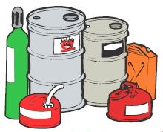
Introduction
Workplace Hazards
Hazard Control
Decision Making
Risk Assessment
Review
Workplace Hazards – Chemical Hazards
Any chemical source such as release of chemical materials with toxic properties.

Slide 28


Introduction
Workplace Hazards
Hazard Control
Decision Making
Risk Assessment
Review
Workplace Hazards – Psychosocial
  Workplace violence, harassment, stress, etc. are considered as hazards with psychological impacts on workers

Slide 29

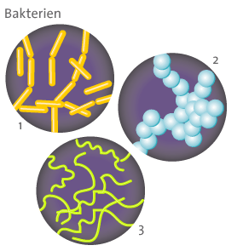

Introduction
Workplace Hazards
Hazard Control
Decision Making
Risk Assessment
Review
Workplace Hazards – Biological
Any biological source that may cause illnesses or other effects on the body such as viruses, insects, animals, bacteria, plants, etc.

Slide 30
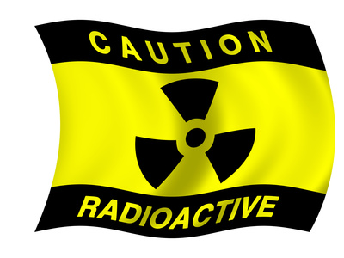
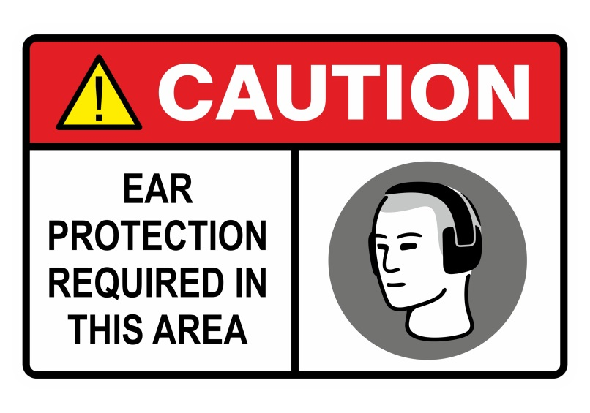
Introduction
Workplace Hazards
Hazard Control
Decision Making
Risk Assessment
Review
Workplace Hazards – Physical Hazards
Hazards such as noise, radiation, high pressure or vacuum, etc are considered as physical type of hazards.

Slide 31

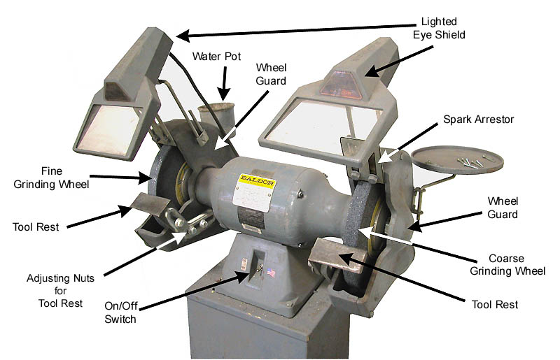
Introduction
Workplace Hazards
Hazard Control
Decision Making
Risk Assessment
Review
Workplace Hazards - Safety
Inappropriate machine guarding, slipping and tripping, breakdowns, equipment malfunction are categorized as safety hazards in workplaces.

Slide 32
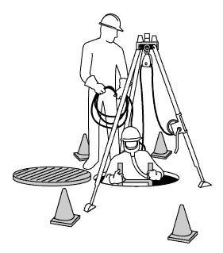
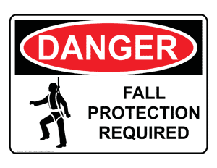
Introduction
Workplace Hazards
Hazard Control
Decision Making
Risk Assessment
Review
Workplace Hazards - Safety
High risk activities are types of job that need special attention as in case of an occurrence, the results may be fatal or serious injuries. They normally need special training and/or permit.

Slide 33
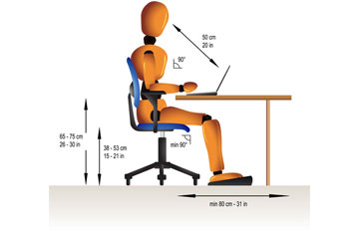
Introduction
Workplace Hazards
Hazard Control
Decision Making
Risk Assessment
Review
Ergonomic Hazards
Ergonomic hazards occur when the type of work, body positions and working conditions put strain on the worker’s body.
These damages may not be effective immediately and can cause injuries over the time.
Short term injuries may result in muscle pain and sore muscles however, the long term exposure may cause serious health problems.
Ref: Training solutions. Em powers, copyright @2010

Slide 34
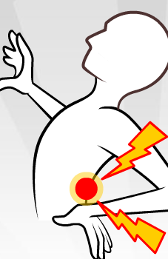
Introduction
Workplace Hazards
Hazard Control
Decision Making
Risk Assessment
Review
Ergonomic Hazards
Examples of ergonomic Hazards are:
  Improperly adjusted workstations and chairs
  Frequent lifting
  Poor posture
  Awkward movements such as shaking legs, especially if they are repetitive
  Repeating the same movements over and over
  Using excessive force
  Vibration
Ref: Training solutions. Em powers, copyright @2010

Slide 35
Introduction
Workplace Hazards
Hazard Control
Decision Making
Risk Assessment
Review
Hazard Control – Ergonomic
Preventive solutions
  Regardless of whether or not workers have reported Musculoskeletal Disorders (MSD_ symptoms, or whether or not they have filed WCB/WSIB claims, MSD prevention needs to be a key part of a workplace health and safety program. MSD risk factors should be handled like any other workplace hazard.

Slide 36
Introduction
Workplace Hazards
Hazard Control
Decision Making
Risk Assessment
Review
Hazard Control – Ergonomic
Employers should:
Advise and train workers about the MSD risk factors in their job and in the workplace
Encourage workers to participate in the health and safety program through early reporting of MSD symptoms or concerns
Identify and assess job related MSD risk factors
Put in place controls to reduce workers’ exposure to MSD risk factors, including design considerations
Follow-up to make sure preventive measures are working

Slide 37
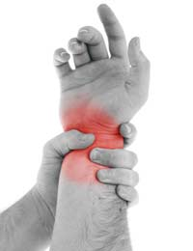
Introduction
Workplace Hazards
Hazard Control
Decision Making
Risk Assessment
Review
Hazard Control – Ergonomic
What engineering designs would you consider to reduce MSDs?
Ref: Avoid MSDs at work, www.safework.co.uk

Slide 38
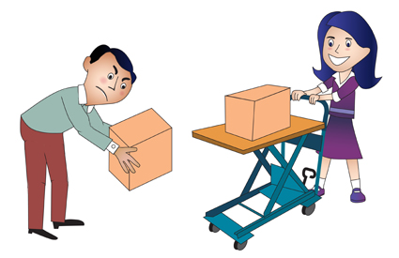
Introduction
Workplace Hazards
Hazard Control
Decision Making
Risk Assessment
Review
Hazard Control – Ergonomic
Designs as simple as the raising cart in the figure, can simply reduce the risks of MSD.
It is important to ensure equipment maintenance can be conducted in an ergonomically friendly way, without excessive bending, reaching, etc.
Ref: Prevention of MSDs, www.riskmanagement365.com

Slide 39
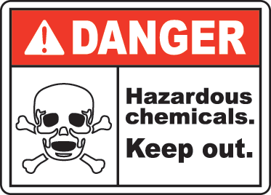
Introduction
Workplace Hazards
Hazard Control
Decision Making
Risk Assessment
Review
Chemical Hazards
Chemical hazards in the workplaces will vary by the type of industry.
Some most common hazards at workplaces are:
  Liquids like cleaning products, paints, acids, solvents especially chemicals in an unlabeled container (warning sign!)
  Vapors and fumes, for instance those that come from welding or exposure to solvents
  Gases like acetylene, propane, carbon monoxide and helium
  Flammable materials like gasoline, solvents and explosive chemicals.

Slide 40
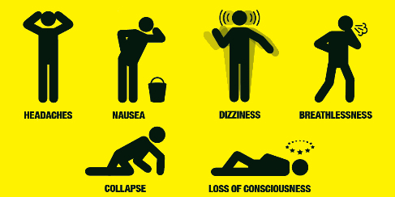
Introduction
Workplace Hazards
Hazard Control
Decision Making
Risk Assessment
Review
Chemical Hazards – Carbon Monoxide
Carbon monoxide
  Carbon monoxide is a tasteless, odorless and colorless gas that is highly toxic to humans.
Locations
  This hazard may occur while breathing from an air compressor source.
  The air compressor contains air lubricants that may break down in high temperature and produce carbon monoxide.
  In some cases, the exhaust air of a diesel engine or any nearby source might enter the compressor.
Signs of carbon monoxide poisoning
Ref: “Hogg Mechanical Industry” , Carbon Monoxide Poisoning.

Slide 41
Introduction
Workplace Hazards
Hazard Control
Decision Making
Risk Assessment
Review
Hazard Control – Carbon Monoxide
Precautions
  The compressor must be connected to clean outdoor source for the intake air. The compressor must be used and maintained according to the manufacturer's instructions.
  Ensure that whenever potential sources of CO are introduced (diesel fork trucks, generators, furnaces, natural gas dryers, etc. ) that the design accounts for the potential of these fuel burning devices to accumulate CO and adequate ventilation is provided.
  The carbon monoxide level must be monitored using detectors.

Slide 42
Introduction
Workplace Hazards
Hazard Control
Decision Making
Risk Assessment
Review
Chemical Hazards – Asbestos
Asbestos is a naturally occurring silicate mineral that can be separated into fibers considered to be a health hazard.
Location
  Asbestos may be found in these building locations:
    Corrugated roof panels that have substances of asbestos cement
    Some paints and textured coatings
    Fire protection and structural steel
    Pipes, water tanks and gutters
    Insulations - thermal and acoustic

Slide 43
Introduction
Workplace Hazards
Hazard Control
Decision Making
Risk Assessment
Review
Hazard Control – Asbestos
Precautions
  Ensure that all asbestos containing materials are identified and workers are informed
  Remediation must be done by qualified workers
  Testing must be conducted to confirm the presence or absence of asbestos prior to disturbing the area. This is a regulatory requirement in the Ontario construction regulations.
  Proper PPE such as protective clothing (chemical suits, gloves, hoods, respirators, etc.) must be available.

Slide 44


Introduction
Workplace Hazards
Hazard Control
Decision Making
Risk Assessment
Review
Chemical Hazards – Compressed Gases
Compressed gases
  There are many products available as compressed gases that contain gases and mixture of gases in a pressure cylinder.
There are three forms of compressed gases:
  Dissolved
  Liquefied
  Non-liquefied
Dissolved
  The most common gas for this type is acetylene which is known to be a very unstable gas in terms of its properties.
  Acetylene can be exploded even at atmospheric pressure. Therefore it is normally used and stored in high pressure gas cylinders.

Slide 45
Introduction
Workplace Hazards
Hazard Control
Decision Making
Risk Assessment
Review
Chemical Hazards – Compressed Gases
Liquefied
  For liquefied, initially the cylinder is almost full of liquid, and gas fills the space above the liquid. As gas is removed from the cylinder, enough liquid evaporates to replace it, keeping the pressure in the cylinder constant. Anhydrous ammonia, chlorine, propane, nitrous oxide and carbon dioxide are examples of liquefied gases.
  Health hazards of compressed gasses, in some gas species, the contact between the skin or eye and liquefied gases in liquid form can freeze the tissue and result in a burn-like injury.

Slide 46
Introduction
Workplace Hazards
Hazard Control
Decision Making
Risk Assessment
Review
Chemical Hazards – Compressed Gases
Non-liquefied
  Gases such as oxygen and nitrogen that do not become liquid at normal temperature are non-liquefied compressed gases.
Pressure hazards of compressed gases
  Due to the high pressure of the cylinder, the gas can be released quickly by either opening the valve or due to a broken valve.
  This might even occur at lower pressure as well.
Health hazards
  Health hazards associated with compressed gasses can vary depending on the gas type, area of exposure (eye, skin, inhalation, etc.), concentration and the length of exposure.

Slide 47
Introduction
Workplace Hazards
Hazard Control
Decision Making
Risk Assessment
Review
Chemical Hazards – Compressed Gases
Flammable gasses
  Flammable gasses can burn and explode in some certain conditions.
  Generally, the concentration of gas in air must be lower than its flammable range to be safe from any incidents.
  For gasses within the flammable range, any ignition source in workplace such as open flame, a spark and even hot surfaces can result in tragedy.
  In some cases, there is no need of any ignition source as auto-ignition temperate of a gas can be minimum when the gas self-ignites itself.

Slide 48
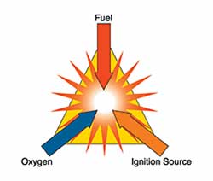
Introduction
Workplace Hazards
Hazard Control
Decision Making
Risk Assessment
Review
Chemical Hazards – Compressed Gases
It is highly recommended that the area with compressed gasses is away from any ignition source or the flammable range and concentration of the gas is monitored.
Some gases have very low auto-ignition temperatures. For example, phosphine's auto-ignition temperature of 100°C (212°F) is low enough that it could be ignited by a steam pipe or a lit light bulb. Some compressed gases, such as silane and diborane, are pyrophoric - they can ignite spontaneously in air.

Slide 49
Introduction
Workplace Hazards
Hazard Control
Decision Making
Risk Assessment
Review
Chemical Hazards – Compressed Gases
  Flash-back can occur with flammable gases. Many flammable compressed gases are heavier than air.
  If a cylinder leaks in a poorly ventilated area, these gases can settle and collect in sewers, pits, trenches, basements or other low areas. The gas trail can spread far from the cylinder. If the gas trail contacts an ignition source, the fire produced can flash back to the cylinder.

Slide 50
Introduction
Workplace Hazards
Hazard Control
Decision Making
Risk Assessment
Review
Chemical Hazards – Compressed Gases
Oxidizing gasses
  Oxidizing gases include any gases containing oxygen at higher than atmospheric concentrations (above 23-25 percent), nitrogen oxides, and halogen gases such as chlorine and fluorine.
  These gases can react rapidly and fatally with the following gasses:
    Organic (carbon-containing) substances such as most flammable gases, flammable and combustible liquids, oils, greases, many plastics and fabrics
    Finely-divided metals
    Other oxidizable substances such as hydrazine, hydrogen, hydrides, sulphur or sulphur compounds, silicon and ammonia or ammonia compounds

Slide 51


Introduction
Workplace Hazards
Hazard Control
Decision Making
Risk Assessment
Review
Chemical Hazards – Compressed Gases
Dangerously reactive gasses
  Some pure compressed gases are chemically unstable and in case of exposure to a minimal temperature and/or pressure increase, they may go through some chemical reactions.
  There is a high possibility that these reactions will result in explosion and other dangerous hazards such as chemical substance.
  Some of the common dangerously reactive gases are acetylene, 1,3-butadiene, methyl acetylene, vinyl chloride, tetrafluoroethylene and vinyl fluoride.

Slide 52
Introduction
Workplace Hazards
Hazard Control
Decision Making
Risk Assessment
Review
Chemical Hazards – Compressed Gases
Corrosive materials
  Corrosive materials can attack the body with a single touch by destroying the skin layers.
  They immediately show their effects after exposure.
  They might be hazardous in other ways too, depending on the particular corrosive material.
  Acids and bases are considered the very commonly known corrosive materials.
  Common acids include hydrochloric acid, sulfuric acid, nitric acid, chromic acid, acetic acid and hydrofluoric acid.
  Common bases are ammonium hydroxide, potassium hydroxide (caustic potash) and sodium hydroxide (caustic soda).

Slide 53
Introduction
Workplace Hazards
Hazard Control
Decision Making
Risk Assessment
Review
Chemical Hazards – Organic Peroxide
Organic peroxide
  An organic peroxide is any carbon containing organic material with two oxygen atoms compounded.
  Organic peroxides can be severe fire and explosion hazards.
Hazards
  The main hazard related to organic peroxides are fire and explosion.
  Organic peroxides may also be toxic or corrosive.

Slide 54
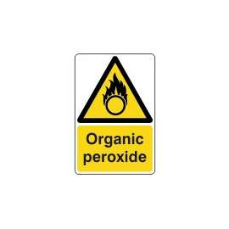
Introduction
Workplace Hazards
Hazard Control
Decision Making
Risk Assessment
Review
Chemical Hazards – Organic Peroxide
  The amount of exposure, the area of exposure and type of exposure are playing important roles in determining a possible body harm.
  Corrosive organic peroxides can also attack and destroy metals.

Slide 55
Introduction
Workplace Hazards
Hazard Control
Decision Making
Risk Assessment
Review
Chemical Hazards – Organic Peroxide
Organic peroxide
  Usage
    Plastics and rubber industries are the main users of organic peroxides.
    Organic peroxides and mixtures containing an organic peroxide are used as accelerators, activators, catalysts, cross-linking agents, curing agents, hardeners, initiators and promoters.
    It is important to take the necessary steps to know the materials being used as accelerators, activators, catalysts, etc. for the workers in that sector.
    Using the terms such as accelerators, activators, catalysts, etc. may cause confusion about the hazardous level and serious accidents may occur.

Slide 56
Introduction
Workplace Hazards
Hazard Control
Decision Making
Risk Assessment
Review
Chemical Hazards – Toxic Materials
Toxic materials
  Toxic materials are dangerous and most likely to be around the workplace area.
  There are many ways of toxic materials entering the body:
    Skin contact
    Inhalation
    Non-hygienic practices
  Toxic materials can cause serious health effects in an exposed individual.

Slide 57
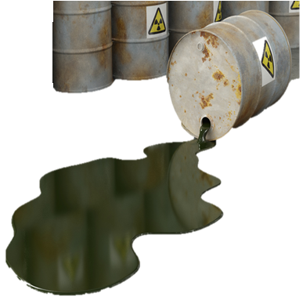
Introduction
Workplace Hazards
Hazard Control
Decision Making
Risk Assessment
Review
Chemical Hazards – Toxic Materials
  The degree of hazard associated with any toxic material is related to the exact material the person is exposed to, concentration of the material, the route into the body and the amount absorbed by the body.
Ref: Hazardous materials, palm beach county, www.pbcgov.com

Slide 58
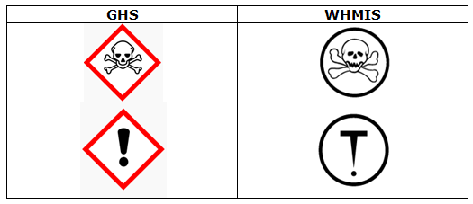
Introduction
Workplace Hazards
Hazard Control
Decision Making
Risk Assessment
Review
Chemical Hazards – Toxic Materials
Toxic materials are classified as they are shown in the table.
WHMIS categorizes toxic materials in two divisions:
  Division 1: Materials causing immediate and serious toxic effects (top symbol)
  Division 2: Materials causing other toxic effects (bottom symbol)

Slide 59
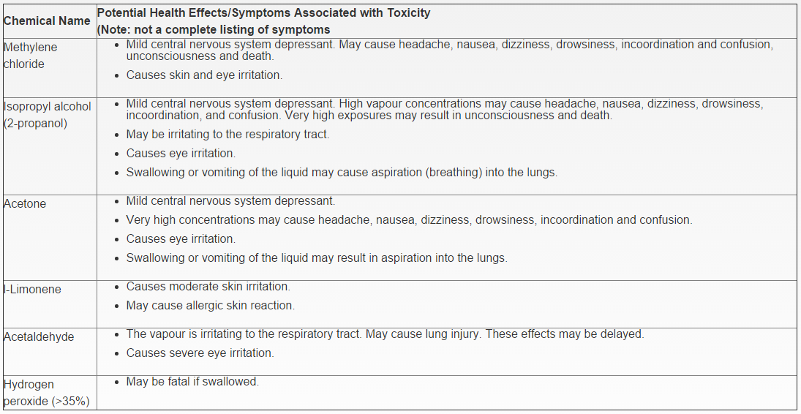
Introduction
Workplace Hazards
Hazard Control
Decision Making
Risk Assessment
Review
Chemical Hazards – Toxic Materials
Ref: Canadian Centre for Occupational Health and Safety, copyright 1997-2014, www.ccohs.ca

Slide 60
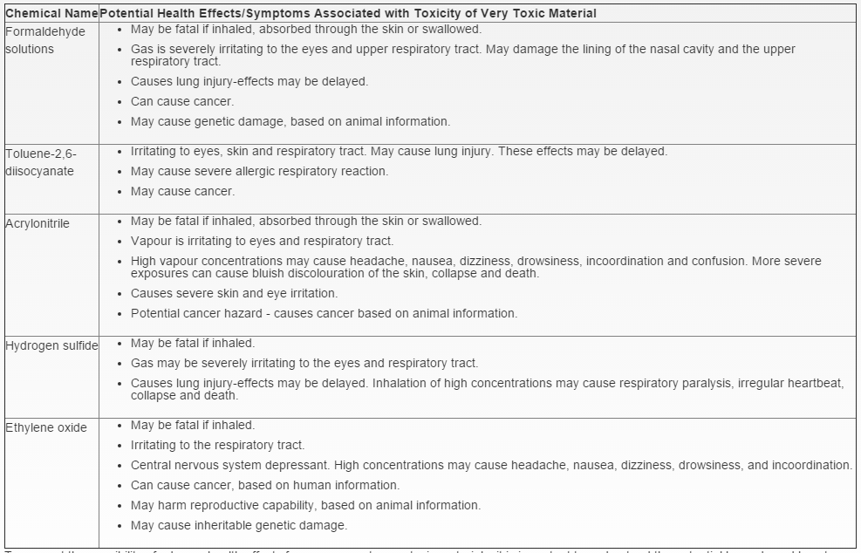
Introduction
Workplace Hazards
Hazard Control
Decision Making
Risk Assessment
Review
Chemical Hazards – Toxic Materials
Ref: Canadian Centre for Occupational Health and Safety, copyright 1997-2014, www.ccohs.ca

Slide 61
Introduction
Workplace Hazards
Hazard Control
Decision Making
Risk Assessment
Review
Hazard Control – Chemical
General tips for chemical safety
  Always read the label on the chemical bottle.
  Always follow the directions and precautions listed on the label.
  Never use a chemical if you are unsure what it is or how to protect yourself.
  Always take the time to protect yourself and those working around you.
  Always dispose of a chemical properly. Every municipality has a household hazardous waste drop-off location. For safe disposal of chemical products at work, contact your health and safety representative.

Slide 62
Introduction
Workplace Hazards
Hazard Control
Decision Making
Risk Assessment
Review
Hazard Control – Chemical
Controlling chemical hazards in the workplace
  Reduce or eliminate the use of hazardous chemicals whenever possible.
  Maintain adequate ventilation systems to reduce concentrations of airborne chemicals.
  Practicing good personal hygiene (e.g. washing hands) and maintaining regular workplace cleaning routines can reduce the amount of a chemical substance that is absorbed by a worker’s body. Learn how to avoid carrying hazardous substances home.

Slide 63
Introduction
Workplace Hazards
Hazard Control
Decision Making
Risk Assessment
Review
Psychosocial Hazards
Psychosocial hazards are hazards that impact the mental state of workers.
Violence, stress, and harassment are examples of this type of workplace hazard.
Regulations have been enacted in recent years to protect workers from these hazards in the workplace. For example, most Canadian jurisdictions now have a requirement for employers to have workplace violence policy in place.

Slide 64
Introduction
Workplace Hazards
Hazard Control
Decision Making
Risk Assessment
Review
Hazard Control - Psychosocial
Preventive solutions
  Implementing collective risk assessment and management measures, as it is done with other workplace hazards
  Adopting collective and individual preventive and control measures
  Increasing the coping ability of workers by increasing their control over their tasks
  Improving organizational communication
  Allowing workers’ participation in decision making
  Building up social support systems for workers within the workplace
  Taking into account the interaction between working and living conditions
  Enhancing the value placed on safety and health within the organization

Slide 65

Introduction
Workplace Hazards
Hazard Control
Decision Making
Risk Assessment
Review
Reckless Endangerment
- Definition: Reckless endangerment consists of acts that create a substantial risk of serious physical injury to another person. The accused person isn't required to intend the resulting or potential harm, but must have acted in a way that showed a disregard for the foreseeable consequences of the actions.
- Ontario Workplace Violence -
“Worker must not engage in any prank,
contest, feet of strength, unnecessary running
or rough and boisterous conduct.”
[section 28(2)(d)]

Slide 66

Introduction
Workplace Hazards
Hazard Control
Decision Making
Risk Assessment
Review
Biological Hazards
Biological hazards are also known as biohazards. Any biological source of danger such as viruses, insects, etc. that can cause harm to the health of living organism is considered as a biohazard.
Workplace diseases are also biohazards and using administrative hazard control methods such as workplace and employee hygiene, this hazard can be avoided.
Employees who experience any symptoms of body abnormality should immediately report and be treated.
Bio hazards are everywhere in the working environment and there is no certain area. Therefore, workers need to be aware and always take personal and workplace hygiene seriously.

Slide 67
Introduction
Workplace Hazards
Hazard Control
Decision Making
Risk Assessment
Review
Biological Hazards - Examples
Disease | Symptoms | Preventions
Clostridium difficile: This is a bacterium associated with diarrhea and intestinal inflammation. Normally affected by people who have other conditions. | Fever Nausea Abdominal pain Loss of appetite Watery diarrhea | Educate workers Hygiene practices in accordance to safety culture Appropriate protective clothing
Common cold: This is an infection of upper respiratory tract, the nose, nasal passages and the throat. | Laryngitis (inflammation of the larynx) Worsening of asthma Ear infection Bronchitis (inflammation of the bronchial membranes) | Wash hands frequently Take fresh air every once in a while Stay out of contact of other people Use common cold consumer tablets
Indoor air quality – Moulds and Fungi: This micro-organism generated from breakdown of leaves, wood and other plants can enter a building through air and they can grow on wood and/or drywall. | Eye, nose and throat irritation Fatigue Aggravation of asthma Headaches Concentration difficulty Cough | Vent showers and moisture generating Humidity control and dehumidifiers Exhaust fans when cooking or washing Immediate flood or spill cleaning Rapid stain removal of carpets

Slide 68
Introduction
Workplace Hazards
Hazard Control
Decision Making
Risk Assessment
Review
Biological Hazards - Examples
Disease | Symptoms | Preventions
Hepatitis A: This is a liver infectious disease caused by the hepatitis A virus (HAV). | Fever Tiredness Loss of appetite Nausea Adnominal pain Dark urine | Educate workers Hygiene practices in accordance to safety culture Appropriate protective clothing
Hepatitis B: This is a liver infectious disease caused by the hepatitis B virus (HBV). | Mild symptoms such as general discomfort Joint pain Abdominal pain fatigue | Hepatitis A preventions plus: Safe collection of fluids and tissues for disposal Safe removal and disposal of protective clothing Detailed observation of using sharp objects

Slide 69
Introduction
Workplace Hazards
Hazard Control
Decision Making
Risk Assessment
Review
Biological Hazards - Examples
Disease | Symptoms | Preventions
Hepatitis C: This is a liver infectious disease caused by the hepatitis B virus (HBV). | Fever Nausea and vomiting Stomach pain Extreme fatigue Skin yellowing | Safe collection of fluids and tissues for disposal Safe removal and disposal of protective clothing Detailed observation of using sharp objects
Influenza: Caused by viruses that infect the respiratory tact including nose, throat and lungs. | Fever Cough Sore throat Runny nose Headache fatigue | Flu vaccines Canadian national advisory committee recommends flu shots for people over six months old.
Hepatitis A: This is a liver infectious disease caused by the hepatitis A virus (HAV). | Fever Tiredness Loss of appetite Nausea Adnominal pain Dark urine | Educate workers Hygiene practices in accordance to safety culture Appropriate protective clothing

Slide 70


Introduction
Workplace Hazards
Hazard Control
Decision Making
Risk Assessment
Review
Physical Hazards
Physical hazards are type of hazards that do not necessarily need any contact with the source and it can easily harm the body whether long term effects or instant damage.
Some common physical hazards at workplace include but not limited to:
  Noise
  Electrical
  Manual Labor

Slide 71
Introduction
Workplace Hazards
Hazard Control
Decision Making
Risk Assessment
Review
Hazard Control – Noise
Dependant on the context and conditions, but may include for example:
  Eliminate the source of the noise where possible
  Find alternative, quieter equipment to use
  Insulate worker areas from noise producing machines
  Reduce the amount of time spent in a high noise environment
  Provide hearing protection
  Provide hearing tests for workers to establish any loss of hearing attributable to work

Slide 72
Introduction
Workplace Hazards
Hazard Control
Decision Making
Risk Assessment
Review
Hazard Control – Electrical
Dependant on the context and conditions, but may include for example:
  Ensure only appropriately licensed or registered electricians carry out electrical work
  Switch off electricity where possible before working on equipment
  Ensure electrical equipment is in good working order (testing and tagging)
  Use battery operated tools rather than mains power tools where possible
  Meet electrical safety standards

Slide 73
Introduction
Workplace Hazards
Hazard Control
Decision Making
Risk Assessment
Review
Hazard Control – Manual Labor
Dependant on the context and conditions, but may include for example:
  Assess your workplace / workstation and identify risks or possible contributing factors
  Is the task necessary?
  Provide specialist equipment to assist in lifting/ carrying / moving people or objects
  Carry smaller loads
  Take breaks from repetitive work or introduce variation to the work
  Plan work to avoid the need to lift/carry / move objects when your body is fatigued
  Lower levels of stress. Tension in muscles long term can lead to injury

Slide 74
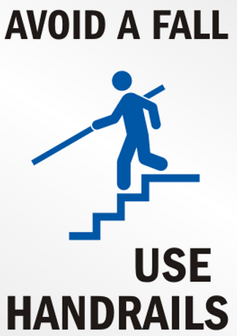

Introduction
Workplace Hazards
Hazard Control
Decision Making
Risk Assessment
Review
General Safety Hazards
There are many possible safety hazards that are categorized as general safety hazards, such as working at heights, machine pinch points and electrical shock.

Slide 75
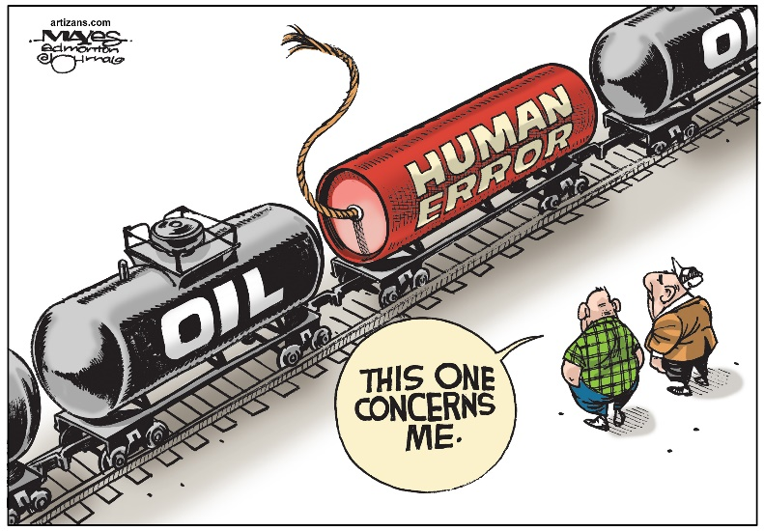
Introduction
Workplace Hazards
Hazard Control
Decision Making
Risk Assessment
Review
General Safety Hazards
Safety hazards are known as general classification of hazards.
These hazards consist of mechanical and human error hazards.
For instance, slipping and tripping are considered safety hazards. Loss of concentration during walking and accidentally touching running equipment is also an example of a human error safety hazard.

Slide 76
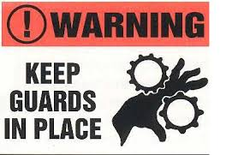
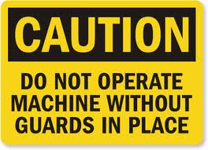
Introduction
Workplace Hazards
Hazard Control
Decision Making
Risk Assessment
Review
General Safety Hazards
Improper machinery guarding is an example of a mechanical hazard.
Equipment should be designed so that no part of a worker’s body (e.g. hands, fingers, hair) can become entangled in or touch moving equipment.

Slide 77
Introduction
Workplace Hazards
Hazard Control
Decision Making
Risk Assessment
Review
Hazard Control – Safety
Preventive solutions
According to the Canada Labour Code, the preventive measures for safety hazards are required by law.
Section 19.5:
The employer shall, in order to address identified and assessed hazards, including ergonomics-related hazards, take preventive measures to address the assessed hazard in the following order of priority:
  the elimination of the hazard, including by way of engineering controls which may involve mechanical aids, equipment design or redesign that take into account the physical attributes of the employee

Slide 78
Introduction
Workplace Hazards
Hazard Control
Decision Making
Risk Assessment
Review
Hazard Control – Safety
As part of the preventive measures, the employer shall develop and implement a preventive maintenance program in order to avoid failures that could result in a hazard to employees.
The employer shall ensure that any preventive measure shall not in itself create a hazard and shall take into account the effects on the work place.
The preventive measures shall include steps to address:
  a newly identified hazard in an expeditious manner
  ergonomics-related hazards that are identified when planning implementation of change to the work environment or to work duties, equipment, practices or processes
The employer shall ensure that any person assigned to implement ergonomics-related prevention measures has the necessary instruction and training.

Slide 79
Introduction
Workplace Hazards
Hazard Control
Decision Making
Risk Assessment
Review
Hazard Control – Safety
Certain hazards potentially pose such an elevated risk to workers, that they are singled out. Many companies call procedures related to these hazards “life saving rules” or “cardinal rules” as failure to follow these rules may result in death or severe injury.
These hazards are also generally covered in regulations.
Life saving rules:
  Lock, Tag, Clear, Try, Release
  Vessel Entry (Confined Space Entry)
  Line Breaks
  Fall Protection
  High Energy
  Intentional overriding of safety or environmental interlocks
  Reckless endangerment
  Seat Belts and mobile phones

Slide 80
Introduction
Workplace Hazards
Hazard Control
Decision Making
Risk Assessment
Review
Difference In Life Saving Rules From General Safety Rules
Failure to follow Life saving rules have a higher potential to result in serious injury including death.
Life saving rules are often regulated. (i.e. LTCTR, vessel entry, fall arrest, seat belts/ cell phones )
The response is generally more severe to violations of life saving rules, often resulting in termination or disciplinary action.

Slide 81
Introduction
Workplace Hazards
Hazard Control
Decision Making
Risk Assessment
Review
High Risk Activities
Introduction to high risk activities

Slide 82
Introduction
Workplace Hazards
Hazard Control
Decision Making
Risk Assessment
Review
High Risk Activities
Activities at work that are dangerous and need special training and/or permit to perform, are referred as High Risk Activity (HRA).
Depending on the job site, the activities may vary but some general HRAs are:
  Driving
  Fall from heights
  High-Pressure cleaning
  Working with high temperature equipment
  Confined space
  Line breaks
  Suspended loads
  Powered industrial trucks

Slide 83
Introduction
Workplace Hazards
Hazard Control
Decision Making
Risk Assessment
Review
Line Break
Line Break: Opening cleared or uncleared lines or equipment by actions that may include, but are not limited to:
  Breaking flanges
  Removing one or more bolts from flanges
  Removing valve bonnets and non-return (i.e., check) valve caps
  Breaking pipe joints
  Disconnecting tubing
  Disconnecting loading and unloading process hoses
  Opening inspection ports
  Making subtle adjustments (e.g., replacing packing on a valve)
  Before conducting a line break on site, formal training must be taken.
Notes:
Possible discussion:
a) Have the group provide examples of first breaks at this site
b) How do we protect ourselves during line breaks?
Blind / blank
Also need appropriate PPE.
Make break in such a way as to direct and potential release away from you (line of fire).

Slide 84
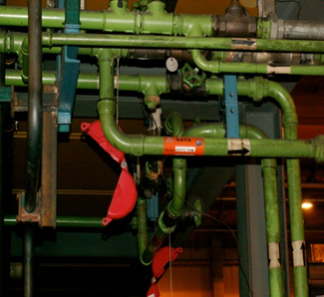
Introduction
Workplace Hazards
Hazard Control
Decision Making
Risk Assessment
Review
Line Break
Consider performing line break on a pipe:
Ensure piping has been shut down, isolated, blocked and cleared per company’s safe operation standards.
Control all job related energy and/or flow sources and lock out for the time the line break is being performed.
Ensure appropriate personal protective equipment have been used.
Log all actions performed with exact date and time.

Slide 85
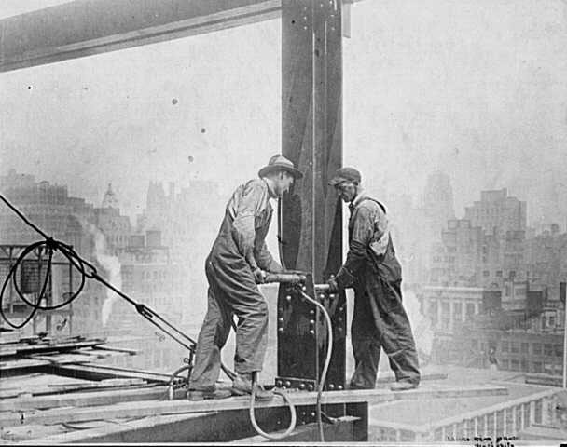
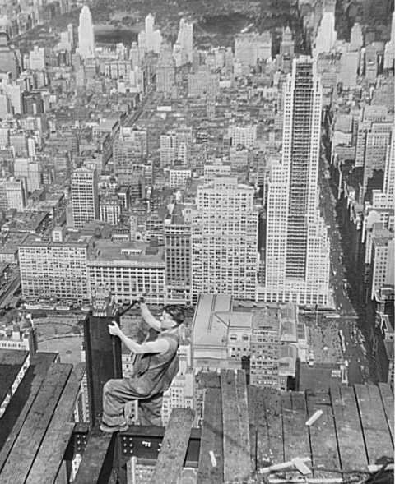
Introduction
Workplace Hazards
Hazard Control
Decision Making
Risk Assessment
Review
Fall Protection
In Canada over 42,000 workers get injured annually due to fall accidents. This number represents about 17% of the “lost time injuries" that were accepted by workers' compensation boards or commissions across Canada (based on statistics from Association of Workers' Compensation Boards of Canada, 2011).
All workers who use fall protection must be trained.
Where possible, processes should be designed to eliminate or minimize working from heights

Slide 86

Introduction
Workplace Hazards
Hazard Control
Decision Making
Risk Assessment
Review
Fall Protection
What is the difference between fall restraint and fall protection?
  Fall restraint is a system that does not allow the worker to get to the edge.
  Fall protection is required when working at the edge where no guard rail exists.

Slide 87
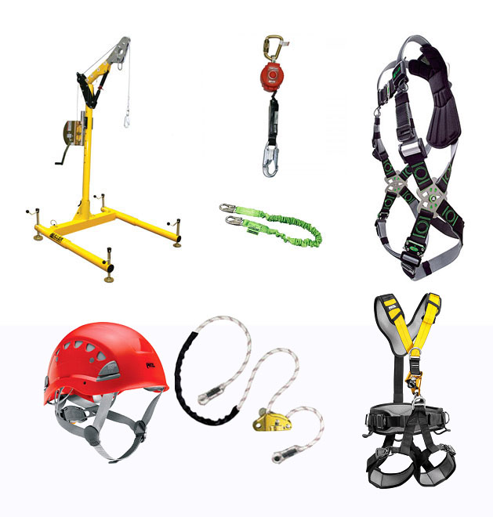
Introduction
Workplace Hazards
Hazard Control
Decision Making
Risk Assessment
Review
Fall Protection
In Ontario, ministry of labour requires employees working in heights to have special training.
In addition to training, there are some regulatory safety equipment needed under O.Reg. 213/91.
For construction for instance, these equipment are:
  Fall restricting system
  Travel restraint system
  Fall arrest system
  Safety net
  Work/Safety belt

Slide 88
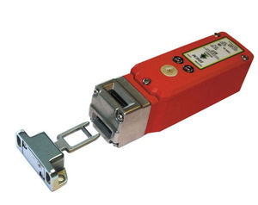
Introduction
Workplace Hazards
Hazard Control
Decision Making
Risk Assessment
Review
Intentional Overriding of an Interlock
Interlocks serve as important safety devices in industrial settings, where they protect employees from devices such as extruders, blenders, cutters etc.
While interlocks can be something as sophisticated as curtains of infrared beams and photo-detectors, they are often just switches.

Slide 89
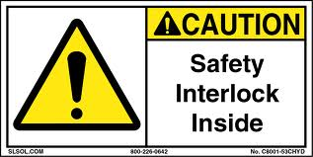
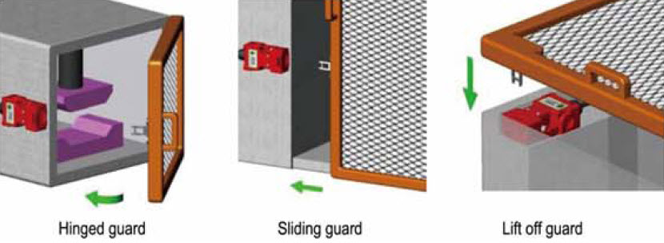
Introduction
Workplace Hazards
Hazard Control
Decision Making
Risk Assessment
Review
Intentional Overriding of an Interlock
Safety instrumented function (SIF)—also referred to as a PSM safety interlock. A function with a specified Safety Interlock, performed by an Safety Interlock System, that detects an out-of-limit (i.e., abnormal) condition or improper sequence and, without human intervention, either halts further action to prevent the process from entering an unsafe state or takes corrective action to bring the process to a functionally safe state. The SIF protects against the undesired consequence of a specific process hazardous event.

Slide 90
Introduction
Workplace Hazards
Hazard Control
Decision Making
Risk Assessment
Review
High Energy or Live Work
High energy is defined as a high energy circuit or device which when faulted can generate enough energy to create a fireball that will cause cell death by causing skin temperature to rise to at least 205ºF in 0.1 seconds (6 cycles)- 2nd degree burns. A high energy device is any device with a supply of 600 V, 200amp, and fed from a 750 KVA transformer or higher.
Only qualified electrical personnel may attempt any high energy switching
High energy work is any work with voltage above 50V

Slide 91

Introduction
Workplace Hazards
Hazard Control
Decision Making
Risk Assessment
Review
Drivers – Use of Cellphone
Ontario's ban on hand-held devices while driving took effect on October 26, 2009.
The law makes it illegal for drivers to talk, text, type, dial or email using hand-held cell phones and other hand-held communications and entertainment devices. The law also prohibits drivers from viewing display screens unrelated to the driving task, such as laptops or DVD players, while driving.

Slide 92
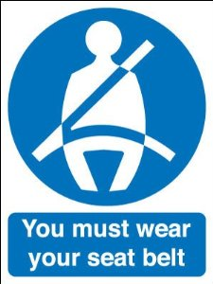
Introduction
Workplace Hazards
Hazard Control
Decision Making
Risk Assessment
Review
Drivers – Seat Belt
Today 93% of Canadians use their seat belts. Each percentage increase in the national seat belt wearing rate has helped to reduce the number of motor vehicle fatalities.
The 7% of Canadians not wearing seat belts account for almost 40% of fatalities in vehicle collisions. Ensure that you wear your seat belt properly, and that everyone else in your vehicle is protected by a seat belt or child restraint.
Seat belts save about 1,000 lives a year in Canada.

Slide 93

Introduction
Workplace Hazards
Hazard Control
Decision Making
Risk Assessment
Review
Confined Space
Definition of confined space:
It is large enough to allow full-body entry.
It has a restricted means of entry and exit.
It is not designed for continuous human occupancy.

Slide 94
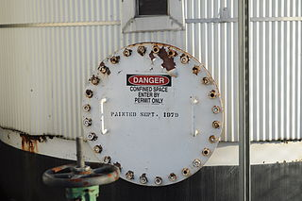
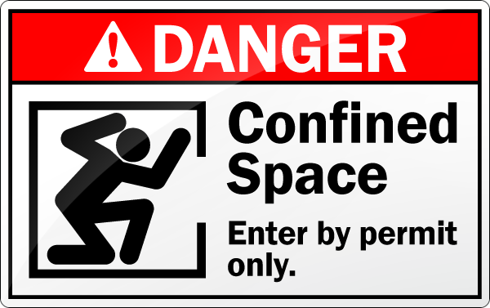
Introduction
Workplace Hazards
Hazard Control
Decision Making
Risk Assessment
Review
Confined Space
Many workers are injured and killed each year while working in confined spaces. An estimated 60% of the fatalities have been among the would-be rescuers.
All workers who enter a confined space or who perform related work, must be trained.

Slide 95
Introduction
Workplace Hazards
Hazard Control
Decision Making
Risk Assessment
Review
Confined Space
According to Ontario’s ministry of labour, the confined space is regulated due to atmospheric hazards that may occur.
The atmospheric hazards are:
  The accumulation of flammable, combustible or explosive agents,
  An oxygen content in the atmosphere that is less than 19.5 per cent or more than 23 per cent by volume, or
  The accumulation of atmospheric contaminants, including gases, vapours, fumes, dusts or mists, that could,
  Result in acute health effects that pose an immediate threat to life, or
  Interfere with a person's ability to escape unaided from a confined space.
Ref: Ontario Ministry of Labour

Slide 96
Introduction
Workplace Hazards
Hazard Control
Decision Making
Risk Assessment
Review
High Risk Activities
For more details about high risk activities, please visit the following website:
http://www.ccohs.ca/oshanswers/hsprograms/workingalone.html

Slide 97
Quiz I
Section 4 – Qualitative Risk Assessment
Section 4 – Risk Analysis Methods
INJURIES CAUSED BY REPEATING THE SAME MOVEMENT CONTINUOUSLY ARE A TYPE OF …
    PHYSICAL HAZARD
    ERGONOMIC HAZARD
    BIOLOGICAL HAZARD
    SAFETY HAZARD
FLASH-BACK OCCURE WITH:
    FLAMMABLE GASES
    CARBON MONOXIDE
    ASBESTOS
    CORROSIVE MATERIALS
CHEMICAL PRODUCT CONTAINERS CAN BE DISPOSED IN ANY BIN.
    TRUE
    FALSE

Slide 98
Quiz I
4) EMPLOYEES ARE NOT RESPONSIBLE FOR DOING WHICH OF THE FOLLOWING?
A) FOLLOWING SAFETY RULES
B) SUPERVISING CO-WORKERS
C) REPORTING HAZARDOUS CONDITIONS
D) USING PPE
WHICH TYPE OF HAZARD IS MOST COMMON IN THE WORKPLACE?
A) CHEMICAL HAZARDS
B) BIOLOGICAL HAZARDS
C) PHYSICAL HAZARDS
D) PSYCHOSOCIAL HAZARDS
NAME THE 3 SOURCES TO CAUSE FIRE OR EXPLOSION.
  ______________________________________
  ______________________________________
  ______________________________________
WHAT ARE THE 3 DEFINITIONS OF CONFINED SPACE?
  ______________________________________
  ______________________________________
  ______________________________________

Slide 99
Quiz I
WHAT IS THE DIFFERENCE BETWEEN FALL RESTRAINT AND FALL PROTECTION?
______________________________________________________________
______________________________________________________________
______________________________________________________________

Slide 100
Introduction
Workplace Hazards
Hazard Control
Decision Making
Risk Assessment
Review
Hazard Identification and Control
  Hazards at workplaces must be managed and controlled using appropriate methods.
  In Canada, hazard control is under provincial Occupational Health and Safety regulations or the federal Canada Labour Code, which clearly state that all the necessary precautions have to be taken to protect workers at workplaces.
  The law also states that all the necessary information must be clearly stated and available for workers that are operating different tools and equipment.
  Any potential source of danger at workplaces should be identified and treated as a hazard. Therefore necessary precautions must be applied.

Slide 101
Introduction
Workplace Hazards
Hazard Control
Decision Making
Risk Assessment
Review
Hazard Identification and Control
Define the hazard
List the possible harms
State controlling options
Apply controlling methods
Review
How to identify and control hazards:
  This diagram shows how a potential hazard can be controlled before causing any harm.

Slide 102
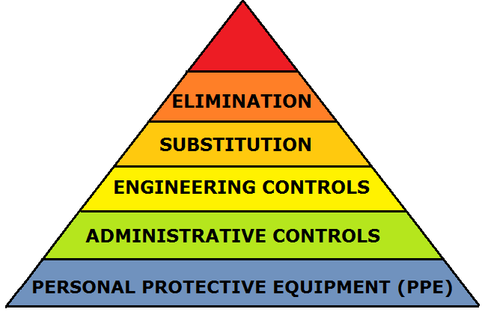
Introduction
Workplace Hazards
Hazard Control
Decision Making
Risk Assessment
Review
Hazard Identification and Control
  The methods for controlling hazards are as follow:
    Elimination or substitution
    Engineering controls
    Administrative controls
    Personal Protective Equipment (PPE)

Slide 103
Introduction
Workplace Hazards
Hazard Control
Decision Making
Risk Assessment
Review
Hierarchy of Safety Controls or “Safeguards
Elimination or substitution
Most Expensive
Most Effective
Engineering Controls
Warnings
Administrative Controls
Personal Protective Equipment
Least Expensive
Least Effective
Notes:
Safeguards - Hierarchy (or Priority or Preference) of Safeguards.
Ones that don’t rely on people following rules and procedures. More expensive, complicated – barriers, guards, engineering controls.
Elimination and Engineer Controls are generally more effective – they don’t rely on people. Eliminate the hazard.
And those that do rely on people.
The rub is people are human – we will eventually get tired, make mistakes and sometimes make poor decisions.
Warnings, Admin and PPE Safeguards do rely on people (recognizing, thinking & taking action).
PEOPLE have to understand and act. Warning devices (visual or audible), procedures, checklists, training, etc.
PPE is the last line of defense.
We usually use a combo of Safeguards to add “Layers Of Protection/Prevention”.

Slide 104
Introduction
Workplace Hazards
Hazard Control
Decision Making
Risk Assessment
Review
Hierarchy of Safety Controls or “Safeguards
These rely on people!
Elimination or substitution
Most Expensive
Most Effective
Engineering Controls
Warnings
Administrative Controls
Personal Protective Equipment
Least Expensive
Least Effective

Slide 105
Let’s look at examples of some of these controls
Introduction
Workplace Hazards
Hazard Control
Decision Making
Risk Assessment
Review
Hazard Identification and Control

Slide 106


Introduction
Workplace Hazards
Hazard Control
Decision Making
Risk Assessment
Review
Elimination or Substitution
    Elimination is the most effective risk control method as the hazard will permanently be removed from the job site.
    However, some hazardous materials are key components to the operation of that facility and cannot be eliminated

Slide 107
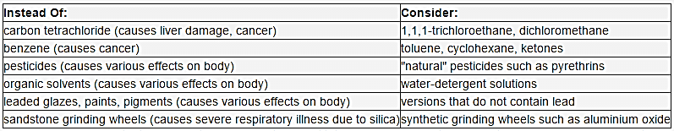
Introduction
Workplace Hazards
Hazard Control
Decision Making
Risk Assessment
Review
Elimination or Substitution
    Therefore, an alternate solution may be substitution of a less hazardous material. Canadian Centre for Occupational Health and Safety (CCOHS) uses the following example as suggestions for substitution of some chemicals.

Slide 108
Introduction
Workplace Hazards
Hazard Control
Decision Making
Risk Assessment
Review
Engineering Controls
Engineering controls are one of the most reliable methods of controlling hazardous materials and/or operations.
It is simply an engineering design that has all the safety features to protect the workers and the working environment from hazards.
There three types of engineering control method:
  Ventilation
  Process control
  Enclosure and/or isolation of the emission source
Engineering designs are playing an important role in controlling chemical hazards as there are designated engineered stations for testing, controlling the process and storing some highly hazardous chemicals.

Slide 109
Introduction
Workplace Hazards
Hazard Control
Decision Making
Risk Assessment
Review
Engineering Controls
As an engineer, some of your main working ethics should be:
  Making products safe for all those in using environment
  Value human life more than money
  Have courage to admit your mistakes
  Point out all the problems you find in your design
It is important to ensure that all the actions you take as an engineer are well within the occupational health and safety act.
Not only that, you should consider yourself as one of the responsible health and safety represents towards your design.

Slide 110
Introduction
Workplace Hazards
Hazard Control
Decision Making
Risk Assessment
Review
Engineering Controls
The following list is some of the responsibilities that a safety engineer has:
Research and interpret safety standards.
Handle effective Industrial Hygiene Program.
Support individual facilities to execute strategic initiatives to reach and sustain world class safety processes.
Assess risk on safety and ergonomics.
Evaluate facility procedures to determine conditions needing enhancement.
Create, enhance and maintain company safety programs, training and reports.
Lead safety project and manage risk execution using project management skills.

Slide 111
Introduction
Workplace Hazards
Hazard Control
Decision Making
Risk Assessment
Review
Engineering Controls– Safety engineer responsibilities
Oversee facility and processes to adhere to OHSA and corporate guidelines.
Suggest measures to minimize or eliminate industrial accidents and health hazards.
Develop, execute and handle occupational safety and health procedures.
Develop and review safety procedures.
Extend field support and support during normal operations and maintenance shut down.
Audit, investigate accident and analyze root causes and take corrective action.
Guide for kaizen and small group safety projects and assist Environmental Health and Safety (ISO) activities.

Slide 112
Introduction
Workplace Hazards
Hazard Control
Decision Making
Risk Assessment
Review
Engineering Controls – Ventilation
Ventilation can eliminate or reduce released gases, debris, etc. by clearing the contaminated air and replacing it with clean air in the working environment.
Ventilation is extremely adaptable and applicable to most chemicals and operations and has the ability to quickly remove the contaminated air from work environments.
Engineered ventilation systems can be readily accessible at the designated work stations and the workers can control the system while working.

Slide 113
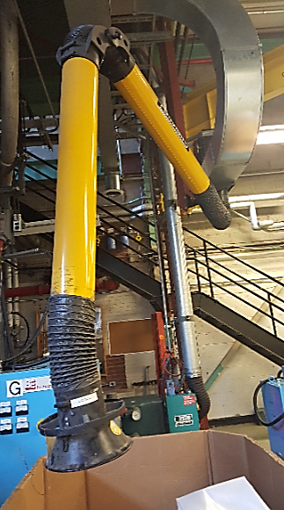
Introduction
Workplace Hazards
Hazard Control
Decision Making
Risk Assessment
Review
Engineering Controls – Ventilation
This image shows a practical example of a flexible ventilation system. This picture was taken at DuPont Canada, Kingston, ON facility.

Slide 114
Introduction
Workplace Hazards
Hazard Control
Decision Making
Risk Assessment
Review
Engineering Controls – Ventilation
The hood, located at the face of the vent, helps capture and remove contaminants from the area.
The ductwork moves the air to a rooftop vent or cleaning device, such as a thermal oxidizer or absorber, that may be engineered into the system.
In some cases, there is an exhaust fan on top instead of a cleaning device.
The exhaust fan must overcome all the losses due to friction, hood entry and fittings in the system to produce the intended flow.
Air cleaning devices are important as they clean the air from any particles, gasses, vapours, etc. and protect the surrounding environment by sending clean air to the exhausts.
These ventilation devices generally require provincial air discharge permits.

Slide 115
Introduction
Workplace Hazards
Hazard Control
Decision Making
Risk Assessment
Review
Engineering Controls – Process Control
Process control is monitoring a process carefully using engineering devices to ensure all the safety considerations are taken into account and the process will not be hazardous to the workers.
Process management of change for the facilities as well as the technology are important tools to reduce hazards.
For instance, using water for grinding and drilling can improve the safety, as the friction force between the equipment and work surface reduces, therefore the equipment will not heat up and sparks are less likely to be generated.
Using electric motors rather than diesel ones is environmentally friendly and eliminates diesel emissions.
Using mechanical equipment rather than manual methods for transportation can eliminate ergonomic and other safety hazards.

Slide 116
Introduction
Workplace Hazards
Hazard Control
Decision Making
Risk Assessment
Review
Engineering Controls – Enclosure or Isolation
Enclosing hazards will help protect workers from the hazards.
For example, reactive chemicals that were recently used in the workplace could still be reactive and pose a hazard if not properly enclosed and controlled. Isolating the work area is an effective means of controlling the hazard.
The use of ventilation tools such as fume hoods, elephant trunks, and ventilated enclosures which are close to work stations and/or throughout the job site provides a means of reducing risk of exposure to chemicals

Slide 117
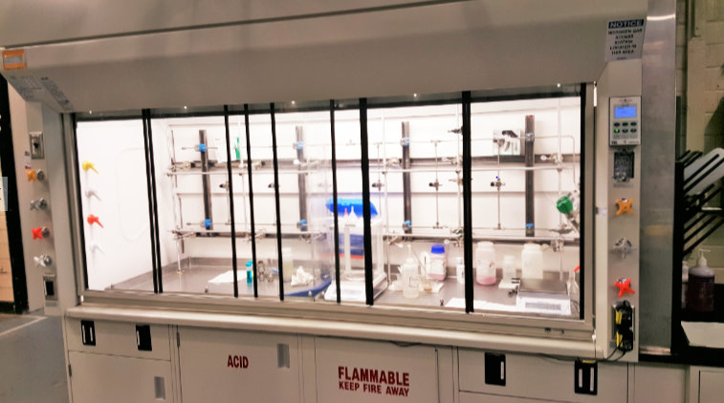
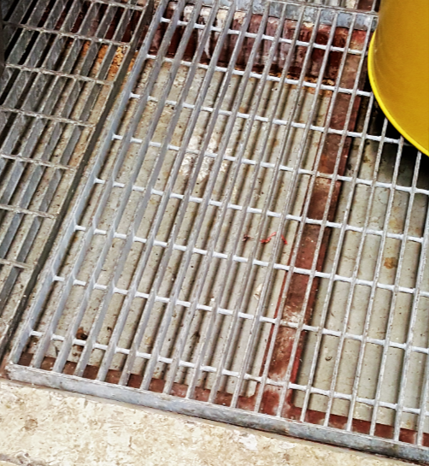
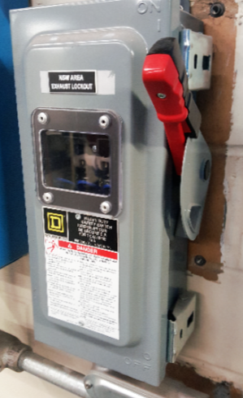
Introduction
Workplace Hazards
Hazard Control
Decision Making
Risk Assessment
Review
Engineering Controls Examples
An example of engineering design for process control and ventilation
An example of engineering design for potential leaking chemicals
An example of engineering design for lock out

Slide 118
Let’s move on to “Administrative Controls”
Introduction
Workplace Hazards
Hazard Control
Decision Making
Risk Assessment
Review
Hazard Control

Slide 119
Introduction
Workplace Hazards
Hazard Control
Decision Making
Risk Assessment
Review
Administrative Controls
Examples of administrative controls are:
  Education and training
  Work practices and safety culture concept
  Personal and facility hygiene
  Emergency response and preparedness

Slide 120
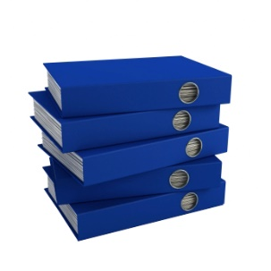
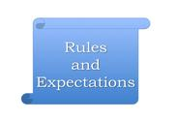

Introduction
Workplace Hazards
Hazard Control
Decision Making
Risk Assessment
Review
Administrative Controls
Can help protect workers by:
  setting boundaries to work stations
  providing specific rules and guidelines
  setting time limits for working around hazardous areas
  ensuring the personal protective devices are at the workers disposal are examples of administrative controls.
Another effective administrative control is posting signs visible to workers at the entrance of each room to identify hazards and the required Personal Protection Equipment (PPE). This way, workers will be informed about the possible dangers and how the danger can be prevented.

Slide 121
Introduction
Workplace Hazards
Hazard Control
Decision Making
Risk Assessment
Review
Administrative Controls – Education and Training
There are various ways for an employer to provide education and training to raise awareness of occupational health and safety hazards and issues:
  Hands-on training in an operating area
  Classroom instruction
  Regular safety meetings, daily, weekly or monthly
  Email or posting printed material concerning are forms of educating workers under administrative control.
It is important to verify the effectiveness of the training by testing or quizzing the workers about the health and safety at the workplace. This ensures the workers understand the training.
Safety education may also contain information on emergency response, to ensure proper response/rescue and prevent additional injuries or fatalities.
If a location cannot provide on site emergency response, arrangements with trained professionals can be made.

Slide 122
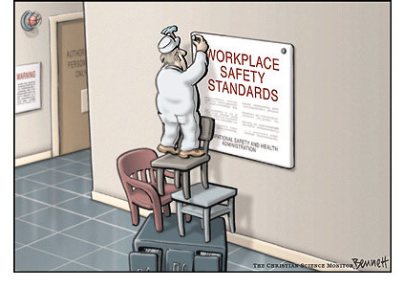
Introduction
Workplace Hazards
Hazard Control
Decision Making
Risk Assessment
Review
Administrative Controls – Work Practices and Safety Culture Concept
Generating rules and regulations in regards to safe operation of workplace equipment is the main objective of work practices or performance control.
Proper maintenance and test schedules for equipment is also important to ensure safe operation.
By creating a safe work practice environment, the safety culture will be more effective and the workers will follow the safety culture.
Ref: Sign media, free sign, UK

Slide 123
Introduction
Workplace Hazards
Hazard Control
Decision Making
Risk Assessment
Review
Administrative Controls – Personal and Facility Hygiene
Poor industrial hygiene in the workplaces raises the potential for occupational injury and illness.
Using administrative controls, such as housekeeping protocols and safe handling procedures, the employers can provide a clean working environment that helps remind the employees of the importance of a good safety culture, and operating discipline.
Good operational discipline will positively impact production and quality as well.
It is also important to use administrative signs and isolate contaminated areas to ensure safety of workers.
PPE must also be kept clean and in good repair.

Slide 124
Introduction
Workplace Hazards
Hazard Control
Decision Making
Risk Assessment
Review
Administrative Controls – Emergency Response and Preparedness
Some facilities may have trained emergency crew on site to handle specific hazardous occurrences at work; however, all workers must be aware of the basic emergency responses to be prepared in emergency situations.
Emergency responders may also be exposed to bodily fluids such as vomit or blood which contain pathogens.
In an emergency, the situation can be controlled until emergency crews arrive at site. Also, workers will keep themselves safe from the hazards.

Slide 125

Introduction
Workplace Hazards
Hazard Control
Decision Making
Risk Assessment
Review
Administrative Controls – Emergency Response and Preparedness
Ensuring that trained First aid and CPR resources are available with training updated at appropriate intervals helps ensure the quality of response.
Having an emergency preparedness checklist, helps remind workers about potential concerns and how to respond in case of emergencies.
Ref: Sign media, free sign, UK

Slide 126

Introduction
Workplace Hazards
Hazard Control
Decision Making
Risk Assessment
Review
Lock, Tag, Clear, Try, Release (Lockout/Tagout)
Every year in Canada, workers are injured or killed because equipment, machinery or processes were not properly locked out.
Lockout is used during operations such as maintenance, repair, cleaning and replacement of machinery, during which normal control measures may not be working, and new hazards may occur.

Slide 127
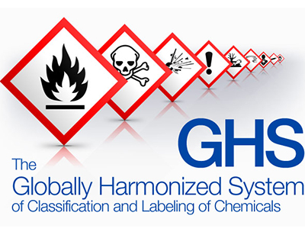

Introduction
Workplace Hazards
Hazard Control
Decision Making
Risk Assessment
Review
Administrative Controls
Let’s study the two very detailed administrative hazard control systems

Slide 128
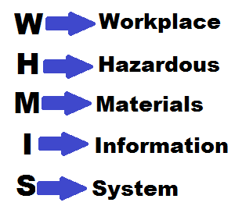
Introduction
Workplace Hazards
Hazard Control
Decision Making
Risk Assessment
Review
Administrative Controls – WHMIS
WHMIS is a nationwide system developed to provide information on hazardous materials at workplaces. This system has been in effect in Canada since 1988.
WHMIS also brings a classification system to list all the materials within the workplace in a data sheet.
MSDS (Material Safety Data Sheets) is what required by WHMIS to be present in workplaces working with hazardous materials.
Currently Canadian WHMIS requires 9 sections for MSDS.

Slide 129
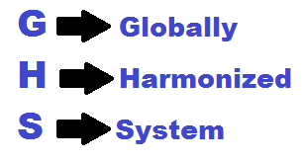
Introduction
Workplace Hazards
Hazard Control
Decision Making
Risk Assessment
Review
Administrative Controls – GHS (WHMIS 2.0)
WHMIS regulations in Canada were modified in July 2015 to include the requirements of the Globally Harmonized System (GHS).
GHS is a system of classification and labeling of the hazards.
It communicates health and safety on labels and safety data sheets (SDS) with a goal of harmonizing the hazard classification and labeling system globally.
GHS was developed by an international group of health and safety experts.

Slide 130

Introduction
Workplace Hazards
Hazard Control
Decision Making
Risk Assessment
Review
Administrative Controls – WHMIS (Controlled Products)
Controlled products are materials that are regulated by WHMIS to be listed as hazardous materials.
Controlled substances fall into one or more categories of the 6 WHMIS categories.
WHMIS intends to raise awareness for all the workers working with controlled products to be aware of the danger and wear the appropriate Personal Protection Equipment (PPE).
WHMIS training is MANDATORY for all the workers working with chemicals.

Slide 131
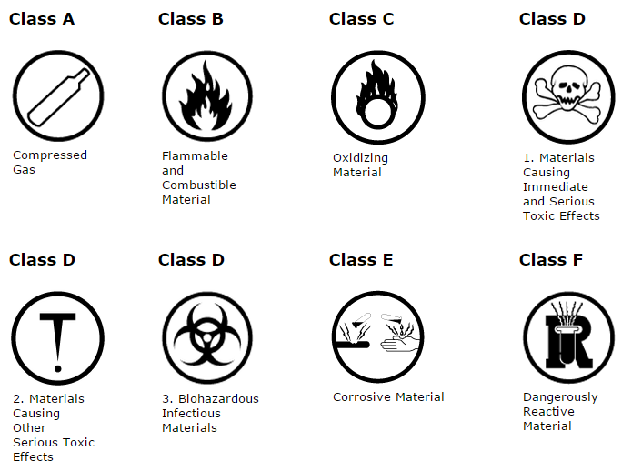
Introduction
Workplace Hazards
Hazard Control
Decision Making
Risk Assessment
Review
Administrative Controls – WHMIS Symbols

Slide 132

Introduction
Workplace Hazards
Hazard Control
Decision Making
Risk Assessment
Review
Administrative Controls – WHMIS Labeling
Ref: Ontario ministry of labor

Slide 133

Introduction
Workplace Hazards
Hazard Control
Decision Making
Risk Assessment
Review
Administrative Controls – GHS Labeling
Ref: OSHA, Government of USA

Slide 134

Introduction
Workplace Hazards
Hazard Control
Decision Making
Risk Assessment
Review
Administrative Controls – WHMIS Symbols Vs. GHS Pictograms
Ref: DuPont, WHMIS and WHMIS 2.0

Slide 135

Introduction
Workplace Hazards
Hazard Control
Decision Making
Risk Assessment
Review
Personal Protective Equipment (PPE)
PPE is considered the last line of defense from a hazard and an important part of hazard control.
Some types of PPE are chemical protective clothing, hard hats, safety shoes, respiratory equipment, gloves, etc.
Part of administration control is managing the information about PPE for every hazard within the facility.
It is important for every worker to know the selection process for PPE.
Ref: Sign media, free sign, UK

Slide 136
Introduction
Workplace Hazards
Hazard Control
Decision Making
Risk Assessment
Review
PPE Selection Process
Identify hazards within the work area
Identify the possible harms may be resulted from those hazards
Select the appropriate PPE
Ensure proper fit of the PPE
Notes:
Reworded

Slide 137
Quiz II
WHICH ONE IS NOT A METHOD OF HAZARD CONTROL?
  PROCESS CONTROL
  DIRECT SUPERVISION
  EDUCATION AND TRAINING
  VENTILATION
WHEN IT COMES TO HAZARD CONTROL, WHAT COMES FIRST AS THE REQUIRED METHOD BASED ON THE HIERARCHY?
  PPE
  ENGINEERING CONTROLS
  ADMINISTRATIVE CONTROLS
  ELIMINATION
WHICH ONE OF THE FOLLOWING IS NOT A METHOD OF ADMINISTRATIVE CONTROL?
  PROCESS CONTROL
  EMERGENCY PREPAREDNESS
  SIGNS AND INFORMATIVE LABELS
  SAFETY CULTURE
WHAT DOES PPE STAND FOR?
  PERSONAL PREPAREDNESS EVALUATION
  PERSONAL PROTECTIVE EQUIPMENT
  PERSONAL PROFESSIONAL EQUIPMENT
  PERSONAL POWERED EQUIPMENT
Section 4 – Bowtie Analysis
Section 4 – Risk Analysis Methods

Slide 138
Introduction
Workplace Hazards
Hazard Control
Decision Making
Risk Assessment
Review
Decision Making
Decision making
Identify problem or opportunity
Collect information
Analyze the situation
Develop options
Evaluate the options and alternatives
Make a selection
Implement the decision

Slide 139
Introduction
Workplace Hazards
Hazard Control
Decision Making
Risk Assessment
Review
Decision Making
As this seems to be a natural instinct for people to make decisions on a daily basis; however, there is a science behind making an educated decision to minimize the risks.
These 7 steps are recommended for making an educated decision
  Identify a problem or opportunity
    Recognizing a problem and identifying whether the problem is worthwhile to be solved is the first step.
    What should be focused is the reality behind the issue and one can consider whether the decision can satisfy questions such as:
      Will it make a difference?
      How worthwhile will it be?
  Collect as much as information as possible
    What needs to be known before making a decision is very important.
    Also, seeking help from people working in that area for their knowledge is beneficial.

Slide 140
Introduction
Workplace Hazards
Hazard Control
Decision Making
Risk Assessment
Review
Decision Making
Analyze the situation
  Define the available alternative actions.
  Analyze whether the situation can be controlled by those alternatives.
Develop options
  Develop several possible options for the situation.
  For each option, one can ask “what if” questions to determine the options are sufficient enough.
Evaluate the options and alternatives
  Evaluate feasibility, acceptability and desirability.
  Determine the best alternative that will achieving the objective

Slide 141

Introduction
Workplace Hazards
Hazard Control
Decision Making
Risk Assessment
Review
Decision Making
Make a selection
  Select the proffered alternative
  Determine if there might be any problems it create.
Implement the decision
  After careful consideration and following the necessary steps, act on the decision.
  Reconsider the allocated resources for implementation and make sure this is accepted and supported by colleagues.

Slide 142
Introduction
Workplace Hazards
Hazard Control
Decision Making
Risk Assessment
Review
Decision Making Matrix
In this table the options and objectives are listed. Based on the each objective, an option will be rated to determine the overall level of importance.
For instance, considering an equipment change in a factory, the employee responsible to make an educated decisions can consider the following objectives:
  Cost
  Safety
  Durability
  Adaptability/trainability
  Overall effectiveness
Please note that the objectives may vary based on the employer’s decision or other factors.

Slide 143
Introduction
Workplace Hazards
Hazard Control
Decision Making
Risk Assessment
Review
Decision Making Matrix
Let’s say your employer asked you to choose the best option for an old equipment replacement; How would you rate the objectives?
 | Cost | Safety | Durability | Effectiveness | Total
Option 1: Do not change
Option 2: Brand new purchase
Option 3: Used purchase

Slide 144
Introduction
Workplace Hazards
Hazard Control
Decision Making
Risk Assessment
Review
Decision Making Matrix
 | Cost | Safety | Durability | Effectiveness | Total
Option 1: Do not change | 10 | 2 | 1 | 1 | 14
Option 2: Brand new purchase | 3 | 10 | 10 | 7 | 30
Option 3: Used purchase | 5 | 7 | 6 | 4 | 22
The rating in this example shows that buying a brand new equipment might be a better option.
In order to get more accurate results, it is strongly recommended to weigh each objective. For instance, safety always comes first and must have the highest weight. Therefore, the rate of the option can be multiplied by the weight.

Slide 145
Introduction
Workplace Hazards
Hazard Control
Decision Making
Risk Assessment
Review
Decision Making Matrix
Considering the example below with the following rates of cost (8), Safety (10), Durability (8) and Effectiveness (7):
 | Cost | Safety | Durability | Effectiveness
Option 1: Do not change | 10 | 2 | 1 | 1
Option 2: Brand new purchase | 3 | 10 | 10 | 7
Option 3: Used purchase | 5 | 7 | 6 | 4
Then the result for option 2 will be as follow:
(3 x 8) + (10 x 10) + (10 x 8) + ( 7 x 7) = 253

Slide 146
Introduction
Workplace Hazards
Hazard Control
Decision Making
Risk Assessment
Review
Risk Assessment
One of the most critical processes to prevent tragedies is risk assessment where:
  The hazard will be identified.
  The risk associated with that hazard will be evaluated.
  The appropriate solutions will be determined to whether control or eliminate the hazard.
Anything at workplace that may cause harm, particularly to people should be identified as a hazard and the risk assessment should be conducted to control or eliminate.

Slide 147
Introduction
Workplace Hazards
Hazard Control
Decision Making
Risk Assessment
Review
Risk Assessment
Risk assessment is beneficial as it helps to:
  Identify who might be at risk (employees, staff, visitors, contractors, etc.)
  Prioritize hazards and control measures
  Determine of adequacy of existing control measures
  Prevent injuries or illnesses
  Create awareness and inform people of the existing risks

Slide 148
Introduction
Workplace Hazards
Hazard Control
Decision Making
Risk Assessment
Review
Risk Assessment
Risk assessment aims to remove a hazard or reduce the level of the risk to an acceptable level.
The assessment should consider all equipment as well as employees
A risk assessment matrix is one of the very effective methods to determine the level of severity of the risk.
Below are some of the components that should be taken into account for conducting risk assessment.
  Identification of hazards
  Consideration of different circumstances such as power outage, shutdowns, emergencies and normal operational situations
  Evaluation and monitoring of the risk to ensure it is under control

Slide 149
Introduction
Workplace Hazards
Hazard Control
Decision Making
Risk Assessment
Review
Risk Assessment
  Evaluation of likelihood and severity of the injury or illness
  Reviewing all the available health and safety information about the hazard such as MSDSs, manufacturers literature, results of testing, etc.
  Keeping any necessary documentation or records that include the detailed risk assessment technique outlining evaluation details and conclusions.
Identify
Evaluate
Control
Review

Slide 150
Introduction
Workplace Hazards
Hazard Control
Decision Making
Risk Assessment
Review
Risk Assessment
Below is a summarized version of hazard identification process:
  Conduct a research of past incidents including their severity and any harm or damage resulted
  Consider all the people helping the workplace to operate (employees, drivers, cleaners, etc.)
  Include non-routine activities such as maintenance or repair
  Overlook the possible impacts of the hazards as well as the foreseeable unseal conditions
  Include risk assessment for the visitors and the public
  Ensure the risk assessment accounts for new and less experienced people

Slide 151
Introduction
Workplace Hazards
Hazard Control
Decision Making
Risk Assessment
Review
Risk Assessment
Each hazard should be studied individually to determine the possible and the level of the risks it may cause. The following methods are recommended to study a hazard:
  Product information issued by the manufacturer
  Facts about that product and past experiences
  Information from trustworthy sources and organizations
  Reviewing MSDS/SDS and manufacturer documentation
  Help from occupational health and safety professionals
  Test results of the hazardous materials or equipment
  Previous injury information

Slide 152

Introduction
Workplace Hazards
Hazard Control
Decision Making
Risk Assessment
Review
Risk Assessment
The following factors are important to contribute to the level of risk:
  The work environment
  The system being used
  The range of foreseeable conditions
  The capability, skill and experience of the workers

Slide 153
Introduction
Workplace Hazards
Hazard Control
Decision Making
Risk Assessment
Review
Risk Assessment
In order to determine the severity of the hazards, they should be ranked and prioritized. It is important to consider personnel exposure to the hazard first and treat this as a priority. Below are recommended for ranking and prioritizing:
  Percentage of workforce exposed
  Degree of harm
  Probability of the occurrence
  Frequency of exposure
The above are helpful but not limited. There is no simple one way to understand the importance of the risks caused by hazards.
Risk assessment matrix is a very effective method to determine the risks of hazards.
The matrix is in form of a table that basically determines the likelihood and the severity of the hazards

Slide 154
Introduction
Workplace Hazards
Hazard Control
Decision Making
Risk Assessment
Review
Risk Assessment Matrix
The following terms are used to define the likelihood of harm:
  Very Likely
    This is the most frequent likeliness of the occurrence. For instance, if a worker is exposed to the hazard on every work shift, it is very likely to harm more people
  Likely
    This level could indicate a typical exposure of once a year
  Unlikely
    This indicates the very low percentage of the exposure; normally once in a lifetime.

Slide 155

Introduction
Workplace Hazards
Hazard Control
Decision Making
Risk Assessment
Review
Risk Assessment Matrix
  Very Unlikely
    This is the least risk level and it is normally an educated assessment of a chance of exposure of 1% by an individual in their working lifetime.
Ref: Pamikan, Risk assessment

Slide 156
Introduction
Workplace Hazards
Hazard Control
Decision Making
Risk Assessment
Review
Risk Assessment Matrix
Definition for severity of harm
  When the potential severity of harm needs to be established, consider the following:
    Part(s) of the body likely to be affected.
    Nature of the harm:
      Slightly harmful
        First Aid Treatment - Minor cuts, scratches, eye irritation from dust, etc.
    Harmful
      Medical Treatment - Burns, concussion, minor fractures, etc.
    Extremely harmful
      Lost or Restricted Work - Major fractures, poisoning, fatal injuries, etc.

Slide 157
Introduction
Workplace Hazards
Hazard Control
Decision Making
Risk Assessment
Review
Risk Assessment Matrix
Definition of risk level
  Very high
    These risks are unacceptable and are need of immediate attention and control measures. In most cases these risks are controlled for the workplace lifetime.
  High
    Substantial efforts must be made to reduce the risk and eliminate any possible harm it may cause. These risks are also in need of proper control measures.
  Medium
    Careful considerations must be taken into account whether the risks could be lowered or not and apply control measures if necessary.

Slide 158

Introduction
Workplace Hazards
Hazard Control
Decision Making
Risk Assessment
Review
Risk Assessment Matrix
  Low
    These risks are normally not in need of control measures unless they can be implemented at a very low cost.
  Very low
    These are acceptable risks and there is no further action required for their control.
Ref: Quality risk analysis, Intehopen

Slide 159

Introduction
Workplace Hazards
Hazard Control
Decision Making
Risk Assessment
Review
Risk Assessment Matrix
Example of hazard priority setting
Ref: Hazard and risk assessment, CCOHS

Slide 160

Introduction
Workplace Hazards
Hazard Control
Decision Making
Risk Assessment
Review
Risk Assessment Matrix
An example of a risk matrix

Slide 161
Quiz III
DURING THE EXECUTION OF A PROJECT, A RISK IS IDENTIFIED BY A TEAM MEMBER. THIS RISK IS NOT IN THE RISK REGISTER (A SYSTEM THAT REGISTERS EXISTING RISKS). AS A PROJECT MANAGER, WHAT IS THE FIRST ACTION YOU WOULD TAKE?
  DISCUSS THE RISK WITHIN THE TEAM TO ASCERTAIN THE IMPACT AND PROBABILITY OF THE RISK
  ANALYZE THE RISK
  HOLD A MEETING WITH THE TEAM LEADS TO DETERMINE DEPENDENCY AND SECONDARY RISKS
  UPDATE THE RISK REGISTER
STATE 2 IMPORTANT BENEFITS OF RISK ASSESSMENT.
  ____________________________________________
  ____________________________________________

Slide 162
Quiz III
FOR A MORE ACCURATE DECISION, WHAT COULD BE USED IN DECISION MAKING MATRIX?
  ACTUAL DATA COLLECTED FOR EACH OPTION
  WEIGHTING THE OBJECTIVES
  LIMITING THE ALTERNATIVES
  ALL OF THE ABOVE
WHAT IS THE OUTCOME OF THE RISK MATRIX?
  TO RAISE AWARENESS
  TO DEFINE AND CONTROL ACCEPTABLE AND UNACCEPTABLE RISKS
  TO DECIDE IF THE WORKPLACE IS SAFE
  TO PROFIT THE COMPANY

Slide 163
Case Study
The lack of clear instructions and proper supervision in the dangerous business of demolition lay at the core of a breach of the Occupational Health and Safety Act that resulted in a $75,000 fine being imposed on Delta Pty Ltd in the Industrial Relations Commission.
This conclusion by Justice Boland in the case that led to two workers sustaining serious injuries after a building collapsed sent a clear safety message to all demolition operators, the Acting General Manager of WorkCover NSW stated.
In 1997 the defendant was contracted to demolish a number of buildings on the Fox Studio premises in Sydney. On 30 May one of the buildings was being demolished in a method known as controlled collapse.
Two employees of the defendant were on a scissor lift cutting timber purlins inside the building when the structure collapsed, toppling the lift. One worker sustained a compound fracture to one arm, injuries to the liver, fractured ribs and a fractured pelvis. The other employee suffered a fractured pelvis, loss of several teeth, and injuries to his tendon, cheek and mouth.

Slide 164
Case Study
The court heard that hinge cuts and rust in several of the building’s steel supports had weakened the structure and contributed to its collapse. Justice Boland said that the absence of the demolition supervisor as approved by the defendant’s state manager, and his replacement with someone who was not experienced enough for such a dangerous operation, was a serious error of judgement in respect of the defendant’s responsibilities under the Occupational Health and Safety Act.

Slide 165
Case Study
How many employees were injured in the accident?
Identify the hazard(s) in the article above.
List the factors that contributed to the accident.
List some control measures that could have been used to prevent the accident.
Why was the employer held responsible.
Notes:
These questions aim to test the knowledge of the audience and some may have more than one correct answer. These questions can be practiced and discussed in groups.

Slide 166
Introduction
Workplace Hazards
Hazard Control
Decision Making
Risk Assessment
Review
Review
Accidents are unwanted and can happen anytime during a working shift.
What matters is understanding how we can predict the possible accidents and prevent them from turning into tragedies.
Those accidents that can cause harm to people and the workplace are categorized as hazards when it comes to occupational health and safety.
A responsible employer has all the safety measures to identify and control hazards to provide a safe working environment for employees.
Learning from past experiences is important. As engineers, it is your responsibility to perform tasks with extra caution and check the outcome over and over again to ensure worker safety.
Your iron ring is a reminder of a tragedy in 1907 - the Quebec bridge collapse.
With the advantages of today’s tools and technologies, tragedies such as these can be avoided.

Slide 167

Introduction
Workplace Hazards
Hazard Control
Decision Making
Risk Assessment
Review
Review
Past reports of injuries and fatalities are always good references to understand how important hazard control and safety considerations are.
The Quebec bridge collapsed two times and cost 88 lives and the iron ring is a continuing reminder of that tragedy.
Always think safe, stay safe and decide safe.

Slide 168

Introduction
Workplace Hazards
Hazard Control
Decision Making
Risk Assessment
Review
Review – Types of hazards
  Ergonomics
  Chemical
  Psychosocial
  Biological
  Physical
  Safety
  High Risk Activities
Ref: Sign media, free sign, UK

Slide 169
Introduction
Workplace Hazards
Hazard Control
Decision Making
Risk Assessment
Review
Review – Physical Hazards
A physical hazard is defined as "A factor within the environment that can harm the body without necessarily touching it. Vibration and noise are examples of physical hazards“
Physical hazards include, but aren't limited to, electricity, radiation, pressure, noise, heights and vibration

Slide 170
Introduction
Workplace Hazards
Hazard Control
Decision Making
Risk Assessment
Review
Review – Physical Hazards – Noise mitigation
Considering a common physical hazard, noise, the risks are as follow:
  Temporary loss of hearing or permanent hearing loss from exposure to noise exceeding prescribed standards.
  Tinnitus (or ringing in the ears) which usually goes away but in severe cases it may not, causing additional problems
The first recommendation to eliminate the hazard is to replace the equipment with one that is quieter.
However, understanding that the above might not be feasible, the worker may reduce the time working around the noisy equipment and use appropriate hearing protection.

Slide 171
Introduction
Workplace Hazards
Hazard Control
Decision Making
Risk Assessment
Review
Review – Chemical Hazards
Chemical hazards require close evaluation, as the harm can be permanent and catastrophic.
There are many materials at workplaces that can be categorized as chemical hazards. A common one is cleaning products. If a company has variety of chemical products for business use, then strict hazard control methods should be applied to ensure safety.
Compressed gases, cleaning products, asbestos, carbon monoxide, organic peroxide, flammable and/or toxic liquids are some examples of chemical hazards within workplace.
Using specific areas for storing chemicals and chemical resistant surfaces for liquid chemicals, is an essential practice.
It is important for workers to know where the closest safety showers and eye wash stations are to flush the exposed area in case of an exposure.

Slide 172
Introduction
Workplace Hazards
Hazard Control
Decision Making
Risk Assessment
Review
Review – Ergonomics
An ergonomic hazard is a physical factor within the environment that harms the musculoskeletal system. Ergonomic hazards include things such as repetitive movement, manual handling, workplace/job/task design, uncomfortable workstation height and poor body positioning.
Other examples are improper lifting, or lifting over the recommended weight limit.
Workers need to recognize that what may seem to be comfortable for them may actually pose a longer term ergonomic risk.

Slide 173
Introduction
Workplace Hazards
Hazard Control
Decision Making
Risk Assessment
Review
Review – Industrial Hygiene
This common hazard is the diseases within the workplaces.
It is very important to maintain personal hygiene at workplaces and always wash hands and stay clear of the people who seem to be sick.
Some chemical materials may also cause biological hazards which means in case of exposure, the individual will become sick depending on the type of material that has been used in the chemical.
Emergency responders may also be exposed to bodily fluids such as vomit or blood which contain pathogens.
PPE and the workplace must be kept clean

Slide 174
Introduction
Workplace Hazards
Hazard Control
Decision Making
Risk Assessment
Review
Review – Psychosocial Hazards
Psychosocial hazards are types of hazards that have an impact on the mental state of workers.
Violence, discrimination, and harassment are examples of this type of hazard which can lead to stress.
Changes to regulations and social norms mean that some types of discrimination and harassment are less prevalent than in years past. For example, people were sometimes discriminated against for age, gender or sexual orientation.
It is recommended that workers talk to a trusted resource, such as a friend, therapist, supervisor or manager to ensure that the issue is resolved.
Many workplaces have Employee Assistance Plans to assist workers in dealing with psychosocial hazards.

Slide 175
Introduction
Workplace Hazards
Hazard Control
Decision Making
Risk Assessment
Review
Review – Safety Hazards
This general hazard category focuses on two aspects - mechanical hazards and human error hazards.
Examples for this hazard are slips, trips and falls, being struck by a tool or moving equipment, and situations that my cause MSDs.
Below are additional examples:
  Careless driving habits
  electrical hazards
  Spills on floors or tripping hazards such as blocked aisles or cords running across the floor
  Working from heights including ladders, scaffolds, roofs, or any raised work area
  Unguarded machinery and moving machinery parts; guards removed or moving parts that a worker can accidentally touch
  Electrical hazards like frayed cords, missing ground pins, improper wiring
  Confined spaces

Slide 176
Introduction
Workplace Hazards
Hazard Control
Decision Making
Risk Assessment
Review
Review – High Risk Activities (HRA)
Activities at work that are dangerous and need special training and/or permit to perform, are referred as High Risk Activity (HRA).
Depending on the job site, the activities may vary but some general HRAs are:
  Driving (Including use of cell phone and seat belt)
  Fall from heights
  High-Pressure cleaning
  Working with high temperature equipment
  Confined space
  Line breaks
  Suspended loads
  Powered industrial trucks

Slide 177
Introduction
Workplace Hazards
Hazard Control
Decision Making
Risk Assessment
Review
Review – Hazard Control
Purpose
Any potential source that may cause harm is a hazard.
After identifying the hazard, the control methods should be applied accordingly.
There are four types of hazard control methods:
  Elimination or substitution
  Engineering controls
  Administrative controls
  Personal protection equipment (PPE)
The priority of using a control method is the same as sorted above.
The most effective way of hazard control is eliminating the hazard permanently or at least substituting with a less hazardous equipment or material.

Slide 178
Introduction
Workplace Hazards
Hazard Control
Decision Making
Risk Assessment
Review
Review – Hazard Control
Hazard control hierarchy

Slide 179
Introduction
Workplace Hazards
Hazard Control
Decision Making
Risk Assessment
Review
Review – Engineering Controls
Engineering hazard control has three types:
  Ventilation
    At most of the workstation where there is a chance the worker my inhale debris, chemicals, etc. there should be specific ventilation system to ensure the contaminated air is removed.
  Process control
    Some processes need monitoring however the nature of the process might be so risky to harm people. Therefore, there should be specific designs just to enclose the process in a protected area and also monitor the process. These designated engineering designs have their own ventilation as well.
  Enclosure and/or Isolation
    It is important to isolate the emission source to prevent disasters. For instance, leak friendly surfaces are engineering designs that are meant to store the possibly leaking materials in a protected area.

Slide 180
Introduction
Workplace Hazards
Hazard Control
Decision Making
Risk Assessment
Review
Review – Administrative Controls
Purpose
Administrative hazard control is an important method of controlling hazards. Warning and safety signs in the workplace are examples of administrative controls. This type of control has 4 types:
  Education and training
    Seminars about workplace safety
    Raising awareness through social media
    Frequent meetings about safety considerations
    Creating case scenarios to place the employees in the situation
  Work practices and safety culture concept
    Safe work practices by everyone
    Maintaining a solid reliable safety culture
    Understanding the concepts of safe thinking
    If possible, select a designated team with more training on emergency procedures.

Slide 181

Introduction
Workplace Hazards
Hazard Control
Decision Making
Risk Assessment
Review
Review – Administrative Controls
  Personal and facility hygiene
    This prevents spreading unwanted biohazards
    It also makes the workplace look clean and fresh
  Emergency response and preparedness
    Ensuring that employees are familiar with emergency responses
Ref: Sign media, free sign, UK

Slide 182
Introduction
Workplace Hazards
Hazard Control
Decision Making
Risk Assessment
Review
Review – PPE
Personal protection equipment is the last line of defense. It is very important to wear the right PPE for different parts of workplace due to its nature of the job. Although using administrative methods, the appropriate for each workstation within the workplace should be listed, below are some suggestion for selecting the right PPE:
  Identify hazards within the work area
  Identify the possible harms may be resulted from those hazards
  Select the appropriate PPE
  Ensure proper fitting of the equipment

Slide 183
Introduction
Workplace Hazards
Hazard Control
Decision Making
Risk Assessment
Review
Review – Decision Making
Making an educated decision is a technique that requires some knowledge and it is very effective at workplaces. Studying the concepts of decision making will help appropriate instant deciding in emergency cases. Below are suggestions for making an educated decision:
  Identify a problem or opportunity
    Recognizing a problem and identifying whether the problem is worthwhile to be solved is the first step.
    What should be focused is the reality behind the issue and one can consider whether the decision can satisfy questions such as:
      Will it make a difference?
      How worthwhile will it be?
    Collect as much as information as possible

Slide 184
Introduction
Workplace Hazards
Hazard Control
Decision Making
Risk Assessment
Review
Review – Decision Making
Analyze the situation
  Define the available alternative actions.
  Analyze whether the situation can be controlled by those alternatives.
Develop options
  Develop several possible options for the situation.
  For each option, one can ask “what if” questions to determine the options are sufficient enough.
Evaluate the options and alternatives
  Evaluate feasibility, acceptability and desirability.
  Determine the best alternative that will achieving the objective

Slide 185
Introduction
Workplace Hazards
Hazard Control
Decision Making
Risk Assessment
Review
Review – Decision Making
A decision making matrix is a method that helps proper decision making based on the objectives one may have. Considering the example below with the following rates of cost (8), Safety (10), Durability (8) and Effectiveness (7):
 | Cost | Safety | Durability | Effectiveness
Option 1: Do not change | 10 | 2 | 1 | 1
Option 2: Brand new purchase | 3 | 10 | 10 | 7
Option 3: Used purchase | 5 | 7 | 6 | 4
Then the result for option 2 will be as follow:
(3 x 8) + (10 x 10) + (10 x 8) + ( 7 x 7) = 253

Slide 186
Introduction
Workplace Hazards
Hazard Control
Decision Making
Risk Assessment
Review
Review – Risk Assessment
With the goal of eliminating potentially dangerous hazards, risk assessment is a method of protection by considering the risks of hazards and taking action accordingly.
Below are some of the components that should be taken into account for conducting risk assessment.
  Identification of hazards
  Consideration of different circumstances such as power outage, shutdowns, emergencies and normal operational situations
  Evaluation and monitoring of the risk to ensure it is under control
  Evaluation of likelihood and severity of the injury or illness
  Reviewing all the available health and safety information about the hazard such as MSDSs, manufacturers literature, results of testing, etc.
  Keeping any necessary documentation or records that include the detailed risk assessment technique outlining evaluation details and conclusions.

Slide 187
Introduction
Workplace Hazards
Hazard Control
Decision Making
Risk Assessment
Review
Review – Risk Assessment
The Risk Matrix is also popularly known as the Probability and Impact Matrix. The Risk Matrix is used during Risk Assessment and is born during Qualitative Risk Analysis in the Risk Management process. It is a very effective tool that could be used successfully with Senior Management to raise awareness and increase visibility of risks so that sound decisions on certain risks can be made in context.

Slide 188

Thanks to all the participants

Slide 189
Useful Websites
www.ccohs.ca
www.ihsa.ca
www.labour.gc.ca
www.canoshweb.org
www.servicecanada.gc.ca
The provincial health and safety websites
The Provincial ministry of labour websites

Slide 190
References
Association of Workers' Compensation Boards of Canada / Association Des Commissions Des Accidents Du Travail Du Canada." Association of Workers' Compensation Boards of Canada / Association Des Commissions Des Accidents Du Travail Du Canada. 8 Mar. 2015. Web. 6 July 2015.
  http://awcbc.org/
"Health and Safety." Government of Ontario, Ministry of Labour Health and Safety. 2015. Web. 16 July 2015.
  http://www.labour.gov.on.ca/
"Public Health Ontario." Public Health Ontario. 2015. Web. 9 June 2015.
  http://www.publichealthontario.ca/
"Occupational Health and Safety." Government of Alberta Occupational Health and Safety. 2015. Web. 21 Aug. 2015.
  http://work.alberta.ca/occupational-health-safety.html/
"Workplace Hazards and Hazard Control." Government of Canada, Canadian Centre for Occupational Health and Safety. 19 June 2015. Web. 4 Aug. 2015.
  https://www.ccohs.ca/
Minerva Canada Safety Management Courses." Minerva Canada - Legal. 2015. Web. 6 Sept. 2015.
  http://www.safetymanagementeducation.com/

Slide 191
References
Robson, Lynda S., Judith A. Clarke, Kimberley Cullen, Amber Bielecky, Colette Severin, Philip L. Bigelow, Emma Irvin, Anthony Culyer, and Quenby Mahood. "The Effectiveness of Occupational Health and Safety Management System Interventions: A Systematic Review." Safety Science (2007): 329-53. Print.
  http://library.ryerson.ca/
"Health and Safety Topics." Worksafebc.com. 2015. Web. 21 Sept. 2015.
  http://www.worksafebc.com/
"Safe Work Australia." Occupational Health and Safety. 2015. Web. 14 Sept. 2015.
  http://www.safeworkaustralia.gov.au/
Chamberlin, John. "Hazard Identification and Control." SpaceOps 2008 Conference (2008). Print.
  http://library.ryerson.ca/
"UNITED STATES DEPARTMENT OF LABOR." Occupational Safety and Health Administration. 2015. Web. 5 Sept. 2015.
  http://www.dol.gov/
Dejoy, David M. "Reprint of “Managing Safety in the Workplace: An Attribution Theory Analysis and Model”." Journal of Safety Research(2013). Web.
  http://library.ryerson.ca/

Slide 192
References
Kromhout, H. "Design of Measurement Strategies for Workplace Exposures." Occupational and Environmental Medicine 59.5 (2002): 349-54. Web.
  http://library.ryerson.ca/
"High-Risk Activities." Infrastructure health and safety association “. Web. 28 Dec. 2015.
  http://www.ihsa.ca/
The last case study:
"Health and Safety Case Study." WorkCover NSW. 2015. Web. 28 Aug. 2015.
https://www.workcover.nsw.gov.au/

