Slide 1


Robotics Safety
Guohua Cui, Dan Zhang and Marc A. Rosen
Faculty of Engineering and Applied Science
University of Ontario Institute of Technology
Oshawa, Ontario, Canada
July 2014

Slide 2
1. Introduction to robotics safety
2. Types of robots & industrial robots
3. Types and sources of robotics hazards
4. Robotcs safety requirements
5. Robot safeguards
6. Robot safety standards
Contents
1. Introduction to robotics safety
2. Types of robots and industrial robots
2.1. Definition of robots and industrial robots
2.2. Classifications of robots
2.2.1. Classification based on design configuration
2.2.2. Classification based on control systems
2.2.3. Classification based on path generation
2.3. Industrial robot components
2.3.1. Mechanical unit
2.3.2. Power source
2.3.3. Control system
3. Types and sources of robotics hazards
3.1. Types of robot accidents
3.2 Examples of robot accidents
3.3. Sources of hazards
4. Robot safety requirements
4.1. Requirements and safety measures in normal
operation
4.2.Demands and safety measures in special
operation modes
4.3. Demands on safety control systems
5. Robot safeguards
5.1. Robot safeguards from design to operation
5.1.1. Risk assessment
5.1.2. Robot safety begins with the design process
5.2. Robot safeguards and engineering applications
5.2.1. Today’s safeguarding methods
5.2.2. Instruction to improve robot safety
5.2.3. Typical engineering applications
5.3 Lessons learned from key incidents involving
robots
6. Robot safety standards
6.1. Technology and standardization
development overview
6.2. Current standards for robotic safety
References

Slide 3
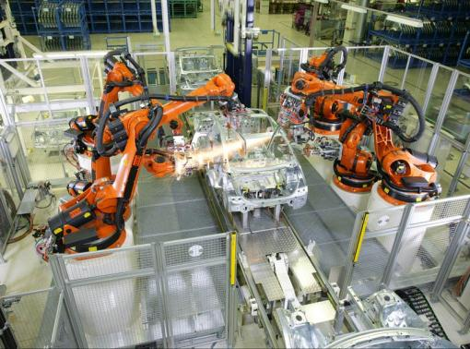
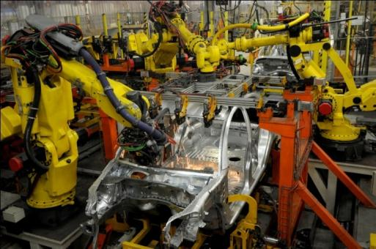
1. Introduction to robotics safety
2. Types of robots & industrial robots
3. Types and sources of robotics hazards
4. Robotcs safety requirements
5. Robot safeguards
6. Robot safety standards
Section 1---Introduction to robotics safety
Introduction to robotics safety
Types of robots and industrial robots
Types and sources of robotics hazards
Robot safety requirements
Robot safeguards
Robot safety standards
1 of 3

Slide 4
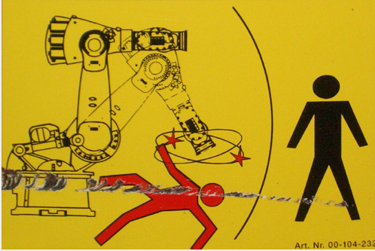
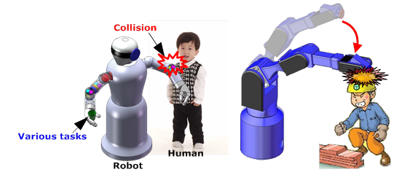
1. Introduction to robotics safety
2. Types of robots & industrial robots
3. Types and sources of robotics hazards
4. Robotcs safety requirements
5. Robot safeguards
6. Robot safety standards
Section 1---Introduction to robotics safety
Robot safety is extremely important
Most accidents with robots occur during programming, maintenance, repair, setup and testing, all of which involve human interaction
Common causes:
lack of employee training
improper use of safety guards
2 of 3

Slide 5
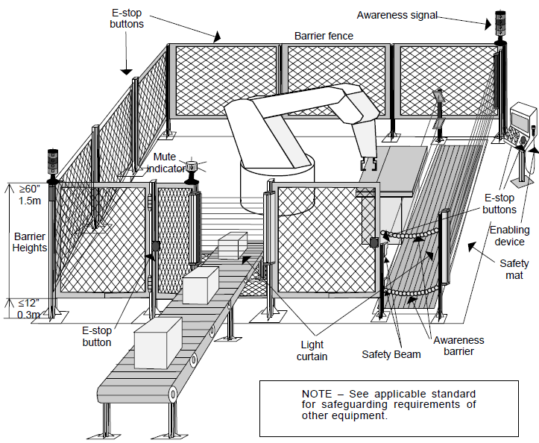
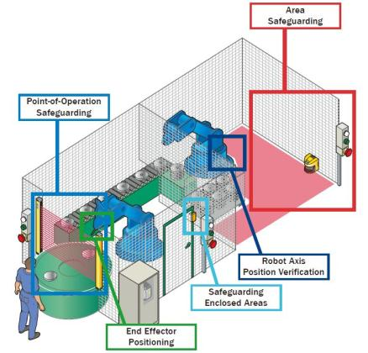
1. Introduction to robotics safety
2. Types of robots & industrial robots
3. Types and sources of robotics hazards
4. Robotcs safety requirements
5. Robot safeguards
6. Robot safety standards
Section 1---Introduction to robotics safety
Effective robot safety systems
Note: Robots, depending on the task, may generate paint mist, welding fumes, plastic fumes, etc. In general, the robot, on occasion is used in environments or tasks too dangerous for workers, and as such creates hazards not specific to the robot but specific to the task.
3 of 3

Slide 6
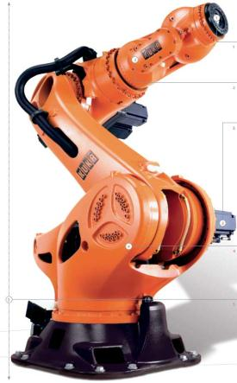
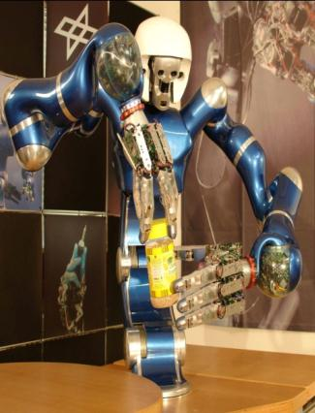
1. Introduction to robotics safety
2. Types of robots & industrial robots
3. Types and sources of robotics hazards
4. Robotcs safety requirements
5. Robot safeguards
6. Robot safety standards
Section 2--- Types of robots & industrial robots
What is a robot?
A robot is a machine built for real-world functions that is computer-controlled
Some types:
Industrial Robots
Military Robots
Medical Robots
Mobile Robots
Service Robots
Nano Robots
1 of 9

Slide 7
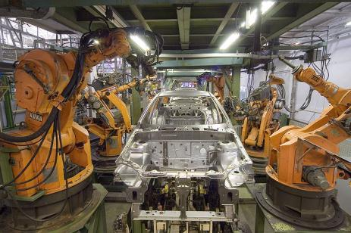
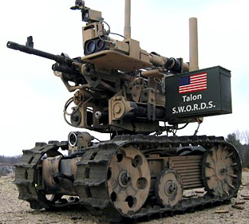
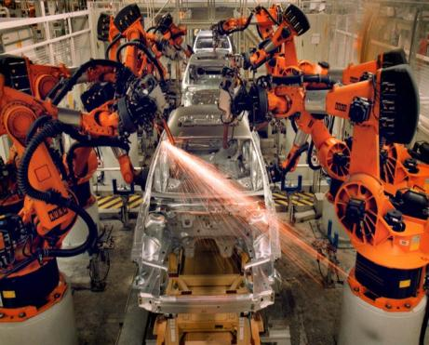
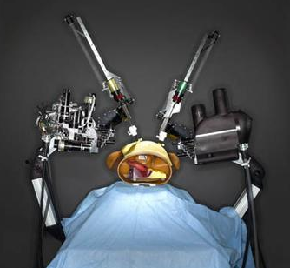
1. Introduction to robotics safety
2. Types of robots & industrial robots
3. Types and sources of robotics hazards
4. Robotcs safety requirements
5. Robot safeguards
6. Robot safety standards
Section 2--- Types of robots
2 of 9

Slide 8
1. Introduction to robotics safety
2. Types of robots & industrial robots
3. Types and sources of robotics hazards
4. Robotcs safety requirements
5. Robot safeguards
6. Robot safety standards
Section 2---What are industrial robots?
Industrial robots are, multifunctional, mechanical devices, programmable in 3 or more axes, designed to move material, parts, tools or specialized devices through variable programmed motions to perform a variety of tasks.
Industrial robots perform many functions, e.g., material handling, assembly, arc welding, resistance welding, machine tool load and unload functions, painting and spraying.
An industrial robot system includes not only industrial robots but also any devices and/or sensors required for the robot to perform its tasks as well as sequencing or monitoring communication interfaces.
3 of 9

Slide 9
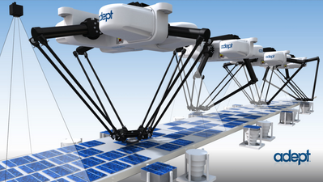
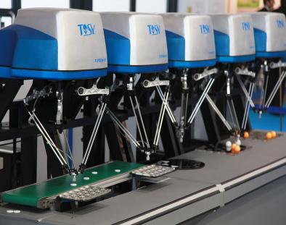
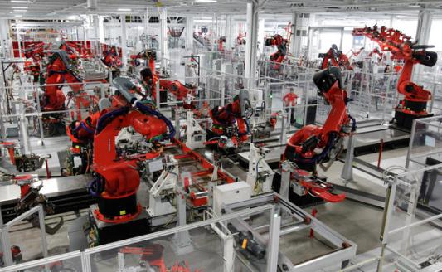
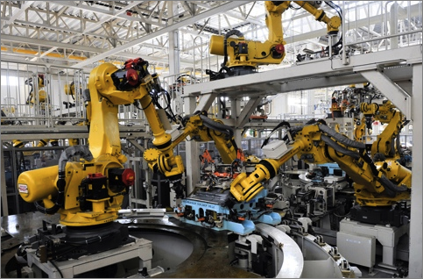
1. Introduction to robotics safety
2. Types of robots & industrial robots
3. Types and sources of robotics hazards
4. Robotcs safety requirements
5. Robot safeguards
6. Robot safety standards
Section 2---What are industrial robots?
4 of 9

Slide 10
1. Introduction to robotics safety
2. Types of robots & industrial robots
3. Types and sources of robotics hazards
4. Robotcs safety requirements
5. Robot safeguards
6. Robot safety standards
Section 2---Types of industrial robots
Seven types of robot design configurations exist:
        • Cartesian Coordinate Robots
        • Cylindrical Robots
        • Spherical Robots
        • SCARA Robots
        • Delta Robots
        • Articulated Robots
        • Snake Arm Robots
5 of 9

Slide 11
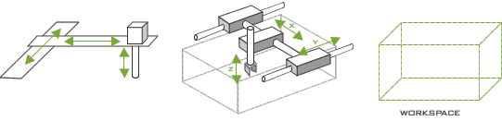
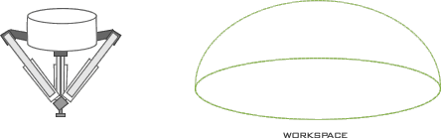
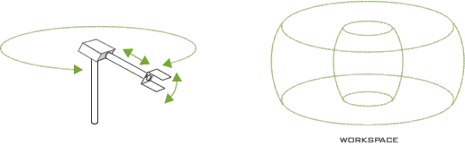
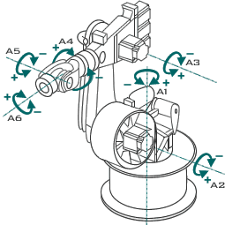
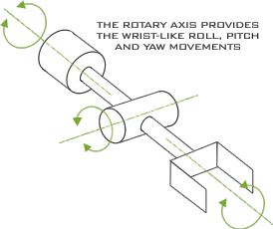
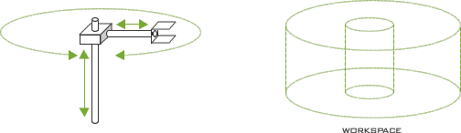
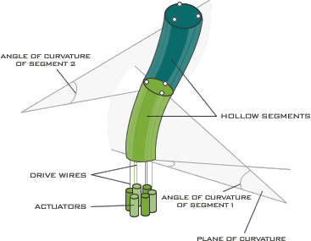
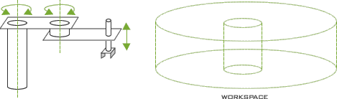
1. Introduction to robotics safety
2. Types of robots & industrial robots
3. Types and sources of robotics hazards
4. Robotcs safety requirements
5. Robot safeguards
6. Robot safety standards
Section 2--- Types of industrial robots
6 of 9
Notes:
Various robot design configurations, which are included in this classification, are shown in above figs.：
（1）Cartesian coordinate robots；（2）Cylindrical robots；（3）Spherical/Polar robots ;
（4）SCARA robots；（5）Delta robots；（6）Articulated/joint-arm robots; （7）Snake arm robots.

Slide 12
1. Introduction to robotics safety
2. Types of robots & industrial robots
3. Types and sources of robotics hazards
4. Robotcs safety requirements
5. Robot safeguards
6. Robot safety standards
Section 2--- Types of industrial robots
Two types of control systems exist:
        • Servo robots
        • Nonservo robots
Three types of paths generated exist:
        • point-to-point path
        • controlled path
        • continuous path
7 of 9
Notes:
Servo robots
Servo robots are controlled through the use of sensors that continually monitor the robot's axes and associated components for position and velocity. This feedback is compared to the desired information which has been programmed and stored in the robot's memory. The motors are actuated to move the actuator to the desired position/speed.
Non-servo robots
Non-servo robots do not have the feedback capability, and their axes are controlled through a system of mechanical stops and limit switches.

Slide 13
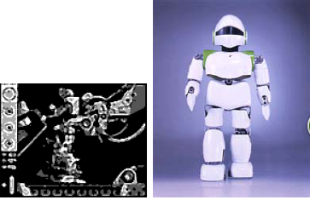
1. Introduction to robotics safety
2. Types of robots & industrial robots
3. Types and sources of robotics hazards
4. Robotcs safety requirements
5. Robot safeguards
6. Robot safety standards
Section 2--- Types of industrial robots
Manipulators: the most commonly used robots in the industrial environment
Mobile Robots: unmanned vehicles capable of locomotion
Hybrid Robots: mobile robots with manipulators
(Images from AAAI and How Stuff Works, respectively)
8 of 9

Slide 14
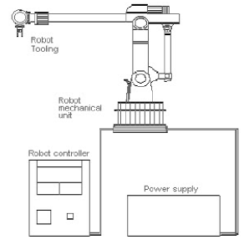
1. Introduction to robotics safety
2. Types of robots & industrial robots
3. Types and sources of robotics hazards
4. Robotcs safety requirements
5. Robot safeguards
6. Robot safety standards
Section 2--- Robot Components
Body
Effectors
Actuators
Sensors
Controller
Software
Industrial robots have four
main components:
• Mechanical unit
• Power source
• Control system
• Robot tool
9 of 9

Slide 15

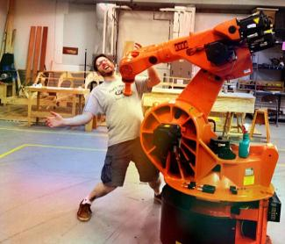
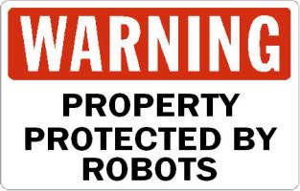



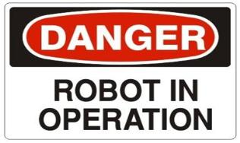

1. Introduction to robotics safety
2. Types of robots & industrial robots
3. Types and sources of robotics hazards
4. Robotcs safety requirements
5. Robot safeguards
6. Robot safety standards
Section 3---Types and sources of robotics hazards
Why are industrial robots dangerous?
1 of 13

Slide 16
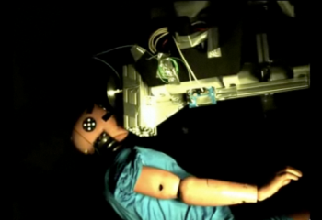
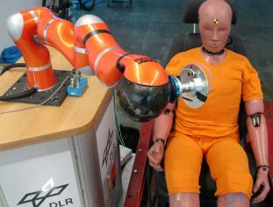

1. Introduction to robotics safety
2. Types of robots & industrial robots
3. Types and sources of robotics hazards
4. Robotcs safety requirements
5. Robot safeguards
6. Robot safety standards
Section 3---Types of robot accidents
Typical types of robot accidents:
A robotic arm or controlled tool causes an accident
A robot places an individual in a risk circumstance
An accessory of the robot's mechanical parts fails
The power supplies to the robot are uncontrolled
2 of 13

Slide 17
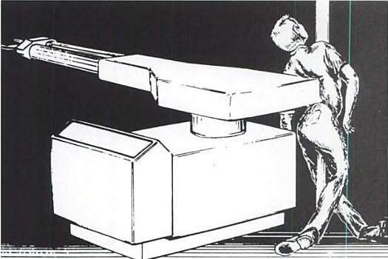
1. Introduction to robotics safety
2. Types of robots & industrial robots
3. Types and sources of robotics hazards
4. Robotcs safety requirements
5. Robot safeguards
6. Robot safety standards
Section 3---Examples of robot accidents
Example 1: First fatal robot-related accident in the U.S.
On July 21, 1984, a die cast operator was working with an automated die cast system utilizing a Unimate Robot, which was programmed to extract the casting from the die-cast machine, dip it into a quench tank and insert it into an automatic trim press.
A neighboring employee discovered the victim pinned between the right rear of the robot and a safety pole in a slumped but upright position. The victim died five days later in the hospital.
3 of 13

Slide 18
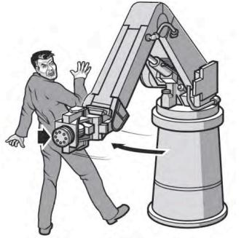
1. Introduction to robotics safety
2. Types of robots & industrial robots
3. Types and sources of robotics hazards
4. Robotcs safety requirements
5. Robot safeguards
6. Robot safety standards
Section 3---Examples of robot accidents
Example 2:
A material handling robot was operating in its automatic mode and a worker violated safety devices to enter the robot work cell. The worker became trapped between the robot and a post anchored to the floor, was injured and died a few days later.
Example 3:
A maintenance person climbed over a safety fence without turning off power to a robot and performed tasks in the robot work zone while it was temporarily stopped. When the robot recommenced operation, it pushed the person into a grinding machine, killing the person.
4 of 13

Slide 19
1. Introduction to robotics safety
2. Types of robots & industrial robots
3. Types and sources of robotics hazards
4. Robotcs safety requirements
5. Robot safeguards
6. Robot safety standards
Section 3---Examples of robot accidents
Details of some other reported robot-related accidents:
2000: The head of a person was crushed between a conveyor and a robot. The task of the robot was to feed cows at a farm.
2005: A person was crushed between a manipulator (resembling a gantry type robot) and a conveyor. The task of the manipulator was to move bricks from one conveyor to another at a brick factory.
2006: A person was crushed between a robot and a conveyor. The task of the robot was to move trays to a conveyor, in an application in the dairy industry.
5 of 13

Slide 20
1. Introduction to robotics safety
2. Types of robots & industrial robots
3. Types and sources of robotics hazards
4. Robotcs safety requirements
5. Robot safeguards
6. Robot safety standards
Section 3---Types of robot accidents
Robotic incidents can be grouped into four categories:
1. Impact or collision accidents
2. Crushing and trapping accidents
3. Mechanical part accidents
4. Other accidents
6 of 13

Slide 21
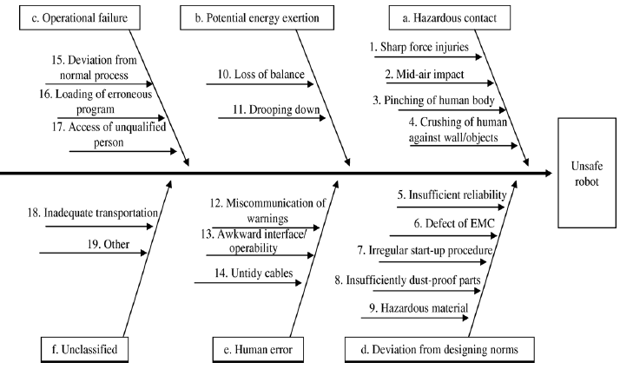
1. Introduction to robotics safety
2. Types of robots & industrial robots
3. Types and sources of robotics hazards
4. Robotcs safety requirements
5. Robot safeguards
6. Robot safety standards
Section 3---Sources of hazards
Human Interaction
Control Errors
Unauthorized Access
Mechanical Failures
Environmental Sources
Power Systems
Improper Installation
7 of 13

Slide 22
1. Introduction to robotics safety
2. Types of robots & industrial robots
3. Types and sources of robotics hazards
4. Robotcs safety requirements
5. Robot safeguards
6. Robot safety standards
Section 3---Sources of hazards
Human Interaction: Hazards from human interaction associated with programming, interfacing activated peripheral equipment, or connecting live input-output sensors to a microprocessor or a peripheral device, can cause dangerous, unpredicted movement or action by a robot
Control Errors: Intrinsic faults within the control system of the robot, errors in software, and electromagnetic interference are possible control errors
Unauthorized Access: Entry into a robot's safeguarded area is generally potentially hazardous
Mechanical Failures: Operating programs may not account for cumulative mechanical part failure, which can allow faulty or unexpected operation to occur
8 of 13

Slide 23
1. Introduction to robotics safety
2. Types of robots & industrial robots
3. Types and sources of robotics hazards
4. Robotcs safety requirements
5. Robot safeguards
6. Robot safety standards
Section 3---Sources of hazards
Environmental Sources: Electromagnetic interference (transient signals) can exert an undesirable influence on robotic operation and increase the potential for injury to any person working in the area
Power Systems: Pneumatic, hydraulic or electrical power sources that have malfunctioning control or transmission elements in the robot power system can disrupt electrical signals to the control and/or power-supply lines
Improper Installation: The design, requirements, layout of equipment, utilities, and facilities of a robot or robot system, if inadequate, can lead to inherent hazards
9 of 13

Slide 24
1. Introduction to robotics safety
2. Types of robots & industrial robots
3. Types and sources of robotics hazards
4. Robotcs safety requirements
5. Robot safeguards
6. Robot safety standards
Section 3---Case studies: incidents and lessons learned
Machine Operator Crushed by Robotic Platform (Nebraska, 1999)
Incident:
  A 23-year-old carousel operator at a meat packing plant was killed when his foot tripped a light sensor causing a computer controlled robotic platform to descend, crushing his skull.
  He had been watching a technician work on a conveyor and apparently stepped on the conveyor for a better view.
  The conveyor the mechanic was working on had been shut off but the entire system had not been locked out. Power still remained to the light sensors and the robotic platform.
  When the platform descended it pinned the victim between it and the conveyor. The victim was pronounced dead at the scene.
10 of 13

Slide 25
1. Introduction to robotics safety
2. Types of robots & industrial robots
3. Types and sources of robotics hazards
4. Robotcs safety requirements
5. Robot safeguards
6. Robot safety standards
Section 3---Case studies: incidents and lessons learned
Machine Operator Crushed by Robotic Platform (Nebraska, 1999)
Lessons learned:
  Ensure all equipment is properly locked out/tagged out prior to performing maintenance on it.
  Consider implementing a spot inspection program to ensure all employees are complying with safety requirements.
  Develop procedures to ensure individuals not involved in maintenance activities are not in the immediate area of the maintenance being performed.
  Consider installing a protective grate around access areas to the robotic platform.
11 of 13

Slide 26
1. Introduction to robotics safety
2. Types of robots & industrial robots
3. Types and sources of robotics hazards
4. Robotcs safety requirements
5. Robot safeguards
6. Robot safety standards
Section 3---Case studies: incidents and lessons learned
Mold Setter’s Head Struck by Cycling Gantry Robot (Michigan, 2001)
Incident:
  A 29-year old male was struck on the head by a cycling single-side gantry robot. He had recently changed a mold on a 1500-ton horizontal injection-molding machine.
  The victim climbed on top of the purge guard and leaned over the top of the stationary platen of the machine to see if the tools were left in the mold area, and placed his head beneath the robot’s gantry frame. His position placed him between the robot’s home position and the robot’s support frame on the stationary platen.
  The robot cycled, and the victim’s head was struck from the side and crushed between the robot and the robot’s support frame. The victim was pronounced dead on arrival at the local hospital.
12 of 13

Slide 27
1. Introduction to robotics safety
2. Types of robots & industrial robots
3. Types and sources of robotics hazards
4. Robotcs safety requirements
5. Robot safeguards
6. Robot safety standards
Section 3---Case studies: incidents and lessons learned
Machine Operator Crushed by Robotic Platform (Nebraska, 1999)
Lessons learned:
  The robot and the point of operation should be safeguarded to prevent entry during automatic operation.
  Users should conduct a risk assessment of the robot/robot system to identify equipment, installation, standards, and process hazards so adequate employee safeguards are provided.
  Users should ensure that personnel who interact with the robot or robot system, such as programmers, teachers, operators and maintenance personnel are trained on the safety issues associated with the task, robot and robot system.
13 of 13

Slide 28
1. Introduction to robotics safety
2. Types of robots & industrial robots
3. Types and sources of robotics hazards
4. Robotcs safety requirements
5. Robot safeguards
6. Robot safety standards
Section 4---Robotcs safety requirements
Requirements and safety measures in normal operation
Demands and safety measures in special operation modes
Demands on safety control systems
1 of 5

Slide 29
1. Introduction to robotics safety
2. Types of robots & industrial robots
3. Types and sources of robotics hazards
4. Robotcs safety requirements
5. Robot safeguards
6. Robot safety standards
Section 4---Requirements and safety measures in normal operation
The use of robot technology necessitates hazard analysis, risk assessment and safety measures
The following can serve as guidelines:
Prevent physical access to hazardous areas
Prevent injuries as a result of the release of energy
Apply interfaces between normal operation and special operation to enable the safety control system to automatically recognize the presence of personnel
2 of 5

Slide 30
1. Introduction to robotics safety
2. Types of robots & industrial robots
3. Types and sources of robotics hazards
4. Robotcs safety requirements
5. Robot safeguards
6. Robot safety standards
Section 4---Demands and safety measures in special operation modes
Certain special operation modes (e.g., setting up, programming) of an industrial robot require movements which must be assessed directly at the site of operation
The movements should be:
only of the scheduled type and speed
prolonged only as long as instructed
performed only if it can be guaranteed that no parts of the human body are in the danger zone
3 of 5

Slide 31
1. Introduction to robotics safety
2. Types of robots & industrial robots
3. Types and sources of robotics hazards
4. Robotcs safety requirements
5. Robot safeguards
6. Robot safety standards
Section 4---Demands on safety control systems
Suggested measures to provide reliable safety control systems :
Redundant and diverse layouts of electro-mechanical control systems including test circuits
Redundant and diverse set-ups of microprocessor control systems developed by different teams (this modern approach is considered state-of-the-art, and often includes safety light barriers)
Redundant control systems that take into account mechanical as well as electrical failures
4 of 5

Slide 32
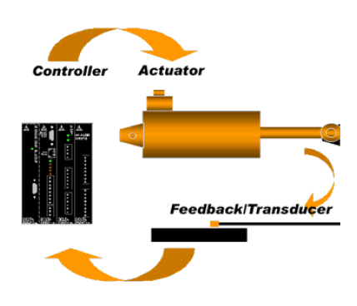
1. Introduction to robotics safety
2. Types of robots & industrial robots
3. Types and sources of robotics hazards
4. Robotcs safety requirements
5. Robot safeguards
6. Robot safety standards
Section 4---Robot controller
Controllers direct a robot how to move
Two controller paradigms exist:
Open‐loop controllers execute robot movement without feedback
Closed‐loop controllers execute robot movement and judge progress with sensors; they can thus compensate for errors
5 of 5

Slide 33
1. Introduction to robotics safety
2. Types of robots & industrial robots
3. Types and sources of robotics hazards
4. Robotcs safety requirements
5. Robot safeguards
6. Robot safety standards
Section 5---Robotic safeguards from design to operation
Topics to consider for robot safeguards:
What are the potential hazards of the robotic cell?
What safeguarding technologies are available?
How can unnecessary personnel be keep out, and necessary personnel protected?
How much panel space must be used for relays?
How difficult or easy will the troubleshooting of the system be?
What is the overall reliability and safety of the system?
1 of 16

Slide 34
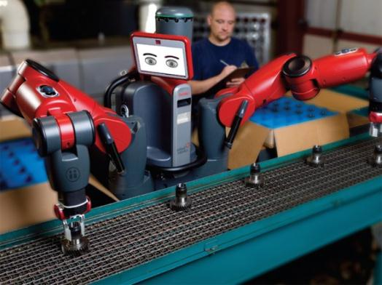
1. Introduction to robotics safety
2. Types of robots & industrial robots
3. Types and sources of robotics hazards
4. Robotcs safety requirements
5. Robot safeguards
6. Robot safety standards
Section 5---Robotic risk assessment
The first step in designing a safe robot system is to understand the hazards that exist in the system
At each stage of the robot and robot system development, a risk assessment should be performed
Assessment criteria:
severity
potential injury
frequency of access to the hazard
possibility of avoidance
2 of 16

Slide 35
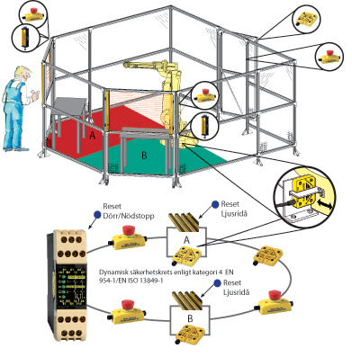
1. Introduction to robotics safety
2. Types of robots & industrial robots
3. Types and sources of robotics hazards
4. Robotcs safety requirements
5. Robot safeguards
6. Robot safety standards
Section 5---Robot safety begins with the design process
Safeguards should be designed into and around the robotic cell early in the design process
Perimeter Guarding
Hard-guarding and optical perimeter guards
Protection on the inside
Area safety scanners and light curtains
3 of 16

Slide 36

1. Introduction to robotics safety
2. Types of robots & industrial robots
3. Types and sources of robotics hazards
4. Robotcs safety requirements
5. Robot safeguards
6. Robot safety standards
Section 5---Safeguarding considerations for other stages
The following should be considered in the planning, installation and subsequent operation of a robot or robot system:
Safeguarding devices
Awareness devices
Safeguarding the teacher
Operator safeguards
Attended continuous operation
Maintenance and repair personnel
Safety training
4 of 16

Slide 37
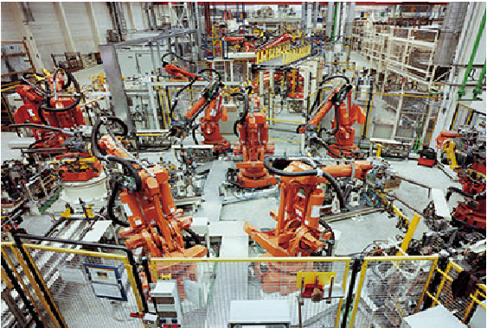
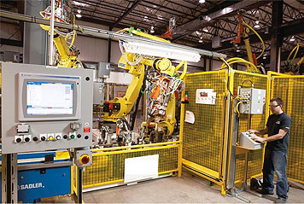
1. Introduction to robotics safety
2. Types of robots & industrial robots
3. Types and sources of robotics hazards
4. Robotcs safety requirements
5. Robot safeguards
6. Robot safety standards
Section 5---Robot safeguard measures
Measures taken to safeguard a robot depend on the circumstances of its operation and surrounding environment
5 of 16

Slide 38
1. Introduction to robotics safety
2. Types of robots & industrial robots
3. Types and sources of robotics hazards
4. Robotcs safety requirements
5. Robot safeguards
6. Robot safety standards
Section 5---Today’s safeguarding methods
Perimeter fencing
Interlocking devices
Presence sensing devices (light curtains, laser scanning devices, pressure sensitive mats)
Audible and visible warning systems
Manipulator position indication and limiting (mechanical limits, position switches, limit switches)
Enabling devices
Other safeguard devices
6 of 16

Slide 39
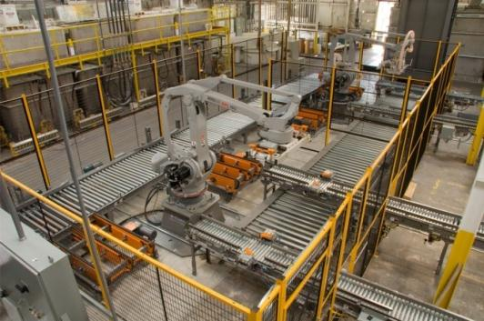
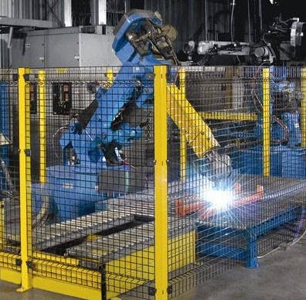
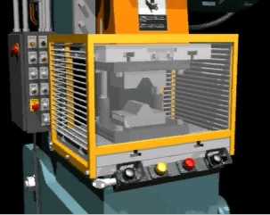
1. Introduction to robotics safety
2. Types of robots & industrial robots
3. Types and sources of robotics hazards
4. Robotcs safety requirements
5. Robot safeguards
6. Robot safety standards
Section 5---Today’s safeguarding methods
Fences and barriers
7 of 16
Notes:
A fixed barrier guard is a fence that requires tools for removal. Barrier guards are appropriate safeguards for full-revolution and part-revolution mechanical power presses. Barrier guards are designed to keep the operator's hands and arms from entering the "danger zone" as prescribed by the particular machine. Barrier guards are usually the first point-of-operation safeguard considered for machines.

Slide 40
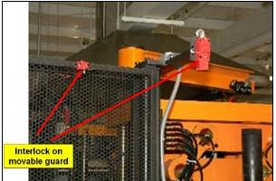

1. Introduction to robotics safety
2. Types of robots & industrial robots
3. Types and sources of robotics hazards
4. Robotcs safety requirements
5. Robot safeguards
6. Robot safety standards
Section 5---Today’s safeguarding methods
Interlocking devices
8 of 16
Notes:
Guard-operated interlocking devices, key interlocking devices (transfer of key from control to access gate) and solenoid locks are all types of interlocking devices . As shown in Fig, an interlocking device is a physical barrier around a robot’s work envelope that incorporates gates equipped with interlocks

Slide 41
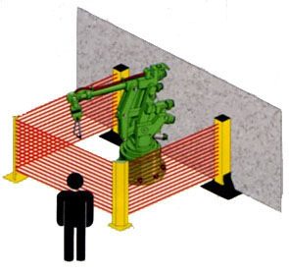
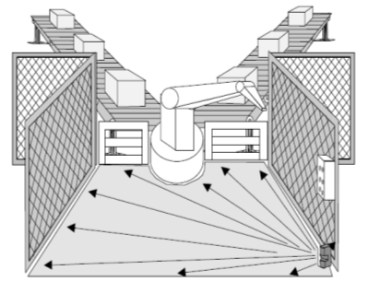
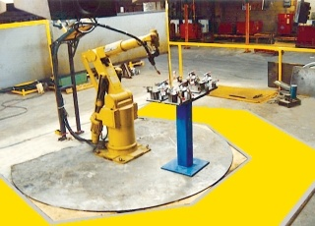
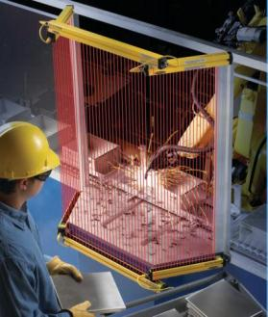
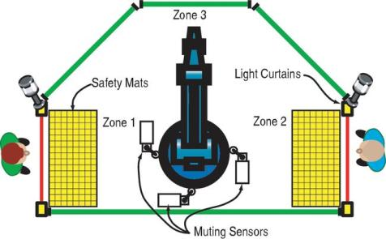
1. Introduction to robotics safety
2. Types of robots & industrial robots
3. Types and sources of robotics hazards
4. Robotcs safety requirements
5. Robot safeguards
6. Robot safety standards
Section 5---Today’s safeguarding methods
Presence sensing devices (light curtains, laser scanning devices, pressure sensitive mats)
9 of 16
Notes:
(1) Light curtains. If an obstruction is detected within the path of the light beam, an output is triggered. This method provides instant access to the workspace, and multiple instances can provide different safety zones. However they cannot shield against projectile hazards.
(2) Laser scanning devices. These devices use a single laser beam to map an area and detect any changes which would signify a potential hazard, and trigger an output. These devices normally operate below the working level of the robot.
(3) Pressure-sensitive mats. These trigger an output if pressure is applied to the surface. Length of stride, speed of approach and system response time must be considered in placement

Slide 42
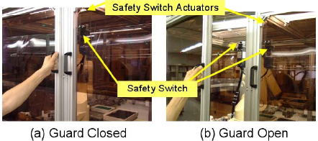
1. Introduction to robotics safety
2. Types of robots & industrial robots
3. Types and sources of robotics hazards
4. Robotcs safety requirements
5. Robot safeguards
6. Robot safety standards
Section 5---Today’s safeguarding methods
Manipulator position indication and limiting: mechanical limits and limit switches
10 of 16

Slide 43
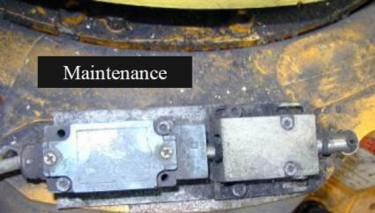



1. Introduction to robotics safety
2. Types of robots & industrial robots
3. Types and sources of robotics hazards
4. Robotcs safety requirements
5. Robot safeguards
6. Robot safety standards
Section 5---Today’s safeguarding methods
Manipulator position indication and limiting: position switch
11 of 16

Slide 44

1. Introduction to robotics safety
2. Types of robots & industrial robots
3. Types and sources of robotics hazards
4. Robotcs safety requirements
5. Robot safeguards
6. Robot safety standards
Section 5---Today’s safeguarding methods
Enabling device
12 of 16
Notes:
An enabling device is used in conjunction with other devices to ensure that operation cannot begin unless the device is actuated

Slide 45
1. Introduction to robotics safety
2. Types of robots & industrial robots
3. Types and sources of robotics hazards
4. Robotcs safety requirements
5. Robot safeguards
6. Robot safety standards
Section 5---Instruction to improve robot safety
Use boundary warning devices, barriers and interlocks around robot systems
Offer annual robot safety training for employees working on the floor with robots
Provide work cell operators with training geared toward their particular robot
Create and implement a preventive maintenance program for robots and work cells
Ensure operators read and understand robot system documentation, including material on robot safety
Ensure that only capable employees who know the safety requirements for working with a robot operate robot systems
13 of 16

Slide 46

1. Introduction to robotics safety
2. Types of robots & industrial robots
3. Types and sources of robotics hazards
4. Robotcs safety requirements
5. Robot safeguards
6. Robot safety standards
Section 5---Typical engineering applications
ABB SafeMove - the next generation in robot safety
SafeMove is an electronics and software based safety approach that ensures safe and predictable robot motion; it allows leaner more economic and flexible operation
video\ABB_Safemove__The_Next_Generation_in_Robot_Safety_-_YouTube.mp4
14 of 16

Slide 47

1. Introduction to robotics safety
2. Types of robots & industrial robots
3. Types and sources of robotics hazards
4. Robotcs safety requirements
5. Robot safeguards
6. Robot safety standards
Section 5---Example 1
Example 1: Monitor and increase safety of tool zones
15 of 16

Slide 48
1. Introduction to robotics safety
2. Types of robots & industrial robots
3. Types and sources of robotics hazards
4. Robotcs safety requirements
5. Robot safeguards
6. Robot safety standards
Section 5---Examples 2 and 3
Example 2: Safe stand still/direct loading of a robot
Example 3: Safe axis ranges with track motions
16 of 16

Slide 49

1. Introduction to robotics safety
2. Types of robots & industrial robots
3. Types and sources of robotics hazards
4. Robotcs safety requirements
5. Robot safeguards
6. Robot safety standards
Section 6---Robot safety standards
Overview of the technology and standardization development
1 of 6

Slide 50
1. Introduction to robotics safety
2. Types of robots & industrial robots
3. Types and sources of robotics hazards
4. Robotcs safety requirements
5. Robot safeguards
6. Robot safety standards
Section 6---Robot safety standards
Present status of safety standards for robots in Europe and North America
Type of safety standard | Europe | North America
Robot safety standard | ISO 10218-1:2011 (robot) ISO 10218-2:2011 (robot systems and integration) | ANSI/RIA R15.06 / ANSI/RIA/ISO 10218 / RIA TR R15.206 CAN/CSA-Z434-03 (R2013) (robots and robot systems)
Machinery safety standard | ISO 12100:2010 (risk assessment) ISO 13849-1:2006 (functional safety) IEC 62061:2005 (functional safety) | CSA-Z432-04 (R2009) ANSI B11.0-2011
2 of 6

Slide 51
1. Introduction to robotics safety
2. Types of robots & industrial robots
3. Types and sources of robotics hazards
4. Robotcs safety requirements
5. Robot safeguards
6. Robot safety standards
Section 6---Robot safety standards
Current standards for robotic safety:
ANSI/RIA R15.06 / ANSI/RIA/ISO 10218 / RIA TR R15.206
CAN/CSA-Z434-03 (R2013)
ISO 10218-1:2011 and ISO 10218-2:2011
Notes:
In the U.S., ISO 10218 and ANSI RIA 15.06.1999 are both valid
The Robotic Industries Association (RIA) and the Canadian Standards Association now are cooperating to publish a single harmonized standard for the U.S. and Canada
The new standard—ANSI/RIA R15.06 in the U.S. and CAN/CSA Z434 in Canada—will be a “four-in-one” document that includes ISO 10218-1:2011, ISO 10218-2:2011, and the unique requirements of both countries
3 of 6
Notes:
1、Standard Number :ANSI/RIA R15.06 / ANSI/RIA/ISO 10218 / RIA TR R15.206
The ANSI/RIA R15.06 / ANSI/RIA/ISO 10218 / RIA TR R15.206 - Industrial Robots Safety Package provides the fundamentals for industrial robots and systems as it pertains to the safety requirements. The safety requirements are applicable to manufacturers, integrators, installers and personnel.
The ANSI/RIA R15.06 / ANSI/RIA/ISO 10218 / RIA TR R15.206 - Industrial Robots Safety Package includes:
ANSI/RIA R15.06-2012
ANSI/RIA/ISO 10218-1-2007
RIA TR R15.206-2008
2、Standard Number :CAN/CSA-Z434-03 (R2013)
This safety Standard applies to the manufacture, remanufacture, rebuild, installation, safeguarding, maintenance and repair, testing and start-up, and personnel training requirements for industrial robots and robot systems.
Publish date: 2003-02-01
Supersedes: CAN/CSA-Z434-94
Reaffirmed: 2013-05-09
3、Standard Number :ISO 10218-1:2011 and ISO 10218-2:2011
The ISO 10218-1 standard for the robot, and the ISO 10218-2 standard for robot systems and integration were both published 1 July 2011.
ISO 10218-1 standard:
(1) For the robot;
(2) An approved standard and adopted as an ANSI standard
ISO 10218-2 standard:
(1) For the robot systems and integration;
(2) An approved standard
New features in ISO 10218 (not available before)
(1) Cable-less pendants – wireless operation
(2) Collaborative robots
(3) Simultaneous motion control
(4) Synchronous robots

Slide 52
1. Introduction to robotics safety
2. Types of robots & industrial robots
3. Types and sources of robotics hazards
4. Robotcs safety requirements
5. Robot safeguards
6. Robot safety standards
Section 6---Robot safety standards
Standard: ANSI/RIA R15.06 / ANSI/RIA/ISO 10218 / RIA TR R15.206
The ANSI/RIA R15.06 / ANSI/RIA/ISO 10218 / RIA TR R15.206 - Industrial Robots Safety Package provides the fundamentals for industrial robots and systems as it pertains to the safety requirements
The safety requirements are applicable to manufacturers, integrators, installers and personnel
The ANSI/RIA R15.06 / ANSI/RIA/ISO 10218 / RIA TR R15.206 - Industrial Robots Safety Package includes:
ANSI/RIA R15.06-2012
ANSI/RIA/ISO 10218-1-2007
RIA TR R15.206-2008
4 of 6

Slide 53
1. Introduction to robotics safety
2. Types of robots & industrial robots
3. Types and sources of robotics hazards
4. Robotcs safety requirements
5. Robot safeguards
6. Robot safety standards
Section 6---Robot safety standards
Standard: CAN/CSA-Z434-03 (R2013)
CAN/CSA-Z434-03 (R2013) - Industrial Robots and Robot Systems - General Safety Requirements
This safety standard applies to the manufacture, remanufacture, rebuild, installation, safeguarding, maintenance and repair, testing and start-up, and personnel training requirements for industrial robots and robot systems
Publish date: 2003-02-01
Supersedes: CAN/CSA-Z434-94
Reaffirmed: 2013-05-09
5 of 6
Notes:
1、Standard Number :ANSI/RIA R15.06 / ANSI/RIA/ISO 10218 / RIA TR R15.206
The ANSI/RIA R15.06 / ANSI/RIA/ISO 10218 / RIA TR R15.206 - Industrial Robots Safety Package provides the fundamentals for industrial robots and systems as it pertains to the safety requirements. The safety requirements are applicable to manufacturers, integrators, installers and personnel.
The ANSI/RIA R15.06 / ANSI/RIA/ISO 10218 / RIA TR R15.206 - Industrial Robots Safety Package includes:
ANSI/RIA R15.06-2012
ANSI/RIA/ISO 10218-1-2007
RIA TR R15.206-2008
2、Standard Number :CAN/CSA-Z434-03 (R2013)
This safety Standard applies to the manufacture, remanufacture, rebuild, installation, safeguarding, maintenance and repair, testing and start-up, and personnel training requirements for industrial robots and robot systems.
Publish date: 2003-02-01
Supersedes: CAN/CSA-Z434-94
Reaffirmed: 2013-05-09
3、Standard Number :ISO 10218-1:2011 and ISO 10218-2:2011
The ISO 10218-1 standard for the robot, and the ISO 10218-2 standard for robot systems and integration were both published 1 July 2011.
ISO 10218-1 standard:
(1) For the robot;
(2) An approved standard and adopted as an ANSI standard
ISO 10218-2 standard:
(1) For the robot systems and integration;
(2) An approved standard
New features in ISO 10218 (not available before)
(1) Cable-less pendants – wireless operation
(2) Collaborative robots
(3) Simultaneous motion control
(4) Synchronous robots

Slide 54
1. Introduction to robotics safety
2. Types of robots & industrial robots
3. Types and sources of robotics hazards
4. Robotcs safety requirements
5. Robot safeguards
6. Robot safety standards
Section 6---Robot safety standards
Standard: ISO 10218-1:2011 and ISO 10218-2:2011
The ISO 10218-1 standard for the robot, and the ISO 10218-2 standard for robot systems and integration, were both published 1 July 2011
ISO 10218-1: For robot (an approved standard and adopted as an ANSI standard)
ISO 10218-2: For robot system and integration (an approved standard )
New features in ISO 10218:
Cable-less pendants – wireless operation
Collaborative robots
Simultaneous motion control
Synchronous robots
6 of 6
Notes:
1、Standard Number :ANSI/RIA R15.06 / ANSI/RIA/ISO 10218 / RIA TR R15.206
The ANSI/RIA R15.06 / ANSI/RIA/ISO 10218 / RIA TR R15.206 - Industrial Robots Safety Package provides the fundamentals for industrial robots and systems as it pertains to the safety requirements. The safety requirements are applicable to manufacturers, integrators, installers and personnel.
The ANSI/RIA R15.06 / ANSI/RIA/ISO 10218 / RIA TR R15.206 - Industrial Robots Safety Package includes:
ANSI/RIA R15.06-2012
ANSI/RIA/ISO 10218-1-2007
RIA TR R15.206-2008
2、Standard Number :CAN/CSA-Z434-03 (R2013)
This safety Standard applies to the manufacture, remanufacture, rebuild, installation, safeguarding, maintenance and repair, testing and start-up, and personnel training requirements for industrial robots and robot systems.
Publish date: 2003-02-01
Supersedes: CAN/CSA-Z434-94
Reaffirmed: 2013-05-09
3、Standard Number :ISO 10218-1:2011 and ISO 10218-2:2011
The ISO 10218-1 standard for the robot, and the ISO 10218-2 standard for robot systems and integration were both published 1 July 2011.
ISO 10218-1 standard:
(1) For the robot;
(2) An approved standard and adopted as an ANSI standard
ISO 10218-2 standard:
(1) For the robot systems and integration;
(2) An approved standard
New features in ISO 10218 (not available before)
(1) Cable-less pendants – wireless operation
(2) Collaborative robots
(3) Simultaneous motion control
(4) Synchronous robots

Slide 55
References
[1] B. S. Dhillon. “Robot safety analysis methods”, in Proceedings of the 11th National Conference on Machines and Mechanics. Delhi, India, pp. 86-93, 2003.
[2] ANSI/RIA R15.06-1999, American National Standard for Industrial Robots and Robot Systems —Safety Requirements, American National Standards Institute, Inc.
[3] http://thebreakthrough.org/index.php/voices/roger-pielke-jr/its-not-about-the-machines/. Roger Pielke Jr, how leading economists misunderstand productivity and jobs, in: The Breakthrough, Accessed October, 2013.
[4] http://commons.wikimedia.org/wiki/File:KUKA_Industrial_Robots_IR.jpg. From Wikimedia Commons, the free media repository, Accessed October, 2013.
[5] http://hopetotheend.com/robots.html. ROBOTS, Accessed October, 2013.
[6]https://www.google.ca/?gws_rd=cr&ei=WttSUsDBIMTgrQHUx4DYAQ#q=medical+robots. Accessed October, 2013.
[7] http://www.looptechnology.com/robotic-robot-types.asp. Types of Robots, in: Loop Technology, Robotics, Accessed October, 2013.
[8] https://www.osha.gov/dts/osta/otm/otm_iv/otm_iv_4.html . Industrial robots and robot system safety, in: OSHA Technical Manual (OTM), Section IV: Chapter 4, Occupational Safety & Health Administration (OSHA), U.S. Department of Labor, Washington, DC. Accessed August, 2013.

Slide 56
References
[9] http://www.osh.net/articles/archive/osh_basics_2002_may24.htm. Maureen Alvarez, working safely around industrial robots, in: Gateway for Safety & Health Information Resources, Accessed August, 2013.
[10] http://www.ilo.org/oshenc/part-viii/safety-applications/item/972-safety-principles-for-industrial-robots?tmpl=component&print=1. Marty Albert, Retsch Toni, Schmitter Guido, safety principles for industrial robots, in: 58. Safety Applications, Encyclopedia of Occupational Health and Safety, International Labor Organization, Geneva. 2011. Accessed August, 2013.
[11]http://www.robotics.org/content-detail.cfm/Industrial-Robotics-Featured-Articles/Robot-Safety-Begins-with-the-Design-Process/content_id/1120. S. Kelly, Robot safety begins with the design process, in: Robotics Online. Accessed August 2013.
[12] K. Behnisch. White paper: Safe collaboration with ABB robots electronic position switch and SafeMove.
[13] http://www.looptechnology.com/robotic-robot-safety.asp. Robot Safety, in: Loop Technology, Robotics. Accessed October, 2013.
[14]https://www.osha.gov/pls/oshaweb/owadisp.show_document?p_table=DIRECTIVES&p_id=1703. Guidelines for Robotics Safety, in: Occupational Safety & Health Administration (OSHA), U.S. Dept. of Labor, Washington, DC. Accessed August, 2013.

Slide 57
References
[15] K. Okada, I. Maeda and Y. Sugano. “Risk assessment of robot cell production system that achieved high productivity and safety in HMI environment,” Proc. Int. Conf. on Safety of Industrial Automated Systems, pp. 181–186, Tokyo, Japan, 2007.
[16] http://www.robots.com/articles/viewing/robot-safety. Robot Safety, in: RobotWorx, Accessed August, 2013.
[17] http://www.abb.com/product/seitp327/ec6cfad87f69dd2dc12572d300775f5b.aspx. SafeMove - Next generation in robot safety, in: ABB, Accessed August 2013.
[18] S. Kock, J. Bredahl, P.J. Eriksson. Taming the robot - Better safety without higher fences. ABB Review 4, 2006.
[19] J. Fryman, B. Matthias. Safety of industrial robots: from conventional to collaborative applications. Proceedings of ROBOTIK 2012; 7th German Conference on Robotics, Munich, Germany, pp. 51-55, 2012.
[20] ISO 10218 “Robots and robotic devices – safety requirements for industrial robots”, with parts 1 (“Robots”) and 2 (“Robot systems and integration”), International standard for robot safety, Geneva, 2011.
[21] CAN/CSA-Z434-03 (R2008) - Industrial Robots and Robot Systems - General Safety Requirements, Canadian Standard Association.
[22] Fryman, J. Changes Coming in the New Industrial Robot Safety Standard. http://www.metalformingmagazine.com/magazine/article.asp?aid=6417.

Slide 58
Questions?

