Slide 1
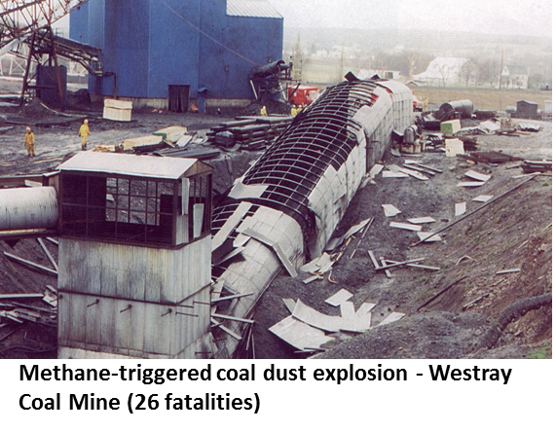
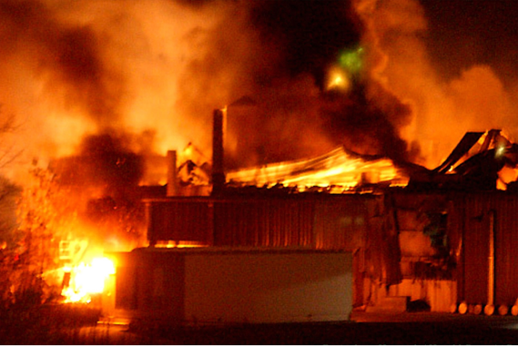

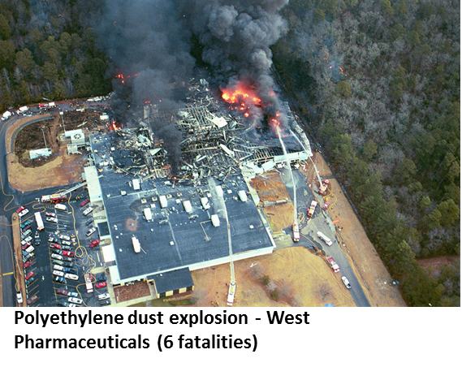
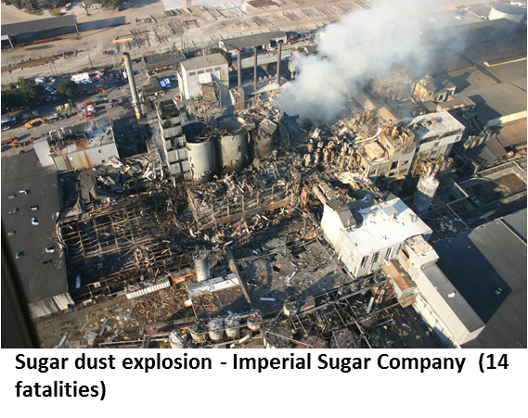
Dust can explode!
Dust Explosion Fundamentals
Notes:
Dusts can explode. This is a surprising fact to some people but it should not be a surprise to those who handle and process combustible dusts in industry. The slide gives four examples of process incidents to illustrate that dust explosions can and do occur, and that the consequences can be devastating. Unfortunately there are many more dust explosion incident descriptions available in the public domain literature. Other examples are given throughout the module.
Of the incidents shown on the slide, Westray and Imperial Sugar are examined in greater detail in the Case Studies section; West Pharmaceuticals is the subject of one of the exercises in the Evaluation section.
Photographs
Top Left: Richard, K.P., Justice, “The Westray Story – a Predictable Path to Disaster. Report of the Westray Mine Public Inquiry”, Province of Nova Scotia, Halifax, NS (1997).
Top Right: CSB, “Investigation Report. Aluminum Dust Explosion. Hayes Lemmerz International-Huntington, Inc.”, Report No. 2004-01-I-IN, U.S. Chemical Safety and Hazard Investigation Board, Washington, DC (2005).
Bottom Left: CSB, “Investigation Report. Dust Explosion. West Pharmaceutical Services, Inc.”, Report No. 2003-07-I-NC, U.S. Chemical Safety and Hazard Investigation Board, Washington, DC (2004).
Bottom Right: CSB, “Investigation Report. Sugar Dust Explosion and Fire. Imperial Sugar Company”, Report No. 2008-05-I-GA, U.S. Chemical Safety and Hazard Investigation Board, Washington, DC (2009).

Slide 2
Fire triangle and explosion pentagon
Dust Explosion Fundamentals
FUEL
IGNITION
FUEL
IGNITION
MIXING
OXIDANT
OXIDANT
CONFINEMENT
Notes:
Recall the previous discussion concerning the fire triangle and explosion pentagon elements. In a dust fire or explosion, the fuel is of course a solid. It is therefore possible for combustible dust to form layers on equipment and facility surfaces; these layers may burn but they will not explode.
The mixing criterion introduces perhaps the most fundamental difference between gas and dust explosions – again based on the physical state of the fuel. In a dust/air mixture, the dust particles are strongly influenced by gravity; an essential prerequisite for a dust explosion is therefore the formation of a dust/oxidant suspension. An airborne dust cloud will either burn as a flash fire or will explode depending on the degree of confinement.
As noted previously, confinement does not need to be complete for a fast-burning flame to transition to an explosion, regardless of fuel type. Partial confinement and turbulence-generating obstacles leading to a high degree of congestion can also be effective in this regard.
Later in the module, we will examine in detail each element of the dust explosion pentagon as well as the special case of dust fires. Before doing that, let’s look at a practical example of the dust explosion pentagon in the next slide.

Slide 3
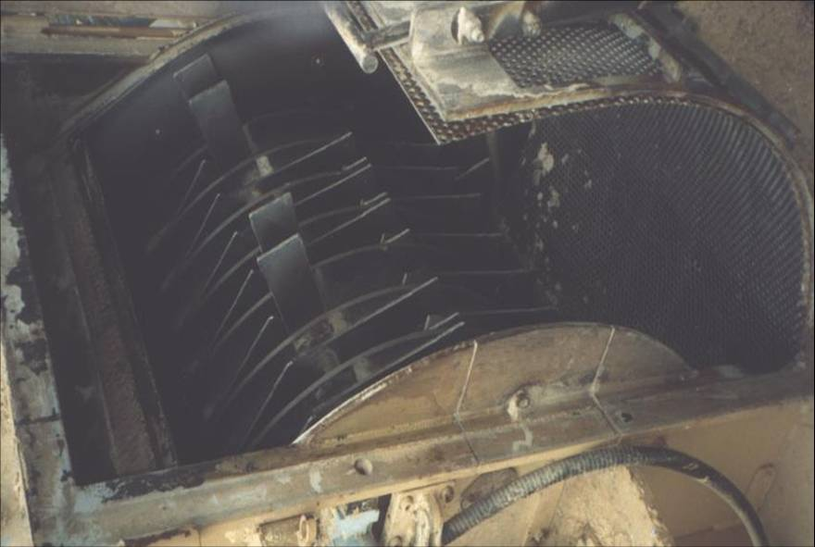
Hammermill – pentagon in practice
Dust Explosion Fundamentals
Notes:
A hammermill is a process unit used for pulverizing raw material. The slide shows a hammermill (with the cover open) used in a wood-processing facility to accomplish size reduction of sawdust and wood chips (FUEL). Magnetic devices are placed on the feed side of the mill to prevent tramp metal from entering (IGNITION SOURCE). Inside the hammermill, the pulverizing process produces a cloud (MIXING) of wood dust and air (OXIDANT). With the cover closed (CONFINEMENT), the pentagon is complete.
In spite of all best efforts to remove potential ignition sources, hammermills are prone to experience dust explosions. They are therefore designed and built strong enough to withstand the overpressure originating from such an event inside them.
Photograph: Amyotte, P.R., Pegg, M.J., Khan, F.I., Nifuku, M. and Yingxin, T., “Moderation of Dust Explosions”, Journal of Loss Prevention in the Process Industries, 20, 675-687 (2007).

Slide 4
How dusts explode
Dust Explosion Fundamentals
Chemical explosion
  Propagating combustion reaction
Reaction mechanism
  Dust/air mixture heterogeneous; reaction may be heterogeneous (few) or homogenous (most)
  Most dusts explode as gas explosions
    Volatiles from solid material
Explosion: FUEL (dust) and OXIDANT are MIXED, ignited by IGNITION SOURCE, and sufficient CONFINEMENT results in overpressure development
Notes:
A dust explosion occurs as a result of a chemical reaction (combustion), which is propagated or transmitted spatially through the reaction mass. A dust explosion is therefore a chemical explosion as opposed to a physical explosion.
A dust/air mixture is heterogeneous (two phases). The combustion reaction can be either heterogeneous or homogeneous (one phase). However, only a few dusts undergo heterogeneous combustion, such as the reaction of fine carbon dust with gaseous oxygen.
The vast majority of dust explosion reactions are homogeneous. In these cases, the dust explosion actually occurs as a gas explosion following the generation of volatile matter from the solid dust. Using the example of polyethylene plastic, the plastic would first melt and vapourize, creating a gaseous fuel that would undergo homogeneous combustion with oxygen. This is a step-wise process that may involve the additional complication of a solid, outer oxide layer as in the case of some metals such as aluminum. The next slide shows evidence of this reaction sequence for an organic dust (coal).
Globally – as per the explosion pentagon we have seen previously – the dust and oxidant mix, and the airborne cloud is ignited by an ignition source. Sufficient confinement results in overpressure development from the reaction. The result is an explosion with potentially destructive capabilities.

Slide 5
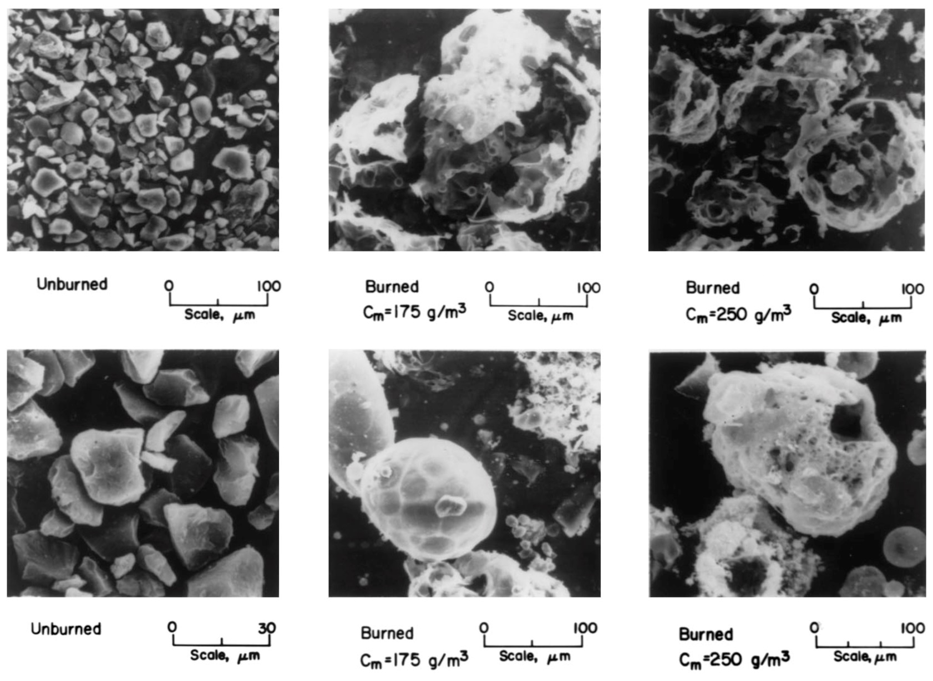
How coal dust explodes
Dust Explosion Fundamentals
Notes:
Coal dust explodes in a sequence involving heating to the point of pyrolysis followed by ignition of the evolved volatile matter and subsequent gas-phase flame propagation.
The slide shows scanning electron microscope (SEM) pictures of Pittsburgh seam bituminous coal dust before and after explosion in a laboratory-scale chamber. The burned char residue is seen to consist of rounded particles (or cenospheres), some of which have become fractured or display “blow holes” from which volatiles have been emitted. It is these volatiles that burn in a coal dust explosion leading to increased temperature and pressure in an enclosed volume.
Photograph: Cashdollar, K.L., “Overview of Dust Explosibility Characteristics,” Journal of Loss Prevention in the Process Industries, 13, 183-199 (2000).
Note that C_{m} is the dust cloud concentration at the time of explosion.

Slide 6
Dust explosion parameters
Dust Explosion Fundamentals
Laboratory-scale testing can determine dust explosion parameters for hazard/risk determination
Likelihood of occurrence
  MEC: Minimum Explosible Concentration
  MIE: Minimum Ignition Energy
  MIT: Minimum Ignition Temperature
  LOC: Limiting Oxygen Concentration
Severity of consequences
  P_{max}: Maximum explosion pressure
  (dP/dt)_{max}: Maximum rate of pressure rise
  K_{St} = (dP/dt)_{max} · V^{1/3}
Notes:
Text books and data bases can be helpful as indicators of explosibility, but they cannot be seen as a substitute for actual test data on the material being processed. The next slide shows some of the standards and laboratory-scale equipment available for acquiring data for the various explosion parameters shown in the current slide.
Each of these parameters can be categorized according to one of the two components of risk – likelihood of occurrence or severity of consequences. As such, their usefulness lies in developing adequate measures for either the prevention or mitigation of a dust explosion. As we will see in detail later in the module, there are several ways to reduce dust explosion risk once the basic explosibility parameters shown in this slide are known.
Likelihood of Occurrence
MEC, or minimum explosible concentration, is the term used for the LFL, or lower flammability limit, of a dust cloud. Typical units of MEC are g/m³.
MIE, or minimum ignition energy, is (according to the definition previously given) the minimum electric spark energy that will ignite a dust cloud. Typical units of MIE are °C.
MIT, or minimum ignition temperature, is the term used for the AIT, or autoignition temperature of a dust cloud. (MIT is sometimes called MAIT, or minimum autoignition temperature). Typical units of MIT are °C.
[There is another minimum ignition temperature parameter for dust layers called the LIT, or layer ignition temperature. Typical units of LIT are °C.]
LOC, or limiting oxygen concentration, is the minimum oxygen concentration in the atmosphere required for flame propagation in a dust cloud. Typical units are volume %.
Severity of Consequences
P_{max}, (dP/dt)_{max} and K_{St} are all as previously defined with the previously identified typical units. Note that in K_{St}, the St subscript comes from the first two letters of the German word for dust (staub).

Slide 7
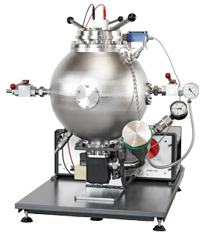
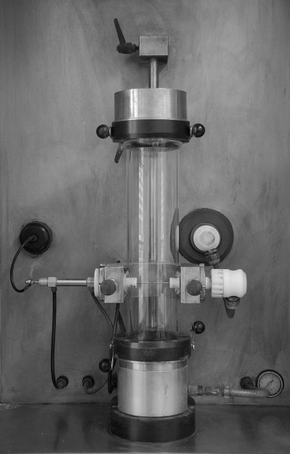
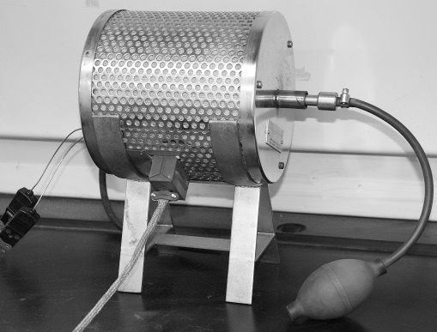
Testing standards and equipment
Dust Explosion Fundamentals
ASTM E1226-12a: Standard Test Method for Explosibility of Dust Clouds
ASTM E1515-07: Standard Test Method for Minimum Explosible Concentration of Combustible Dusts
ASTM E2019-03 (2013): Standard Test Method for Minimum Ignition Energy of a Dust Cloud in Air
ASTM E1491-06 (2012): Standard Test Method for Minimum Autoignition Temperature of Dust Clouds
20-L Apparatus
MIKE3 Apparatus
BAM Oven
Notes:
This slide shows examples of ASTM International testing standards as well as dust explosion test equipment manufactured by Kuhner AG in Basel, Switzerland. There are other global testing standards and manufacturers of laboratory-scale dust explosion equipment.
P_{max}, (dP/dt)_{max} and K_{St} can be determined according to ASTM E1226 in the 20-L apparatus (or 20-L Siwek chamber, after its designer).
MEC can be determined according to ASTM E1515 in the 20-L apparatus.
MIE can be determined according to ASTM E2019 in the MIKE3 apparatus.
MIT can be determined according to ASTM E1491 in the BAM oven.
As indicated in the Resources section of the module, these and other testing standards are available on the ASTM International web site.

Slide 8
Risk control standards
Dust Explosion Fundamentals
NFPA 61 – Agriculture and Food Industries
NFPA 68 – Deflagration Venting
NFPA 69 – Prevention Systems
NFPA 120 – Coal Mines
NFPA 484 – Combustible Metals
NFPA 499 – Electrical Installations
NFPA 654 – Manufacturing, Processing and Handling Dusts
NFPA 664 – Wood Processing
Notes:
The National Fire Protection Association (United States) has published several standards relating to the prevention and mitigation of dust explosions:
NFPA 61 – Standard for the Prevention of Fires and Dust Explosions in Agricultural and Food Processing Facilities
NFPA 68 – Standard on Explosion Protection by Deflagration Venting
NFPA 69 – Standard on Explosion Prevention Systems
NFPA 120 – Standard for Fire Prevention and Control in Coal Mines
NFPA 484 – Standard for Combustible Metals
NFPA 499 – Recommended Practice for the Classification of Combustible Dusts and of Hazardous (Classified) Locations for Electrical Installations in Chemical Process Areas
NFPA 654 – Standard for the Prevention of Fire and Dust Explosions from the Manufacturing, Processing, and Handling of Combustible Particulate Solids
NFPA 664 – Standard for the Prevention of Fires and Explosions in Wood Processing and Woodworking Facilities
As indicated in the Resources section of the module, these and other risk control standards are available on the NFPA web site.
Similar to the testing standards listed on the previous slide, there are other global risk control standards. Examples include the European (EN) Standards and the VDI Guidelines in Germany. The Health and Safety Executive or HSE (United Kingdom) web site (www.hse.gov.uk) gives a good overview of two European Directives for controlling explosive atmospheres – ATEX 95 (ATEX Equipment Directive) and ATEX 137 (ATEX Workplace Directive).

Slide 9
Element 1 of 5 – Fuel
Basic Fire Principles
Basic Explosion Principles
Dust Explosion Fundamentals
Fuel
Ignition Source
Oxidant
Mixing
Confinement
Dust Layer Fires
Prevention and Mitigation
Case Studies
Resources
Evaluation
FUEL
IGNITION
FUEL
MIXING
OXIDANT
CONFINEMENT
Notes:
This section covers dust as a fuel source. Combustible dust is defined, including conditions of particle size and shape, and examples of combustible dusts and typical process units that experience dust explosions are given. Dust layers and airborne concentrations arising from layers are described. Finally, the unique fuel system known as a hybrid mixture is examined.

Slide 10
Dust and combustible dust
Fuel
NFPA definition of dust
  Any finely divided solid, 500 µm or less in diameter
NFPA definition of combustible dust
  A combustible particulate solid that presents a fire or deflagration hazard when suspended in air or some other oxidizing medium over a range of concentrations, regardless of particle size or shape.
Notes:
The NFPA distinguishes between a dust and a combustible dust. By these definitions, not all dusts are combustible dusts and not all combustible dusts are dusts!
Confusing? A bit perhaps, but the takeaway lesson here is that the important definition for our purposes is combustible dust. Throughout this module, whenever the word dust is used, it should be taken to mean a combustible dust as per the above NFPA definition.
One should not view a defined boundary of 500 µm as a sharp delineation between dusts that are explosible and those that are non-explosible. What determines whether a given particulate material represents a dust explosion hazard is its actual chemical composition in addition to physical parameters such as particle size and particle shape.

Slide 11
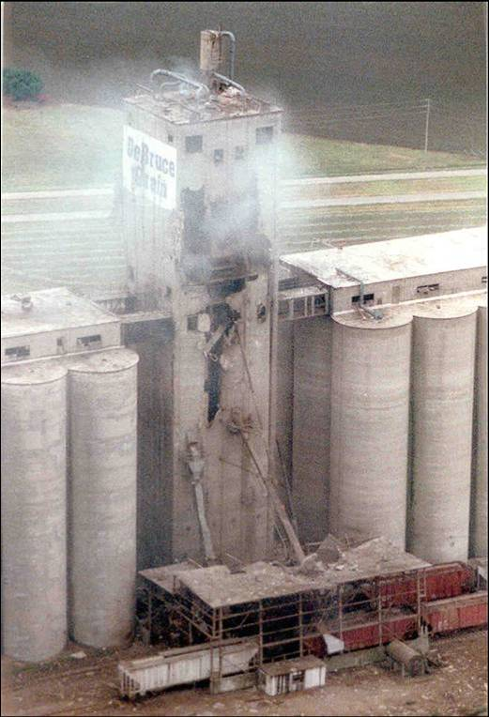
Examples of combustible dusts
Fuel
Coal and coal products
Food products
Metals and alloys
Rubber and plastics
Wood products
Textiles
Pharmaceuticals
Pesticides
DeBruce Grain Elevator Explosion
Notes:
Combustible dusts can be found across many industries. The following is a list of just some of the many types of combustible dusts: coal and coal products such as activated carbon, bituminous coal and pulverized coal; food products such as grain dust, flour, sugar, coffee and dextrose; metals and alloys such as aluminum, bronze, silicon, zinc and titanium; rubber, plastics, polymer and resins; wood and paper; cotton and wool; pharmaceuticals; pesticides.
Because dust explosions arise from the reaction of a fuel with oxygen to generate oxides and heat, they cannot occur with materials that are already stable oxides (such as silicates and carbonates).
References for this slide and further examples can be found in: Amyotte, P., “An Introduction to Dust Explosions. Understanding the Myths and Realities of Dust Explosions for a Safer Workplace”, Elsevier/Butterworth-Heinemann, Waltham, MA (2013).
Photograph: Kauffman, C.W., “The DeBruce Grain Elevator Explosion”, Proceedings of the Seventh International Symposium on Hazards, Prevention, and Mitigation of Industrial Explosions, Volume III, St. Petersburg, Russia (July 7-11, 2008), pp. 3-26.

Slide 12
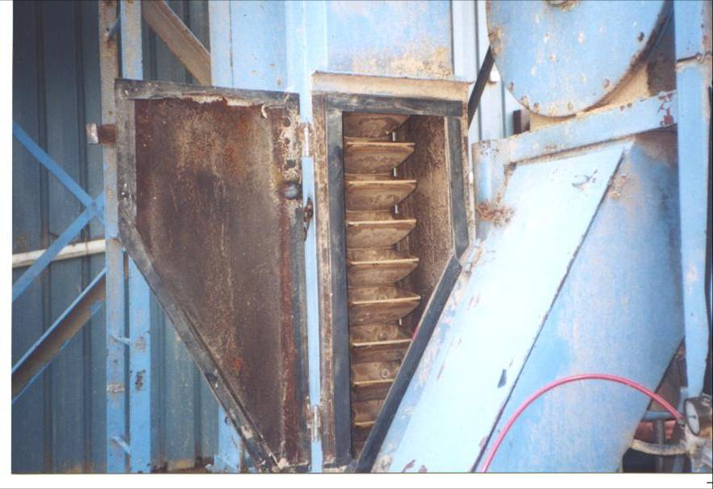
Examples of process units
Fuel
Silos
Hoppers
Dust collectors
Grinders
Dryers
Furnaces
Mixers
Pulverizing units
Conveying systems
Bucket Elevator
Notes:
The previous list of combustible dusts largely defines the industrial plant in which dust explosions are most commonly experienced. Examples of process units that have been subject to the dust explosion problem are given in this slide. Dust collectors are arguably the most at risk in this regard.
References for this slide and further examples can be found in: Amyotte, P., “An Introduction to Dust Explosions. Understanding the Myths and Realities of Dust Explosions for a Safer Workplace”, Elsevier/Butterworth-Heinemann, Waltham, MA (2013).

Slide 13
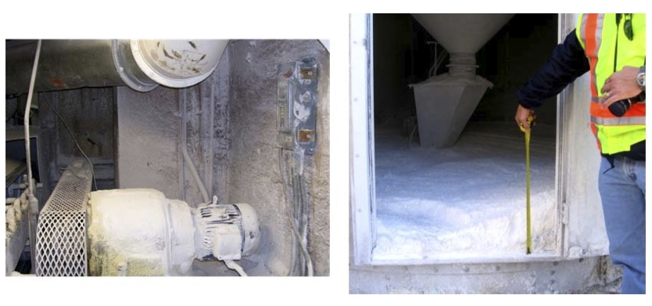
How much layered dust is too much?
Fuel
Sugar dust accumulation on
steel belt drive motor
Cornstarch accumulation under
cornstarch silo
Notes:
Dust explosions occur either inside process vessels in which a dust cloud already exists, or as a result of a dust cloud formed by dispersion of a dust layer. (These mechanisms are treated in more detail later in the module.)
For the latter case, how thick a dust layer is needed to support a dust explosion if the layer forms an airborne cloud? The answer is not very thick – typically on the order of a millimeter or so.
In general, there is too much layered dust if it creates an opaque layer over the surface; for example – if you can’t tell the colour of the surface beneath the layer. Or, there is too much layered dust if you can leave visible markings in the dust, such as leaving footprints or being able to write your initials or “clean me” in the dust.
The slide gives two examples of dust layers. The photograph on the right shows a significant spill, which would easily be considered “too much”. The photograph on the left shows a much thinner dust layer, but it too would be considered “too much”.
Photographs: CSB, “Investigation Report. Sugar Dust Explosion and Fire. Imperial Sugar Company”, Report No. 2008-05-I-GA, U.S. Chemical Safety and Hazard Investigation Board, Washington, DC (2009).

Slide 14
Calculation of dust concentration
Fuel
C = ρ_{bulk} (h/H)
C = dust concentration
ρ_{bulk} = bulk density of dust layer
h = thickness of dust layer
H = height of dust cloud produced from dust layer
Notes:
The concentration of a dust cloud resulting from dispersion of a dust layer in air can be determined by the equation shown in the slide. This is an estimate that assumes complete, uniform dust dispersion. Nevertheless, this simple expression is helpful in demonstrating that very thin layers of combustible dust can be hazardous. An example of the use of this equation is given in the next slide.
Equation Source: Eckhoff, R.K., “Dust Explosions in the Process Industries”, 3rd edition, Gulf Professional Publishing/Elsevier, Boston, MA (2003).

Slide 15
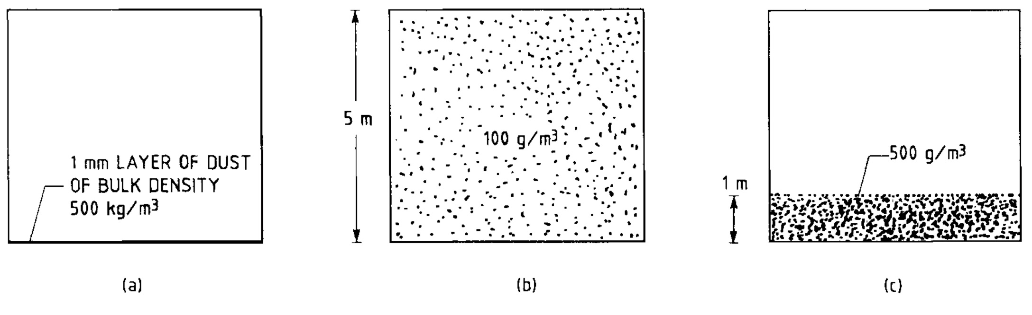
Example: C = ρ_{bulk} (h/H)
Fuel
h = 1 mm
ρ_{bulk} = 500 kg/m³
H = 5 m
C = 100 g/m³
H = 1 m
C = 500 g/m³
Notes:
The figure in the slide shows two scenarios for a given dust layer thickness (1 mm) and bulk density (500 kg/m³).
With uniform dispersion throughout a 5-m high enclosure, the resulting dust cloud will have an average concentration of 100 g/m³. Such a concentration is of the order of the minimum amount required to initiate an explosion – i.e., the MEC – for many dusts.
With only partial dispersion up to 1 m above the enclosure floor, the resulting dust cloud will have an average concentration of 500 g/m³. Such a concentration is of the order of the optimum concentration – i.e., the concentration producing the most destructive overpressures and rates of pressure rise – for many dusts.
Figure: Eckhoff, R.K., “Dust Explosions in the Process Industries”, 3rd edition, Gulf Professional Publishing/Elsevier, Boston, MA (2003).

Slide 16
Particle size
Fuel
In general, as particle size of a given dust decreases, there is an increase in both explosion severity and likelihood
  P_{max} increases
  K_{St} increases (potentially significantly)
  MEC, MIE and MIT all decrease
  Smaller particle → larger surface area → higher reactivity
For nanomaterials, testing to date indicates an increase in explosion likelihood but no significant increase in severity
  Limited severity effect likely caused by particle agglomeration during dispersion
Notes:
The particle size of a given combustible dust has a significant influence on its explosibility. In general, a decrease in particle size has been shown to increase the likelihood of occurrence of a dust explosion as well as its consequence severity. P_{max} increases. (dP/dt)_{max} and hence K_{St} also increase; this increase can potentially be substantial. MEC, MIE and MIT all decrease with decreasing particle size. This is due to surface area effects – a smaller particle means a larger surface area and therefore enhanced reactivity. The fine particles (typically < 75 µm) in a wide particle size distribution make the greatest contribution to dust reactivity and explosibility.
One exception to this general behaviour is nanomaterials. Although only limited test results are currently available, as particle size decreases into the nano-range, there appears to be no significant increase in explosion severity – yet explosion likelihood can increase dramatically. Nanomaterials are extremely sensitive, and may self-ignite under certain testing and handling conditions. Agglomeration of primary nanoparticles into micron-size aggregates during dust dispersion is thought to be responsible for the limited increase in P_{max} and K_{St}.

Slide 17
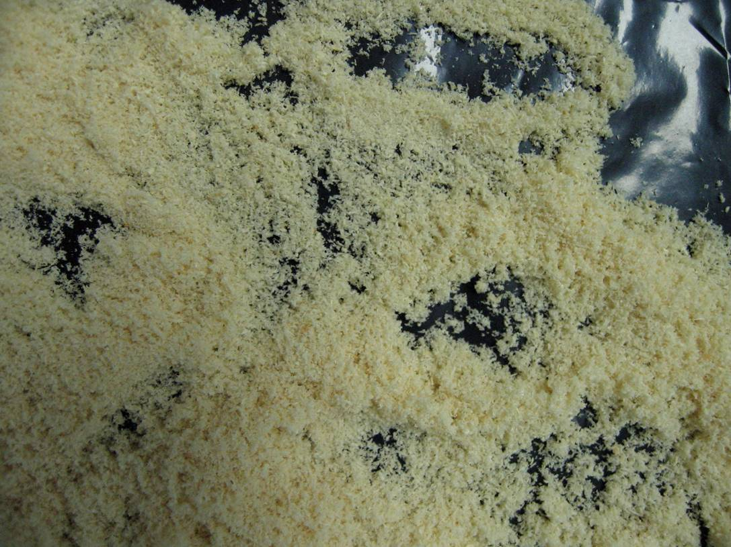
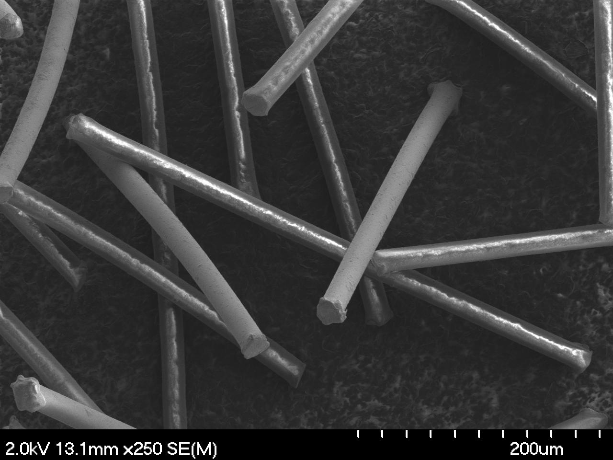
Particle shape
Fuel
Non-spherical particles can be combustible
  Flake-like particles
  Flocculent particles (fibers with L/D ratio)
Wood Fibers
Nylon Flock
Notes:
Dust particles do not need to be spherical or near-spherical to be combustible. Flake-like particles and flocculent materials (fibrous materials better characterized by a length-to-diameter ratio than a particle diameter) can also pose an explosion hazard.
The slide gives two photographs. The one on the left (taken with a normal digital camera) shows combustible wood fibers. The SEM image on the right shows combustible nylon (polyamide 6.6) flock.
Photograph (Left): Amyotte, P.R., Cloney, C.T., Khan, F.I. and Ripley, R.C., “Dust Explosion Risk Moderation for Flocculent Dusts”, Journal of Loss Prevention in the Process Industries, 25, 862-869 (2012).
Photograph (Right): Iarossi, I., Amyotte, P.R., Khan, F.I., Marmo, L., Dastidar, A.G. and Eckhoff, R.K., “Explosibility of Polyamide and Polyester Fibers”, Journal of Loss Prevention in the Process Industries, 26, 1627-1633 (2013).

Slide 18
Both of these dusts are combustible
Fuel
Spherical Polyethylene
Fibrous Polyethylene
Notes:
Each of the spherical and fibrous polyethylene samples shown in the SEMs on this slide pass through a 200-mesh sieve, and are therefore nominally < 75 µm in size. Explosion testing for these samples determined that each was capable of generating overpressures of approximately 7 bar(g) – i.e., seven times atmospheric pressure – and rates of pressure rise as high as 300 – 400 bar/s in a volume of 20 L.
Photographs: Amyotte, P.R., Cloney, C.T., Khan, F.I. and Ripley, R.C., “Dust Explosion Risk Moderation for Flocculent Dusts”, Journal of Loss Prevention in the Process Industries, 25, 862-869 (2012).

Slide 19
Hybrid mixtures
Fuel
Flammable gas and combustible dust
  May each be present in concentrations less than their individual LFL (gas) and MEC (dust), and still be explosible
Result in increased explosion severity and likelihood
Examples
  Methane gas and coal dust
  Natural gas and fly ash
  Hydrocarbon gases and resins
Notes:
A hybrid mixture explosion can occur as a result of the mixing of a flammable gas and a combustible dust. The gas concentration may be less than its lower flammability limit (LFL) and/or the dust concentration may be less than its minimum explosible concentration (MEC), and yet the mixture can still be explosible. The focus when discussing hybrid mixtures is often on admixture of a flammable gas in concentrations below the LFL of the gas itself, to an already explosible concentration of dust.
In a hybrid mixture explosion, there would be higher values of P_{max} and (dP/dt)_{max}, and lower values of MEC and MIE (with respect to the dust alone), which results in an increase in both explosion severity and likelihood of occurrence.
A well-known example of a hybrid mixture is methane gas and coal dust in an underground coal mine. Other examples include natural gas and fly ash in fossil-fuel power plants, and gaseous hydrocarbons and resins in plastic powder production facilities.

Slide 20
Element 2 of 5 – Ignition Source
Basic Fire Principles
Basic Explosion Principles
Dust Explosion Fundamentals
Fuel
Ignition Source
Oxidant
Mixing
Confinement
Dust Layer Fires
Prevention and Mitigation
Case Studies
Resources
Evaluation
FUEL
IGNITION
IGNITION SOURCE
MIXING
OXIDANT
CONFINEMENT
Notes:
This section deals with possible dust explosion ignition sources, as well as introducing minimum ignition energy and minimum explosion temperature testing and results. The relationship between gas and dust MIE values is also described.

Slide 21

Examples of ignition sources
Ignition Source
Flames and direct heat
Hot work
Incandescent materials
Hot surfaces
Electrostatic sparks
Electrical sparks
Friction sparks
Impact sparks
Self-heating
Static electricity
Lightning
Shock waves
Notes:
Dust explosion triggers include the following:
flames and direct heat,
hot work (e.g., welding and cutting),
incandescent material (e.g., smoldering particles),
hot surfaces, (e.g., overheated bearings),
electrostatic sparks (caused by electrostatic discharge from electrical equipment),
electrical sparks (such as may be caused by switching operations),
friction sparks and hot spots (caused by rubbing between solids and friction-induced heating, respectively),
impact sparks (ignition by surface heating resulting from metal-on-metal impact),
self-heating (spontaneous combustion),
static electricity (electrostatic sparks caused by process operations such as pouring and size reduction),
lightning, and
shock waves.
Reference: Abbasi, T. and Abbasi, S.A., “Dust Explosions – Cases, Causes, Consequences, and Control”, Journal of Hazardous Materials, 140, 7-44 (2007).

Slide 22
MIE and MIT testing
Ignition Source
MIE and MIT testing can be conducted to better identify potential ignition source hazards
MIE and MIT test results are applicable to efforts aimed at dust explosion prevention
  Removal of ignition sources
  Grounding and bonding
  Control of process/surface temperatures
Notes:
Many ignition sources involve either an energetic spark or a hot-surface temperature. To better identify potential ignition source hazards in terms of both energy and temperature requirements, minimum ignition energy and minimum ignition temperature testing of a given dust can be conducted.
Test results can be implemented in applications such as removal of ignition sources, grounding and bonding as a form of protection against static electricity build-up and electrostatic discharges, and control of process and surface temperatures.

Slide 23
MIE values of some dusts
Ignition Source
Material | MIE with inductance [mJ] | MIE without inductance [mJ]
Epoxy coating powder | 1.7 | 2.5
Polyester coating powder | 2.9 | 15
Polyamide coating powder | 4 | 19
Magnesium granulate | 25 | 200
Flock | 69-98 | 1300-1600
Notes:
Decades ago, it was believed that all dusts had MIEs greater than 10 mJ. As testing methods were improved, it was discovered that many dusts had much lower MIEs, in the range of 1 mJ or less. The table in the slide shows MIE values for different particulate materials.
MIE is tested both with and without inductance in the spark circuitry. It has been found that the use of inductance usually lowers the MIE, and sometimes the reduction is quite significant as we can see in this table. This is because the use of inductance results in a longer spark duration (i.e., protracted spark), and therefore a higher probability of ignition.
Note: These values, although typical for their dust types are not specific to all similar dusts. A dust source must be tested in order to obtain specific values. Additionally, although particle size is not given for these examples, we know from previous discussion in this module that particle size does have an effect on MIE.
Table adapted from: von Pidoll, U., “The Ignition of Clouds of Sprays, Powders and Fibers by Flames and Electric Sparks”, Journal of Loss Prevention in the Process Industries, 15, 305-310 (2002).

Slide 24
Ignition of titanium dust
Ignition Source
 | MIE [mJ]
Size | With inductance | Without inductance | MIT [°C]
<150 µm | 10-30 | 1-3 | >590
<45 µm | 1-3 | 1-3 | 460
≤20 µm | <1 | <1 | 460
150 nm | Not determined | <1 | 250
60-80 nm | Not determined | <1 | 240
40-60 nm | Not determined | <1 | 250
Notes:
Nano-size metals such as aluminum and titanium have been shown to have very low ignition energies of less than 1 mJ, which is the lower testing limit of the MIKE3 apparatus (shown in a previous slide).
In this table we see these low MIE results for nano-titanium. We also see that even the micron-size dusts have low MIE values. And we also see the decrease in minimum ignition temperature (MIT) from micron- to nano-size titanium.
Table adapted from: Boilard, S.P., Amyotte, P.R., Khan, F.I., Dastidar, A.G. and Eckhoff, R.K., “Explosibility of Micron- and Nano-Size Titanium Powders”, Journal of Loss Prevention in the Process Industries, 26, 1646-1654 (2013).

Slide 25
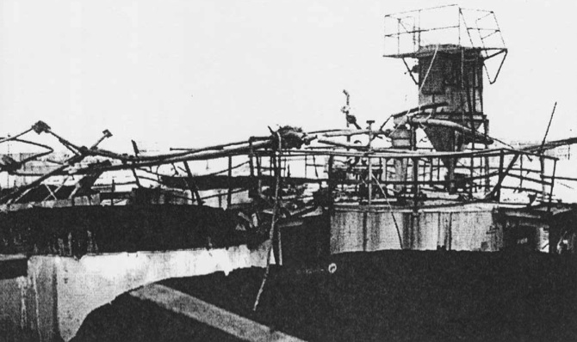
Destruction at 10 mJ
Ignition Source
ABS (Acrylonitrile-Butadiene-Styrene) Plant
Notes:
Flammable gases typically have lower ignition energies than combustible dusts. For example, the CSB report on the Hoeganaes incidents presented in the later module section on Case Studies gives an MIE of 0.02 mJ for hydrogen and > 500 mJ for the iron dust involved in the actual incidents.
(CSB, “Case Study. Hoeganaes Corporation: Gallatin, TN. Metal Dust Flash Fires and Hydrogen Explosion”, No. 2011-4-I-TN, U.S. Chemical Safety and Hazard Investigation Board, Washington, DC (2011).)
But don’t be fooled into thinking that the relatively higher MIEs of combustible dusts mean that dust explosions – once initiated – are not potentially devastating. The figure in this slide indicates otherwise. (Figure: Kao C.-S. and Duh, Y.-S., “Accident Investigation of an ABS Plant”, Journal of Loss Prevention in the Process Industries, 15, 223-232 (2002).)
Kao and Duh (2002) describe a series of dust explosions in the silo area of an ABS (acrylonitrile-butadiene-styrene) plant; the participating materials were ABS (which is a rubber-containing plastic) and SAN (polystyrene-acrylonitrile). Several silos were affected, with the top-plate and bag-filter (dust collector) for each being destroyed. An indication of the plant damage is given by the figure in this slide.
The incident investigation team eventually concluded that the explosion was initiated in one of the silos undergoing gravitational filling of ABS powder, with flame propagation to the other involved silos occurring through interconnecting pipes. The most likely ignition scenario in the first silo was thought to be a bulked brush (conical pile or cone) discharge between the compacted powder and the grounded silo wall. Such discharges are relatively intense and have energies up to several hundred mJ. The MIE of the ABS powder was measured as 10 mJ.
Additional original source material can be found in: Amyotte, P., “An Introduction to Dust Explosions. Understanding the Myths and Realities of Dust Explosions for a Safer Workplace”, Elsevier/Butterworth-Heinemann, Waltham, MA (2013).

Slide 26
Element 3 of 5 – Oxidant
Basic Fire Principles
Basic Explosion Principles
Dust Explosion Fundamentals
Fuel
Ignition Source
Oxidant
Mixing
Confinement
Dust Layer Fires
Prevention and Mitigation
Case Studies
Resources
Evaluation
FUEL
IGNITION
OXIDANT
MIXING
OXIDANT
CONFINEMENT
Notes:
This section examines two aspects related to oxygen as the most common oxidant for combustion: (i) the concept of the limiting oxygen concentration, or LOC, and (ii) the use of inert gases as an explosion prevention technique. LOC is defined and representative values are given. Various candidate inert gases are identified and their effect on key explosion parameters is illustrated.

Slide 27
Limiting oxygen concentration
Oxidant
Oxygen is the most common oxidant
Does not have to be completely removed to prevent a dust explosion
Limiting oxygen concentration (LOC)
  Highest oxygen concentration in a dust/air/inert gas mixture at which an explosion fails to occur
  Value for a given dust depends on inert gas used
  Industry application – inerting
Notes:
Oxygen is the most common oxidant found in industry. Air is typically comprised of 21 % by volume of oxygen.
While an oxidant must be present for combustion to occur, its removal does not need to be complete to prevent the occurrence of a dust explosion. The limiting oxygen concentration (LOC) is defined as the highest oxygen concentration at which an explosion fails to occur in a given dust/air/inert gas mixture.
The inert gas used for this purpose affects the measured value of LOC; the effectiveness of different inert gases is shown in a later slide. LOC data can be applied in industry to a prevention technique known as inerting (in which a process is operated under a blanket of inert gas). However, inerting may not always be feasible, and there can be hazards other than explosions associated with inerting. Some of these hazards are shown in the following slide.

Slide 28
Use of inert gas
Oxidant
Inert gas examples – carbon dioxide, nitrogen argon, helium, steam, flue gas
Inerting can introduce new hazards
  Asphyxiation from reduced oxygen levels in air
  Reaction of inert gas with dust
  Electrostatic discharge when CO₂ is drawn from high-pressure or cryogenic tanks
  Leakage of inert gas in systems under pressure
  Introduction of ignition sources from inerting equipment such as vacuum pumps
Notes:
Candidate inert gases include: carbon dioxide, nitrogen, argon, helium, steam and flue gas.
Inerting can greatly reduce the risk of a dust explosion. In the act of removing one hazard, however, new hazards may be introduced as shown by the list given in the slide. Asphyxiation is a key and insidious hazard; safe oxygen levels for human beings are between 19.5 and 23.5 volume %. Carbon dioxide has been known to react with aluminum dust, and nitrogen with magnesium dust at high temperatures.
References for this slide and further examples can be found in: Amyotte, P., “An Introduction to Dust Explosions. Understanding the Myths and Realities of Dust Explosions for a Safer Workplace”, Elsevier/Butterworth-Heinemann, Waltham, MA (2013).

Slide 29
LOC values of some dusts
Oxidant
Material | LOC with nitrogen [volume %]
Pea flour | 15.5
Calcium stearate | 12.0
Wheat flour | 11.0
High-density polyethylene | 10.0
Sulfur | 7.0
Aluminum | 5.0
Notes:
In this table we see representative values of LOC for various materials. Aluminum dust is highly reactive and therefore has a low LOC.
In industry – to account for operating errors and upset conditions – a safety factor is normally applied to the measured LOC (e.g., the LOC percentage minus a further set percentage such as 2 volume %).
Note: These values, although typical for their dust types are not specific to all similar dusts. A dust source must be tested in order to obtain specific values. Additionally, although particle size is not given for these examples, it should not come as a surprise that particle size has an effect on LOC.
Table and text adapted from: Hoppe, T. and Jaeger, N., “Reliable and Effective Inerting Methods to Prevent Explosions”, Process Safety Progress, 24, 266-272 (2005).

Slide 30
Inert gas effectiveness
Oxidant
Magnesium Dust
Inert Gas | LOC [volume %]
Nitrogen (diatomic) | 6.8
Carbon dioxide (triatomic) | 5.5
Argon (monatomic) | 4.0
Notes:
Inert gases have different degrees of effectiveness. This table shows the LOC values for three different inert gases with a specific sample of magnesium dust. Gases with multiatomic molecules have a greater capacity for energy absorption, and hence would be more effective at inerting than monatomic gases, resulting in a higher LOC value. This is why argon (monatomic) has the lowest LOC of the three gases shown.
Table adapted from: Li, G., Yuan, C.M., Fu, Y., Zhong, Y.P. and Chen, B.Z., “Inerting of Magnesium Dust Coud with Ar, N₂ and CO₂”, Journal of Hazardous Materials, 170, 180-183 (2009).

Slide 31
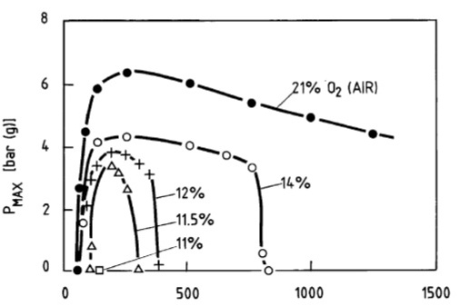
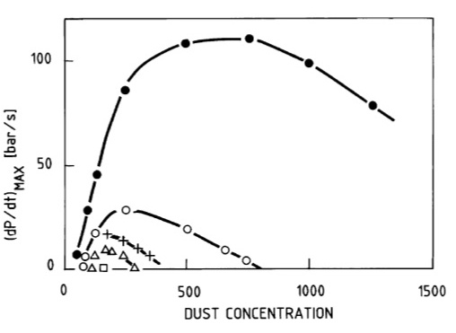
Effect on P_{max} and (dP/dt)_{max}
Oxidant
Brown Coal Dust/Air/Nitrogen
Notes:
This figure shows the inerting effectiveness of nitrogen on the maximum explosion pressure and maximum rate of pressure rise of a sample of brown coal.
It can be seen that the limiting oxygen concentration (LOC) was 11 volume %, as an explosion was no longer possible at this level (zero values of overpressure and rate of pressure rise). We can also see that there was a steady reduction in overpressure and rate of pressure rise as the oxygen concentration was reduced below 21 volume %, until the limiting oxygen concentration was reached.
Figure: Eckhoff, R.K., “Dust Explosions in the Process Industries”, 3rd edition, Gulf Professional Publishing/Elsevier, Boston, MA (2003).
Original Source: Wiemann W., “Influence of Temperature and Pressure on the Explosion Characteristics of Dust/Air and Dust/Air/Inert Gas Mixtures”, In: Cashdollar K.L. and Hertzberg M. (Editors), “Industrial Dust Explosions. ASTM Special Technical Publication 958”, American Society for Testing and Materials, Philadelphia, PA (1987).

Slide 32
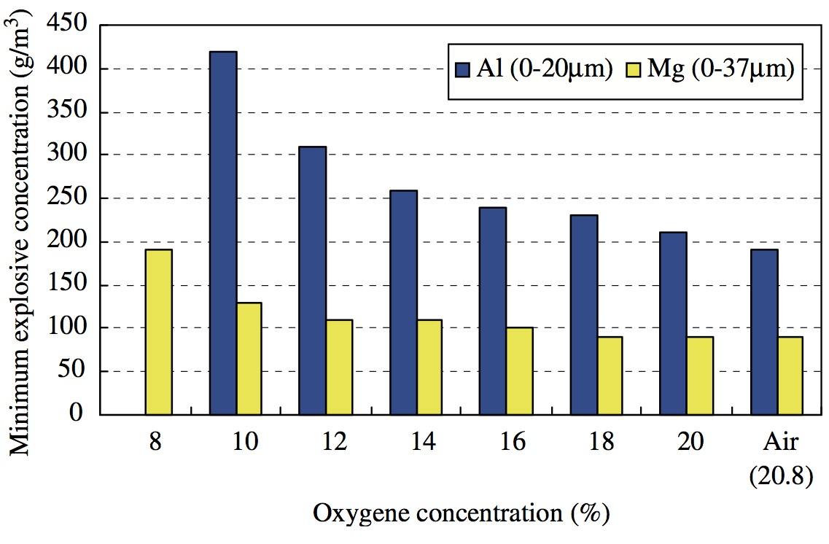
Effect on MEC (nitrogen)
Oxidant
Notes:
This figure shows the inerting effectiveness of nitrogen on the minimum explosible concentration of samples of aluminum and magnesium.
It is clear that the trend with oxygen level reduction is toward a limiting oxygen concentration at which explosions are no longer possible.
Figure: Nifuku, M., Koyanaka, S., Ohya, H., Barre, C., Hatori, M., Fujiwara, S., Horiguchi, S. and Sochet, I., “Ignitability Characteristics of Aluminum and Magnesium Dusts that are Generated During the Shredding of Post-Consumer Wastes”, Journal of Loss Prevention in the Process Industries, 20, 322-329 (2007).

Slide 33
Element 4 of 5 – Mixing
Basic Fire Principles
Basic Explosion Principles
Dust Explosion Fundamentals
Fuel
Ignition Source
Oxidant
Mixing
Confinement
Dust Layer Fires
Prevention and Mitigation
Case Studies
Resources
Evaluation
FUEL
IGNITION
MIXING
MIXING
OXIDANT
CONFINEMENT
Notes:
This section covers the various factors affecting dust layer dispersion. The sequence of primary and secondary explosions is explained, and turbulence effects are discussed.

Slide 34
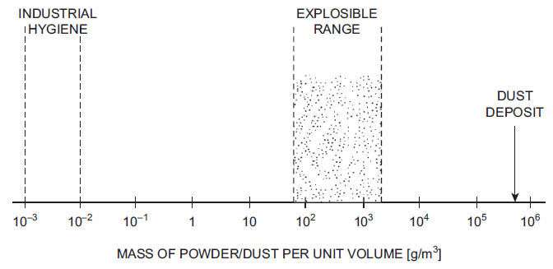
Primary dust explosions
Mixing
Notes:
Explosible dust clouds are optically thick. Eckhoff (2003) puts this in practical terms by quoting the observation that a glowing 25-W light bulb cannot be seen through 2 m of a dust cloud at concentrations exceeding 40 g/m³. Such a concentration is lower than the MEC for many dusts.
Initiation of primary dust explosions therefore usually happens in dust clouds present in process vessels and units such as mills, grinders and dryers – i.e., inside equipment where the conditions of the explosion pentagon are satisfied. The reason for this occurrence is further explained by the figure in the slide. Here, the range of explosible dust concentrations in air at normal temperature and pressure for a natural organic dust (e.g., cornstarch) is compared with the typical range of maximum permissible dust concentrations that are relevant in the context of industrial hygiene, and with a typical density of deposits or layers of natural organic dusts. Clearly, the range of explosible concentrations is orders of magnitude greater than the concentrations permitted in areas inhabited by workers.
Figure: Eckhoff, R.K., “Dust Explosions in the Process Industries”, 3rd edition, Gulf Professional Publishing/Elsevier, Boston, MA (2003).

Slide 35
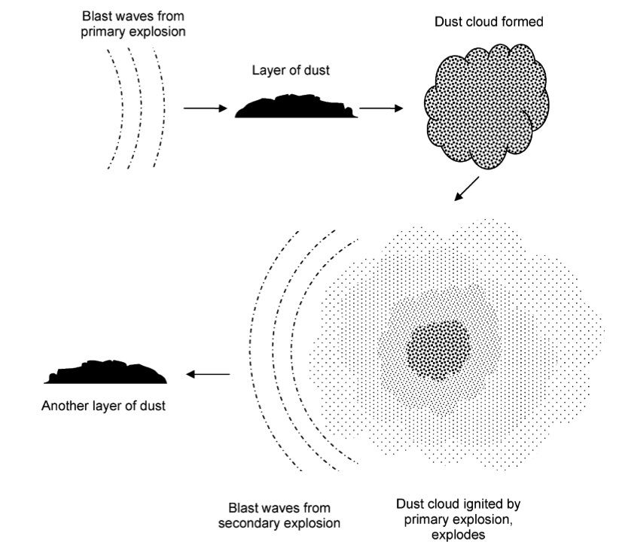
Secondary dust explosions
Mixing
Notes:
Industry experience tells us that dust explosions also occur in process areas, not just inside process units. A secondary explosion can be initiated due to entrainment of dust layers by the blast waves arising from a primary explosion as illustrated by the figure in this slide.
The primary event might be a dust explosion originating in a process unit, or could be any disturbance energetic enough to disperse combustible dust layered on the floor and other surfaces (such as improper cleaning practices using compressed air rather than an explosion-proof vacuum).
Figure: Abbasi, T. and Abbasi, S.A., “Dust Explosions – Cases, Causes, Consequences, and Control”, Journal of Hazardous Materials, 140, 7-44 (2007).

Slide 36
Primary/secondary dust explosions
Mixing
Primary dust explosions generally occur inside process vessels and units
  Mills, grinders, dryers, etc.
Secondary dust explosions are caused by dispersion of dust layers by an energetic disturbance
  Upset conditions/poor housekeeping practices
    Vigorous sweeping; cleaning with compressed air
  Blast wave from primary explosion
    Gas or dust explosion; other explosion types
Notes:
This slide gives a summary of the points made in the previous two slides and accompanying notes. Understanding the concept of primary and secondary dust explosions is one of the most important features of dust explosion risk reduction.

Slide 37
Dustiness/dispersibility
Mixing
Characteristic | Influence on Dispersion
Particle size | Larger diameter → higher settling velocity
Particle specific surface area | Larger specific surface area → lower settling rate
Dust moisture content | Higher moisture content → reduced dispersibility
Dust density | Higher density → higher settling velocity
Particle shape | Asymmetry and roughness → lower settling velocity
Agglomeration processes | Impact effective particle diameter
Notes:
How long a dust cloud remains in suspension depends on its dispersibility or dustiness. Dustiness is defined as the tendency of a dust to form clouds, and is influenced by the six characteristics shown in the table (Klippel, A., Scheid, M. and Krause, U., “Investigations into the Influence of Dustiness on Dust Explosions”, Proceedings of the Ninth International Symposium on Hazards, Prevention, and Mitigation of Industrial Explosions, Krakow, Poland (July 22-27, 2012).)
Particle size – For a given dust density, the terminal settling velocity of spherical particles increases with an increase in particle diameter.
Particle specific surface area – Higher specific surface area leads to a lower settling rate because of greater drag force acting on the particles.
Dust moisture content – Cohesion caused by inter-particle adhesion forces results in a decrease in dispersibility with an increase in dust moisture content.
Dust density – For a given particle diameter, the terminal settling velocity of spherical particles increases with dust density.
Particle shape – Features such as asymmetry in particle shape and roughness in surface texture have been shown to result in lower terminal settling velocities than for smooth, spherical particles due to rotational settling and eddy formation. Flocculent or fibrous dusts would be expected to settle at rates dependent on the orientation of the cylindrical-shaped particles to both the flow and gravitational fields.
Agglomeration processes – Two key aspects of the tendency of dusts to agglomerate become important when considering the concept of an effective particle diameter: (i) attraction between particles in dust layers due to inter-particle cohesion forces, and (ii) rapid coagulation of particles in a dust cloud. In the first instance, dispersion of agglomerates into primary particles is made more difficult; the second case means that even if a dust is well-dispersed, the formation of larger agglomerates in suspension remains a possibility.
Further references for this slide can be found in: Amyotte, P., “An Introduction to Dust Explosions. Understanding the Myths and Realities of Dust Explosions for a Safer Workplace”, Elsevier/Butterworth-Heinemann, Waltham, MA (2013).

Slide 38
Turbulence
Mixing
Some degree of turbulence will always exist in a dust cloud
  No such thing as a quiescent dust cloud within the confines of the earth’s gravitational field
Effects of turbulence
  Increased ignition requirements
    Highly turbulent dust clouds are harder to ignite
  Heightened combustion rates
    Once ignited, highly turbulent dust clouds yield more severe consequences
Notes:
Turbulence is the state of rapid, internal random movement of elements within a dust cloud relative to one another. Some degree of turbulence must exist within a dust cloud to allow for fuel and oxidant mixing.
Ignition temperature and ignition energy requirements both increase at higher turbulence levels. There is also more rapid combustion and overpressure development at higher turbulence levels.
Reference: Eckhoff, R.K., “Dust Explosions in the Process Industries”, 3rd edition, Gulf Professional Publishing/Elsevier, Boston, MA (2003).

Slide 39
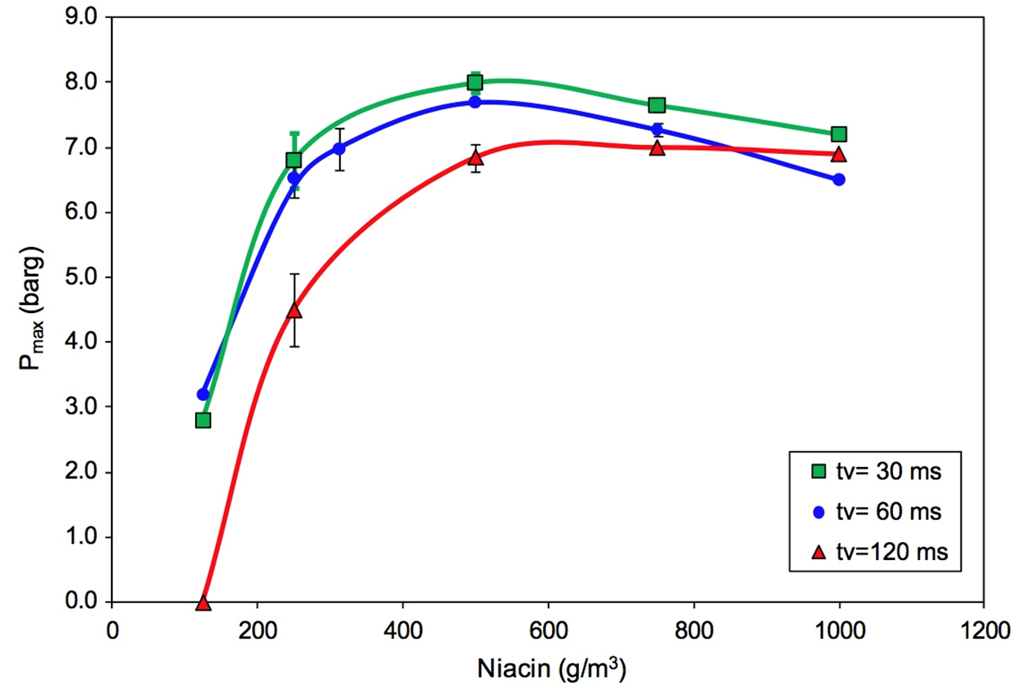
Turbulence and overpressure
Mixing
Notes:
Overpressure is a thermodynamic parameter and as such, turbulence does not have a significant impact on it.
This figure shows the effects of turbulence on explosion overpressure of the pharmaceutical dust, niacin, in the Siwek 20-L apparatus. In the figure, t_{v} refers to the ignition delay time (time between dust dispersion and ignition source activation). As the delay time increases, turbulence intensity decreases and the dust begins to settle out. We see only a small increase in overpressure with a higher level of turbulence (shorter ignition delay time).
Figure: Sanchirico, R., Di Benedetto, A., Garcia-Agreda, A. and Russo, P., “Study of the Severity of Hybrid Mixture Explosions and Comparison to Pure Dust-Air and Vapour-Air Explosions”, Journal of Loss Prevention in the Process Industries, 24, 648-655 (2011).

Slide 40
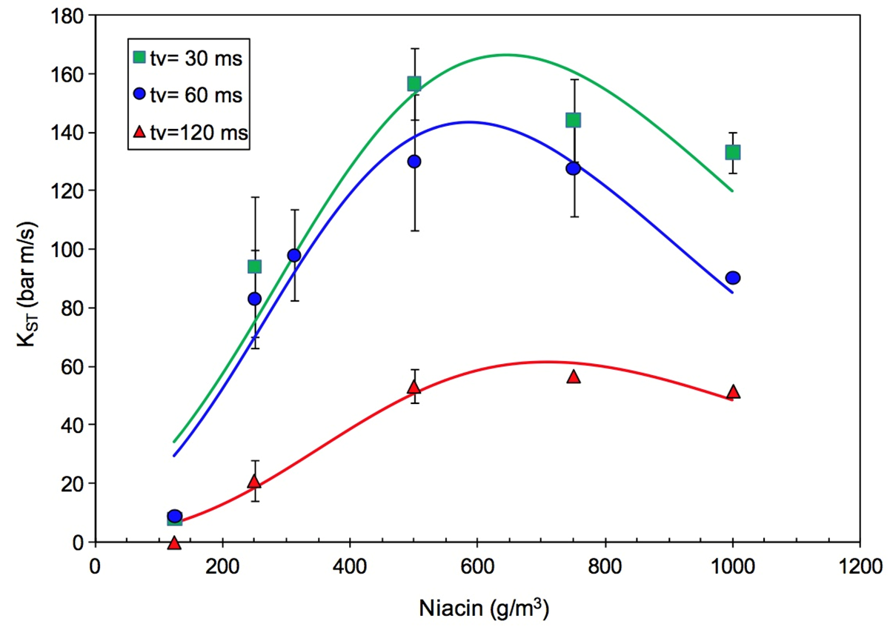
Turbulence and rate of pressure rise
Mixing
Notes:
The rate of pressure rise is a kinetic parameter, and is proportional to the flame propagation rate.
This figure shows the effects of turbulence on rate of pressure rise of niacin dust in the Siwek 20-L apparatus. Here, we see that a higher turbulence level (shorter ignition delay time, t_{v}) leads to a pronounced increase in rate of pressure rise. As the delay time increases, turbulence intensity again decreases and the dust begins to settle out.
Figure: Sanchirico, R., Di Benedetto, A., Garcia-Agreda, A. and Russo, P., “Study of the Severity of Hybrid Mixture Explosions and Comparison to Pure Dust-Air and Vapour-Air Explosions”, Journal of Loss Prevention in the Process Industries, 24, 648-655 (2011).

Slide 41
Element 5 of 5 – Confinement
Basic Fire Principles
Basic Explosion Principles
Dust Explosion Fundamentals
Fuel
Ignition Source
Oxidant
Mixing
Confinement
Dust Layer Fires
Prevention and Mitigation
Case Studies
Resources
Evaluation
FUEL
IGNITION
CONFINEMENT
MIXING
OXIDANT
CONFINEMENT
Notes:
This section examines the role of confinement in the explosion pentagon. Various degrees of confinement and the role of obstacle-generated turbulence (congestion) are described. Venting, the most commonly applied explosion mitigation measure, is also introduced.

Slide 42
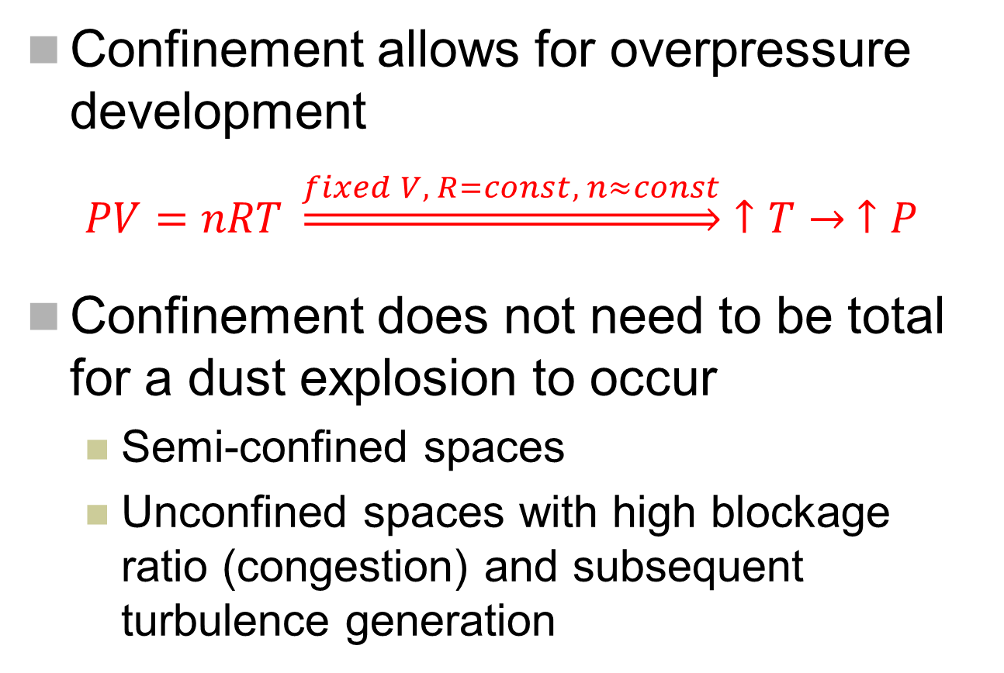
Role of confinement
Confinement
Confinement allows for overpres$\text{sure} \text{development}$
  $$PV=nRT \underset{⇒}{fixed V, R=const, n≈const}↑T→ ↑P$$
Confinement does not need to be total for a dust explosion to occur
  Semi-confined spaces
  Unconfined spaces with high blockage ratio (congestion) and subsequent turbulence generation
Notes:
Confinement allows for the development of explosion overpressure. The ideal gas law illustrates the role of confinement in overpressure development. The molar amounts of reactants and products do not usually differ significantly and the universal gas constant does not change. So in a confined, fixed-volume system, the pressure and temperature changes would be proportional. In other words, for the equal sign to hold true, the increase in temperature due to combustion must be matched by a proportional change in pressure.
However, confinement does not need to be total (or complete) for a dust explosion to occur. Dust explosions can occur in semi-confined spaces, or in unconfined spaces with a high blockage ratio due to flow obstruction (congestion) and ensuing turbulence generation in the unburned dust cloud (explained further in a later slide).
Further references and points of discussion for this slide can be found in: Amyotte, P., “An Introduction to Dust Explosions. Understanding the Myths and Realities of Dust Explosions for a Safer Workplace”, Elsevier/Butterworth-Heinemann, Waltham, MA (2013).

Slide 43
Degree of confinement
Confinement
No confinement/low confinement
  Flash fire
  Dust explosion rare occurrence
Partial confinement
  Fireball with limited pressure rise and flame propagation
  Explosion development possible
Complete confinement
  Full overpressure development
Notes:
The degree of confinement influences the effects of ignition of a combustible dust.
If there is limited confinement, a flash fire can occur with the potential for secondary fires. An unconfined dust explosion would be expected to be a rare occurrence as pressure development in the dust cloud would need to exceed the rate of pressure dissipation at the cloud edge. A combination of rapid combustion reactions such as from flow obstruction, as well as high dust reactivity would be needed.
If there is partial confinement, a fireball with limited pressure rise inside the enclosure, and flame propagation outside the enclosure may occur. Dust explosions can also occur, such as in underground mine workings.
With complete confinement such as inside process vessels, full overpressure can develop.
Further references and points of discussion for this slide can be found in: Amyotte, P., “An Introduction to Dust Explosions. Understanding the Myths and Realities of Dust Explosions for a Safer Workplace”, Elsevier/Butterworth-Heinemann, Waltham, MA (2013).

Slide 44

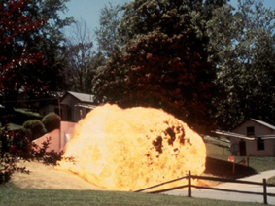
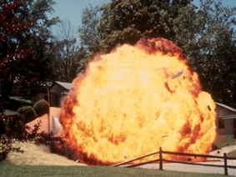
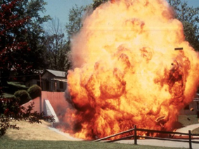
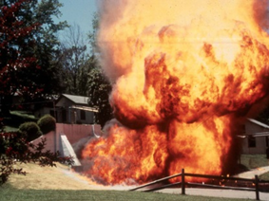
Partial confinement
Confinement
Methane-triggered coal dust explosion
with fireball emerging from mine portal
Bruceton Experimental Mine
Pittsburgh, PA
Notes:
As noted in the previous slide, a dust explosion can occur when there is only partial confinement. An example of such an event would be an explosion in an underground mine. This series of photographs shows the progression of a fireball caused by a methane-triggered coal dust explosion as it emerges from a mine portal.
The next slide explains the underlying physical and chemical phenomena involved in this process.
Photographs courtesy of K.L. Cashdollar.

Slide 45
Partial confinement
Confinement
  Underground mine workings
  Approximate mine gallery as a corridor with one end open, ignition occurring at opposite end
  Explosion development and flame propagation follows corridor
  Burned gases expand behind flame front and push unburned fuel/air mixture toward open end of corridor, generating turbulence
  Flame front accelerates as it reaches turbulent flow field
  Self-accelerating feedback mechanism
Notes:
Explosion development and flame propagation in underground mine workings can be approximated by considering a mine gallery to be a corridor with one end open and ignition occurring at the other closed end.
The piston-like effect of the burned gases expanding behind the flame front pushes the unburned fuel/air mixture toward the open end and results in the generation of post-ignition turbulence in the unburned mixture. The advancing flame front then accelerates as it encounters the turbulent flow field with the end-result being a self-accelerating feedback mechanism between flame speed and turbulence level in the unreacted flow field.
Further references and points of discussion for this slide can be found in: Amyotte, P., “An Introduction to Dust Explosions. Understanding the Myths and Realities of Dust Explosions for a Safer Workplace”, Elsevier/Butterworth-Heinemann, Waltham, MA (2013).

Slide 46
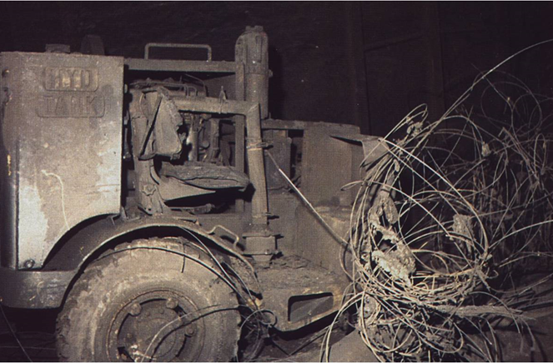
Congestion
Confinement
Obstacles can create congestion (blockage) and generate significant post-ignition turbulence
Boom Truck
Westray
Notes:
Obstacles in the path of an advancing dust flame can create enough congestion or blockage to generate significant post-ignition turbulence. This results in both flame acceleration and increased pressure development.
An example of such a turbulence-generating obstacle is a boom truck (tractor) used in some underground coal mines. The photograph in the slide shows a boom truck post-explosion in the Westray mine (discussed in the Case Studies section of the module).
Photograph: Richard, K.P., Justice, “The Westray Story – a Predictable Path to Disaster. Report of the Westray Mine Public Inquiry”, Province of Nova Scotia, Halifax, NS (1997).

Slide 47
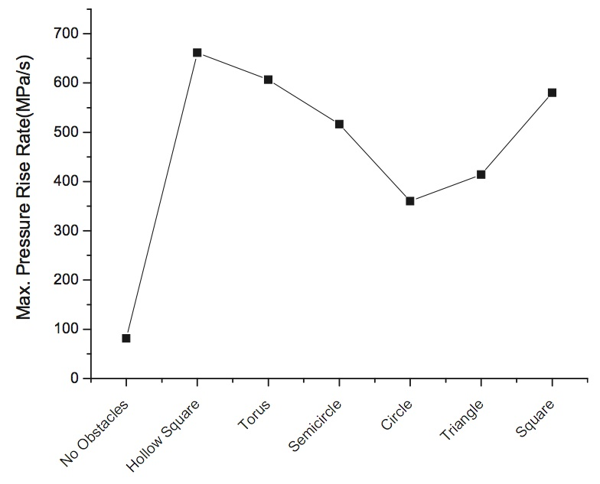
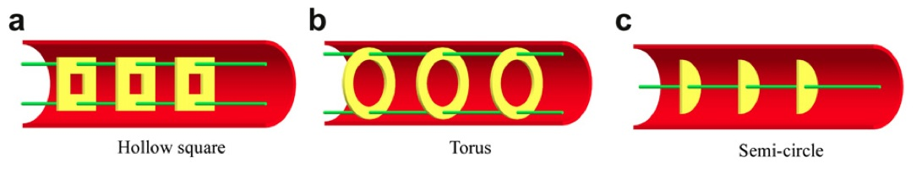
Influence of obstacle type
Confinement
Notes:
These figures shows how different obstacles can influence the rate of pressure rise. The laboratory-scale tests were conducted on coal dust/methane/air mixtures.
As described previously, obstacles create turbulence in the flow of the unburned fuel ahead of the flame. Once the flame reaches this turbulent flow field, the flame surface area is increased, resulting in an enhanced burning rate and higher burning velocity. This in turn creates more turbulence, leading to rapid flame acceleration and heightened rates of pressure rise.
Figures: Zhou, Y., Bi, M. and Qi, F., “Experimental Research into Effects of Obstacle on Methane-Coal Dust Hybrid Explosion”, Journal of Loss Prevention in the Process Industries, 25, 127-130 (2012).

Slide 48
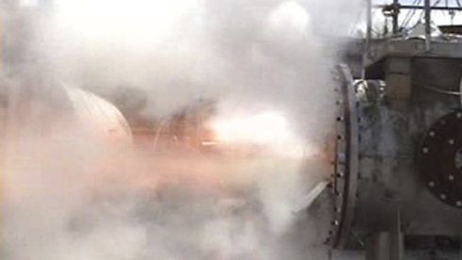
Explosion relief venting
Confinement
Dust explosion mitigation
  Overpressure is reduced by relieving confinement
Corn Flour Explosion with Relief Venting
Notes:
Explosion relief venting is a common – arguably the most common – approach to dust explosion mitigation (protection). Venting allows for reduction in overpressure as a result of confinement relief. This topic will be explored further in the module section on Prevention and Mitigation.
The photograph in the slide shows a vented corn flour dust explosion. It also illustrates the basic idea behind venting. Although flame, combustion products and unburned dust are ejected through the vent, the integrity of the vented enclosure is maintained.
Photograph: Holbrow, P., “Dust Explosion Venting of Small Vessels and Flameless Venting”, Process Safety and Environmental Protection, 91, 183-190 (2012).

Slide 49
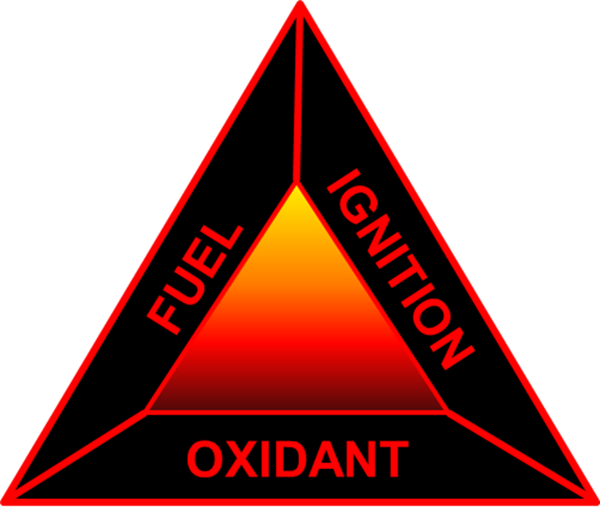
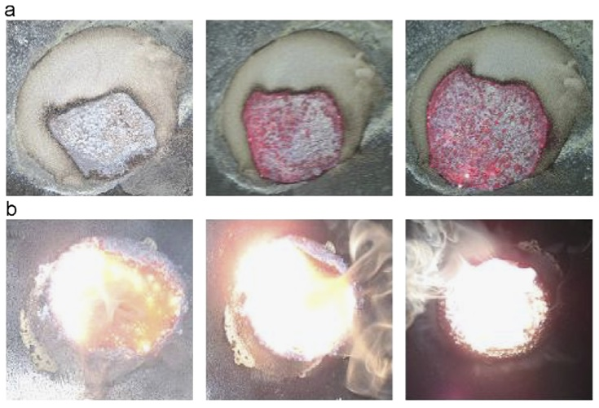
Dust Layer Fires
Basic Fire Principles
Basic Explosion Principles
Dust Explosion Fundamentals
Fuel
Ignition Source
Oxidant
Mixing
Confinement
Dust Layer Fires
Prevention and Mitigation
Case Studies
Resources
Evaluation
Magnesium
Dust Layer Fire
Notes:
In this section, we briefly examine the issue of dust layer fires. Self-ignition of dust layers and ignition by an external source are discussed. The layer ignition temperature or LIT is defined and the effect of layer thickness on LIT is illustrated. Finally, the concept of normalization of deviance is used to explain why dust layer fires are sometimes ignored as predictors of larger fires or explosions.
The fire triangle is again pertinent to the discussion here as explained on the next slide. Note that there are no mixing and confinement elements involved. As we have just seen in the previous section, it is possible for a dust/air cloud to burn rather than explode when confinement is low. This event is termed a flash fire and is a different scenario than layer fires as presented in this section.
The figure in the slide shows a magnesium dust layer fire. The first stage (a) involves slow, lower temperature combustion. The second stage (b) involves rapid, higher temperature combustion of magnesium gas generated from the layer.
Figure: Gang, L., Chunmiao, Y., Peihong, Z. and Baozhi, C., “Experiment-Based Fire and Explosion risk Analysis for Powdered Magnesium Production Methods’’ Journal of Loss Prevention in the Process Industries, 21, 461-465 (2008).

Slide 50
Ignition of dust layers
Dust Layer Fires
Self-heating (self-ignition)
External heat source
  Pieces of metal
    Nut or bolt (heated by repeated contact with equipment surfaces)
  Overheated surface
    Bearing or motor
Layer Ignition Temperature (LIT)
  Minimum temperature required to ignite a layer of dust of a certain thickness
Notes:
Dust layer fires involve a combustible dust, an oxidant (typically oxygen in air), and an Ignition mechanism.
There are two ignition mechanisms for dust layers: self-heating (or self-ignition, or spontaneous combustion) and an external heat source. Self-ignition is described in a later slide.
Eckhoff (2003) gives two possible industrial scenarios for a hot object (external heat source) being in close proximity to a combustible dust: (i) a piece of metal (e.g., a nut or bolt) present in a bulk powder stream and which has been heated by repeated contact with the process equipment boundaries, and (ii) an overheated surface (e.g., a bearing or motor) covered with a layer of dust.
In the case of a dust layer that has accumulated on a heated surface, we can define the LIT (layer ignition temperature) as the lowest hot-surface temperature that will cause ignition of a dust layer having a specified thickness. There is an ASTM test method to measure LIT.
Reference: Eckhoff, R.K., “Dust Explosions in the Process Industries”, 3rd edition, Gulf Professional Publishing/Elsevier, Boston, MA (2003).

Slide 51
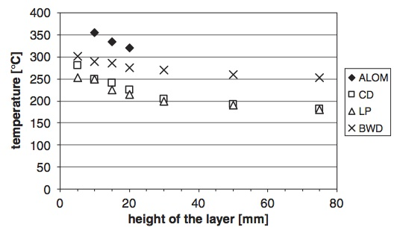
Effect of layer thickness
Dust Layer Fires
ALOM = Aluminum Oxide; CD = Coal Dust; LP = Lycopodium; BWD = Beechwood Dust
Notes:
The LIT of a given dust, like other explosion parameters (e.g., MIE), is not an intrinsic property of the material. Nevertheless, LIT values provide helpful information for industrial practice.
It must be remembered that LIT is a function of layer thickness. The figure in this slide shows LIT data for various dusts over a range of layer thicknesses (or heights). Clearly, LIT values are higher for thinner layers.
Figure: Querol, E., Torrent, J.G., Bennet, D., Gummer, J. and Fritze, J.-P., “Ignition Tests for Electrical and Mechanical Equipment Subjected to Hot Surfaces”, Journal of Loss Prevention in the Process Industries, 19, 639-644 (2006).

Slide 52
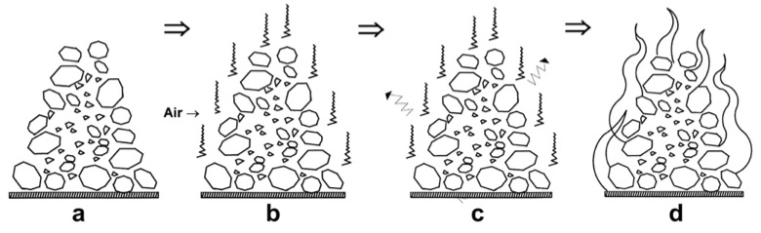
Self-ignition
Dust Layer Fires
Notes:
An external heat source may not be needed for layer ignition to occur. Under certain conditions, a dust pile can self-heat and then ignite. To initiate self-heating, there must be sufficient porosity for air to enter the pile and react with the fuel. Heat must be generated faster than it is lost. Once a critical temperature is achieved, ignition can occur due to thermal runaway.
In the figure shown in the slide we see:
a coal pile having various particle sizes,
air ingress and initial self-heating,
heat losses by conduction, convection and radiation at rates not exceeding the rate of heat generation, and
self-ignition at some critical temperature.
Figure: Sipila, J., Auerkari, P., Heikkila, A.-M., Tuominen, R., Vela, I., Itkonen, J., Rinne, M. and Aaltonen, K., “Risk and Mitigation of Self-heating and Spontaneous Combustion in Underground Coal Storage”, Journal of Loss Prevention in the Process Industries, 25, 617-622 (2012).

Slide 53
Normalization of deviance
Dust Layer Fires
Dust fires are sometimes ignored or normalized
  Accepting as normal (and then ignoring) negative events
  Culture of risk-denial
  Counter to concept of safety culture
Evidence that something is not right in the workplace
  Nothing normal about an unintentional dust fire
Notes:
Dust layer fires generally do not cause the same degree of damage and injury as dust explosions. As such, they might be ignored, or become accepted as normal to operations – simply “the cost of doing business”, or “the way things are done around here”.
This phenomenon is termed normalization of deviance and is part of a workplace culture known as risk-denial. Normalizing evidence that in fact should be seen as a predictor or warning sign of an impending catastrophe, is completely counter to a well-functioning safety culture. We return briefly to this topic in the next section on Prevention and Mitigation.

Slide 54

Prevention and Mitigation
Basic Fire Principles
Basic Explosion Principles
Dust Explosion Fundamentals
Fuel
Ignition Source
Oxidant
Mixing
Confinement
Dust Layer Fires
Prevention and Mitigation
Case Studies
Resources
Evaluation
ALARP
Notes:
This section presents techniques and strategies for preventing and mitigating dust explosions. Although the discussion is specific to dust explosions, the basic principles illustrated are also applicable to gas and vapour explosions.
We begin with a look at an overall approach to risk reduction known as the hierarchy of controls. The various levels in the hierarchy are then examined: (i) inherent safety, (ii) passive engineered safety, (iii) active engineered safety, and (iv) procedural safety. We conclude with the concepts of a safety management system and safety culture.
Prevention and mitigation efforts are aimed at risk reduction. Prevention deals with lessening the likelihood of occurrence of a dust explosion and mitigation with protecting people and plant from the consequences of such an event. In spite of our best efforts to eliminate hazards, there will always be residual risk that must be properly managed.
The figure in this slide gives a representation of the ALARP (As Low As Reasonably Practicable) principle. Vinem (2012) explains that use of the ALARP principle requires examination of both risk levels and risk prevention/mitigation costs, with risk reduction measures being implemented according to cost effectiveness considerations. Thus, a process can be made safer than it was before the introduction of additional safety measures but it cannot be made 100 % safe. More to the point, the potential benefits of attempting to drive process risk to zero will likely be grossly disproportionate to the cost involved. We should talk about safer alternatives, not safe processes.
Figure: Vinem, E., “Ethics and Fundamental Principles of Risk Acceptance Criteria”, Safety Science, 50, 958-967 (2012).
Much of the material in this section is drawn from: Amyotte, P., “An Introduction to Dust Explosions. Understanding the Myths and Realities of Dust Explosions for a Safer Workplace”, Elsevier/Butterworth-Heinemann, Waltham, MA (2013). Original references can be found there.

Slide 55
Hierarchy of controls
Prevention and Mitigation
INHERENT SAFETY
PASSIVE ENGINEERED SAFETY
ACTIVE ENGINEERED SAFETY
PROCEDURAL SAFETY
Notes:
The hierarchy of controls is an ordered arrangement of general risk reduction measures. Inherent safety, being the most effective approach to risk reduction, sits at the top of the hierarchy; it is followed in order of decreasing effectiveness by passive engineered safety devices (e.g., explosion relief vents), then active engineered safety devices (e.g., automatic suppression systems), and finally procedural safety measures (e.g., ignition source control by hot-work permitting).
Each of the four levels, with specific examples for dust explosion control, is explained in this section.

Slide 56
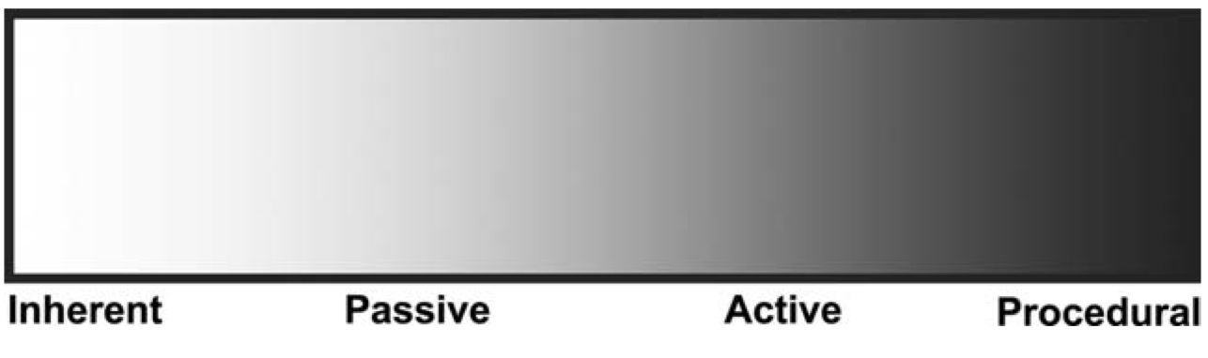
Hierarchy as a continuum
Prevention and Mitigation
Notes:
The figure in this slide illustrates an often overlooked feature of the hierarchy of controls – that it actually represents a continuum of safety measures. It is helpful to view the hierarchy as a spectrum of options rather than as distinct entities having sharply defined boundaries. Hendershot (2010) remarks that while people may disagree about the category in which a given approach falls, what really matters is whether the approach is effective from an engineering design viewpoint.
For example, use of safe work procedures is a procedural safety measure. If the procedures are clearly written and easy to follow, this can also be viewed as an application of the inherent safety principle known as simplification. Also, some might view housekeeping (in which dust accumulations are removed from the workplace) as purely a procedural safety measure, whereas others would see overtones of the inherent safety principle of minimization.
Figure: Hendershot, D.C., “A Summary of Inherently Safer Technology”, Process Safety Progress, 29, 389-392 (2010).

Slide 57
Inherent safety
Prevention and Mitigation
Proactive approach to reduce reliance on engineered or add-on safety devices (both passive and active) and procedural measures
Four basic principles
  Minimization
  Substitution
  Moderation
  Simplification
Notes:
Inherent safety is a proactive approach in which hazards are eliminated or lessened so as to reduce risk with decreased reliance on engineered (add-on) devices and procedural measures.
There are a number of inherent safety principles, of which the most fundamental ones are:
Minimization,
Substitution,
Moderation, and
Simplification.

Slide 58
Minimization
Prevention and Mitigation
Minimize amount of hazardous material in use (when use of such materials cannot be avoided – i.e. elimination)
Notes:
With respect to dust explosions, minimization includes:
Avoidance of the formation of combustible dust clouds. Because of the large quantities of particulate material present in powder handling equipment (which as previously described is where most primary dust explosions occur), it can be difficult, however, to achieve operation at dust concentrations below the MEC.
Removal of dust deposits (avoidance of dust layers). Minimization of fuel loadings in this case is critical to the prevention of secondary dust explosions.

Slide 59
Substitution
Prevention and Mitigation
Replace substance with less hazardous material; replace process route with one involving less hazardous materials
Notes:
With respect to dust explosions, substitution includes:
Replacement of bucket elevators and other mechanical conveying systems with dense-phase pneumatic transport.
Substitution of process hardware with less hazardous materials of construction (e.g., avoiding unnecessary use of insulating materials).
Use of mass flow silos and hoppers rather than funnel flow silos so as to avoid undesired particle segregation and uncontrolled dust cloud formation.
Alteration of a process route that involves handling an explosible powder (e.g., earlier introduction of an inert powder that is a component of the final product).
Replacement of a combustible dust with one that is less hazardous. While this may be difficult to achieve in many cases, opportunities can arise when other factors such as cost motivate process change. For example, petroleum coke is a safer fuel than higher volatile-matter coal (from the perspective of rate of pressure rise). When used in a blended fuel as a partial replacement for pulverized coal in the feed to utility boilers, this inherent safety benefit of petroleum coke is evident.

Slide 60
Moderation
Prevention and Mitigation
Use hazardous materials in least hazardous forms; run process equipment with less severe operating conditions
Notes:
With respect to dust explosions, moderation includes:
Altering the composition of a dust by admixture of solid inertants (pre-explosion); an example is shown in a later slide (Minimum Inerting Concentration).
Increasing the dust particle size so as to decrease its reactivity.
Avoiding the formation of hybrid mixtures of combustible dusts and flammable gases.
Using powders in paste or slurry form.

Slide 61
Simplification
Prevention and Mitigation
Simplify equipment and processes that are used; avoid complexities; make equipment robust; eliminate opportunities for error
Notes:
With respect to dust explosions, simplification includes:
Employing the concept of error tolerance by designing process equipment robust enough to withstand process upsets and other undesired events (e.g., shock- or pressure-resistant design). An example here is the hammermill shown in the Dust Explosion Fundamentals section.
Ensuring information on the hazardous properties of combustible dusts is clear and unambiguous (e.g., by means of thorough and complete Safety Data Sheets).

Slide 62
Minimum inerting concentration
Prevention and Mitigation
Notes:
As we just saw, the direct mixing of a combustible dust and a non-combustible dust (inertant) is an application of the inherent safety principle of moderation. The mixing is done pre-explosion to in fact prevent an explosion from occurring. Inerting in this manner is conducted in coal mines to render coal dust non-explosible by mixing it with sufficient quantities of inert rock or stone dust (such as limestone or dolomite). Of course, this technique cannot be used if the dust is the desired product and must be free of contaminants (for example, in the food processing industry).
The amount of inertant needed depends on the actual inerting mechanism – thermal (heat sink) or chemical (reaction termination). The figure in this slide shows the results of testing conducted to determine the minimum inerting concentration (MIC) for mixtures of Pittsburgh pulverized coal dust and each of three inertants – limestone, sodium bicarbonate (SBC) and monoammonium phosphate (MAP).
The area to the left of each curve represents the explosible region for the fuel/inertant mixture. The area to the right of each curve represents the non-explosible region; here there is sufficient inertant to prevent an explosion. The nose of each curve (or envelope) represents the least amount of inertant that would prevent an explosion regardless of fuel concentration – i.e., the MIC.
The figure clearly illustrates that for inerting of Pittsburgh pulverized coal, limestone is the least effective inertant and MAP is the most effective. Limestone is a pure thermal inhibitor whereas MAP exhibits both thermal and chemical inhibition.
Figure: Dastidar, A.G., Amyotte, P.R., Going, J. and Chatrathi, K., “Flammability Limits of Dusts - Minimum Inerting Concentrations”, Process Safety Progress,18, 56-63 (1999).

Slide 63
Passive engineered safety
Prevention and Mitigation
Add-on safety devices
  Explosion relief vents
  Physical barriers
Have no function other than to act when called upon to mitigate consequences of an explosion
Do not require event detection or device activation
More reliable than active devices
Notes:
The passive engineered safety level in the hierarchy of controls involves the use of safety devices that are added on to the process/facility unit. These devices do not play a production role; rather their extremely important role is to function in accordance with their design purpose to mitigate explosion consequences and protect people and plant.
Passive devices do not require detection of the explosion or activation of moving parts to perform their intended function. As such, they are more reliable than active engineered devices (described later). Like any mechanical device, however, passive engineered features must be properly designed, installed and maintained.
Examples include explosion relief vents to relieve overpressure (mitigation), and physical barriers to limit the propagation of flame and damaging overpressures downstream (mitigation).

Slide 64
Venting
Prevention and Mitigation
Corn Flour Explosion with Relief Venting
Notes:
Venting is the most common approach used to mitigate dust explosion overpressure. As we saw in the Containment section, this is achieved by relieving the confinement criterion of the explosion pentagon. We have also previously seen the above photograph in the Containment section as an example of venting in practice.
An explosion vent is a weak area in the wall of a building (e.g., a relief panel) or a dust-handling unit (e.g., a rupture disk). It is important to properly size the vent; acquiring data from standardized explosion testing of the specific dust is required to perform this task.
Undersized vents may be unable to sufficiently mitigate an explosion as the design pressure of the enclosure will be exceeded. The vent must also be designed to open without obstruction, as a possible obstruction will keep the degree of confinement too high to allow for sufficient overpressure relief.
The protection of plant personnel from relieved overpressure and the expelled mixture of combustion products and burning and unburned dust (as shown in the photograph in the slide), must be taken into account. One approach is to use vent ducting to eject any dust, whether burned, burning or unburned, to a safer location. Another approach is flameless venting, which is described in a later slide.
Photograph: Holbrow, P., “Dust Explosion Venting of Small Vessels and Flameless Venting”, Process Safety and Environmental Protection, 91, 183-190 (2012).

Slide 65
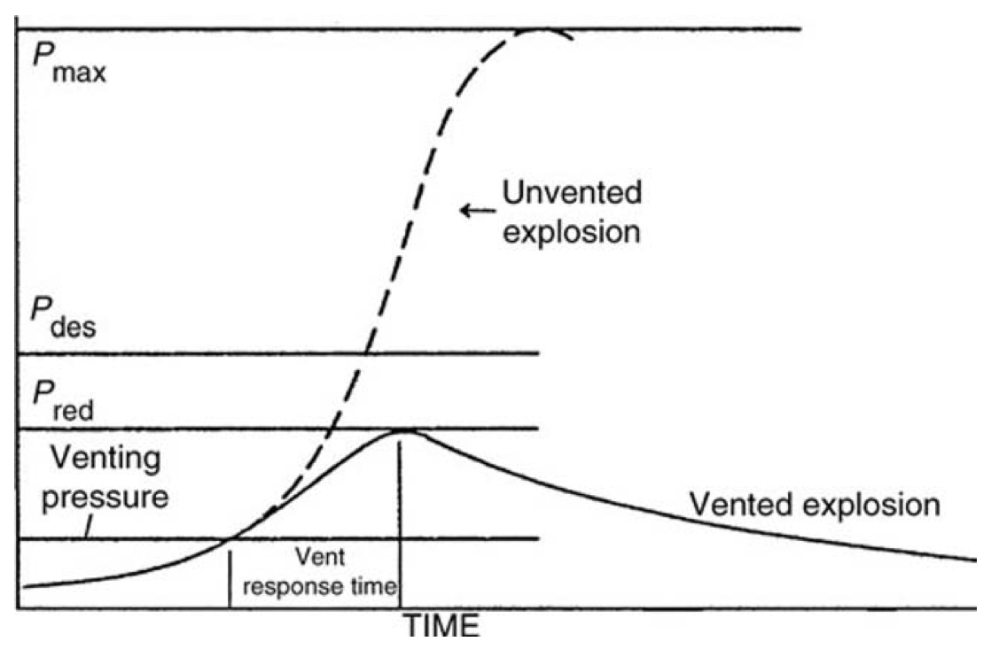
Venting process
Prevention and Mitigation
Notes:
This figure illustrates the venting process in schematic format.
P_{max} = maximum explosion pressure generated in the unvented enclosure
P_{des} = maximum pressure the protected enclosure can withstand
P_{red} = maximum pressure allowed to be generated in the enclosure during explosion
Venting pressure = pressure at which the vent opens (also known as P_{stat})
Figure: Pekalski, A.A., Zevenbergen, J.F., Lemkowitz, S.M. and Pasman, H.J., “A Review of Explosion Prevention and Protection Systems Suitable as Ultimate Layer of Protection in Chemical Process Installations”, Process Safety and Environmental Protection, 83, 1-7 (2005).

Slide 66
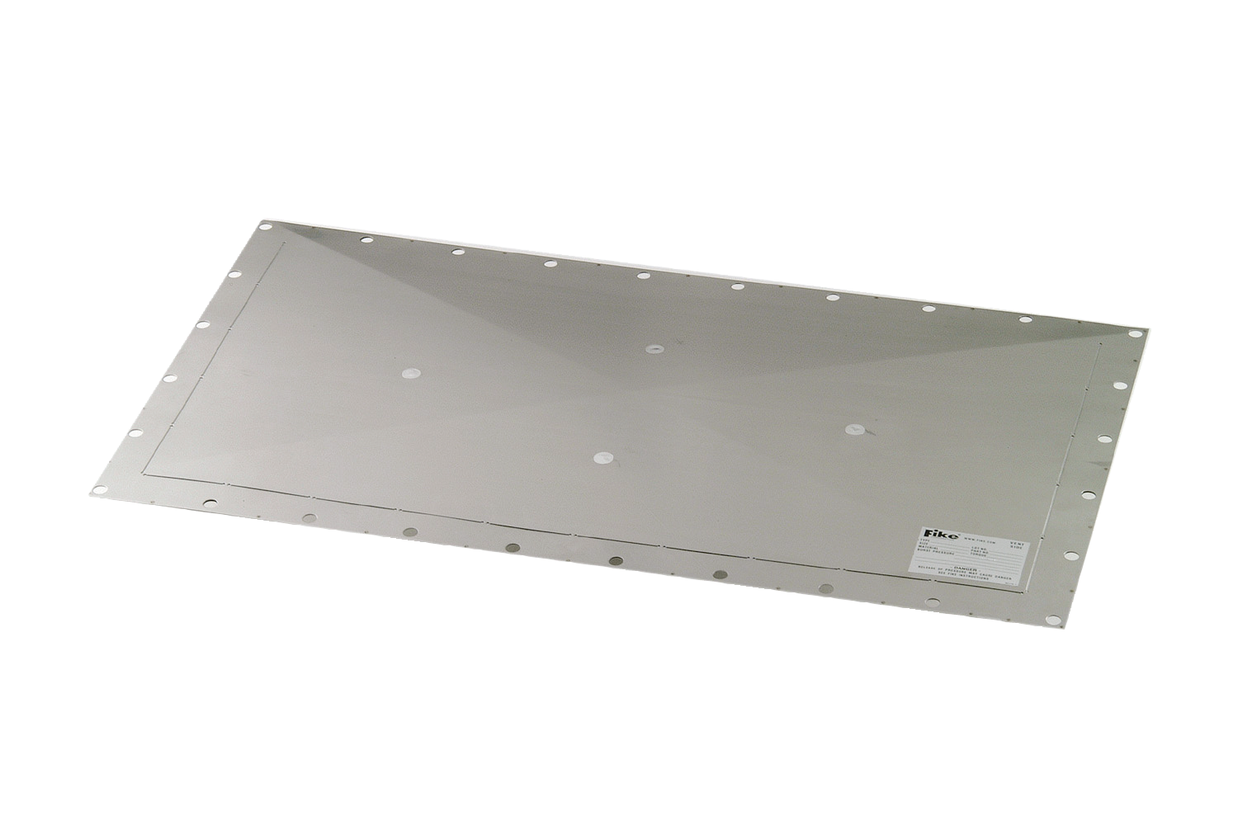
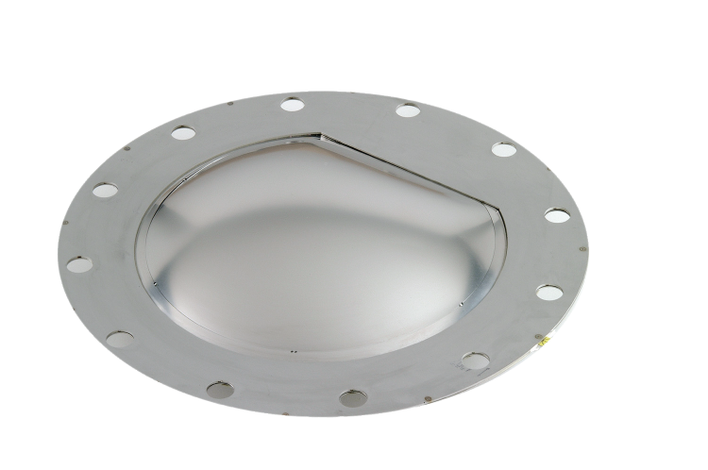
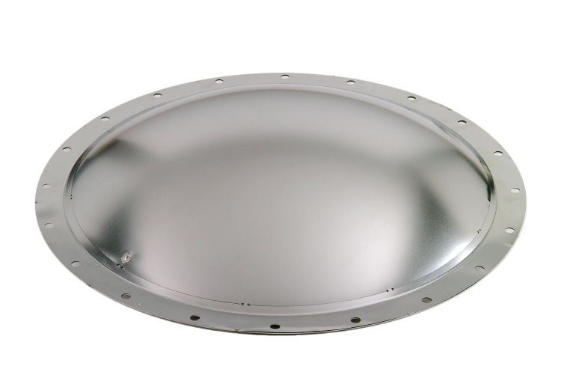
Relief panels and rupture disks
Prevention and Mitigation
Notes:
These are pictures of typical relief panels and rupture disks (i.e., explosion relief vents).
Images courtesy of Jerome Taveau, Fike Corporation (Blue Springs, MO).

Slide 67
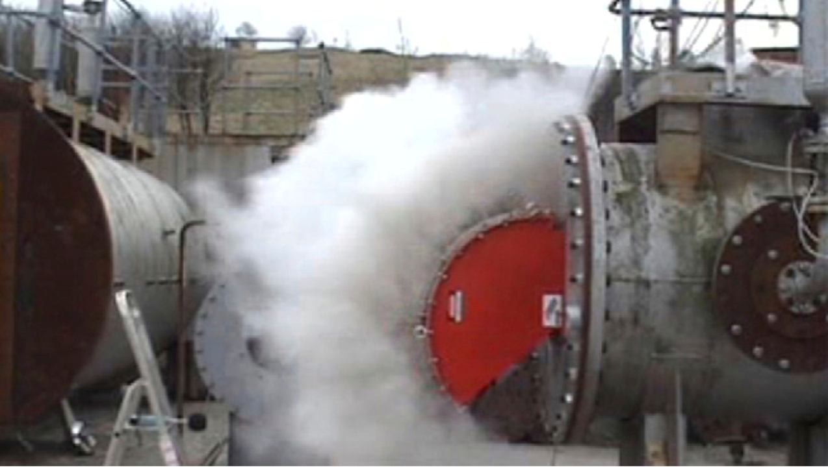
Flameless venting
Prevention and Mitigation
Corn Flour Explosion with Flameless Venting
Notes:
Flameless venting can help to prevent the ejection of dust and flames through the opening of the relief vent. This is achieved by means of a flame arresting device composed of mesh layers with quenching channels that is fitted in conjunction with the vent.
The photograph in this slide shows the same test rig as seen previously, only this time it is fitted with both a relief vent and a flame arrestor. Here we see the effectiveness of the flameless venting device in eliminating flame propagation through the vent and permitting the passage of only smoke, water vapour and some dust.
There are two concerns of note with this method of venting. First, there is a possibility of a reduction in venting efficiency as compared to the relief vent alone. Second, flameless venting into an enclosed area, such as a building, will result in increased pressure within this enclosure which may also then require venting.
Photograph: Holbrow, P., “Dust Explosion Venting of Small Vessels and Flameless Venting”, Process Safety and Environmental Protection, 91, 183-190 (2012).

Slide 68
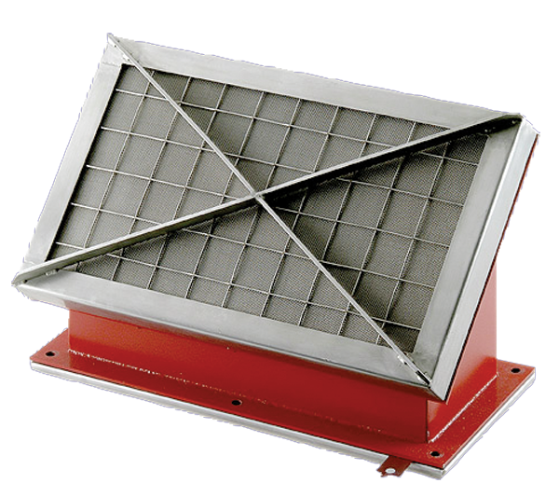
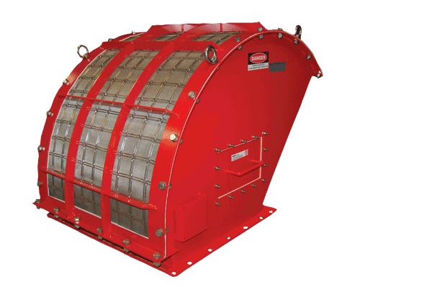
Flame quenching devices
Prevention and Mitigation
Notes:
These are pictures of typical flame quenching devices for use in the technique known as flameless venting.
Images courtesy of Jerome Taveau, Fike Corporation (Blue Springs, MO).

Slide 69
Active engineered safety
Prevention and Mitigation
Add-on safety devices
  Inerting (gas) systems
  Automatic explosion suppression
  Explosion isolation valves
Have no function other than to act when called upon to mitigate consequences of an explosion
Require event detection and device activation
Less reliable than passive devices
Notes:
The active engineered safety level in the hierarchy of controls involves the use of safety devices that are added on to the process/facility unit. These devices do not play a production role; rather their extremely important role is to function in accordance with their design purpose to prevent explosions or mitigate explosion consequences and protect people and plant.
Active devices require detection of the explosion and activation of moving parts to perform their intended function. As such, they are less reliable than passive engineered devices (described earlier). Like any mechanical device, active engineered features must be properly designed, installed and maintained.
Examples include systems using inert gases (prevention), automatic suppression systems (mitigation), and isolation valves to limit the propagation of flame and damaging overpressures downstream (mitigation).
The use of inert gases was previously described in the Oxidant section of the module. Being preventive in nature, these systems themselves do not involve event detection and device actuation. However, they require constant monitoring of oxygen levels by other devices and are often used in conjunction with automatic suppression systems. Inert gas systems should therefore be placed in the active engineered category.

